Slide 1


Ph u Thi Secondary school.
Good morning class!!!

Slide 2

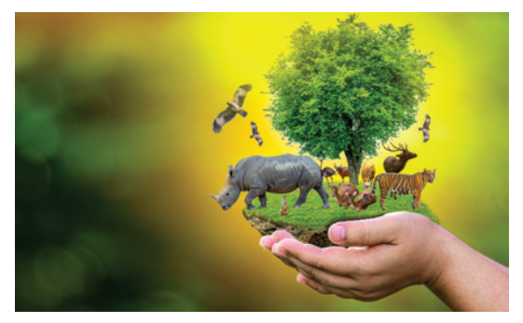
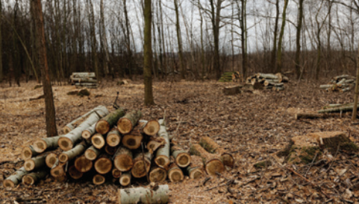
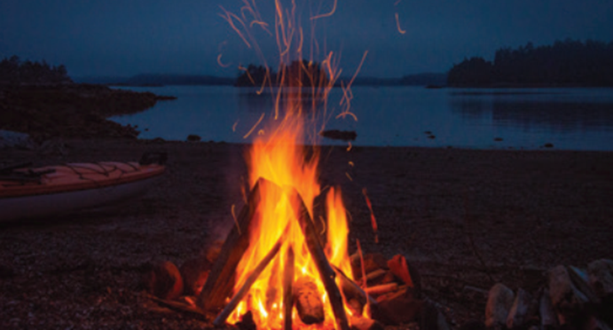
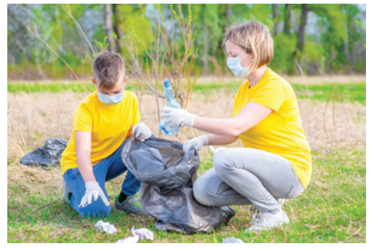
* WARM UP: PELMANISM
1
2
3
4
5
picking up rubbish
protecting endangered species
cutting down trees
saving
water
building a campfire
E
B
C
D
A
1
2
3
4
5

Slide 3

* Tick the actions that protect the environment.
saving
water
protecting endangered species
cutting down trees
building a campfire
picking up rubbish

Slide 4

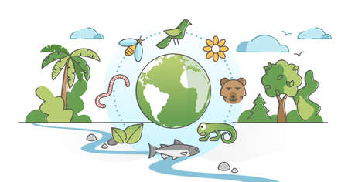
Friday, January 19, 2024
Period 56: Unit
7:
ENVIRONMENTAL PROTECTION
LESSON 2: A CLOSER LOOK 1 (P. 74)

Slide 5
I. OBJECTIVES
By the end of this lesson, Ss will be able to:
1. Knowledge
- Vocabulary: The lexical items related to Environmental Protection
- Pronunciation: Correctly pronounce words that contain the sounds: /bl/ and /kl/

Slide 6

* VOCABULARY
- ecosystem (n):
hệ sinh thái
/ˈiːkəʊsɪstəm/

Slide 7
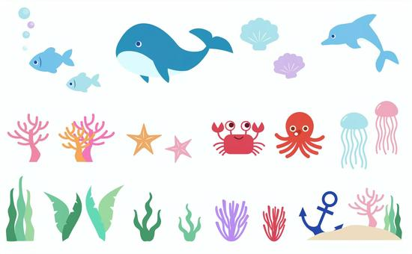
* VOCABULARY
- marine life (n):
sinh vật biển
/məˈriːn laɪf/

Slide 8
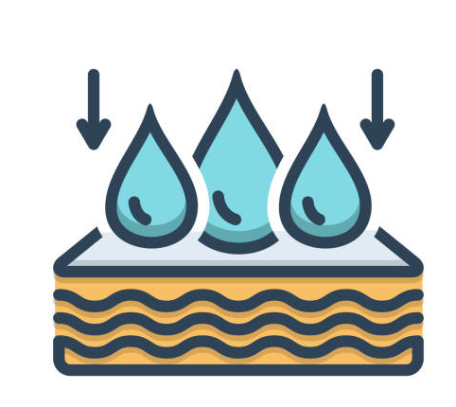
* VOCABULARY
- absorb (v):
hấp thụ
/əbˈzɔːb/

Slide 9
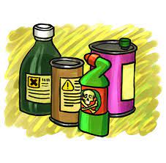
* VOCABULARY
- harmful substance (n):
Chất độc hại, tác nhân gây hại
/ˈhɑːmfl ˈsʌbstəns/

Slide 10
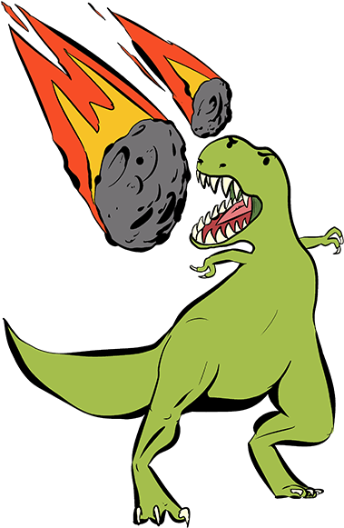
* VOCABULARY
extinction (n):
sự tuyệt chủng
/ ɪkˈstɪŋkʃn/

Slide 11
* VOCABULARY
New words | Pronunciation | Meaning
1. ecosystem (n) | /ˈiːkəʊsɪstəm/ | hệ sinh thái
2. marine life (n) | /məˈriːn laɪf/ | sinh vật biển
3. absorb (v) | /əbˈzɔːb/ | hút, hấp thu
4. harmful substance (n) | /ˈhɑːmfl ˈsʌbstəns/ | chất gây hại
5. extinction (n) | /ɪkˈstɪŋkʃn/ | sự tuyệt chủng

Slide 12
* Checking Vocabulary
New words | Meaning
1. | hệ sinh thái
2. | sinh vật biển
3. | hút, hấp thu
4. | chất gây hại
5. | sự tuyệt chủng
ecosystem (n)
marine life (n)
absorb (v)
harmful substance (n)
extinction (n)

Slide 13
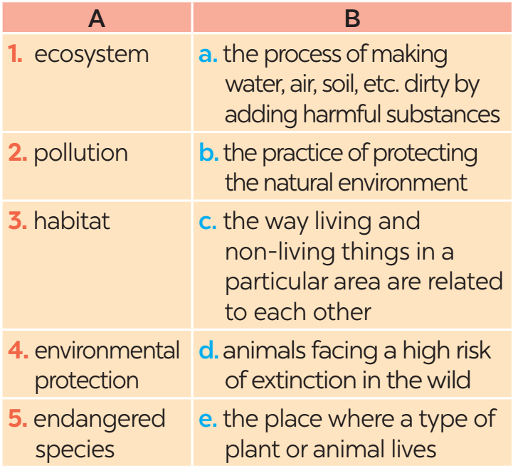
* PRACTICE
1. c 2. a 3. e 4. b 5. d
2
Match each word or phrase in column A with its meaning in column B.

Slide 14
3
Complete each sentence with a word or phrase from the box
habitat cutting down trees ecosystem endangered species carbon dioxide
1. People in my neighbourhood are doing a lot to save ______________.
2. Con Dao National Park provides a rich _______ for marine life.
3. Forests help release oxygen and absorb _____________; they also provide homes for many species.
4. ________________ is a serious environmental concern as it harms natural habitats.
5. An ________ may be a whole forest, or a small pond, and it can be of any size.
Game:

Slide 15


Game: Lucky numbers
1
2
3
4
5
6
7
8
GA
GB
GA
2
4
6
8
10
12
14
GB
2
4
6
8
10
12
14

Slide 16
3
Complete each sentence with a word or phrase from the box.
habitat cutting down trees ecosystem endangered species carbon dioxide
1. People in my neighbourhood are doing a lot to save _________________.
endangered species

Slide 17
3
Complete each sentence with a word or phrase from the box.
habitat cutting down trees ecosystem endangered species carbon dioxide
habitat
2. Con Dao National Park provides a rich _______ for marine life.

Slide 18
3
Complete each sentence with a word or phrase from the box.
habitat cutting down trees ecosystem endangered species carbon dioxide
3. Forests help release oxygen and absorb _____________; they also provide homes for many species.
carbon dioxide

Slide 19
3
Complete each sentence with a word or phrase from the box.
habitat cutting down trees ecosystem endangered species carbon dioxide
Cutting down trees
4. ________________ is a serious environmental concern as it harms natural habitats.

Slide 20
3
Complete each sentence with a word or phrase from the box.
habitat cutting down trees ecosystem endangered species carbon dioxide
5. An _________ may be a whole forest, or a small pond, and it can be of any size.
ecosystem

Slide 21


LUCKY NUMBER!

Slide 22
LUCKY NUMBER!

Slide 23

UNLUCKY NUMBER

Slide 24
3
Complete each sentence with a word or phrase from the box
habitat
Cutting down trees
ecosystem
carbon dioxide
endangered species
1. People in my neighbourhood are doing a lot to save ______________.
2. Con Dao National Park provides a rich _______ for marine life.
3. Forests help release oxygen and absorb _____________; they also provide homes for many species.
4. _______________ is a serious environmental concern as it harms natural habitats.
5. An _________ may be a whole forest, or a small pond, and it can be of any size.

Slide 25

*PRONUNCIATION
How to pronounce words that contain the sounds: /bl/ and /kl/.
4

Slide 26
*PRONUNCIATION
4
Listen and repeat the words. Pay attention to the sounds /bl/ and /kl/.
/bl/ | /kl/
block blast blanket black problem | clean clown club class clear

Slide 27
*PRONUNCIATION
5
Listen and practise the sentences. Underline the words with /bl/, and circle the words with /kl/.
1. Look! There are black clouds all over!
2. A truck blocked the way to the club.
3. The students painted the classroom blue.
4. The wind blew the clock down.
5. We cleaned up the environment after the blast.

Slide 28

* CONSOLIDATION
1
What have we learnt in this lesson?
Vocabulary: The lexical items related to Environmental Protection
Pronunciation: Correctly pronounce words that contain the sounds: /bl/ and /kl/

Slide 29

* Homework
Do ex A1,2, B2 (P. 55.56) in the workbook.
Prepair lesson 3 – A closer look 2

Slide 30


Thank you!
Goodbye!

Slide 31

WARM-UP
AHTTABI
PLTINOOLU
XEOGYN
EEERLAS
BBSOAR
MECYSSOET
-> HABITAT
-> POLLUTION
-> OXYGEN
-> RELEASE
-> ABSORB
-> ECOSYSTEM
JUMBLED

Slide 32
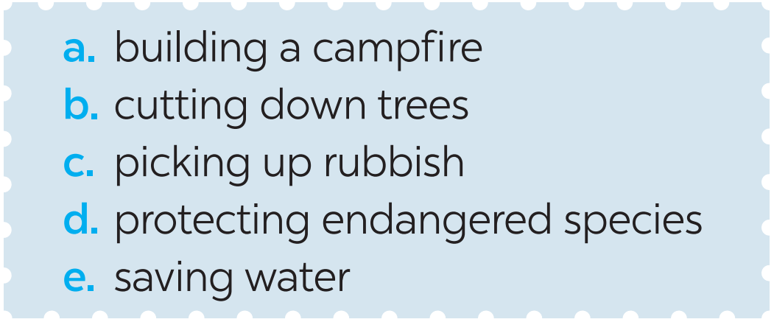
* Warm –up
Game: Pelmanism
1
Label each picture with a phrase from the list.
1. ____________
2. ____________________
picking up rubbish
protecting endangered species

Slide 33
PRACTICE
1
Label each picture with a phrase from the list.
3. ______________
4. ____________
cutting down trees
saving water

Slide 34

PRACTICE
1
Label each picture with a phrase from the list.
5. ________________
building a campfire

