Slide 1

Hello everyone !!!

Slide 2


Monday, January 29, 2024
Unit
7
ENVIRONMENTAL PROTECTION
LESSON 4: COMMUNICATIO (P. 76)

Slide 3
I* OBJECTIVES
By the end of this lesson, Ss will be able to:
1. Knowledge
- Asking for clarification
I. OBJECTIVES
By the end of this lesson, Ss will be able to:
1. Knowledge
- Asking for clarification

Slide 4

* WARM-UP
c
1. Mi: And what do you mean by ‘in the wild’?
d
2. Linda: That means animals that live in their natural habitats, not in zoos.
e
3. Mi: Oh, I get it now. Thanks, Linda.
JUMBLED CONVERSATION
b
4. Linda: Endangered species are animals
in the wild that face a high risk of extinction.
a
5. Mi: Hey, Linda. What does ‘endangered species’ mean?

Slide 5
* WARM-UP
1. Mi: And what do you mean by ‘in the wild’?
2. Linda: That means animals that live in their natural habitats, not in zoos.
3. Mi: Oh, I get it now. Thanks, Linda.
JUMBLED CONVERSATION
4. Linda: Endangered species are animals
in the wild that face a high risk of extinction.
5. Mi: Hey, Linda. What does ‘endangered species’ mean?

Slide 6
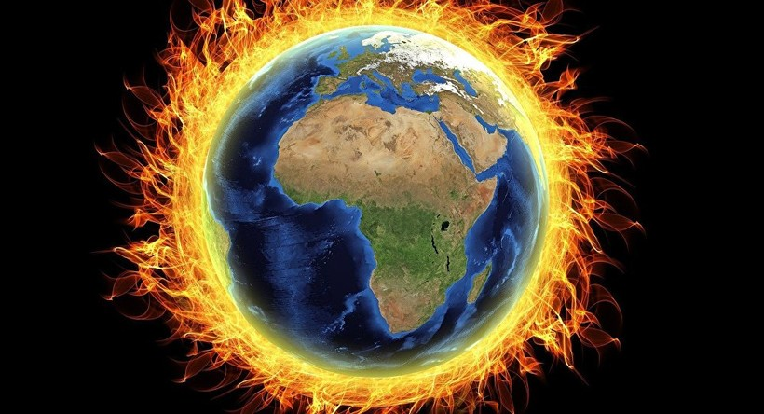
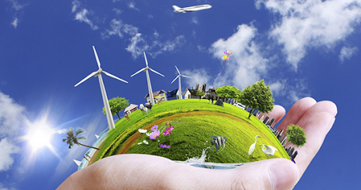
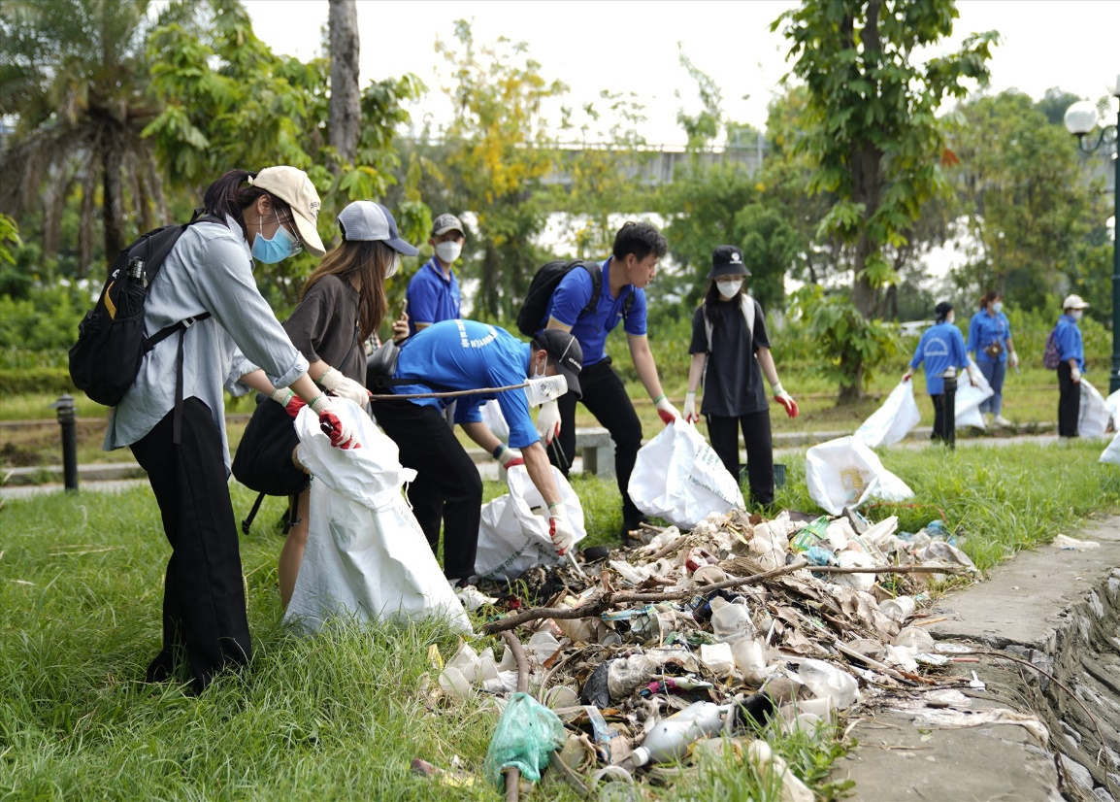
I. New words
global warming /ˈɡləʊbl//
sự nóng lên toàn cầu
pick up litter/
nhặt rác
natural resourses /
tài nguyên thiên nhiên

Slide 7

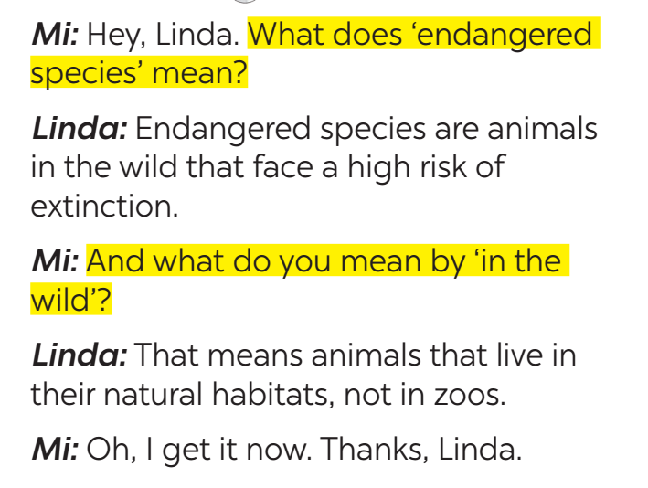
* EVERYDAY ENGLISH
1
Listen and read the conversations. Pay attention to the highlighted sentences.
*Asking for clarifications:(yêu cầu làm rõ)
What does S mean? (S nghĩa là gì?)
What do you mean by …? (Ý của bạn là gì …?)
*Giving clarifications:
(Đưa ra lời giải thích)
It means … (Nó có nghĩa là…)
S + is /are …( S + là…)
That means … (Điều đó có nghĩa là …)

Slide 8

* EVERYDAY ENGLISH
2
Work in pairs. Make similar conversations to ask for and give clarification.
SINGLE-USE PRODUCT:
A: What does it mean by ‘single-use products’?
B: ‘Single-use products’ are products made to be used once only.
A: Oh, thank you.
GLOBAL WARMING:
A: What do you mean by ‘global warming’?
B: It is the increase in the atmosphere’s temperatures caused by the rise of gases, especially carbon dioxide.
A: Oh, thank you.

Slide 9
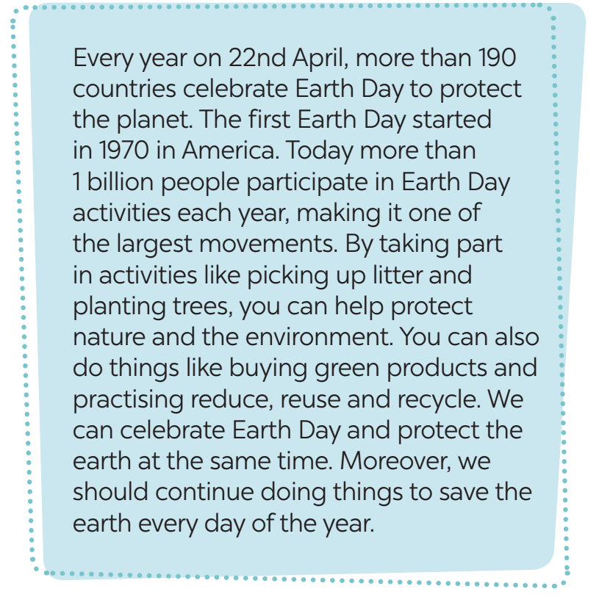

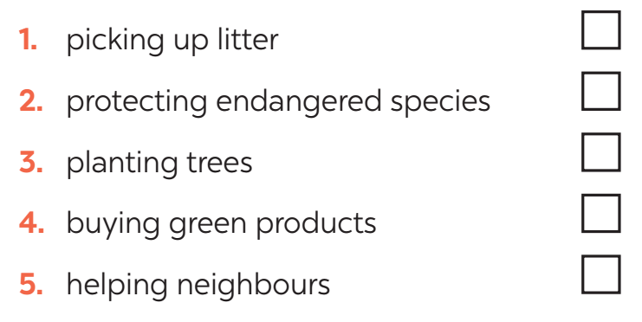
* EARTH DAY
3
Read the passage and tick the correct answers.
WHAT ACTIVITIES DO PEOPLE DO ON EARTH DAY?

Slide 10
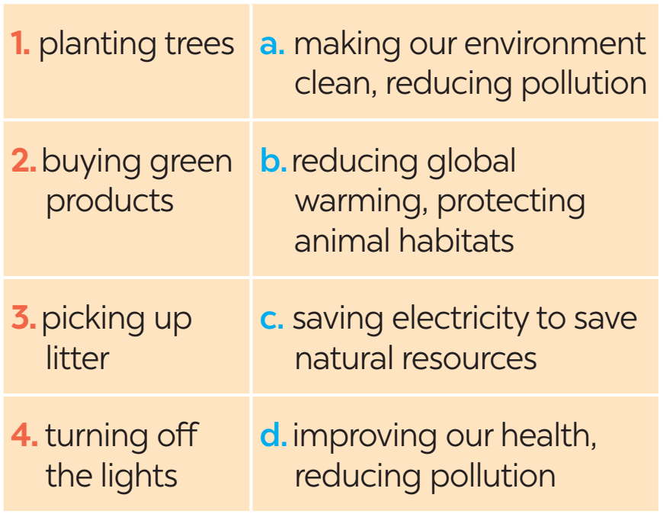
* EARTH DAY
4
Match the activities people do on Earth Day with their results.

Slide 11
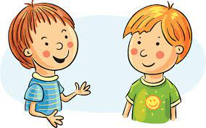
* EARTH DAY
5
Work in pairs. Ask and answer about the things you and your friends do on Earth Day.
We pick up litter and clean the
streets. And you?
What do you do on Earth day?
…

Slide 12
* EARTH DAY
A: What do you do on Earth Day?
B: My family turn off the light for 2 hours.
A: What do you do on Earth Day?
B: My friends and I decided to go to the park and planted trees.

Slide 13

* CONSOLIDATION
What have we learnt in this lesson?
Asking for clarification

Slide 14

* Homework
Do ex C1,2,3 (P. 57) in the workbook.
Prepair lesson 5 – skills 1

Slide 15

Goodbye.
See you again

Slide 16
* EVERYDAY ENGLISH
1
Listen and read the conversations. Pay attention to the highlighted sentences.
*Asking for clarifications:
(yêu cầu làm rõ)
What does S mean? ()
What do you mean by …?
Giving clarifications:
(Đưa ra lời giải thích)
It means … /
S is /are …
That means …

