Slide 1

Hello every one !!!

Slide 2
WARM-UP: JUMBLED WORDS
MEANS OF TRANSPORT
1- OTBA ->
2- ITANR ->
3- NPEILAPRA ->
4- RSOTRPCA ->
5- OTMIROEKB ->
BOAT
TRAIN
AIRPLANE
SPORT CAR
MOTORBIKE

Slide 3


Thursday, January 18, 2024
Period 56. Unit 7
TRAFFIC
LESSON 2: A CLOSER LOOK 1(P. 74 )
VOCABULARY
PRONUNCIATION
HOBBIES

Slide 4
I. OBJECTIVES
By the end of this lesson, Ss will be able to gain:
1. Knowledge
- Vocabulary about the verbs to use means of transport
- Vocabulary to read the road signs.
- Pronunciation: /aɪ/ and /eɪ/

Slide 5
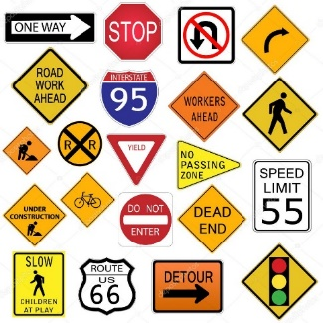
* VOCABULARY
- road sign (n):
Biển báo giao thông
/ˈrəʊd saɪn/

Slide 6
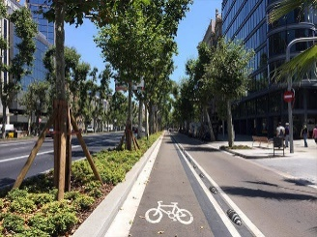
- cycle lane (n):
/ˈsaɪkl leɪn/
Làn đường dành riêng cho xe đạp

Slide 7
- -traffic lights:
/ˈtræfɪk laɪt/
ĐÈN GIAO THÔNG

Slide 8

- Crossroads (n):
/ˈkrɒsrəʊdz/
Ngã tư

Slide 9
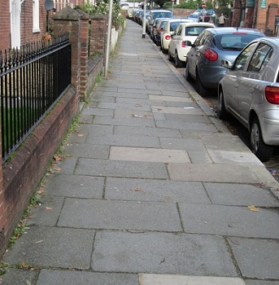
- pavement (n) :
/ˈpeɪvmənt/
vỉa hè
(Footpath)

Slide 10
New words | Pronunciation | Meaning
1. road sign (n) | /ˈrəʊd saɪn/ | biển báo giao thông
2. cycle lane (n) | /ˈsaɪkl leɪn/ | làn đường dành riêng cho xe đạp
3. traffic light (n) | /ˈtræfɪk laɪt/ | đèn giao thông
4. crossroads (n) | /ˈkrɒsrəʊdz/ | ngã tư
5. pavement (n) | /ˈpeɪvmənt/ | vỉa hè

Slide 11
* Checking vocab
say words in English
Ngã tư
road sign
Crossroads
Biển báo giao thông
Đèn giao thông
traffic light
Vỉa hè
Pavement
Làn đường dành cho
xe đạp
cycle lane

Slide 12
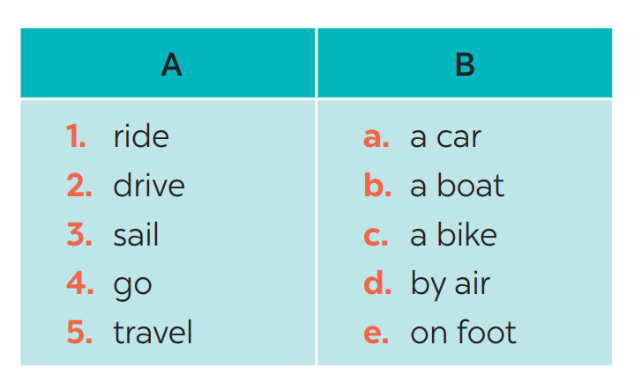
* VOCABULARY
1
Match the words in A with the phrases in B.
1. c
2. a
3. b
4. e
5. d

Slide 13
* VOCABULARY
1
Make your own sentences with these phrases.
My father taught me how to ride a bike.
- drive a car
- ride a bike
- sail a boat
- go on foot
- travel by air
My father usually drives a car to work.
Visitors can sail a boat in Ha Long Bay.
I sometimes go on foot to school.
Nowadays, people can travel by air to
anywhere in the world

Slide 14
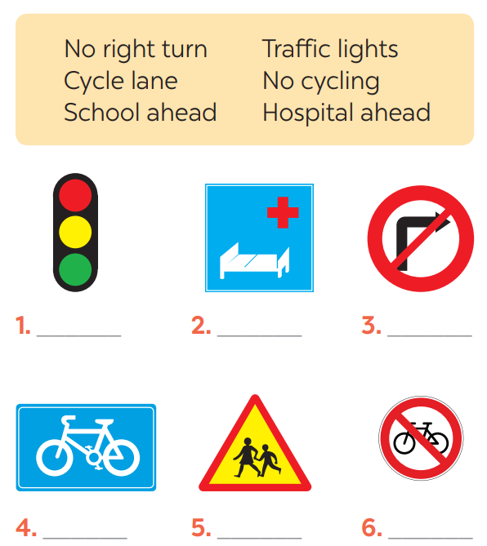
2. Look at these road signs. Then write the correct phrases under the signs.
traffic lights
Hospital ahead
No right turn
cycle lane
School ahead
No cycling

Slide 15

* VOCABULARY
3
Work in pairs. Take turns to say which of the signs in 2 you see on the way to school.
A: On the way to school, there are crossroads, so I see several traffic lights.
B: On my way to school, there is a school, so I see a “school ahead sign”.
….

Slide 16

* PRONUNCIATION
/aɪ/ and /eɪ/
- /aɪ/: fly, kite, drive
- /eɪ/: train, plane, station

Slide 17

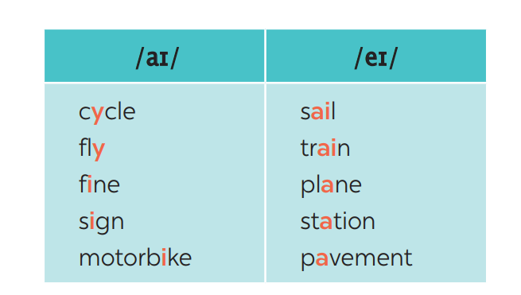
* PRONUNCIATION
4
Listen and repeat. Pay attention to the sounds /aɪ/ and /eɪ/.

Slide 18
* PRONUNCIATION
5
Underline the words with the sound /aɪ/ and circle the words with the sound /eɪ/. Then listen, check and repeat
1. The bus station is far from my house.
2. Remember to ride your bike carefully.
3. We must obey traffіc rules for our safety.
4. You have to get there in time for the train.
5. Don’t ride on the pavement.

Slide 19
* CONSOLIDATION
VOCABULARY
PRONUNCIATION

Slide 20


homework
- Learn by heart new words x 2
- Do A1,2 (P. 54) in the workbook.
- Prepare lesson 3 (A closer look 1)

Slide 21




Slide 22
* PRONUNCIATION
5
Underline the words with the sound /aɪ/ and circle the words with the sound /eɪ/. Then listen, check and repeat
1. The bus station is far from my house.
2. Remember to ride your bike carefully.
3. We must obey traffіc rules for our safety.
4. You have to get there in time for the train.
5. Don’t ride on the pavement.

