Slide 1
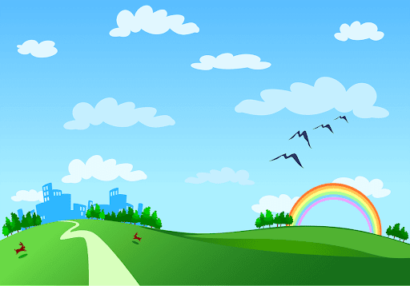
Phu Thi secondary school.
Good morning class!!!

Slide 2

WARM-UP
Game: Brainstorming
bicycle
bus
MEANS OF TRANSPORTS
train
plane
motorbike
helicopter
car
boat
ship

Slide 3

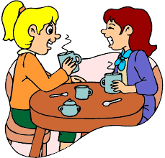
Monday, January 22, 2024
Period 58. Unit 7:
TRAFFIC
LESSON 4: COMMUNICATION (P. 76)
Unit
HOW DO YOU GO TO SCHOOL?

Slide 4
I. OBJECTIVES
By the end of this lesson, students will be able to:
1. Knowledge
- learn how to ask and answer about means of transport and some strange traffic rules.
- practise using some grammar points and vocabulary related to the topic.

Slide 5

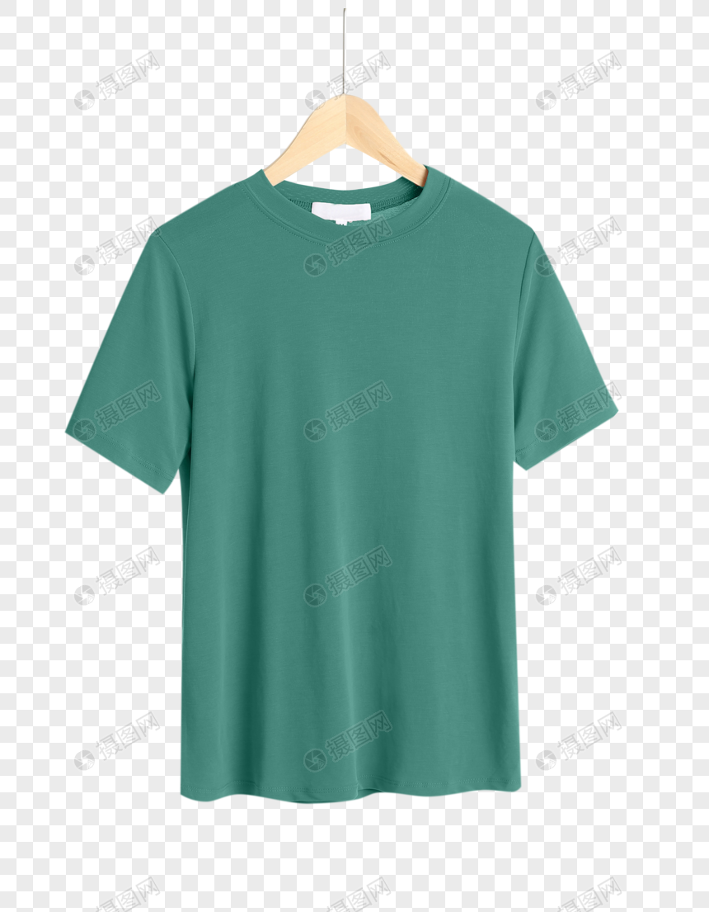
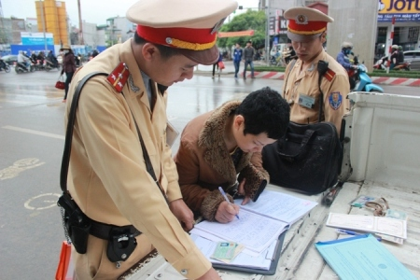
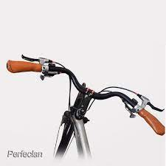
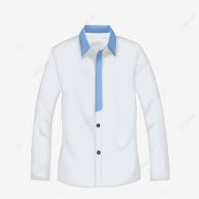
I. New words
roof (n):
mái nhà, mui xe, nóc xe
handlebar /'hændlbɑ:[r]/ (n):
tay lái
shirt (n):
áo sơ mi
T- shirt (n):
áo phông
fine (v):
phạt
allow (v):
cho phép

Slide 6
I. New words
roof (n):
mái nhà, mui xe, nóc xe
handlebar /'hændlbɑ:[r]/ (n):
tay lái
shirt (n):
áo sơ mi
T- shirt (n):
áo phông
fine (v):
phạt
allow (v):
cho phép

Slide 7
I. New words
roof (n):
mái nhà, mui xe, nóc xe
handlebar /'hændlbɑ:[r]/ (n):
tay lái
shirt (n):
áo sơ mi
T- shirt (n):
áo phông
fine (v):
phạt
allow (v):
cho phép

Slide 8

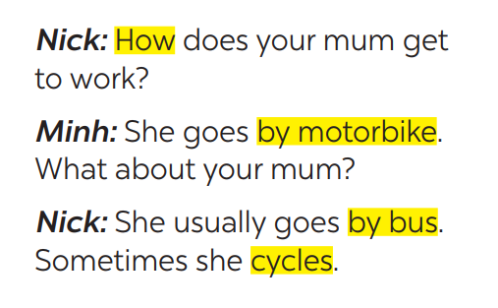

1
Listen and read the conversation, paying attention to the highlighted parts.
Which tense do we use to ask and answer?
Which question word do we use?
* STRUCTURES
How + do /does + S + go to …?
S + go /goes to … by …
(Ask and answer about the means of transport)
(Hỏi và trả lời về phương tiện đi lại)

Slide 9
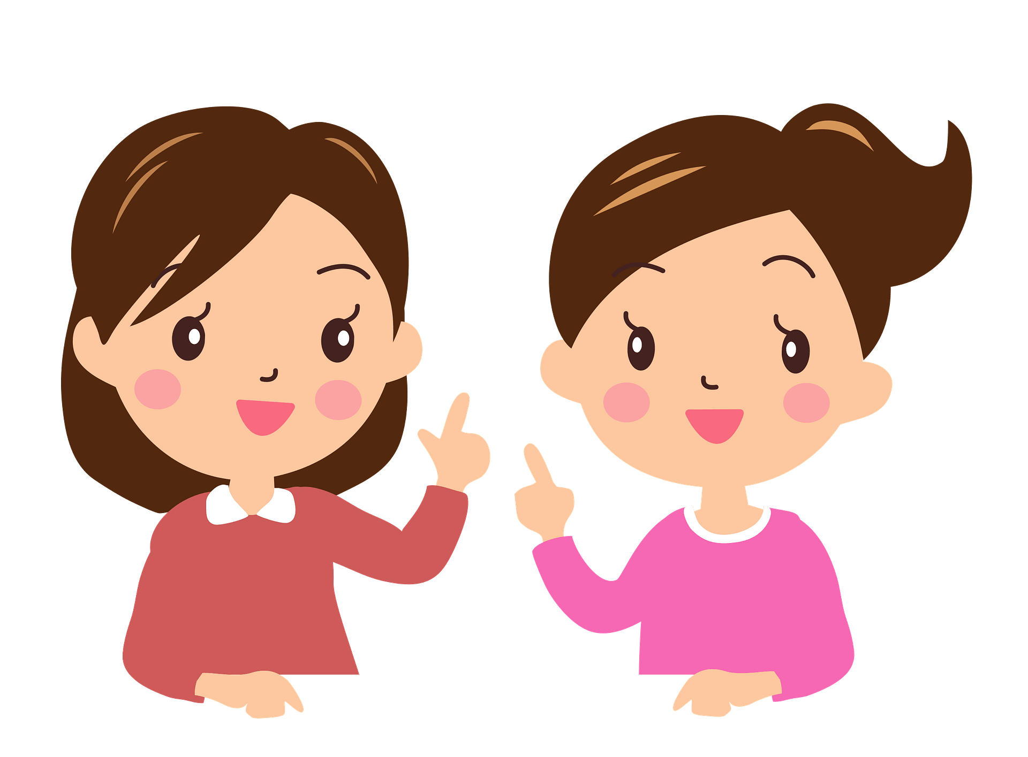
* PRACTICE
2
Work in pairs. Take turns to ask and answer about the means of transport your family members use every day.
He usually drives his car but sometimes he goes by bus.
How does your father
go to work?
He walks because we live near his office.
How about your father?

Slide 10
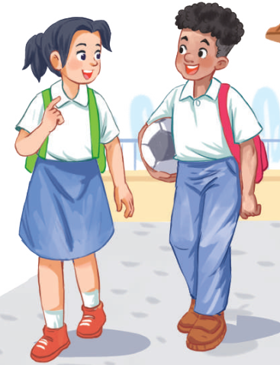
* PRACTICE
2
Ask and answer about the means of transport your family members use every day.
A: How does your father go to work?
B: He usually drives his car but sometimes he goes by bus. How about your father?
A: He walks because we live near his office.

Slide 11
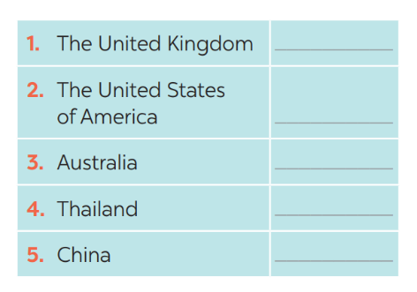
3
When you go on the road, which side do you keep, to the right or to the left?
Which countries below keep to the left? Tick the correct answers.
Strange traffic rules!
✓
✓
✓

Slide 12
4
Listen and check your answers in 3. Then listen again and complete the sentence with no more than THREE words.
One explanation is that some countries use ____________________ as the UK.
the same system
* Audio script
The right side is the wrong side!
Do you know that there are many countries in the world where the traffic rule is to keep to the left? Some of these are the United Kingdom, Australia, Thailand, and so on. There are different explanations
for this. One explanation is that some countries use the same system as the UK.

Slide 13

* PRODUCTION
5
Read the strange driving rules below,
discuss which one do is the strangest rule?

Slide 14

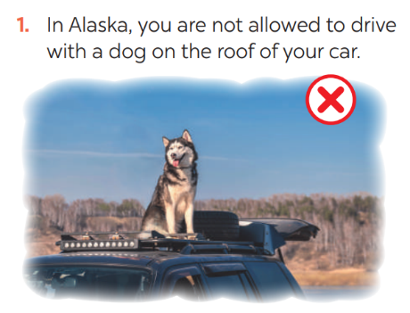
5
Read, discuss which one do is the strangest rule?

Slide 15
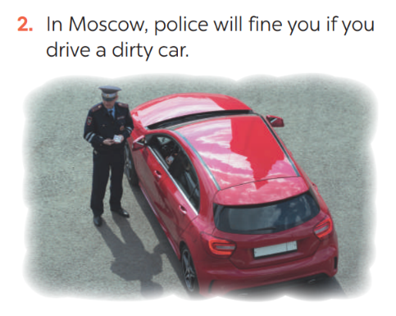
5
Read, discuss which one do is the strangest rule?

Slide 16
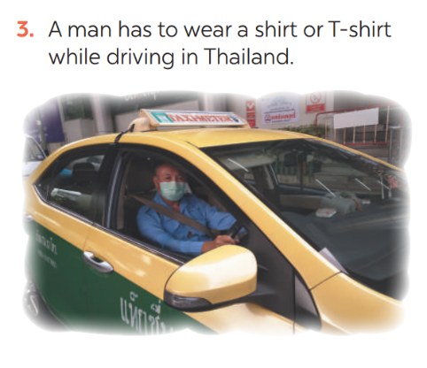
5
Read, discuss which one do is the strangest rule?

Slide 17
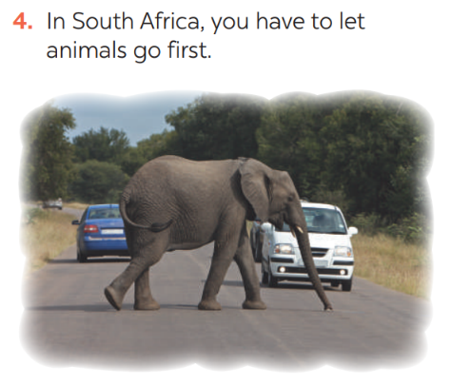
5
Read, discuss which one do is the strangest rule?

Slide 18
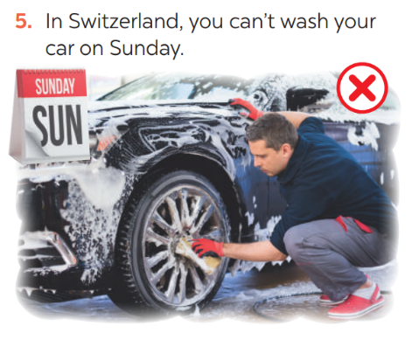
5
Read, discuss which one do is the strangest rule?

Slide 19
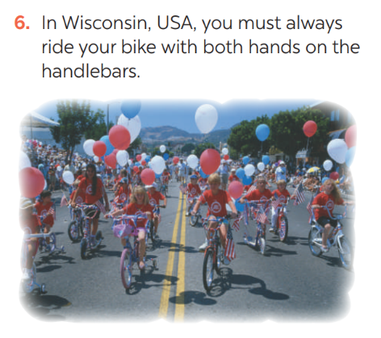
5
Read, discuss which one do is the strangest rule?

Slide 20
* PRODUCTION
5
Work in groups. which one do you think is the strangest rule?
Example: In my opinion, the strangest traffic rule is a man in Thailand has to wear a shirt or T-shirt while driving.

Slide 21

* CONSOLIDATION
In this lesson, we have learn to:
ask and answer about means of transport and some strange traffic rules.
practise using some grammar points and vocabulary related to the topic.

Slide 22


homework
- Do ex C1,2,3 (P. 56,57)in the workbook.
- Prepare lesson 5 ( skills 1)

Slide 23

Thanks for your atendance!
Goodbye. See you again
Notes:
23

