Slide 1
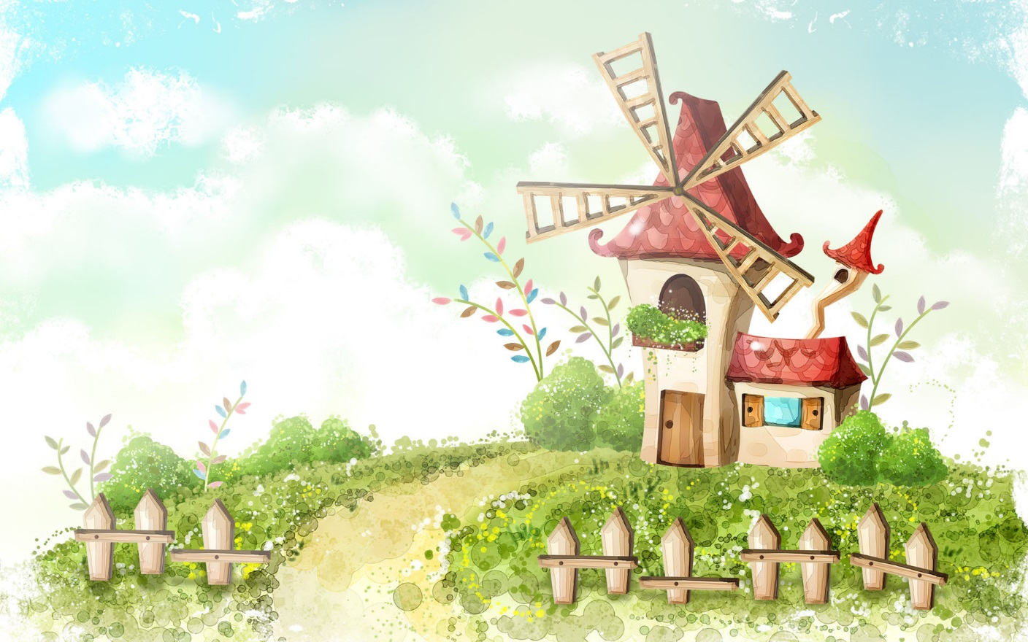
Welcome to our class!!!

Slide 2
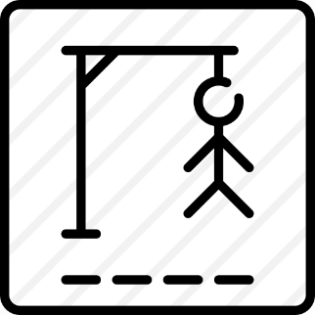


* WARM-UP
Game: Hangman
D A N G E R O U S

Slide 3

Tuesday, January 23, 2024
Period 59. Unit 7
TRAFFIC
LESSON 5: SKILLS 1 (P. 78)
ROAD SAFETY
READING
HOW TO AVOID TRAFFIC
ACCIDENTS
SPEAKING

Slide 4
I. OBJECTIVES
By the end of this lesson, students will be able to gain:
1. Knowledge
+ Reading: - read for specific information about some rules about road safety
+ Speaking: - talk about how to avoid traffic accidents.

Slide 5

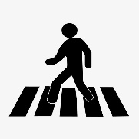
* VOCABULARY
- pedestrian (n):
/pəˈdestrēən/
người đi bộ

Slide 6
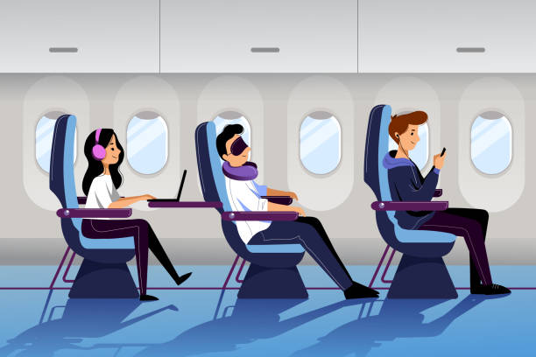
* VOCABULARY
- passenger (n):
/ˈpæsindʒɚ/
hành khách

Slide 7
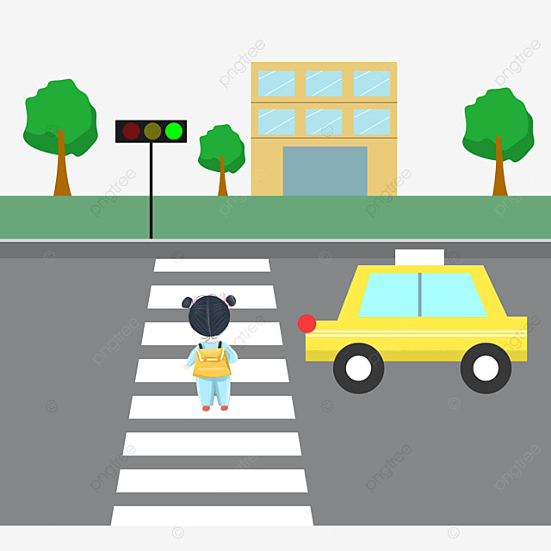
* VOCABULARY
-(to) obey
tuân theo
/əˈbeɪ/

Slide 8
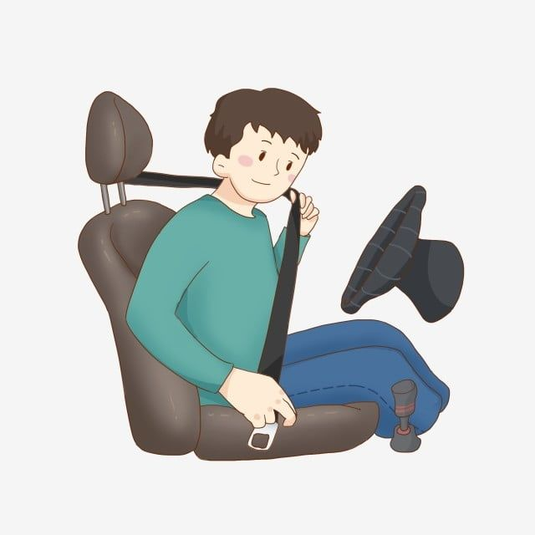
* VOCABULARY
- seatbelt (n)
đai an toàn
/ˈsit:belt/

Slide 9
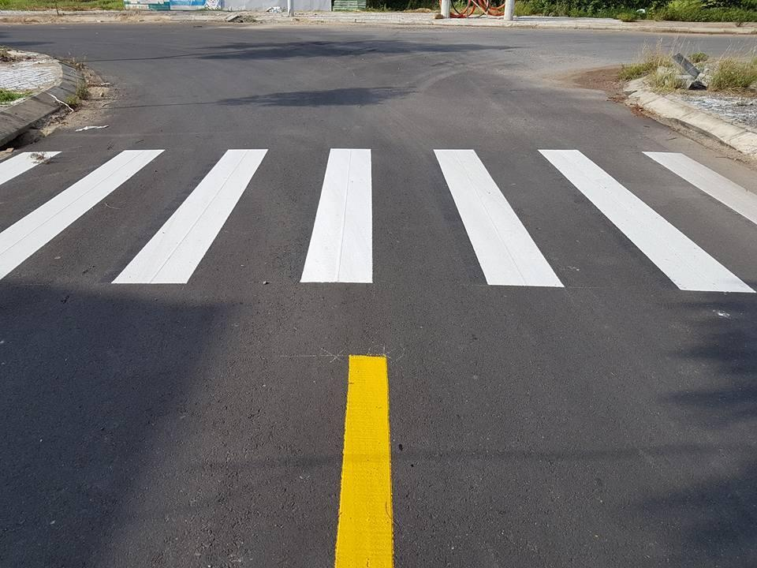
* VOCABULARY
- zebra crossing (n.phr):
vạch kẻ đường
/ˈziːbrə ˈkrɒsɪŋ/

Slide 10
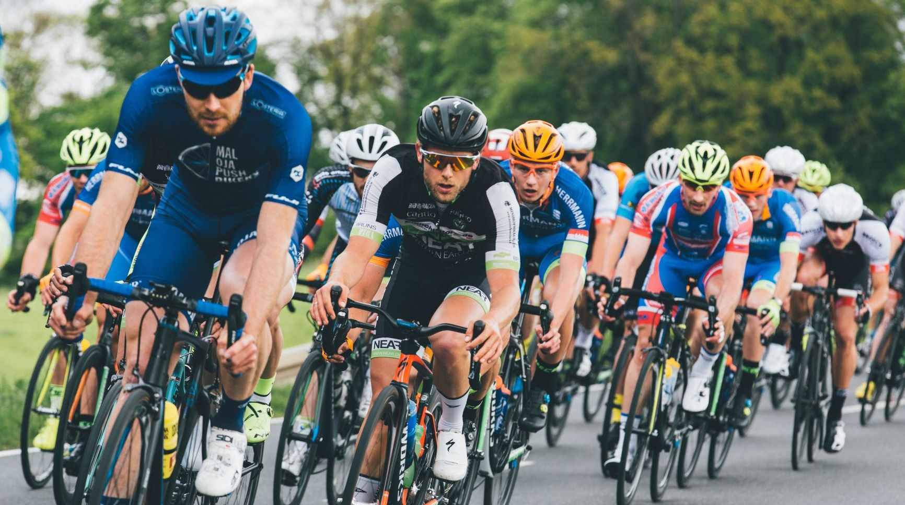
* VOCABULARY
cyclist (n):
/ˈsaɪklɪst/
người đi xe đạp

Slide 11
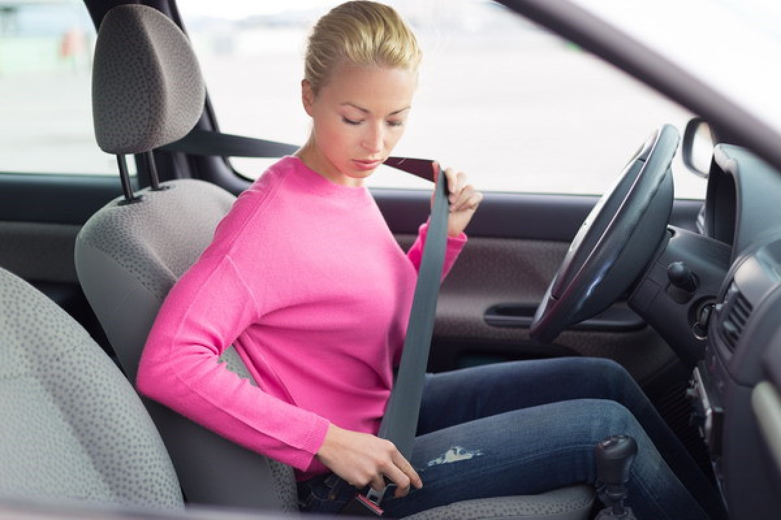

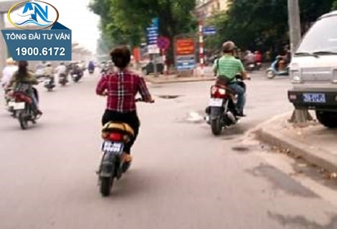
give a signal: (v)
Đưa ra tín hiệu
fasten seat belt (v):
thắt dây an toàn
wear a helmet (v):
đội mũ bảo hiểm

Slide 12
* VOCABULARY
New words | Pronunciation | Meaning
- pedestrian (n) | /pəˈdestrēən/ | người đi bộ
- passenger (a) | /ˈpasinjər/ | hành khách
- (to) obey |  | tuân thủ
- seatbelt (n) | /ˈsit:belt/ | đai an toàn
- zebra crossing (n.phr): | /ˈziːbrə ˈkrɒsɪŋ/ | vạch kẻ đường
- cyclist (n): | /ˈsaɪklɪst/ | người đi xe đạp
/əˈbeɪ/
- give a signal: (v)
đưa ra tín hiệu
- fasten seat belt (v):
thắt dây an toàn
- wear a helmet (v):
đội mũ bảo hiểm

Slide 13
* VOCABULARY
New words | Meaning
 | người đi bộ
 | hành khách
 | tuân thủ
 | dây an toàn
 | vạch kẻ đường
 | người đi xe đạp
- pedestrian (n)
- passenger (a)
- (to) obey
- seat belt (n)
- zebra crossing (n.phr):
- cyclist (n):
- give a signal: (v)
đưa ra tín hiệu
- fasten seat belt (v):
thắt dây an toàn
- wear a helmet (v):
đội mũ bảo hiểm

Slide 14

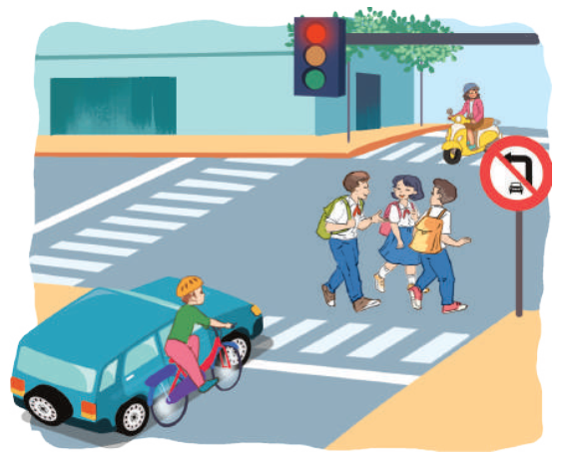
I. READING
1
Dicussion. Look at the pictures:
Can you see anything that is dangerous?
- The situation is very unsafe /dangerous.
- It’s dangerous to ride a bike so close to a car
- these students do not walk across the street at the zebra crossing

Slide 15
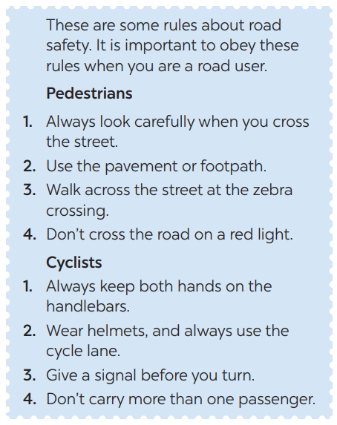
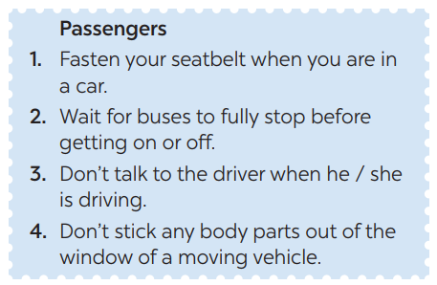
2
Read the following text and choose the correct answer.
This text is about ______.
A. rules for pedestrians
B. traffic lights
C. traffic rules

Slide 16
3
Read the passage again and choose the correct answer A, B, or C.
1. Where should pedestrians cross the street?
2. Which lane should you use when riding a bike?
3. What should you do before you turn while riding a bike?
4. What must you do when you get on or off a bus?
5. What mustn’t you do when you are in a moving vehicle?
GAME:

Slide 17
LUCKY NUMBER
1
Team A
8
2
Team B
2
8
4
6
10
3
2
8
4
6
7
10
6
4
5

Slide 18
3
Read the passage again and choose the correct answer A, B, or C.
1. Where should pedestrians cross the street?
→ They shoud cross the street at the zebra crossing.

Slide 19
3
Read the passage again and choose the correct answer A, B, or C.
2. Which lane should you use when riding a bike?
We should always use the cycle lane.

Slide 20
3
Read the passage again and choose the correct answer A, B, or C.
3. What should you do before you turn while riding a bike?
We should give a signal before we turn while riding a bike.

Slide 21
3
Read the passage again and choose the correct answer A, B, or C.
4. What must you do when you get on or off a bus?
We must wait for buses to fully stop when you get on or off a bus.

Slide 22
3
Read the passage again and choose the correct answer A, B, or C.
5. What mustn’t you do when you are in a moving vehicle?
We mustn’t stick any body parts out of the window
when you are in a moving vehicle.

Slide 23

LUCKY NUMBER!

Slide 24
LUCKY NUMBER!

Slide 25

LUCKY NUMBER
YOU GET A GIFT

Slide 26
3
Read the passage again and choose the correct answer A, B, or C.
1. Where should pedestrians cross the street?
2. Which lane should you use when riding a bike?
3. What should you do before you turn while riding a bike?
4. What must you do when you get on or off a bus?
5. What mustn’t you do when you are in a moving vehicle?
They shoud cross the street at the zebra crossing.
We should always use the cycle lane.
We should give a signal before we turn while riding a bike.
We must wait for buses to fully stop when you get on or off a bus.
We mustn’t stick any body parts out of the window
when you are in a moving vehicle.

Slide 27
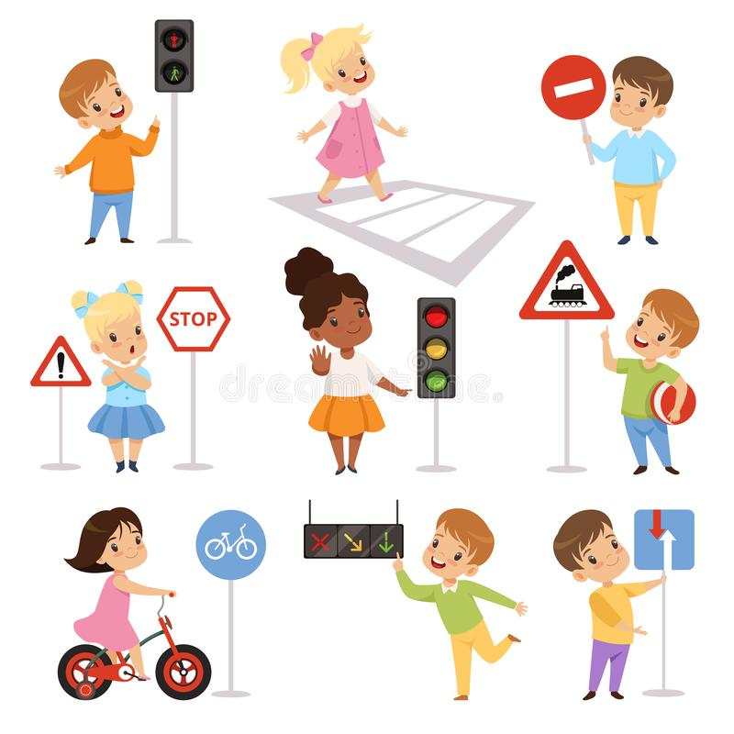
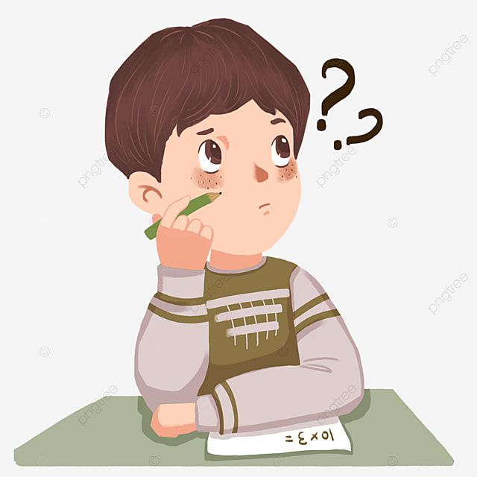
II. SPEAKING
4
Work in groups. Ask and answer the following question:
When you are a road user, what should you NOT do?
- I shouldn’t cross the road on a red light.
- I shouldn’t cycle in the pavement or footpath.
- I shouldn’t ride my bike fast.
- I shouldn’t carry a passenger in front of me.

Slide 28
5
Read the following sentences about these people.
Then work in groups. Discuss who is being safe, and who isn’t

Slide 29


5
Read the following sentences about these people.
Then work in groups. Discuss who is being safe, and who isn’t
1. Hoang is riding a bike, and he is wearing a helmet. 2. It is raining hard, but Mr. Long is driving quickly. 3. The students are standing in a line to get on the school bus. 4. Mr. Binh is taking his daughter to school on his motorbike. She is sitting in front of him. 5. Michelle is cycling to school and she is waving and shouting to her friends.

Slide 30

* CONSOLIDATION
ROAD SAFETY
SPEAKING
READING

Slide 31


HOMEWORK
Do D1,2,3 (P. 57,58) in workbook.
Prepare: Lesson 6 ( Skills 2)

Slide 32

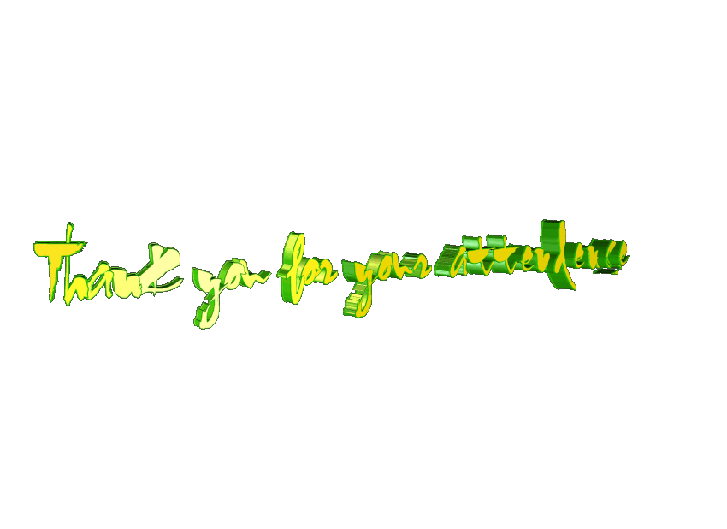

Slide 34
2
HOMEWORK

