Slide 1
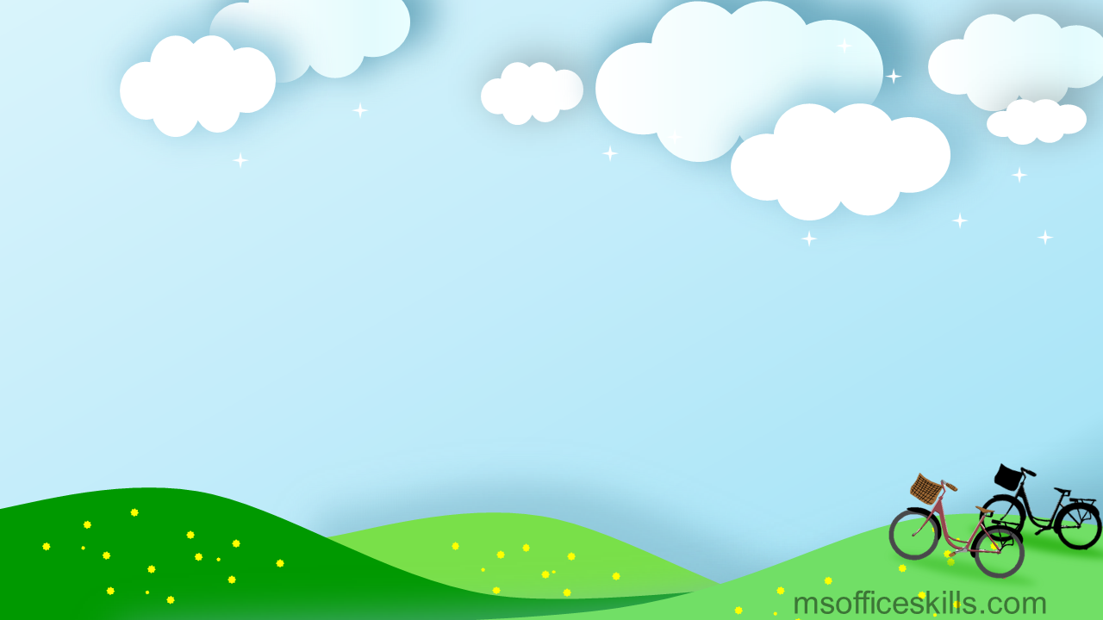
Hello every one !!!

Slide 2


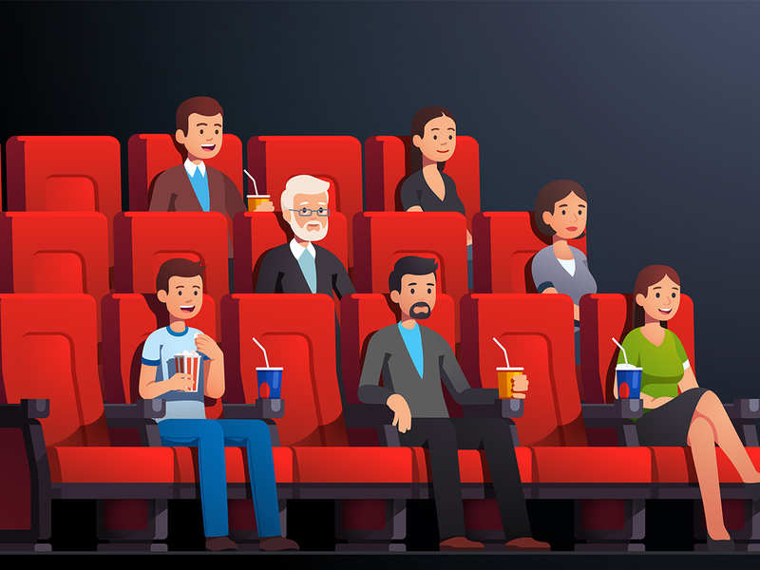
WARM-UP
Chatting
Look at the picture and answer the questions
- What are they doing?
- Do you like watching films?
- What kind of film do you like watching?
- Have you ever watched a movie at the cinema?
Unit
HOBBIES

Slide 3


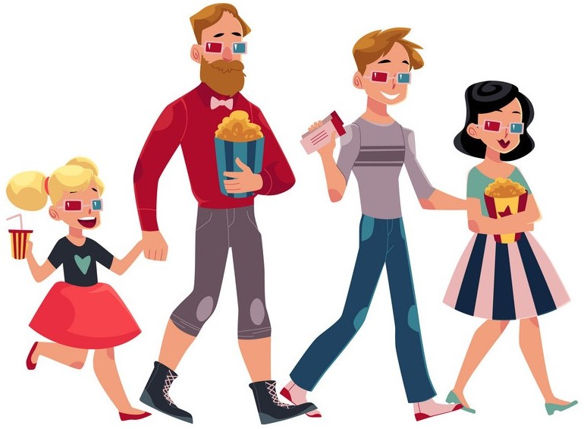
Monday, February 5, 2024
Period 62. Unit 8.
FILMS
LESSON 1: GETTING STARTED (P. 82)
Let’s go to the cinema tonight!

Slide 4
I. OBJECTIVES:
By the end of this lesson, students will be able to gain:
1. Knowledge
- An overview about the topic “Films”
- Lexical items related to the topic “Films”: types of films; adjectives describing films.

Slide 5



Slide 6

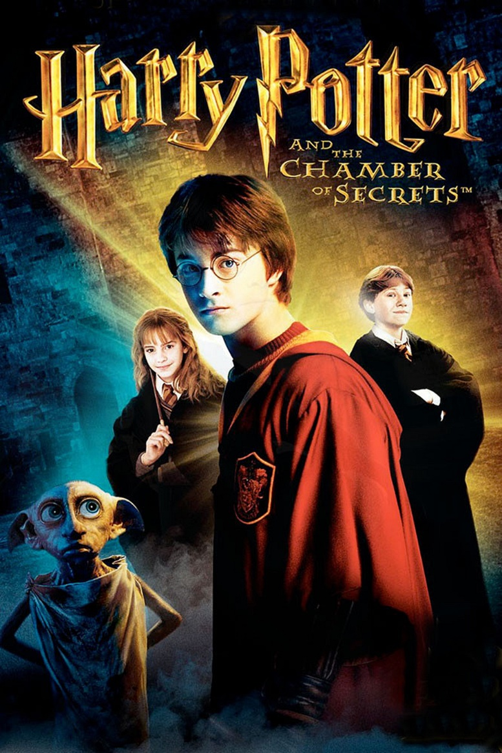
I. VOCABULARY
- fantasy (n): /ˈfæntəsi /
phim giả/viễn tưởng

Slide 7
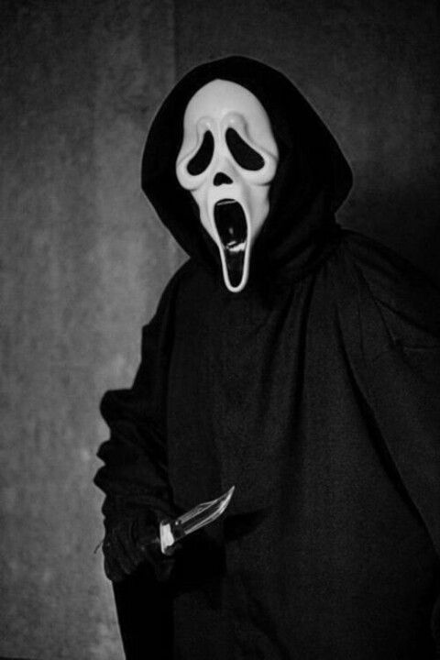
* VOCABULARY
- horror film (n) /'hɒrə fɪlm/:
phim kinh dị

Slide 8
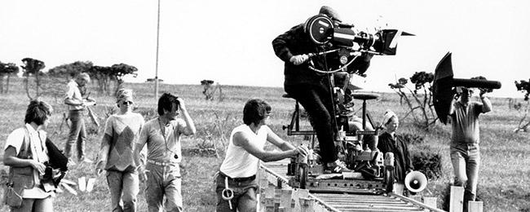
* VOCABULARY
- documentary (n): /dɒkjəˈmentəri/:
phim tài liệu

Slide 9
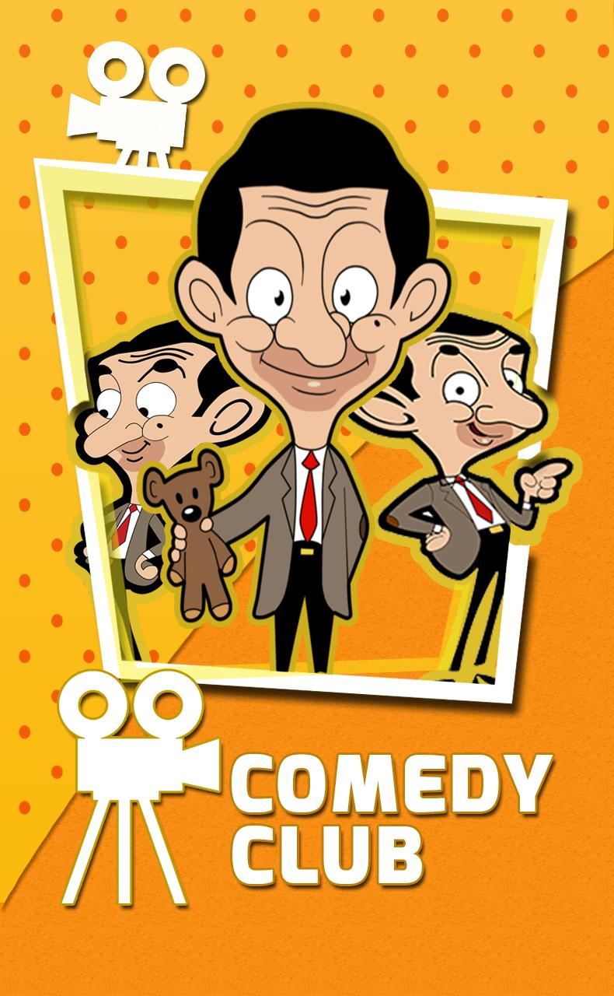
* VOCABULARY
-comedy (n) /ˈkɒmədi/:
phim hài

Slide 10
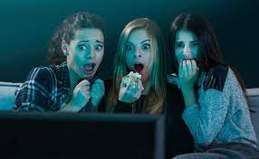
* VOCABULARY
- frightening (adj)
/ˈfraɪtnɪŋ/
sợ = scary

Slide 11

* VOCABULARY
- review (n) :
/rɪˈvjuː/
bình luận

Slide 12
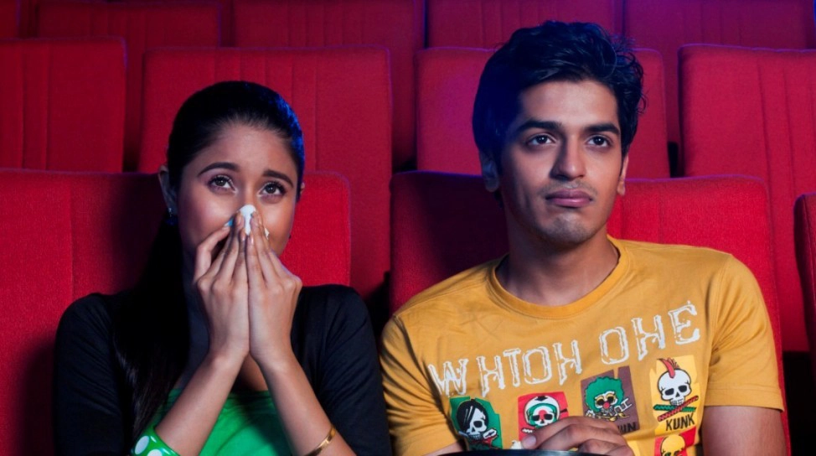
* VOCABULARY
- moving (adj):
/ˈmuːvɪŋ/
xúc động

Slide 13
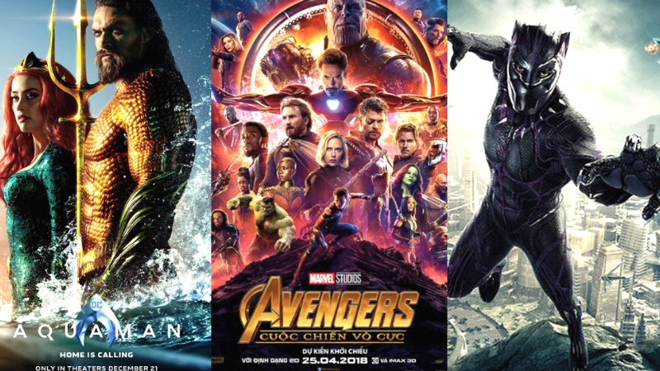
science fiction film :/ˌsaɪəns ˈfɪkʃn/:
phim khoa học viễn tưởng

Slide 14
I. VOCABULARY
New words | Pronunciation | Meaning
-horror film (n) | /'hɒrə fɪlm/ | phim kinh dị
-Documentary (n) | /dɒkjəˈmentri/ | phim tài liệu
-Comedy (n) | /ˈkɒmədi/ | phim hài
-Fantasy (n) | /ˈfæntəsi / | phim giả/ viễn tưởng
-frightening (adj) | /ˈfraɪtnɪŋ/ | sợ hãi
- review (n) | /rɪˈvjuː/ | sự đánh giá, bình luận
- moving (adj): | /ˈmuːvɪŋ/ | xúc động
science fiction film :/ˌsaɪəns ˈfɪkʃn/:
phim khoa học viễn tưởng

Slide 15
* VOCABULARY
New words | Meaning
 | phim kinh dị
 | phim tài liệu
 | phim hài
 | phim giả/ viễn tưởng
 | sợ hãi
 | bình luận
 | Xúc động
-horror film (n)
-documentary (n)
-comedy (n)
-fantasy (n)
-frightening = scary (adj)
- review (n)
- moving (adj)
- science fiction film
phim khoa học viễn tưởng

Slide 16
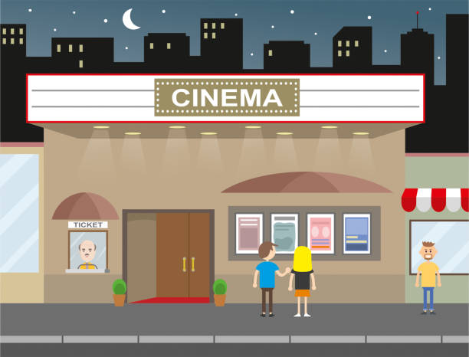
* PRACTICE
1
Listen and read.
Mark: Let's go to the cinema tonight!
Mi: Good idea! What shall we see?
Mark: A Nightmare is on at Sao Mai Cinema tonight.
Mi: Is it a fantasy?
Mark: No, it's a horror film.
Mi: That's too scary for me. Look! An Old Pier is on at Town Cinema. It's a documentary.
Mark: I don't really like documentaries. They're often boring. What about Our Holiday?
Mi: What kind of film is it?
Mark: It's a comedy.
Mi: And who stars in it?
Mark: Kate Harrison and Lily Collins.
Mi: Um, they're pretty good. What's it about?
Mark: It's about two women living in different countries and they decide to exchange houses.
Mi: What are the reviews like?
Mark: Well, although a few people say it's a bit silly, most say it's funny and interesting.

Slide 17
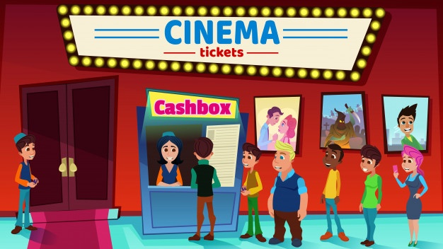
*PRACTICE
2
Read the conversation again and choose the correct answer to each question.

Slide 18
2. Read the conversation again and choose the correct answer to
1. What does Mark suggest doing tonight?
A. Watching a TV show.
B. Watching a film.
C. Staying at home.
2. Why doesn't Mark want to see An Old Pier?
A. He doesn't like that type of film.
B. It's not on at a convenient time.
C. He saw it last week.
3. The word "reviews" in the conversation mostly means
A. people's opinions about a film
B. interesting scenes in a film
C. what people don't like about a film
4. What do people think of Our Holiday?
A. Everyone likes it.
B. No one likes it.
C. Most people like it.

Slide 19



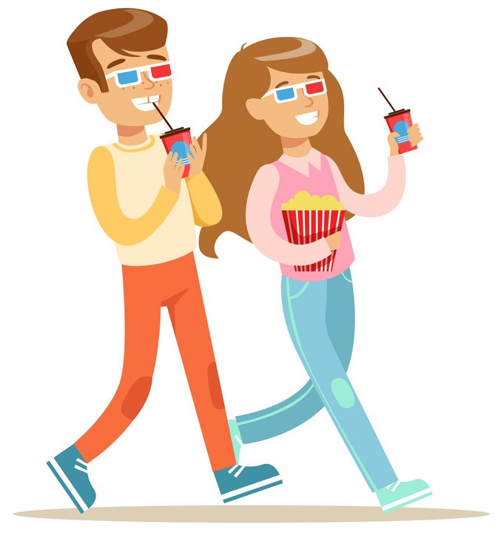
5
4
1
1. What does Mark suggest doing tonight?
3
2
a. Watching a TV show.
b. Watching a film.
c. Staying at home
Mark: Let’s go to the cinema tonight!
Hoa: Good idea! What shall we see?

Slide 20
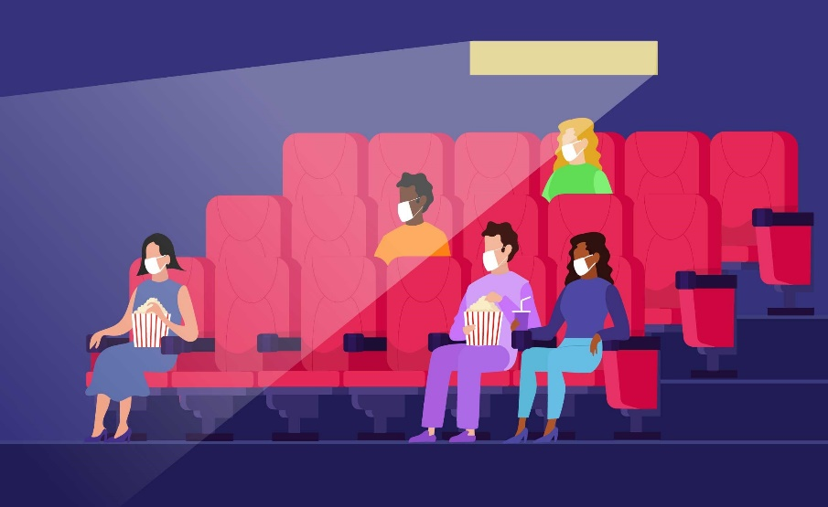
5
4
1
2. Why doesn’t Mark want to see An Old Pier?
3
2
a. He doesn’t like that type of film.
b. It’s not on at a convenient time
c. He saw it last week.
Hoa: That’s too frightening for me. Look! An Old Pier is on at the Town Cinema. It’s a documentary.
Mark: I don’t really like documentaries. They’re often boring. What about Our Holiday?

Slide 21

5
4
1
3. The word “reviews” in the conversation mostly means.
3
2
a. people’s opinions about the film
b. interesting scenes in the film
c. what people don’t like about the film

Slide 22
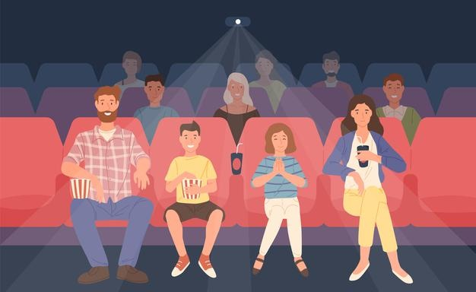
5
4. What do people think of Our Holiday?
4
1
3
2
a. Everyone likes it.
b. No one likes it.
c. Most people like it.
Hoa: What are the reviews like?
Mark: Well, although a few people say it’s a bit silly, most say it’s funny and interesting.

Slide 23
2. Read the conversation again and choose the correct answer to
1. What does Mark suggest doing tonight?
A. Watching a TV show.
B. Watching a film.
C. Staying at home.
2. Why doesn't Mark want to see An Old Pier?
A. He doesn't like that type of film.
B. It's not on at a convenient time.
C. He saw it last week.
3. The word "reviews" in the conversation mostly means
A. people's opinions about a film
B. interesting scenes in a film
C. what people don't like about a film
4. What do people think of Our Holiday?
A. Everyone likes it.
B. No one likes it.
C. Most people like it.

Slide 24
* PRACTICE
3
Choose the correct word or phrase to complete each of
the following sentences.
comedy
Game: Who is faster?
fantasy
science fiction film
Types of films
1. A film that tries to make the audience laugh is a ………………
horror film
docu-mentary
comedy
cartoon

Slide 25
* PRACTICE
3
Choose the correct word or phrase to complete each of
the following sentences.
Game: Who is faster?
comedy
fantasy
science fiction film
Types of films
2. A film that is based only on
imagination, not on real facts, is a …………………
horror film
docu-mentary
fantasy
cartoon

Slide 26
* PRACTICE
3
Choose the correct word or phrase to complete each of
the following sentences.
comedy
Game: Who is faster?
fantasy
science fiction film
Types of films
3. A film that shows real life events or stories is a ……………….
horror film
docu-mentary
documentary
cartoon

Slide 27
* PRACTICE
3
Choose the correct word or phrase to complete each of
the following sentences.
comedy
Game: Who is faster?
fantasy
science fiction film
Types of films
4. A film that is set in the future, often about science, is a
………………………..
horror film
docu-mentary
science fiction film
cartoon

Slide 28
* PRACTICE
3
Choose the correct word or phrase to complete each of
the following sentences.
comedy
Game: Who is faster?
fantasy
science fiction film
Types of films
5. A film in which strange and frightening things happen is a
……………….
horror film
docu-mentary
horror film
cartoon

Slide 29
4
Complete the following sentences with the words in the box.
funny
interesting
frightening
moving
boring
1. Going to the hospital can be _________________ for a child.
2. The film was so _______________ that the audience couldn’t stop laughing.
3. Many people cried when they saw the _______________ scenes of the film.
4. The film last night was so _______________ that we fell asleep.
5. This book is ________________. I got a lot of useful information from it.
frightening
funny
moving
boring
interesting

Slide 30

* PRODUCTION
5
Work in pairs. ask and answer about a type of film. Use some of the adjectives in Task 4.
Example:
A: Do you like documentaries?
B: No, I don’t.
A: Why not?
B: I think they’re boring.

Slide 31
* CONSOLIDATION
Topic of the unit
FILMS
Vocabulary
Types of films
Adjectives describing films

Slide 32

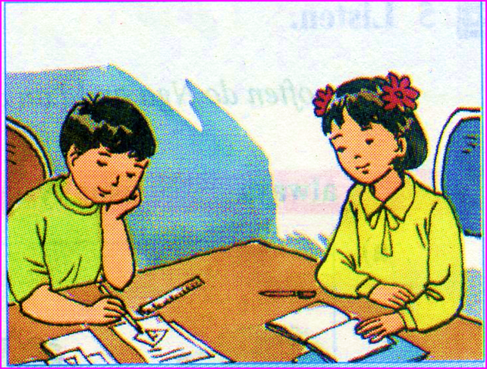
homework
New words x 2
Do ex B1,2,3 (P. 60,61)
Think about your favourite film.
Use at least 3 adjectives to describe it.

Slide 33
Homework
Think about your favourite film.
Use at least 3 adjectives to describe it.

Slide 34
2
Homework
Think about your favourite film.
Use at least 3 adjectives to describe it.

Slide 35

Thanks for your atendance!
Goodbye. See you again
Notes:
35

