Slide 1

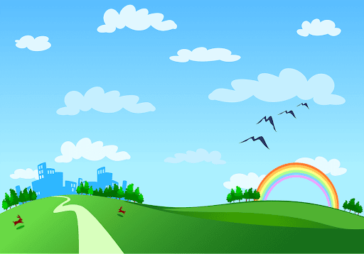
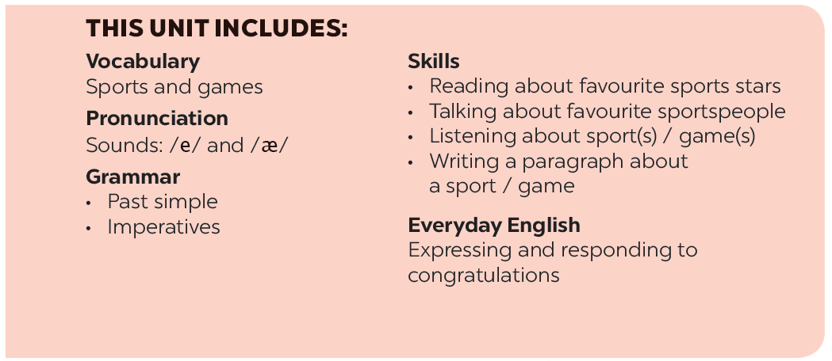
Good morning class

Slide 2
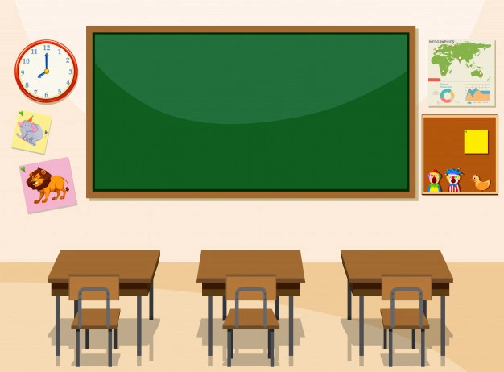

warm -up
Game: Lucky number

Slide 3

LUCKY NUMBERS
1
2
3
4
5
6
7
8
A
2
4
6
8
10
12
14
B
2
4
6
8
10
12
14

Slide 4

LUCKY NUMBER!

Slide 5
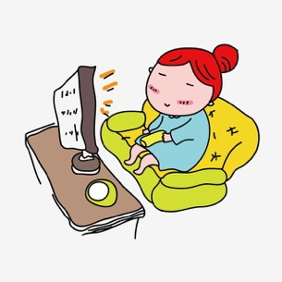
* Complete the following imperative:
Don’t
2. ...……..watch TV more than 3 hours a day. It’s bad for your eyes.

Slide 6
* Complete the following imperative:
Don’t
2. ...……..use your mobile phone more than 3 hours a day. It’s bad for your eyes.

Slide 7
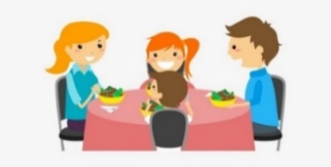
* Complete the question:
Did
3. .……. you have dinner with your parents yesterday?

Slide 8
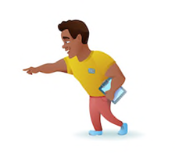
* Look at the picture and complete the sentence:
Listen
4. ……..… to the instructor at the gym.

Slide 9
LUCKY NUMBER!

Slide 10
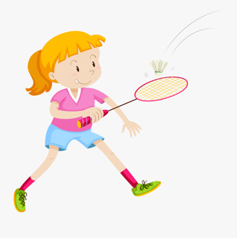
* Look at the picture and complete the sentence:
played badminton
6. Jane …………………………... with her brother last weekend.

Slide 11
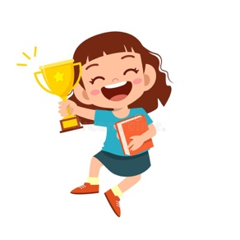
* Translate the following sentence into English:
7. Thứ 2 tuần trước tôi đã chiến thắng trong cuộc thi nói tiếng anh
I won in the Speaking English contest last Monday.

Slide 12
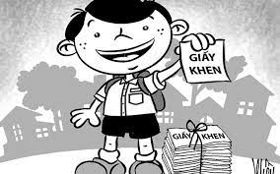
* Complete the sentence:
was
8. Nam ………....a good student last year.

Slide 13




Wednesday, February 14, 2024
PERIOD 65: UNIT 8: SPORTS AND GAMES
LESSON 4:
P. 21
Everyday English
Expressing and responding to congratulations

Slide 14
- Get further information about sports and games.
- Students can also talk about sports and games and about the sports people they like.

Slide 15


Listen and read the short conversation below, paying attention to the highlighted parts.
Duong: Last week I played table tennis with Duy, and I won for the first time.
Mai: Congratulations!
Duong: Thank you, Mai.
Mai: So you’re our class champion now.

Slide 16


Work in pairs. Student A has won a prize in the school’s singing contest / sports competition. Student B congratulates him / her. Make a similar dialogue. Remember to use the highlighted sentences in 1. Then change roles.
Nga : Last week I won the first prize of my school’s singing contest.
Hoa :Congratulations!
Nga : Thank you, Minh.

Slide 17
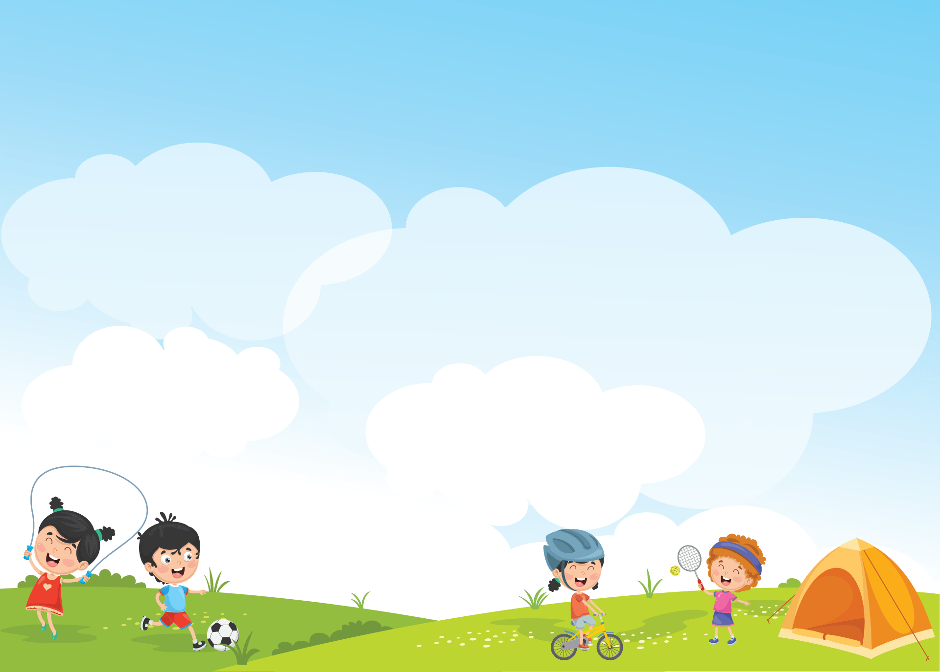

* The sport / game you like

Slide 18

Work in pairs. Do the quiz.
1.
How many players are there in a football match?
There are usually 22 players (11 on each side).
2.
How long does a football match last?
It normally lasts 90 minutes (divided into two halves).
3.
How often do the Olympic Games take place?
They take place every four years.
4.
How long is a marathon?
A marathon is 42.195 kilometres long (26 mile and 385 yards).
5.
Where did the first Olympic Games take place?
They took place in Olympia (in Ancient Greece) (in 776 BC).

Slide 19

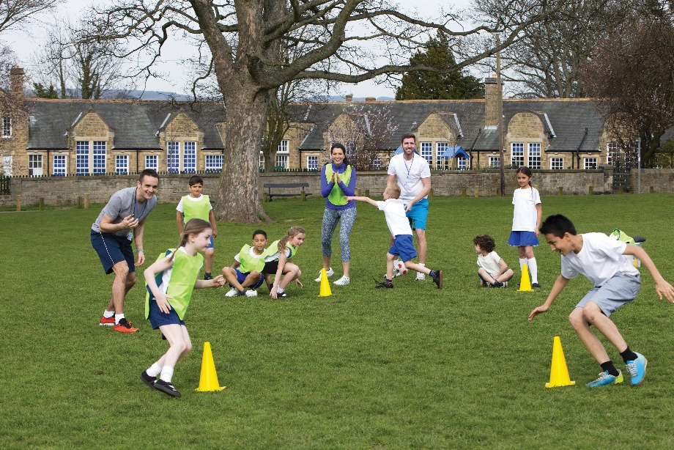
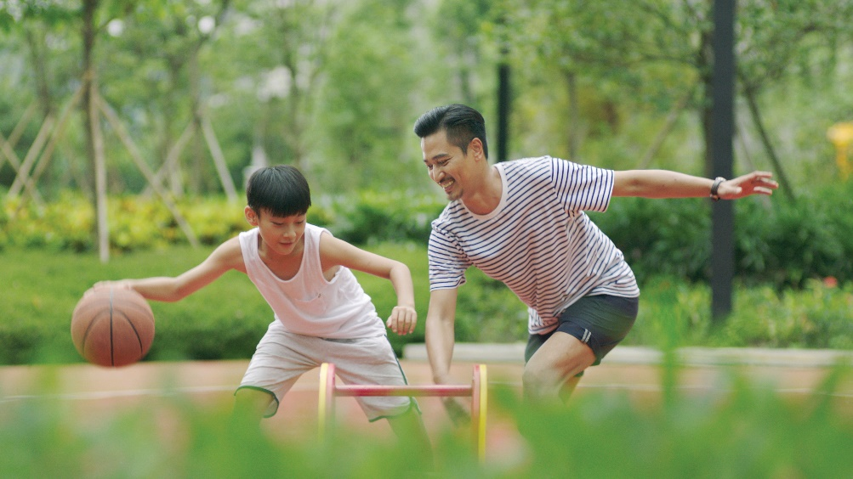
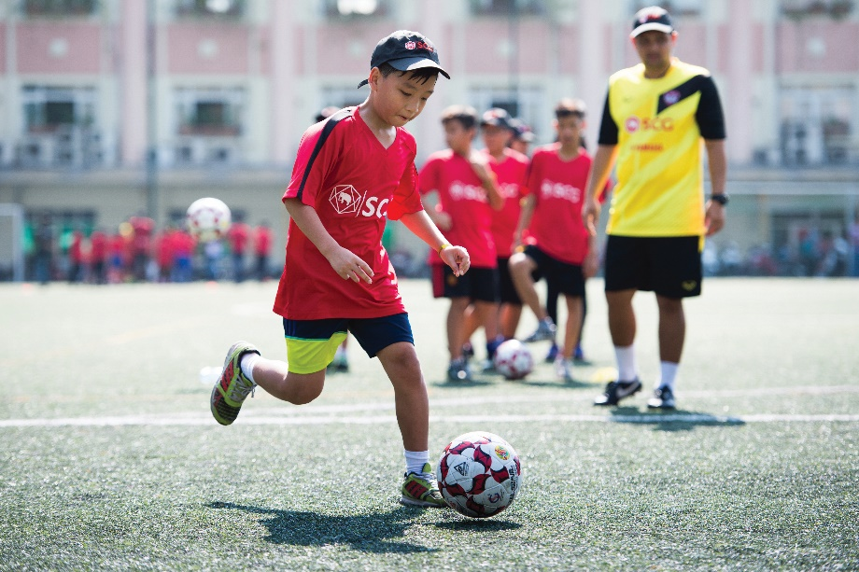
Work in groups. Interview your partners using the following questions. You may ask for more information.
Notes:
City landmarks phải ở trên mục 3

Slide 20
* Interview your partners using the following questions.
1.
What sports / games do you play in your free time? Do you play them well? When and how often do you play them?
2.
Which sport / game do you like watching on TV?
3.
Did you join any clubs?
4.
If you don’t play sport, what do you often do in your spare time?
Report your interviews to the class.

Slide 21
Give example:
A: What sports / games do you play in your free time?
A: Do you play them well?
A: When and how often do you play them?
A: Which sport / game do you like watching on TV?
A: Did you join any clubs?
A: Do you often do anything else in your spare time?
B: In my free time I play badminton and chess.
B: I’m good at badminton, but I’m not good at chess.
B: I play badminton at the weekend and I play chess in the evening.
B: I like watching football matches on TV. The players are really amazing.
B: Well, I often listen to music and chat with my friends.
B: Yes, I do. I’m a member of the chess club of my school.

Slide 22
Give example:
A: What sports / games do you play in your free time?
B: In my free time I play badminton and chess.
A: Do you play them well?
B: I’m good at badminton, but I’m not good at chess.
A: When and how often do you play them?
B: I play badminton at the weekend and I play chess in the evening.
A: Which sport / game do you like watching on TV?
B: I like watching football matches on TV. The players are really amazing.
A: Did you join any clubs?
B: Yes, I do. I’m a member of the chess club of my school.
A: Do you often do anything else in your spare time?
B: Well, I often listen to music and chat with my friends.

Slide 23
Report your interviews to the class.

Slide 24

homework
Write down the results and feedback of the previous interviews.
Do ex B5, 6 (P. 11, 12)
Prepare lesson 5: Skills 1

Slide 25





