Slide 1


PHU THI SECONDARY SCHOOL
Hello every one !!!
love

Slide 2

LUCKY NUMBER!
1
2
3
4
5
6
T. A
2
4
6
8
10
12
14
T. B
2
4
6
8
10
12
14

Slide 3

LUCKY NUMBER!

Slide 4

2. Complete the following imperative:
Don’t
…….. watch TV more than 3 hours a day. It’s bad for your eyes.

Slide 5

3. Complete the question:
Did
….. you have dinner with your parents yesterday?

Slide 6
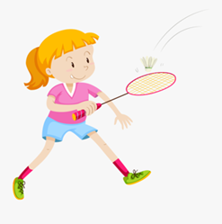
4. Look at the picture and complete the sentence:
played badminton
Jane ………………… …with her brother last weekend.

Slide 7
LUCKY NUMBER!

Slide 8
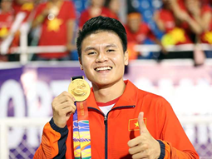
6. Look at the picture and answer the questions
Quang Hai
Who is this man?

Slide 9
Quang Hai is a famous football player in Vietnam

Slide 10
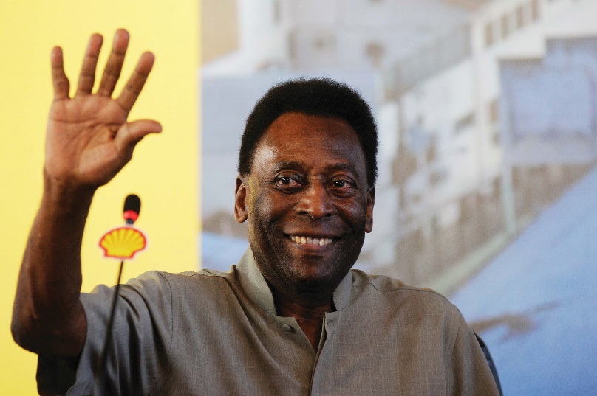
Do you know who this man is?
It’s Pelé

Slide 11
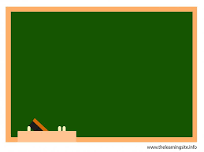

Tuesday, February 20, 2024
PERIOD 65:UNIT 8: SPORTS AND GAMES
LESSON 4: SKILLS 1 (p. 22)
* Reading
* Speaking
- Develop reading skill for general and specific information about Pelé.
- Talk about famous sports people.

Slide 12

Work in pairs. Discuss the questions.
1.
What do you know about Pelé?
2.
What is special about him?
…the best footballer
… from Brazil
… won the World Cup
… the King of Football

Slide 13
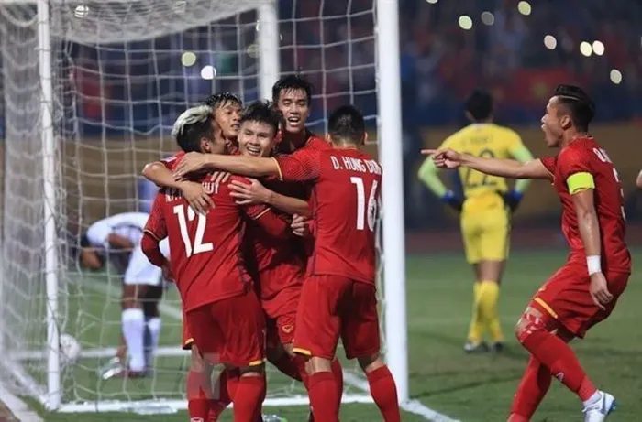
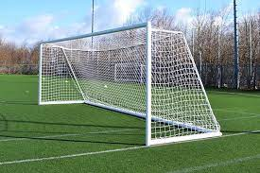
I. Vocabulary
- career (n) /kəˈrɪər/:
nghề nghiệp, sự nghiệp
- goal (n) /ɡəʊl/ :
khung thành, bàn thắng
- score (v, n) /skɔːr/:
ghi bàn, số bàn thắng
- take part in:
tham gia
- win - won (v):
thắng, chiến thắng

Slide 14
* Checking vocabulary
- career (n) /kəˈrɪər/:
nghề nghiệp, sự nghiệp
- goal (n) /ɡəʊl/ :
khung thành, bàn thắng
- score (v, n) /skɔːr/:
ghi bàn, điểm
- take part in:
tham gia
- win - won (v):
thắng, chiến thắng

Slide 15


Read the dialogue quickly to check your ideas in 1.
The PE teacher is talking to her students
about Pelé.
Teacher: Today we’re going to talk about Pelé. Do you know him?
Nick: Yes, I think he’s the best footballer of all time.
Teacher: Right. He was born in 1940 in Brazil. His father taught him to play football at a very young age.
Susan: Oh. When did he begin his career in football?
Teacher: At 15, when he started playing for Santos Football Club. In 1958, he won his first World Cup.
Nick: How many goals did he score in his career?
Teacher: 1,281 goals in total, I think.
Nick and Susan: Wow! Amazing!
Teacher: And he became “Football Player of the Century” in 1999.
Michael: Surely Pelé’s a national hero in Brazil.
Teacher: Yes, and he’s known around the world as “The King of Football”.

Slide 16

Read the text again and answer the questions.
1.
When was Pelé born?
2.
Who first taught him to play football?
3.
How many goals did he score in total?
4.
When did he become “Football Player of the Century”?
5.
What do people call him?
6.
Who is talking to her students about Pelé?

Slide 17
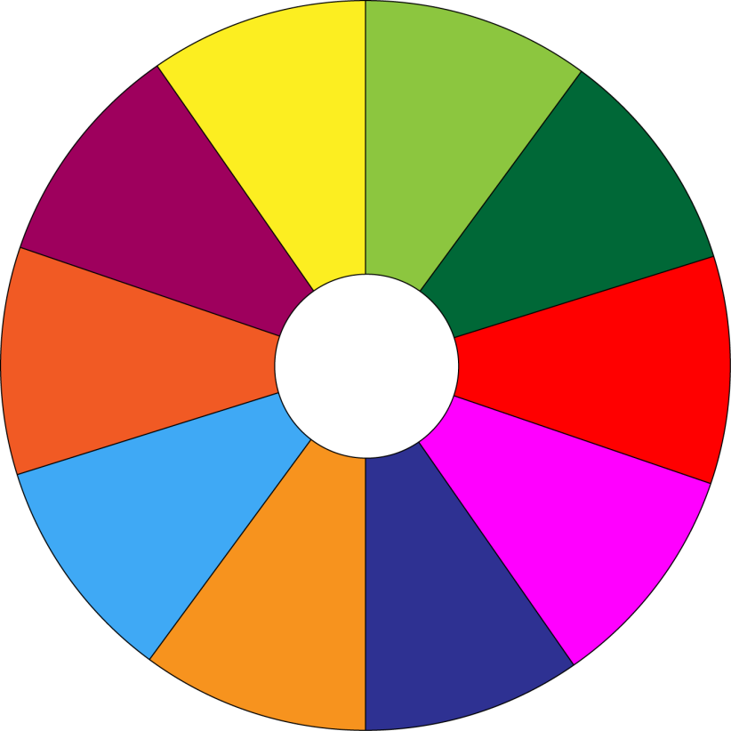
THE BIG WHEEL GAME
QUESTIONS
10
40
30
50
SPIN
1
4
20
10
-15
-20
2
5
05
60
3
6

Slide 18
1. When was Pelé born?
→Pelé was born in 1940.

Slide 19
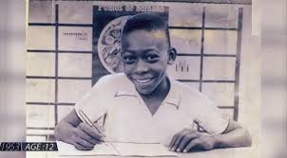
2. Who first taught him to play football?
→ His father did. / His father taught him.

Slide 20
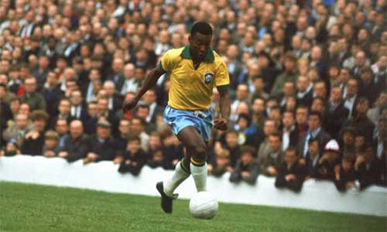
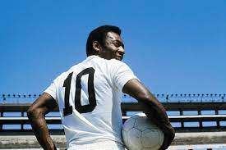
3. How many goals did he score in total?
→ He scored 1,281 goals in total.

Slide 21
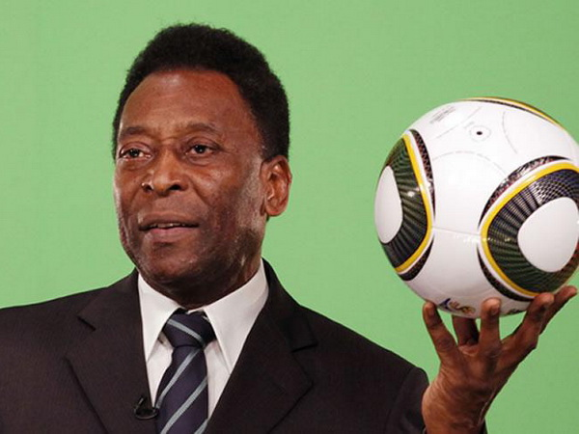
4. When did he become “Football Player of the Century”?
→(He became Football Player of the Century) in 1999.

Slide 22
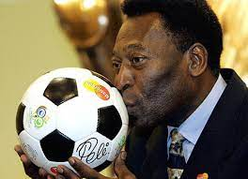
5. What do people call him?
They call him “The King of Football”.

Slide 23
6. Who is talking to her students about Pelé?
The PE teacher is talking to her students about Pelé.

Slide 24
Read the dialogue quickly to check your ideas in 1.
The PE teacher is talking to her students
about Pelé.
Teacher: Today we’re going to talk about Pelé. Do you know him?
Nick: Yes, I think he’s the best footballer of all time.
Teacher: Right. He was born in 1940 in Brazil. His father taught him to play football at a very young age.
Susan: Oh. When did he begin his career in football?
Teacher: At 15, when he started playing for Santos Football Club. In 1958, he won his first World Cup.
Nick: How many goals did he score in his career?
Teacher: 1,281 goals in total, I think.
Nick and Susan: Wow! Amazing!
Teacher: And he became “Football Player of the Century” in 1999.
Michael: Surely Pelé’s a national hero in Brazil.
Teacher: Yes, and he’s known around the world as “The King of Football”.

Slide 25
Read the text again and answer the questions.
The PE teacher is talking to her students
about Pelé.
Teacher: And he became “Football Player of the Century” in 1999.
Yes, and he’s known around the world as “The King of Football”.
1.
When was Pelé born?
Nick: How many goals did he score in his career?
Teacher: 1,281 goals in total, I think.
He was born in 1940 in Brazil.
His father taught him to play football at a very young age.
Pelé was born in 1940.
2.
Who first taught him to play football?
His father did. / His father taught him.
3.
How many goals did he score in total?
He scored 1,281 goals in total.
4.
When did he become “Football Player of the Century”?
(He became Football Player of the Century) in 1999.
5.
What do people call him?
They call him “The King of Football”.
6.
Who is talking to her students to about Pelé?
The PE teacher is talking to her students about Pelé.

Slide 26

II. Speaking
Read the following facts about two famous sportspeople.
Hoang Giang – No. 1 sportsman in shooting
Born: 1978 in Viet Nam
1995: finished sports school
1996: took part in a shooting competition
2001: won a gold medal for shooting
Jenny Green – one of the best female golfers in history
Born: 1972 in Greenland
1987: became a member of local golf club
1994: took part in a female golf tournament
2002: became the female golf champion

Slide 27

Choose one sportsperson in 4. Talk about him / her. Use the following cues.
His / Her name
The sport he / she plays
Why he / she is famous
You like him / her or not
Explain why

Slide 28
Choose one sportsperson in 4. Talk about him / her. Use the following cues.
Hoang Giang – No. 1 sportsman in shooting
Born: 1978 in Viet Nam
1995: finished sports school
1996: took part in a shooting competition
2001: won a gold medal for shooting
His name is Hoang Giang, he was born in 1978 in Viet Nam. He plays shooting. He is famous for being No.1 sportsman in shooting. In 1996, he took part in a shooting competition. In 2001, he won a medal for shooting

Slide 29
Choose one sportsperson in 4. Talk about him / her. Use the following cues.
Jenny Green – one of the best female golfers in history
Born: 1972 in Greenland
1987: became a member of local golf club
1994: took part in a female golf tournament
2002: became the female golf champion
- Her name is Jenny Green. She was born in 1972 in Greenland. She plays golf. She is famous for being one of the best female golfers in history. In 1987, she became a member of local golf club. In 1994, she took part in a female golf tournament and in 2002, she became the female golf champion

Slide 30

* Homework
Learn new words by heart x2.
Do e ex B7,C1,2 (P. 12)
Write about a famous sportsperson.
Prepare: Skills 2.

Slide 31


