Slide 1
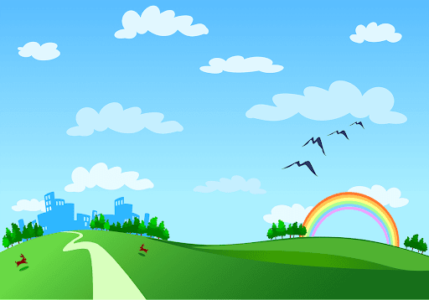
Good morning class

Slide 2

* WARM –UP
* Mind map
(1)…………and Games
Sports
(2)…………..
(3)…………..
Communication
Vocabulary
Grammar
past
Talk about sports and games
Names of sports and games
The (4) ………….
simple.
Imperatives
(5) ………………….

Slide 3
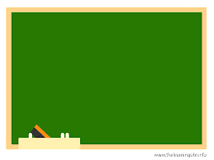
Wednesday, February 21, 2024
PERIOD 68: UNIT 8: SPORTS AND GAMES
LESSON 7 : LOOKING BACK + PROJECT
P. (24,25)
- Review the vocabulary and grammar of Unit 8;
- Apply what they have learnt (vocabulary and grammar) into practice through a project.

Slide 4

* VOCABULARY
Find one odd word / phrase in each question.
1.
A.
volleyball
B.
badminton
C.
bicycle
2.
A.
playground
B.
ball
C.
racket
3.
A.
running
B.
cycling
C.
driving
4.
A.
sports shoes
B.
winter sports
C.
goggles
5.
A.
sporty
B.
intelligent
C.
fit

Slide 5

Put the correct form of the verbs play, do or go in the blanks.
1. Duong can ................ karate.
2. Duy isn't reading now. He.......... table tennis with his friend.
3. Michael ............ swimming nearly every day.
4. Phong didn't play football yesterday. He ........... fishing.
5. Khang ............ volleyball last Saturday.
6. The girLs ............ aerobics in the playground now.

Slide 6
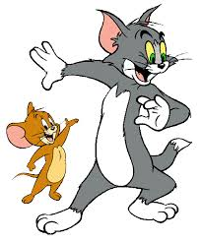
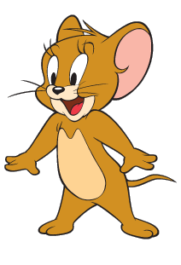
Lucky Numbers
1
2
3
4
5
6
7
8
40
70
10
40
30
20
10
60
20
30
60
70
80
50
50

Slide 7
1. Duong can ................ karate.
do

Slide 8

LUCKY NUMBER!

Slide 9
2. Duy isn't reading now. He..................... table tennis with his friend.
is playing

Slide 10
3. Michael ............ swimming nearly every day.
goes

Slide 11
4. Phong didn't play football yesterday. He ........... fishing.
went

Slide 12
5. Khang ............ volleyball last Saturday.
played

Slide 13
LUCKY NUMBER!

Slide 14
6. The girLs ................ aerobics in the playground now.
are doing

Slide 15
Put the correct form of the verbs play, do or go in the blanks.
1. Duong can ________karate.
2. Duy isn't reading now. He _____________table tennis with his friend.
3. Michael ___________swimming nearly every day.
4. Phong didn't play football yesterday. He __________fishing.
5. Khang ____________volleyball last Saturday.
6. The girls ____________aerobics in the playground now.
do
is playing
goes
went
played
are doing

Slide 16
Put the correct form of the verbs play, do or go in the blanks.
1. Duong can do karate.
2. Duy isn't reading now. He is playing table tennis with his friend.
3. Michael goes swimming nearly every day.
4. Phong didn't play football yesterday. He went fishing.
5. Khang played volleyball last Saturday.
6. The girls are doing aerobics in the playground now.

Slide 17

* Grammar:
The past simple ( Thì quá khứ đơn)
We use the past simple to talk about something that happened in the past.
Example:
(+): I played badminton with Phong yesterday.
(-): I didn’t play badminton…………………………….
(?): Did you play badminton…………………………….?
Yes, I did.
No, I didn’t

Slide 18




* Grammar 1:
The past simple ( Thì quá khứ đơn)
 | To verb | To be
(+): | S + V(2/ed/) + … . | S + was/ were + … .
(-): | S + didn’t + Vo + … . | S + wasn’t/ weren’t + …
(?): | Did + S + Vo + … ? | Was/ Were + S + … .
Answer | →Yes, S + did. →No, S + didn’t. | →Yes, S + was/were. →No, S + wasn’t/ weren’t.
* Notes: Irregular verbs Regular verbs. Vo - V(2/ed) Vo - V(2/ed) go - went play - played
Form:
Grammar
The past simple
Imperatives
Adverbs of time
yesterday, ago, last, in 2000, in the past, when (Trong câu khẳng định)
Work in groups. Ask and answer questions about your last weekend.

Slide 19

* Grammar
Put the verbs in brackets in the correct form.
took
1. The first Olympic Games (take)............. place in Greece in 776 BC.
2. People (start) ........... to use computers about 50 years ago.
3. My brother (not like) .................. to play games when he was small.
4. - What ........ you (do) ............. last weekend?
- I (cycle)............ round the lake with my friends. Then I (watch)............. TV in the afternoon.
started
didn’t like
did
do
cycled
watched

Slide 20

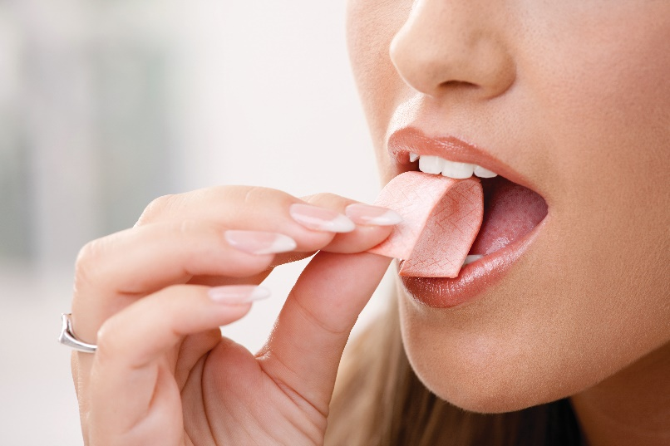
Imperatives
We use imperatives to tell someone to do something, or to give a direct order.
It’s a chewing gum.
Chew it.
Don’t swallow it.
Positive: Vo
Negative: Don’t + Vo

Slide 21

What do you say in these situations?
1. Your friends are making a lot of noise.
+ Please, stop ............ …………..
2. The boy is watching TV for too long.
.......................to play with your friends.
3. Some children are feeding the animals at the zoo, but it is not allowed.
.............................. the animals.
4. The teacher wants the boys to stand in line.
.........................................................
5. Your mother tells you not to touch the dog.
=> ..........................................................
making noise.
Go out
Don’t feed
Stand in line, boys.
Don’t touch the dog.

Slide 22

Fill each blank with ONE word to complete the passage.
Sports and games are very important in our lives. We all can (1) _______ a sport, or a game, or watch sports events on TV or at the stadium. When you listen to the radio every day, you can always (2) _______ sports news. When you open a newspaper, you will always find an article about your (3) _______kind of game. Television programmes about (4) _______ are also very popular, and you can watch something interesting every day. Stories about (5) _______ sports stars are often very interesting.

Slide 23
Fill each blank with ONE word to complete the passage.
Sports and games are very important in our lives. We all can (1) _______a sport, or a game, or watch sports events on TV or at the stadium. When you listen to the radio every day, you can always (2) _______sports news. When you open a newspaper, you will always find an article about your (3) __________kind of game. Television programmes about (4) _________are also very popular, and you can watch something interesting every day. Stories about (5) ___________sports stars are often very interesting.
play
hear
favorite
sports
famous

Slide 24
Fill each blank with ONE word to complete the passage.
Sports and games are very important in our lives. We all can (1) play a sport, or a game, or watch sports events on TV or at the stadium. When you listen to the radio every day, you can always (2) hear sports news. When you open a newspaper, you will always find an article about your (3) favorite kind of game. Television programmes about (4) sports are also very popular, and you can watch something interesting every day. Stories about (5) famous sports stars are often very interesting.

Slide 25

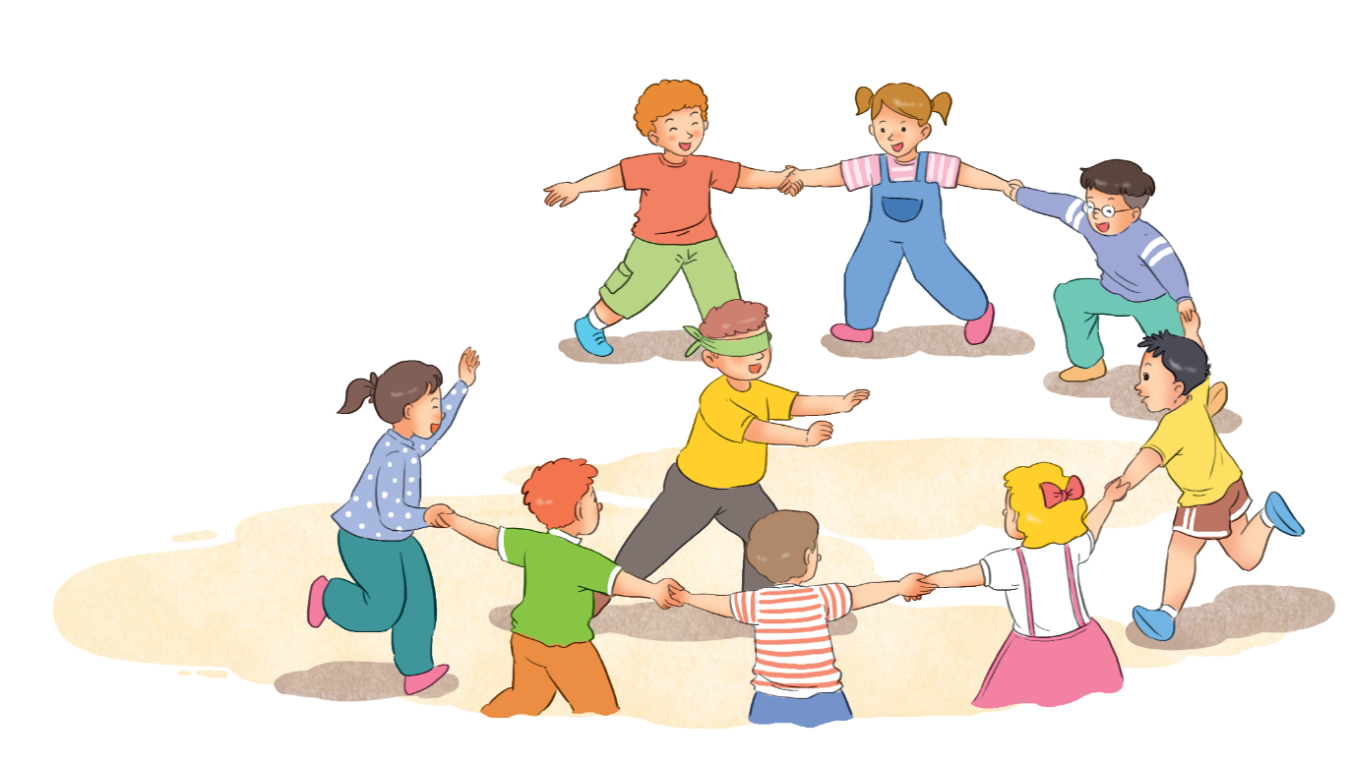
Read the information about a traditional game.
Name of the game: blind man’s buff
Number of players: five or more
Equipment: a blindfold, and open space
How to play:
1.
Players stand in a circle; one person blindfolded (the seeker) stands in the middle.
2.
The seeker tries to touch others without being caught.
3.
When the seeker catches a player, he / she tries to guess who it is by touching that player’s face and hair.
4.
When the seeker guesses that player’s name, he / she becomes the new seeker.

Slide 26
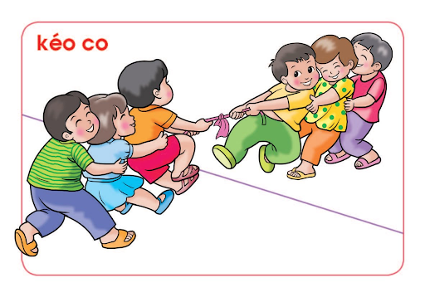
Choose one of the following games and write about it.
Tug of war (rope pulling)
Skipping
Wrestling
Cues:
Name of the game:
Number of players:
Equipment:
How to play:

Slide 27
Choose one of the following games and write about it.
-Name of the game: Tug of war
-Number of players: At least 4 people (2 people for each team)
- Equipment: A long rope
- How to play: Two teams will compete against each other. The center of the rope should align /ə'lain/ (sắp thẳng hàng) with the center marked on the ground. As soon as the referee blows the whistle, each team can start pulling the rope into their territory. Each team pulls the rope along with the members of opposition team to their side. As soon as the second mark on the rope from the center red mark crosses over to center line, the team to pull the rope to their area wins the game.

Slide 28

Work in groups. Take turns to give presentation.
Hello everyone, today I will tell you about a popular traditional game in Viet Nam. The name of the game is tug of war. To play this game, we need at least 4 people and a strong long rope. When playing the game, we must follow the following rule. As soon as the referee blows the whistle, the game starts. Two teams will compete against each other. Each team can start pulling the rope into their territory. The center of the rope should align with the center marked on the ground. Each team pulls the rope along with the members of opposition team to their side. As soon as the second mark on the rope from the center red mark crosses over to center line, the team to pull the rope to their area wins the game.

Slide 29

* Homework
- Do ex E1,2 (P. 15)
- Complete the project.
- Prepare for the next lesson: Unit 9 –Lesson 1 (Getting started.)

Slide 30



