Slide 1
Unit 4
HOW OLD ARE YOU?
Lesson 1

Slide 2
Vocabulary
Who
that
Mr.
/ huː/
/ðæt/
/ˈmɪstər/
: Ai
: Kia
: Thầy, ông, ngài…

Slide 3
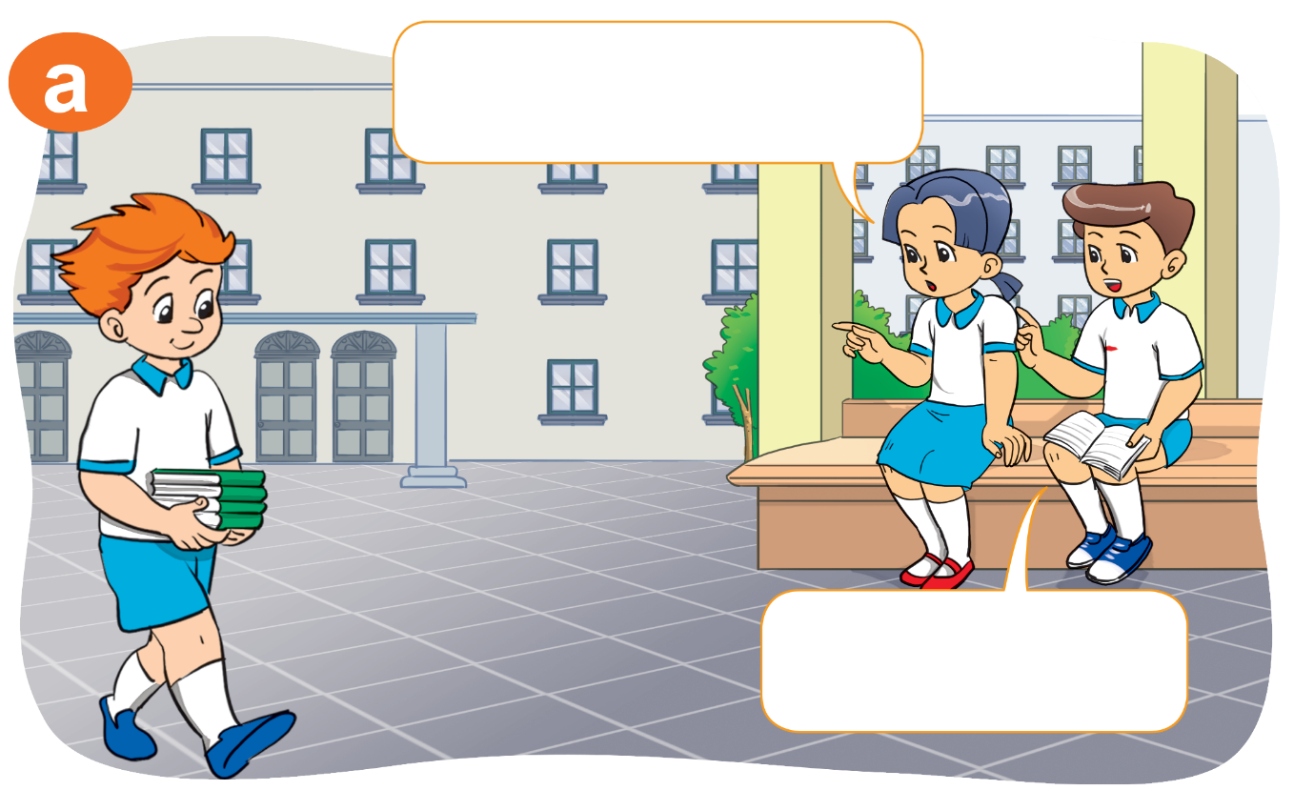
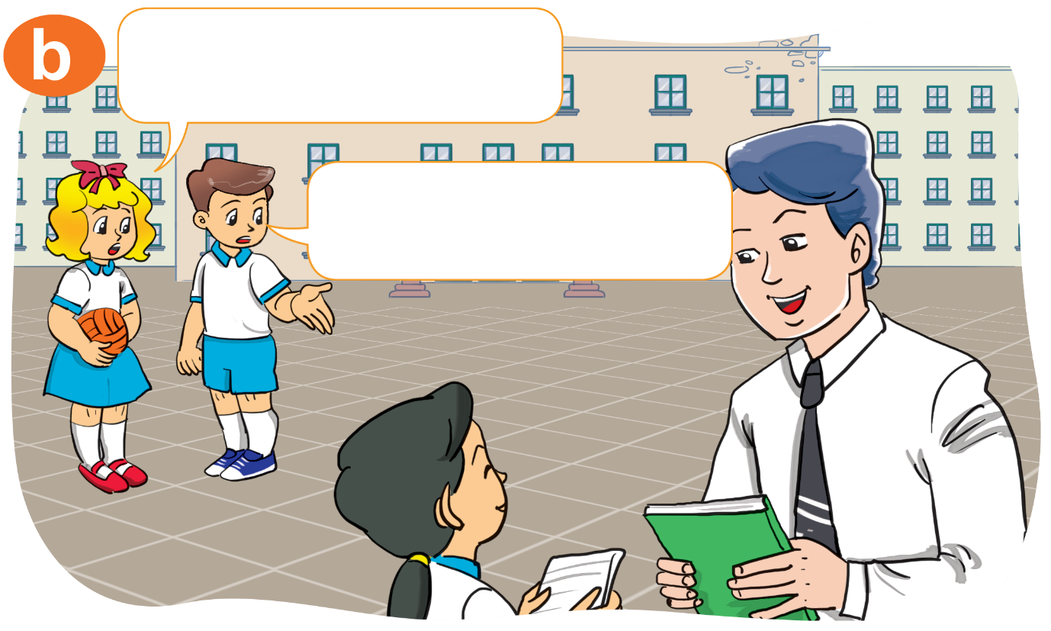


1. Look, listen and repeat
Who's that?
Who's that?
It's Mr Loc.
It's Tony.

Slide 4
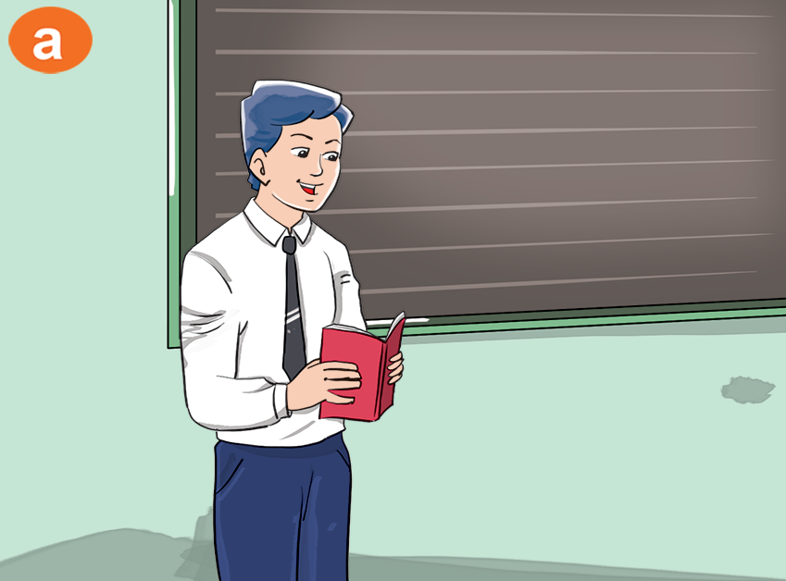


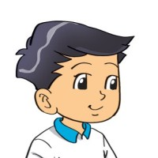

2. Point and say
Who's that?
It’s ______.
Mr Loc

Slide 5
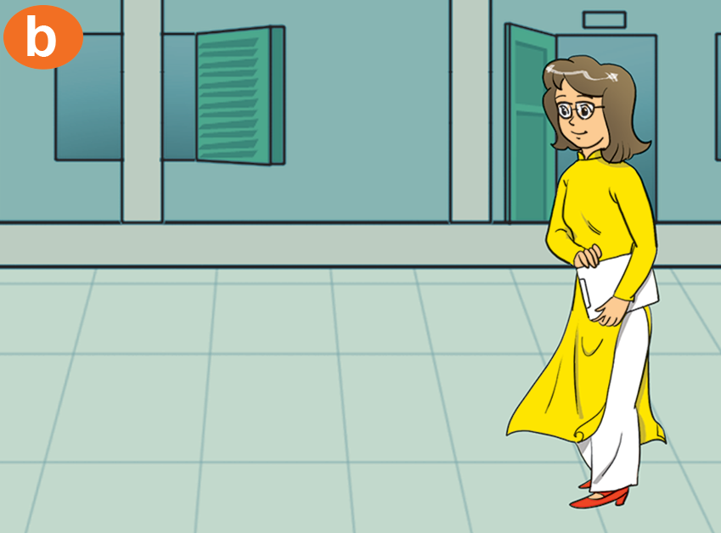

2. Point and say
Who's that?
It’s _________.
Miss Hien

Slide 6
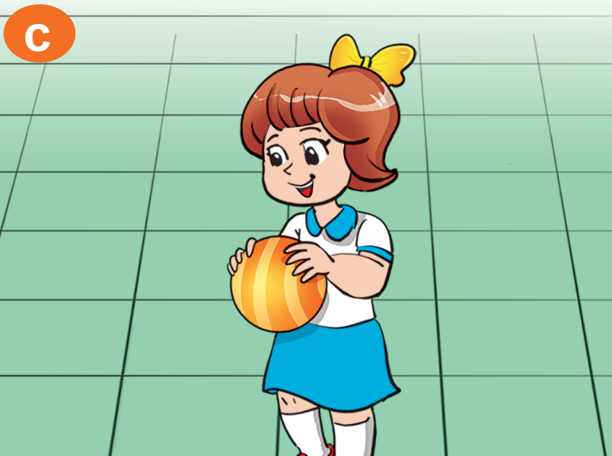
2. Point and say
Who's that?
It’s ______.
Marry

Slide 7

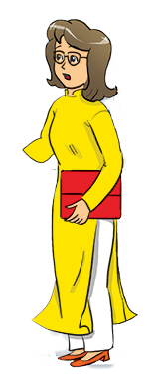







3. Let's talk.
Who's that?
Who's that?
It’s ______.
It’s ______.

Slide 8
Structrure:
Who is + that?
It is + name.
(Kia là ai?)
(Đó là ____.)
1
Who is + this?
It is + name.
(Đây là ai?)
(Đây là ____.)
2

Slide 9
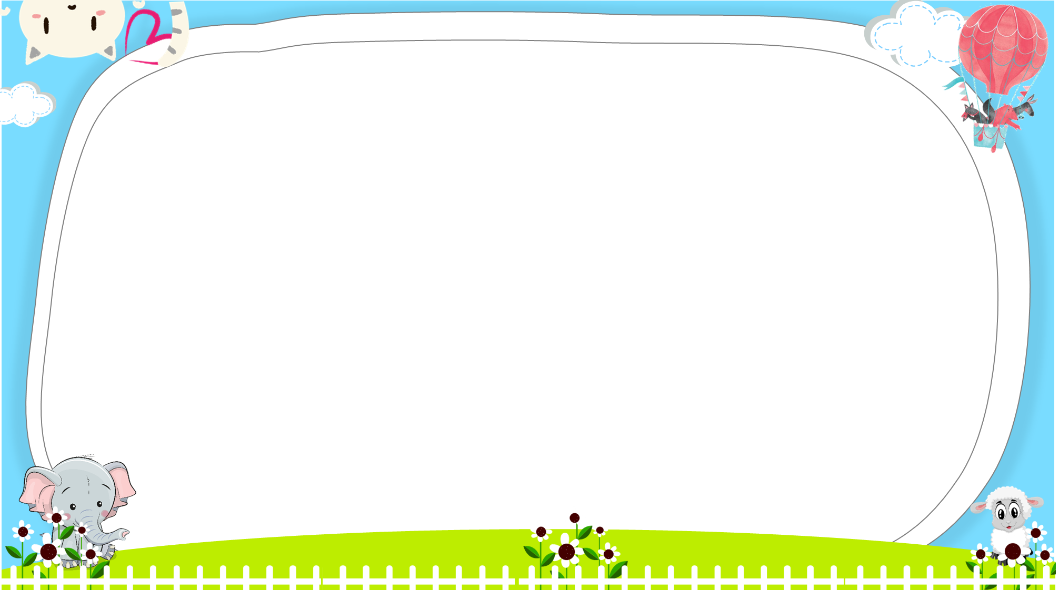





AND
GAME
PLAY
Notes:
Ms Huyền Phạm - 0936.082.789 – YOUTUBE: MsPham. Facebook: Dạy và học cùng công nghệ.

Slide 10



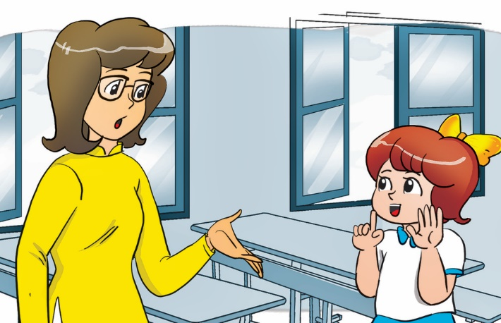
Look and tick
Who’s this?
Who’s that?
This is Mary.
Next
Notes:
Ms Huyền Phạm - 0936.082.789 – YOUTUBE: MsPham. Facebook: Dạy và học cùng công nghệ.

Slide 11
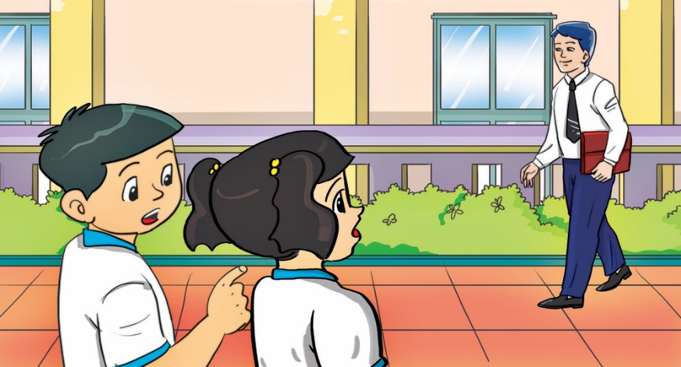
Look and tick
Who’s this?
Who’s that?
Next
Notes:
Ms Huyền Phạm - 0936.082.789 – YOUTUBE: MsPham. Facebook: Dạy và học cùng công nghệ.

Slide 12

Look and tick
Who’s that?
Who’s this?
Next
Notes:
Ms Huyền Phạm - 0936.082.789 – YOUTUBE: MsPham. Facebook: Dạy và học cùng công nghệ.

Slide 13
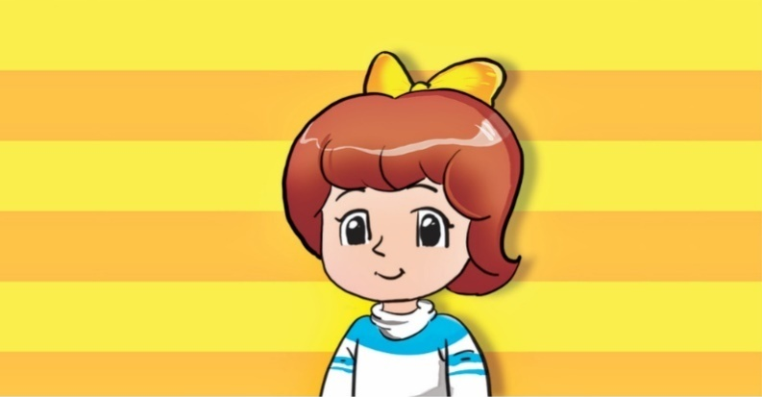

Look and tick
Who’s that?
Who’s this?
Next
Notes:
Ms Huyền Phạm - 0936.082.789 – YOUTUBE: MsPham. Facebook: Dạy và học cùng công nghệ.

Slide 14
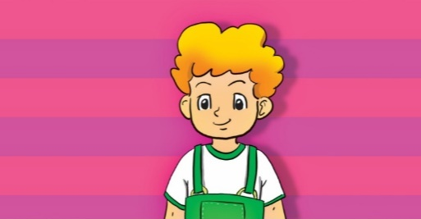
Look and tick
Who’s that?
Who’s this?
Next
Notes:
Ms Huyền Phạm - 0936.082.789 – YOUTUBE: MsPham. Facebook: Dạy và học cùng công nghệ.

Slide 15
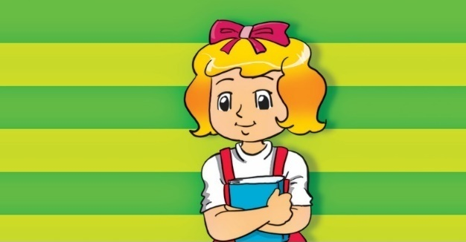
Look and tick
Who’s that?
Who’s this?
Next
Notes:
Ms Huyền Phạm - 0936.082.789 – YOUTUBE: MsPham. Facebook: Dạy và học cùng công nghệ.

Slide 16
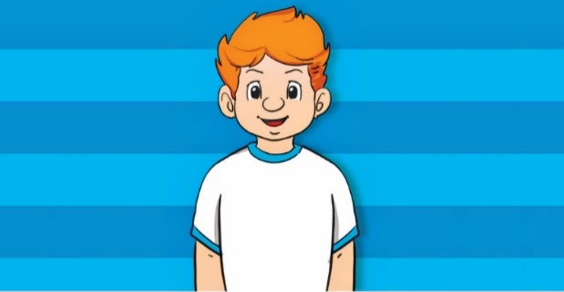
Look and tick
Who’s that?
Who’s this?
Next
Notes:
Ms Huyền Phạm - 0936.082.789 – YOUTUBE: MsPham. Facebook: Dạy và học cùng công nghệ.

Slide 17
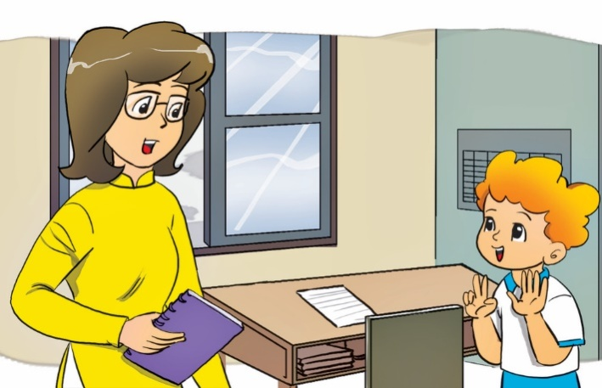
Look and tick
Who’s that?
Who’s this?
This is my teacher.
Next
Notes:
Ms Huyền Phạm - 0936.082.789 – YOUTUBE: MsPham. Facebook: Dạy và học cùng công nghệ.

Slide 18


Notes:
Ms Huyền Phạm - 0936.082.789 – YOUTUBE: MsPham. Facebook: Dạy và học cùng công nghệ.

Slide 19

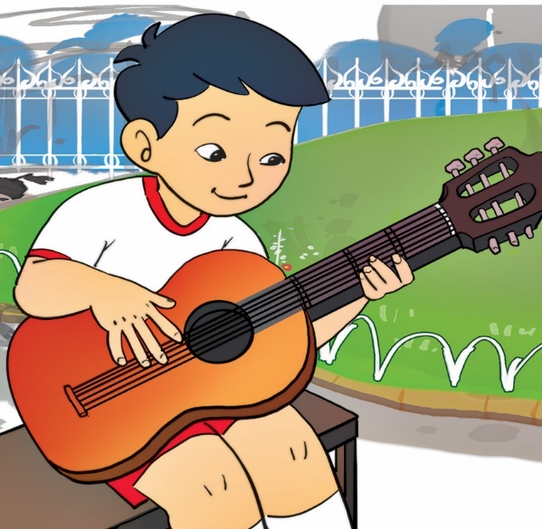
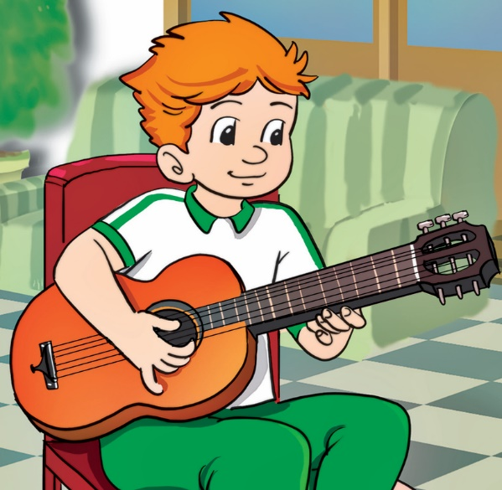

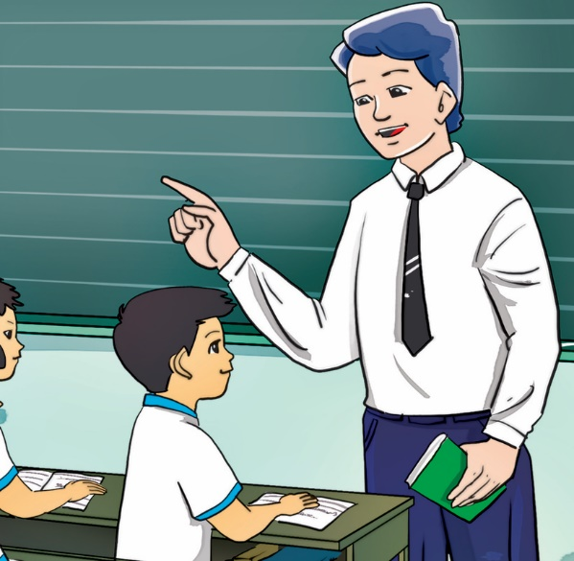
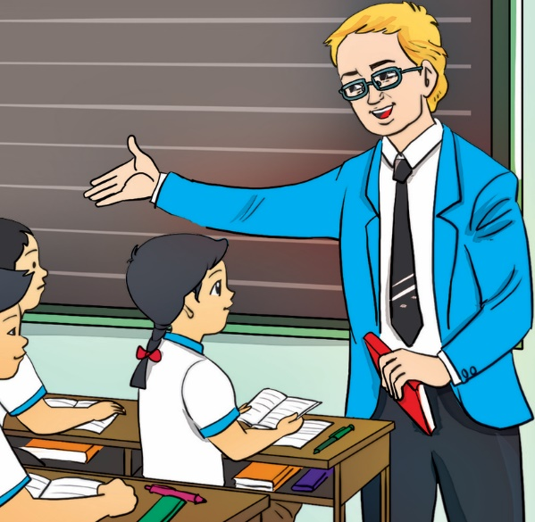


4. Listen and tick.
1
a
b
2
a
b

Slide 20

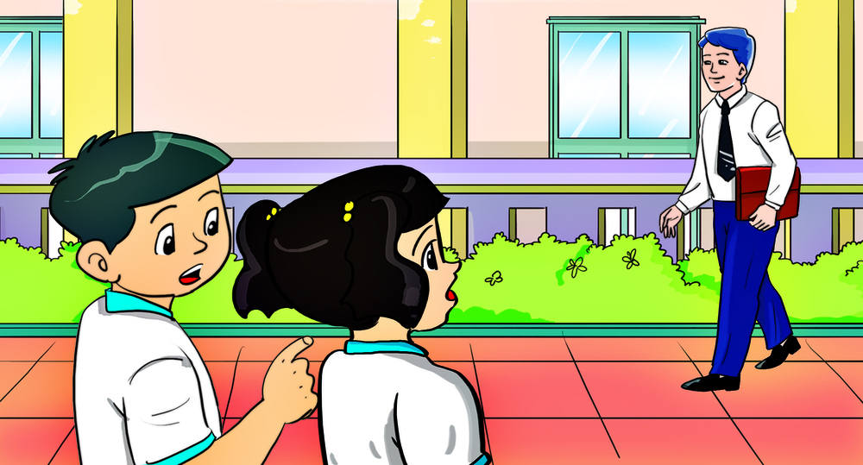
5. Read and write.
A: ________ that?
B: It's Tony.
A: And __________?
B: It's Mr Loc
Who’s
Who’s that

Slide 21
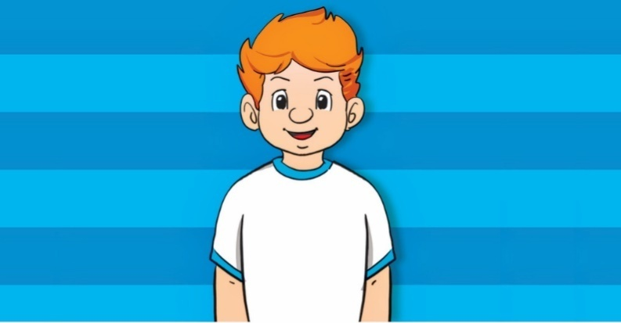
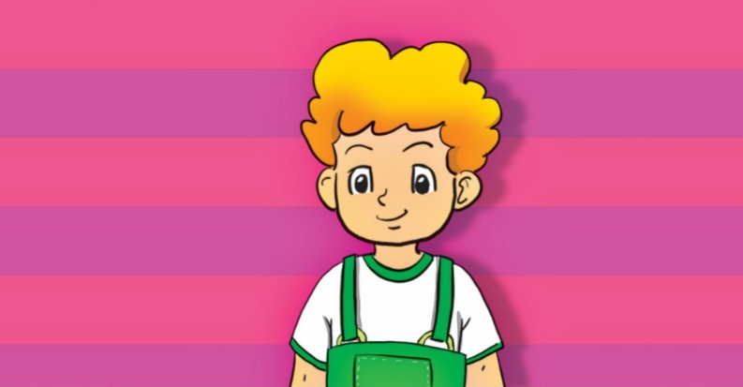
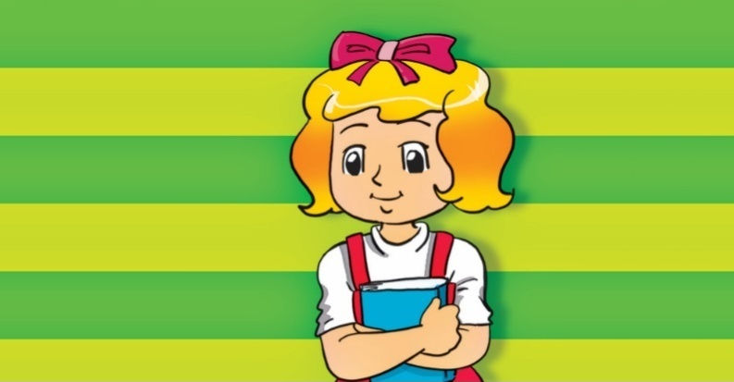
6. Let's write
Who's that?
Tony
Mary
It’s Tony
2. __________.
1. __________.
It’s Mary
Peter
Linda
3. __________.
4. __________.
It’s Peter
It’s Linda

Slide 22

THANK YOU!
Welcome to join with me!

