Slide 1
Unit 05
Are they
your friends?
Lesson 3

Slide 2


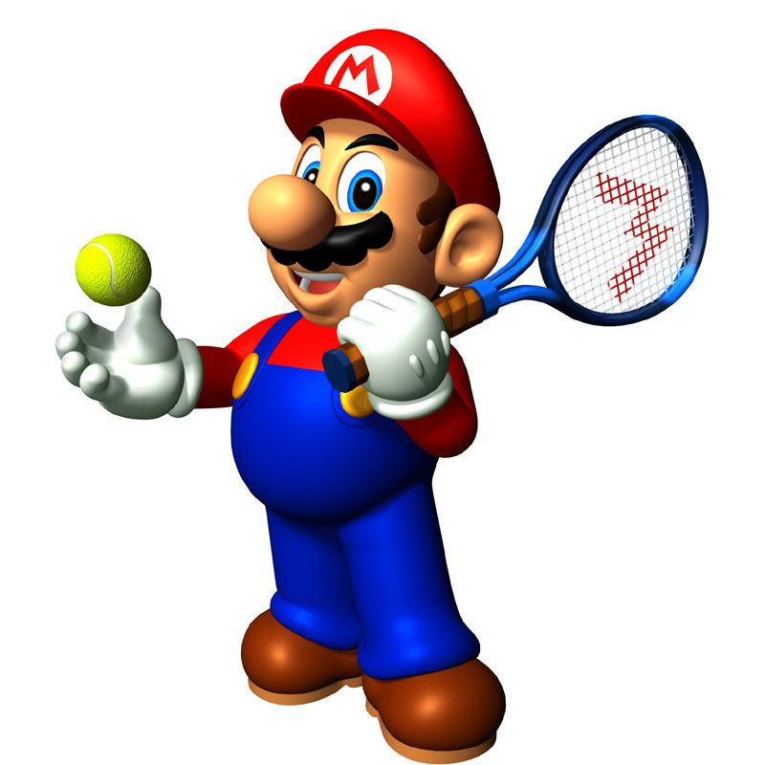





Slide 3
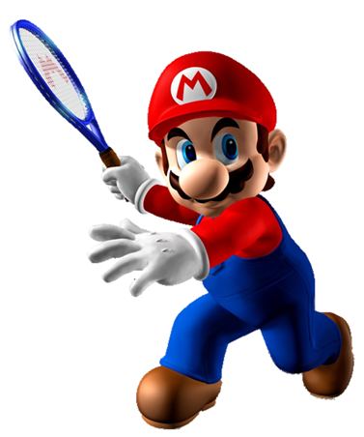
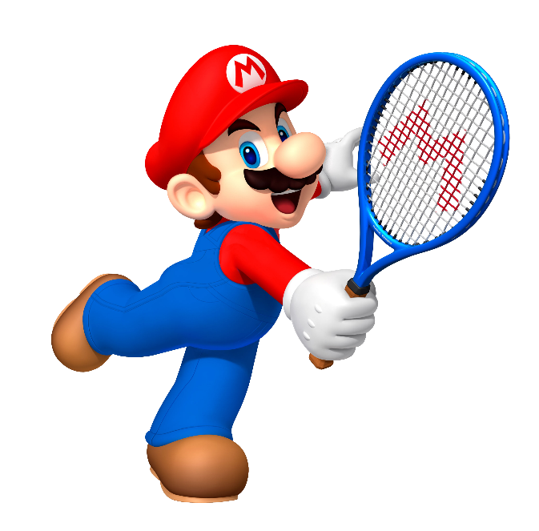

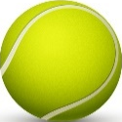
Friends
Friend
This is my ______ Mai.
teachers

Slide 4
This is
They are
_____ my friend Peter.
Is this

Slide 5
They is my friend
This is your friend
A: Hello, __________ Hoa.
B: Hi, Hoa. Nice to meet you.
This is my friend

Slide 6
Your friend
Your friends
Are they _______?
Yes, they are.
My friend

Slide 7
friend
friends
Is she your ________?
Yes, she is.
friendz

Slide 8
Are they
Is she
_____ your friend?
No, he isn’t.
Is he

Slide 9
She is
He is
Is he your friend?
Yes, __________.
They are

Slide 10
Yes, she is.
Yes, he is.
Is she your friend?
Yes, they are.

Slide 11
Is he
Is she
___ your friends?
Are they

Slide 12
Time’s up!

Slide 13
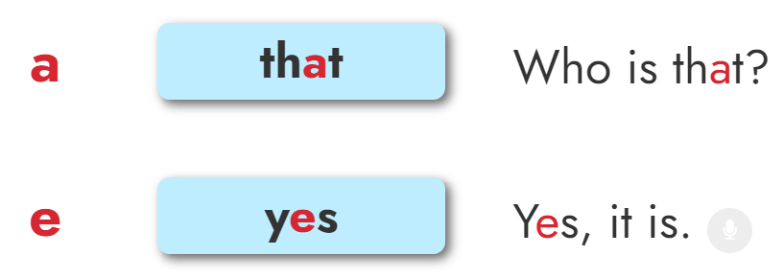

1. Listen and repeat

Slide 14
2. Listen and write.
1. Is _____ your friend?
2. _____, it is.
that
Yes

Slide 15
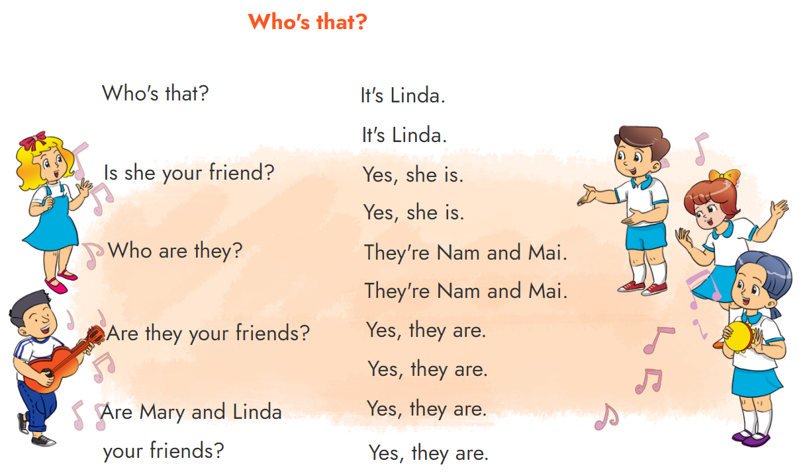


3. Let’s chant

Slide 16
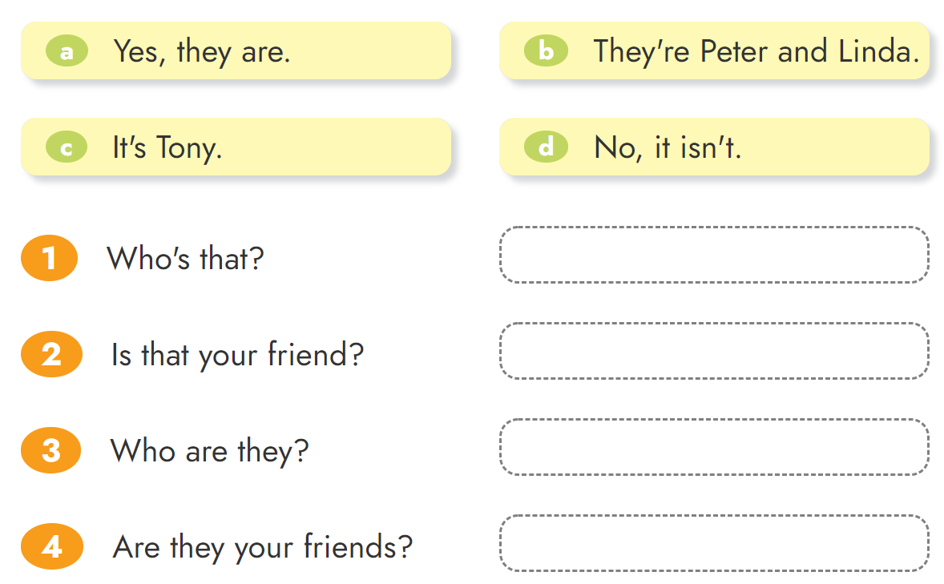
4. Read and match.

Slide 17
5. Circle the correct words.
1. Mai, this is my friend / friends.
2. Who are they / name?
3. Are Peter / Peter and Mary your friends?
4. Yes / No , they are my friends.
5. No, they are / aren't my friends.

Slide 18
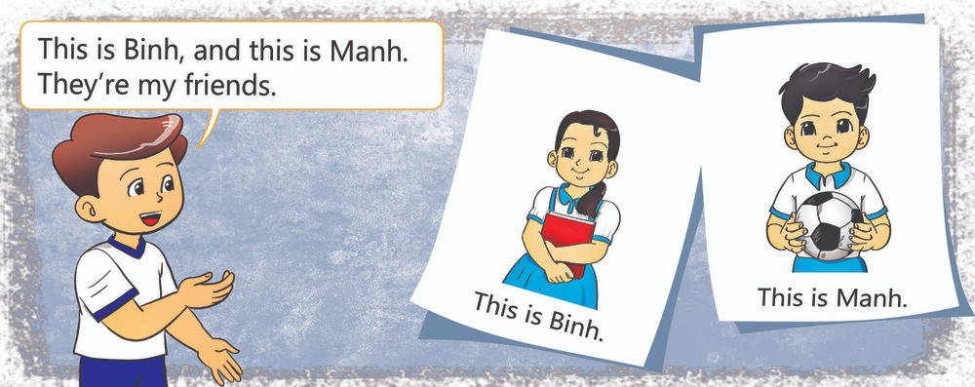
6. Project
Put the photos of your friends on a sheet of paper
and present them to your class.

Slide 19

THANK YOU!
Welcome to join with me!

