Slide 1

Good morning class!!!

Slide 2
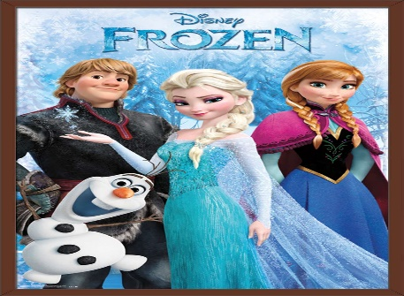
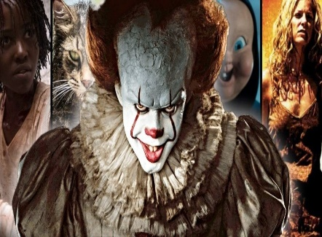
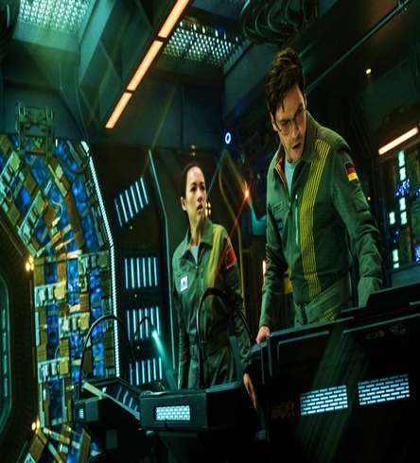
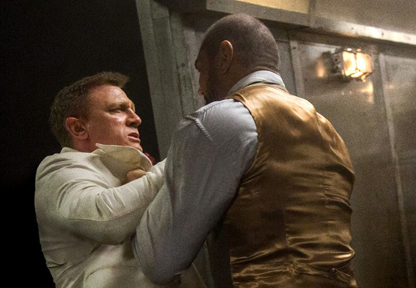
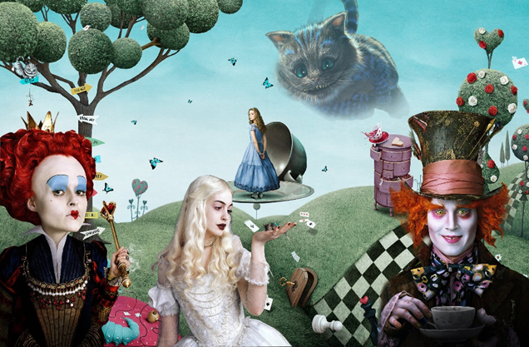
* Warm up:
Game:Pelmanism
1
2
3
4
5
fantasy
6
7
9
10
science fiction film
action film
8
animation
horror film

Slide 3


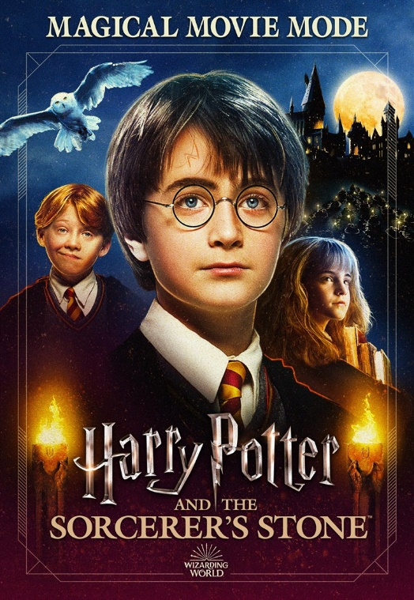
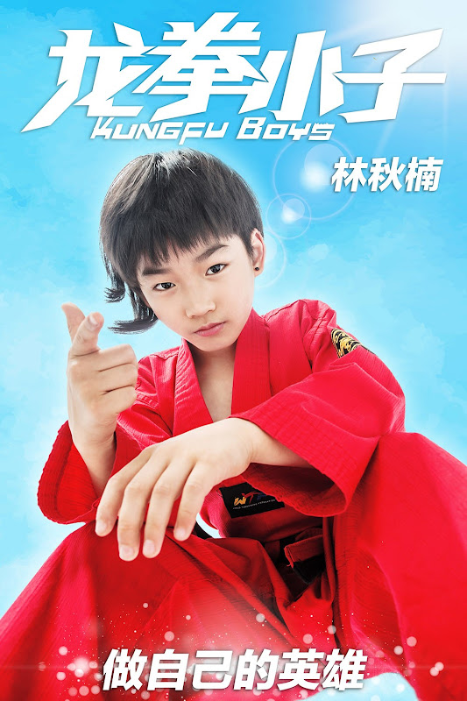
Unit
8
FILMS
LESSON 5: SKILLS 1
READING
SPEAKING

Slide 4


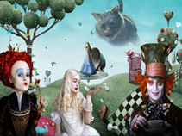
I. READING
1
Work in pairs. Discuss the following questions.
Do you like fantasies?
Why or why not?
I don't like fantasies because it is very boring and not on real facts.

Slide 5
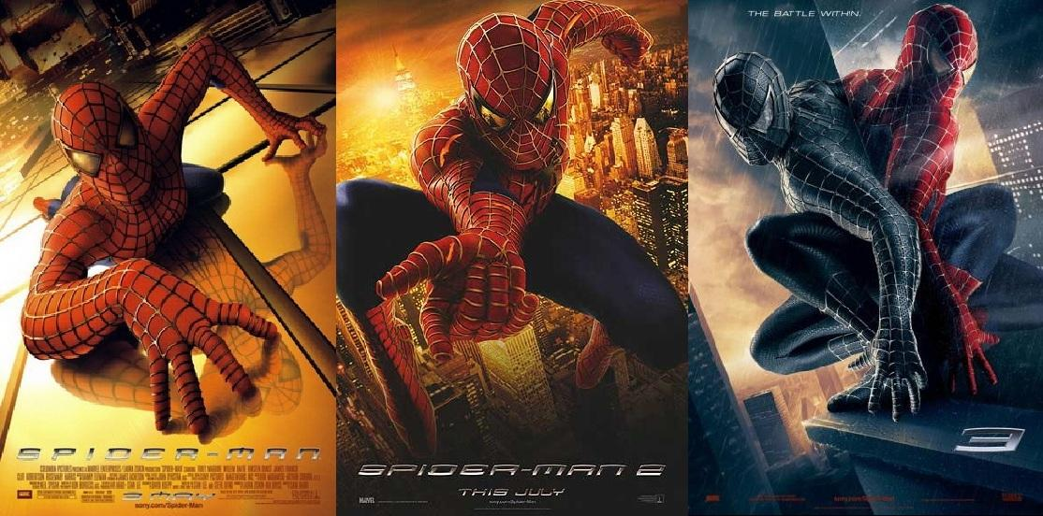
* VOCABULARY
series (n):
chuỗi, loạt (phim dài tập)
/'siəri:z/

Slide 6
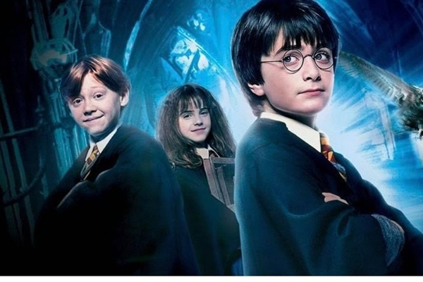
* VOCABULARY
wizard (n):
Thuật sĩ, người có tài phi thường
/'wizəd/

Slide 7
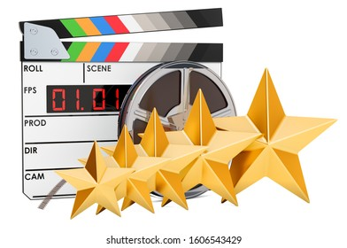
* VOCABULARY
must-see (n):
bộ phim đáng xem, nên xem
/ˈmʌstˈsiː/

Slide 8
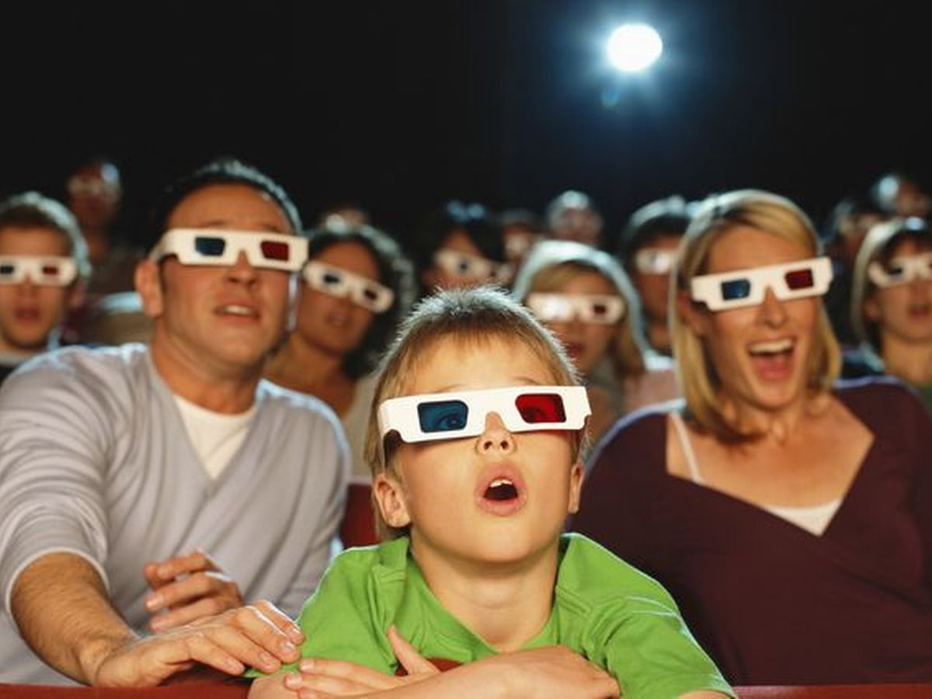
gripping (adj):
cuốn hút, hấp dẫn
/'gripiη/

Slide 9
* VOCABULARY
New words | Pronunciation | Meaning
series | /'siəri:z/ | chuỗi, loạt (phim dài tập)
wizard | /'wizəd/ | phù thủy, người có tài phi thường
must-see | /ˈmʌstˈsiː/ | bộ phim đáng xem, nên xem
gripping | /'gripiη/ | cuốn hút, hấp dẫn

Slide 10
* Checking vocabulary:
New words | Meaning
 | chuỗi, loạt (phim dài tập)
 | Thuật sĩ, người có tài phi thường
 | bộ phim đáng xem, nên xem
 | cuốn hút, hấp dẫn
series
wizard
must-see
gripping

Slide 11
2
Read the film review of Harry Potter and the Sorcerer's Stone on Mark's blog.
Mon, Apr 20th
Harry Potter and the Sorcerer's Stone is a fantasy. Its director is Chris Columbus. It is the first of the Harry Potter film series.
Daniel Radcliffe is one of the stars in the film.
The film tells the story of Harry Potter. He's a powerful wizard. He is a student at a school for wizards and learns about himself, his family, and the bad things happening around him.
The film received a lot of good reviews. People say it's a must-see for teens. I agree because the story is gripping and the acting is excellent. The music is also amazing.
Although Harry Potter and the Sorcerer's Stone is a little frightening at times, it is very interesting and full of action. Go and see it if you can.
Posted by Mark at 5.30 p.m.

Slide 12

2
Match the words or phrases with their meanings.
Words | Meanings
1. series | a. something that is so good that you think others should see it
2. wizard | b. related films that tell stories about the same characters
3. must-see | c. very exciting or interesting
4. gripping | d. a man who has magical powers
1. b
2. d
3. a
4. c

Slide 13

3
Read Mark’s blog and answer the questions.
1. What kind of film is Harry Potter and
the Sorcerer’s Stone?
Harry Potter and the Sorcerer’s Stone is a fantasy.
2. Who is Daniel Radcliffe?
Daniel Radcliffe is one of the stars in the film.

Slide 14

3
Read Mark’s blog and answer the questions.
3. What is the film about?
The film tells the story of Harry Potter. He’s a powerful wizard. He is a student at a school for wizards and learns about himself, his family, and the bad things happening around him.

Slide 15
3
Read Mark’s blog and answer the questions.
4. What do people say about the film?
People say it’s a must-see for teens.

Slide 16
II. SPEAKING
4
Look at the table. Work in pairs. Ask and answer questions
about the film Kungfu Boy.
Film’s name | Kungfu Boy
Director | John Stevenson
Type of film | Comedy
Main actor / actress | Bruce Wane
Main content | About a very big boy who saves his town and becomes a hero
Reviews | Funny and interesting
Time | 4.30 p.m and 8.30 p.m daily
Place | Ngoc Khanh Cinema
Example:
A: How about seeing a film this evening?
B: That’s a great idea. What film shall we see?
A: Kungfu Boy.
B: What kind of film is it?
A: __________________

Slide 17
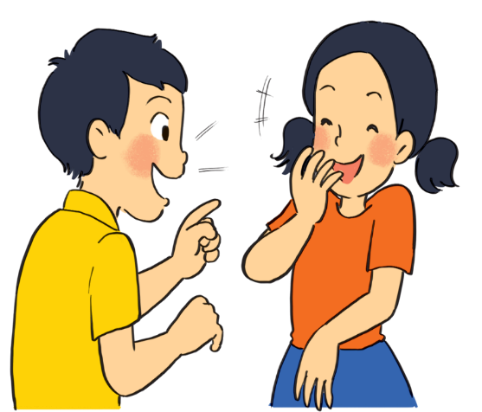
* PRODUCTION (Post-Read & Speak)
5
Work in groups. Take turns to talk about the film Kungfu Boy.
Example:
Kungfu Boy is on at … at … p.m.
It’s (an) … about …
Suggestion:
Kungfu Boy is a comedy directed by John Stevenson. Bruce Wane is the main actor in this film. It's about a very big boy who saves his town and becomes a hero. People say that it's a must-see because it's very funny and interesting. It's at 4.30 p.m. and 8.30 p.m. daily at Ngoc Khanh Cinema. Let's go to see it!

Slide 18
* CONSOLIDATION
Unit
READING
SPEAKING

Slide 19

2
Homework
* Prepare for the lesson: Looking back & Project
Choose one of your favourite films:
– name of the film
– type of film
– its director and main actors / actresses
– a short summary
– your overall opinion about the film
– the showtime and cinema
– pictures or photos to illustrate the film

Slide 20

Thanks for your attendance!
Goodbye. See you again
Notes:
20

