Slide 1
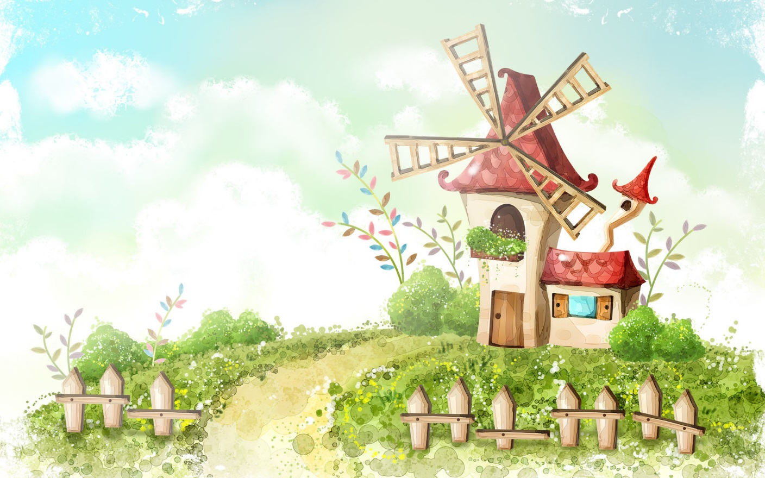
Hello every one!

Slide 2

* WARM-UP
Game: Hangman
- think of the word which has 9 letters related the topic “ENERGY SOURCES”.
- Each member from each team turn by turn guesses the letter in the secret word.
-The team which can find or guess the secret first will be the winner.
R E N E W A B L E

Slide 3


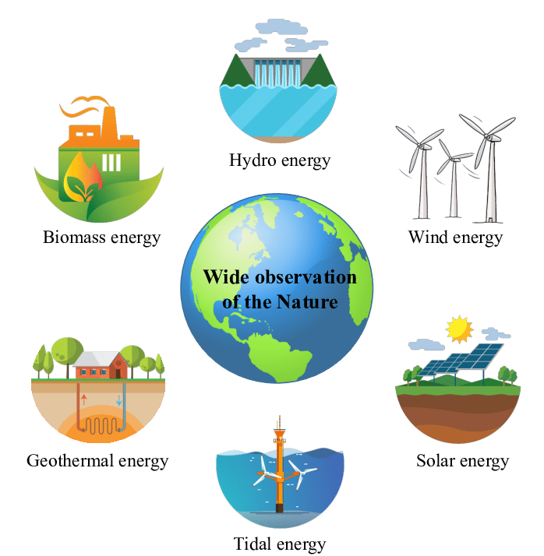
Unit
10
ENERGY SOURCES
LESSON 5: SKILLS 1
Renewable and non-renewable sources of energy.

Slide 4

* VOCABULARY
- produce (v):
Sản xuất
= to make things, mostly in large quantity
Examples:
Companies produce many toys for children before Christmas.
/prəˈdjuːs/

Slide 5
* VOCABULARY
- limited (a):
Bị hạn chế
= not very great in amount or extent
Examples:
Coal is limited.
/əˈveɪləbl/

Slide 6
* VOCABULARY
- available (a):
Có sẵn
= that you can get, buy or find
Examples:
The coal takes a long time to be available again.
/əˈveɪləbl/

Slide 7
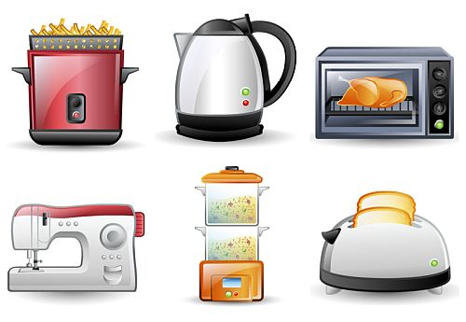
* VOCABULARY
- Electrical appliances (n.phr):
Thiết bị điện
/ɪˈlɛktrɪkəl əˈplaɪənsɪz/

Slide 8
* VOCABULARY
New words | Pronunciation | Meaning
produce (v) | /prəˈdjuːs/ | sản xuất
limited (a) | /əˈveɪləbl/ | bị hạn chế
available (a) | /əˈveɪləbl/ | có sẵn
Electrical appliances (n.phr) | /ɪˈlɛktrɪkəl əˈplaɪənsɪz/ | thiết bị điện

Slide 9
* Checking vocabulary
New words | Meaning
 | sản xuất
 | bị hạn chế
 | có sẵn
 | thiết bị điện
produce
limited
available
Electrical appliances

Slide 10

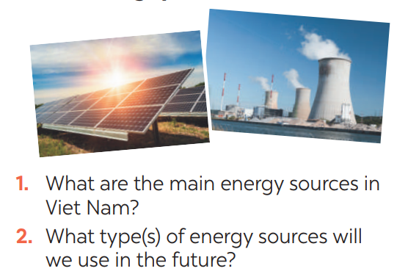
I. READING
1
Dicussion. Look at the pictures:
→ They are hydro energy and energy from coal.
→ We will use solar energy and wind energy.

Slide 11
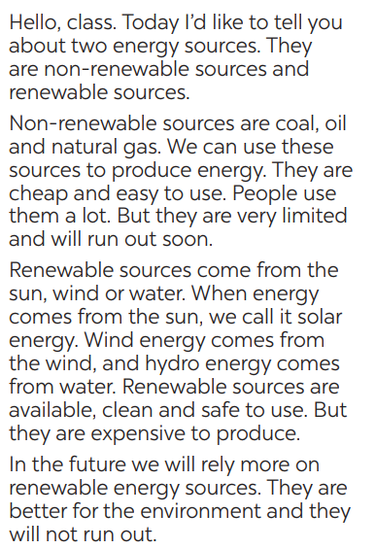
2
Read the text and choose the best option to complete the sentences.

Slide 12
2
Read the text and choose the best option to complete the sentences.
1. Non-renewable sources are cheap and ______.
A. available B. easy to use C. expensive
2. ______ come from the sun, wind or water.
A. Renewable sources B. All energy sources C. Non-renewable sources
3. When energy comes from water, we call it ______.
A. wind energy B. solar energy C. hydro energy
4. Renewable energy sources are better for ______.
A. the environment B. our cars C. hydro energy

Slide 13
3
Read the text again and answer the questions
1. How many energy sources are there? What are they?
2. What do non-renewable sources include?
3. What are the advantages of renewable energy?
4. What will we rely more on in the future?
Game

Slide 14

LUCKY NUMBER!
2
1
6
3
5
4

Slide 15
3
Read the text again and answer the questions
1. How many energy sources are there? What are they?
There are two energy sources. They are non-renewable sources
and renewable sources.

Slide 16
3
Read the text again and answer the questions
2. What do non-renewable sources include?
→ Non-renewable sources are coal, oil and natural gas.

Slide 17
3
Read the text again and answer the questions
3. What are the advantages of renewable energy?
→ Renewable sources are available, clean and safe to use.

Slide 18
3
Read the text again and answer the questions
4. What will we rely more on in the future?
→ In the future, we will rely more on renewable energy sources.

Slide 19



Slide 21
3
Read the text again and answer the questions
* ANSWER KEY:
1. There are two energy sources. They are non-renewable sources and renewable sources.
2. Non-renewable sources are coal, oil and natural gas.
3. Renewable sources are available, clean and safe to use.
4. In the future, we will rely more on
renewable energy sources.

Slide 22
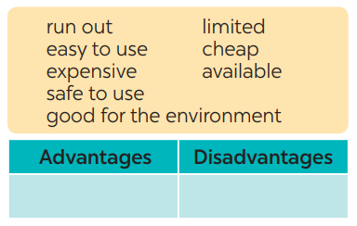
II. SPEAKING
4
Work in groups. Discuss and put the following words or phrases
in the appropriate columns.
easy to use, safe to use, good for environment, cheap, available
run out, expensive, limited

Slide 23

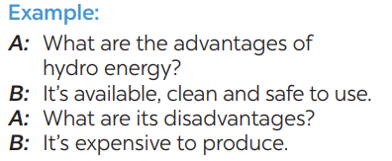
5
Work in pairs. Ask and answer questions about the advantages
and disadvantages of different energy sources

Slide 24
5
Work in pairs. Ask and answer questions about the advantages
and disadvantages of different energy sources
A:
B:
A:
B:
What are the advantages of energy from coal?
It's cheap and easy to use.
What are its disadvantages?
It's limited and not good for the environment

Slide 25


* PRODUCTION
5
Presentation: Advantages and disadvantages of a source of energy.
Hydro power is a renewable source of energy because it comes from water . It is cheap and plentiful . Unfortunately , dams can only be built in certain areas .

Slide 26
* CONSOLIDATION
READING
SPEAKING

Slide 27
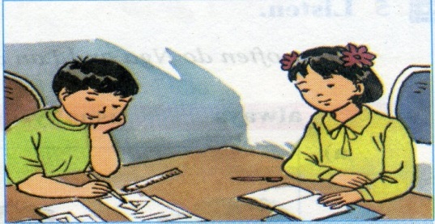
HOMEWORK
- Do exercise in the textbook
- Prepare for the next lesson: Skills 2

Slide 28

Thank you!
Have a nice day!

Slide 29
