Slide 1
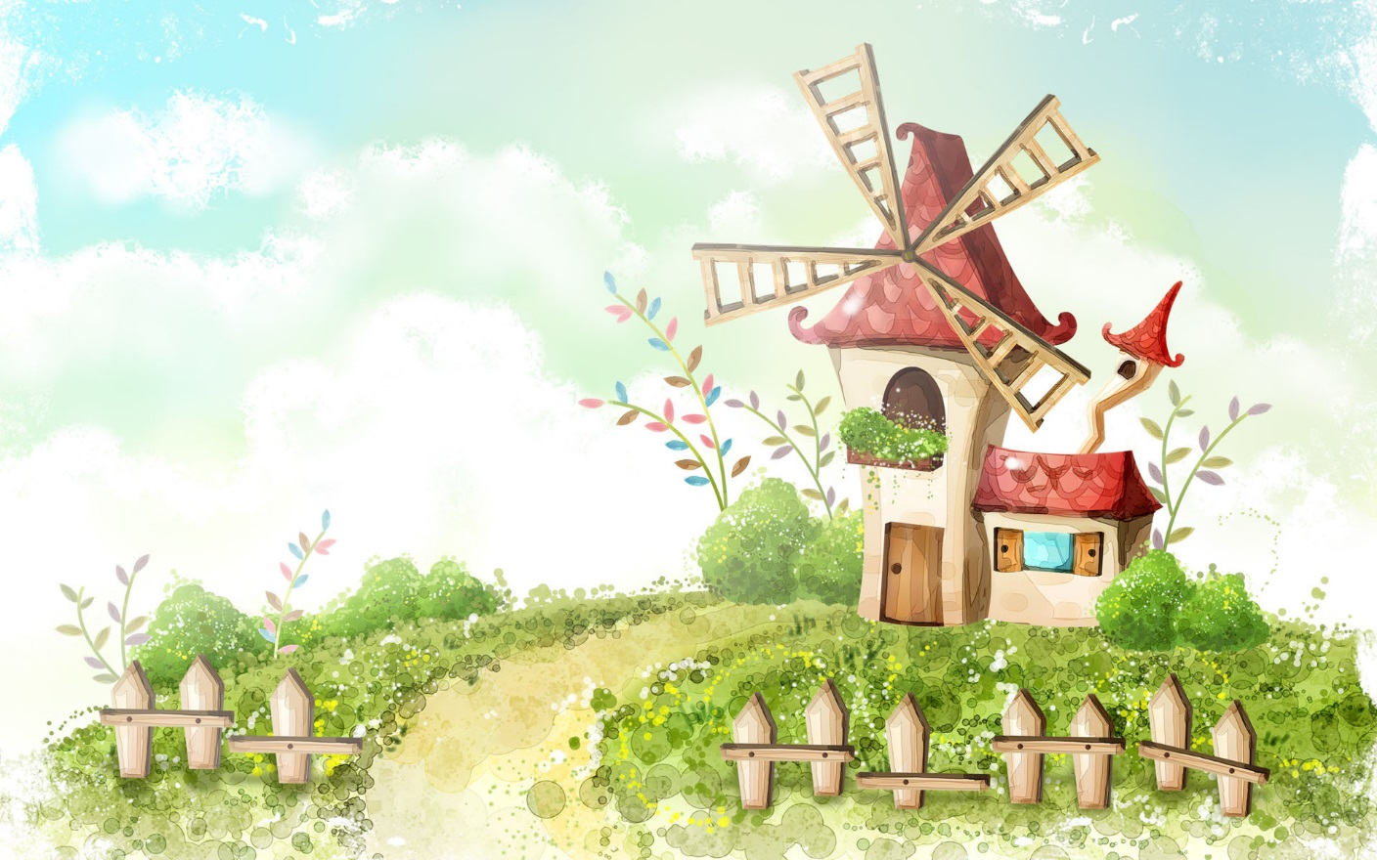
Welcome to our class

Slide 2

WARM-UP
Homework checking
How many English-speaking countries can you find?
United states
Australia
Canada
India
United Kingdom
- …

Slide 3


Unit
12
ENGLISH-SPEAKING COUNTRIES
LESSON 2: A CLOSER LOOK 1
* Vocabulary
Use words related to people and places in the English-speaking countries.
*Pronunciation
ask questions with the correct rising and falling intonation
Unit
HOBBIES

Slide 4

* VOCABULARY
something is native to a place = a place is the home of something
- native (adj):
bản ngữ, nguyên quán
/ˈneɪ.tɪv/

Slide 5
* VOCABULARY
= wonderful, beautiful
- amazing (adj)
tuyệt vời
/əˈmeɪ.zɪŋ/

Slide 6
* VOCABULARY
= rare,
not many
- unique (adj)
độc nhất
/juːˈniːk/

Slide 7
* VOCABULARY
= belonging to a place
- local (adj):
thuộc về địa phương
/ˈləʊ.kəl/

Slide 8
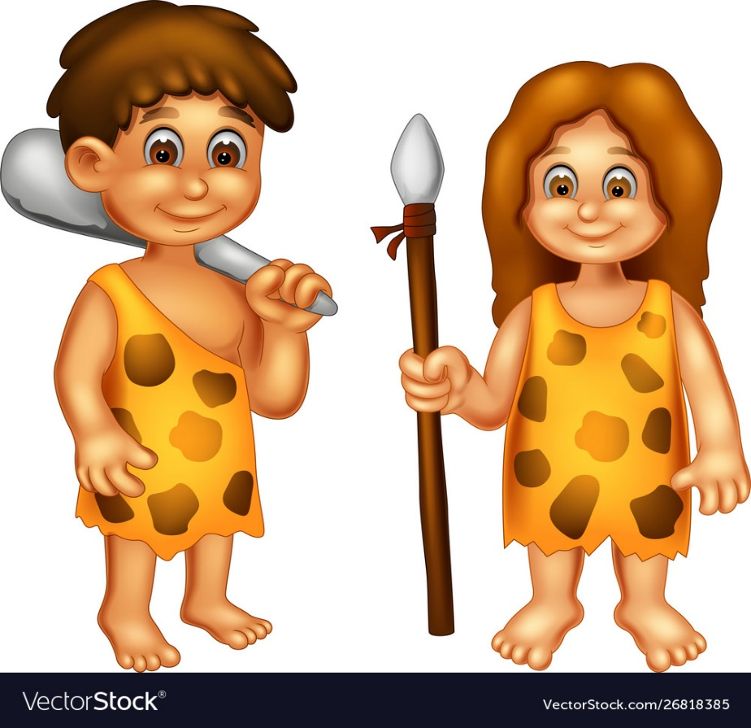
* VOCABULARY
- ancient (adj):
cổ, xưa
/ˈeɪn.ʃənt/

Slide 9
* VOCABULARY
New words | Pronunciation | Meaning
native (adj) | /ˈneɪ.tɪv/ | Bản ngữ, nguyên quán
amazing (adj) | /əˈmeɪ.zɪŋ/ | Tuyệt vời
unique (adj) | /juːˈniːk/ | Độc nhất
local (adj) | /ˈləʊ.kəl/ | Thuộc về địa phương
ancient (adj) | /ˈeɪn.ʃənt/ | Cổ, xưa

Slide 10
* Checking vocab
Say word in EL
Địa phương
local
Tuyệt vời
amazing
Cổ xưa
ancient
Bản ngữ
native
unique
Độc đáo

Slide 11
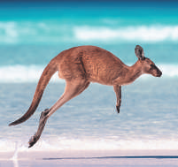
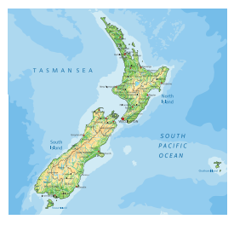
1
Write the words or phrases under the correct pictures.
island country, Scottish kilt, tattoo castle, kangaroo, coastline
kangaroo
island country
1. ____________________
2. ____________________
Notes:
Wordwall game: https://wordwall.net/resource/27241481

Slide 12
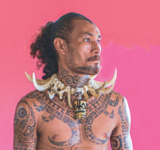
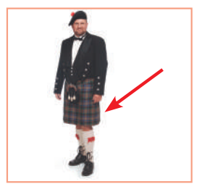
1
Write the words or phrases under the correct pictures.
island country, Scottish kilt, tattoo castle, kangaroo, coastline
tattoo
Scottish kilt
3. ____________________
4. ____________________
Notes:
Wordwall game: https://wordwall.net/resource/27241481

Slide 13
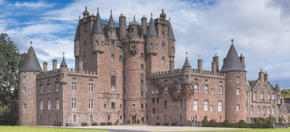
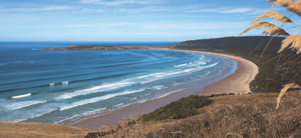
1
Write the words or phrases under the correct pictures.
island country, Scottish kilt, tattoo castle, kangaroo, coastline
coastline
5. ____________________
6. ____________________
castle
Notes:
Wordwall game: https://wordwall.net/resource/27241481

Slide 14
2
Use the words in the box to complete the sentences.
native, amazing, unique, local, ancient
1. From the top of the mountain, we had a(n) _______________ view of the valley below.
2. Scotland is famous for its long history and _______________ castles.
3. The long fences around the sheep farms in Australia are _______________. You can’t find them anywhere else in the world.
4. When you visit a new place, talk to the _______________ people.
5. Kangaroos are _______________ to Australia. It is their home
amazing
ancient
unique
local
native

Slide 15
3
Work in pairs. Discuss and write the word or phrase in the box next to its explanation.
symbol, boat ride, capital, tower
1. a tall narrow building with a small top
2. an object representing a place
3. the most important city of a country
4. a tour on a river
tower
……………………………………
symbol
……………………………………
capital
……………………………………
boat ride
……………………………………

Slide 16

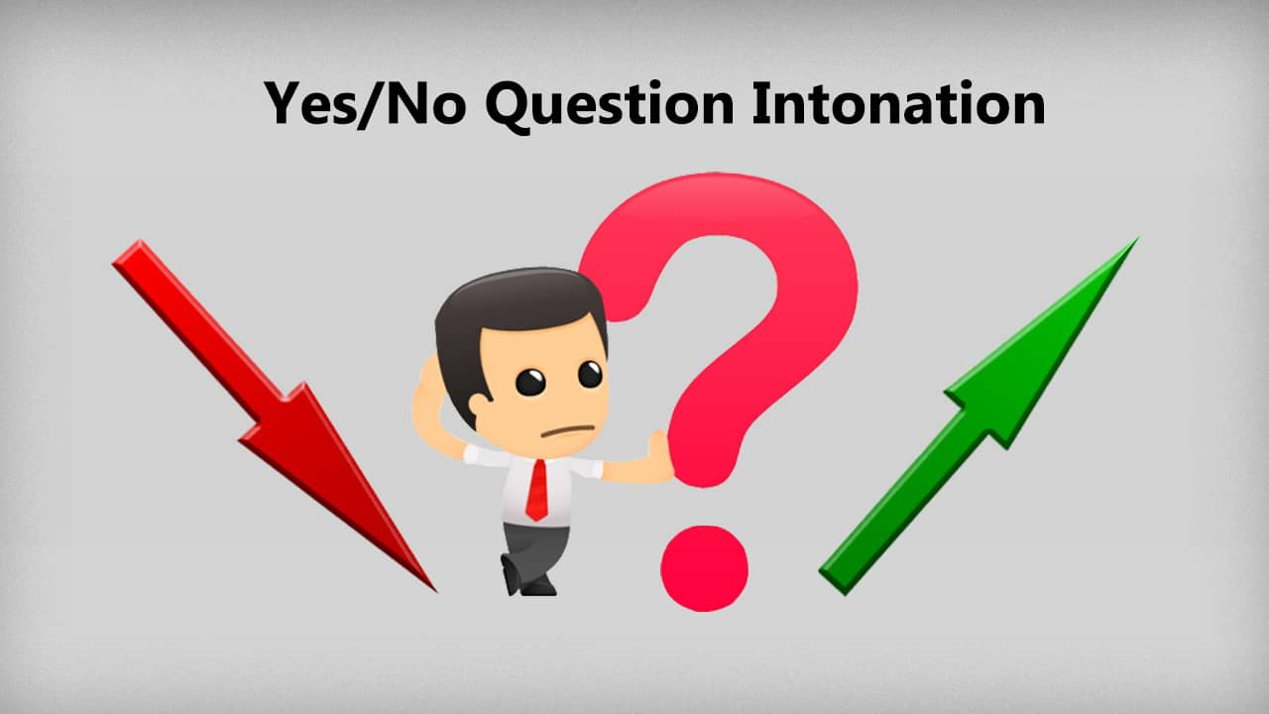
* PRONUNCIATION
Rising and falling intonation for questions

Slide 17
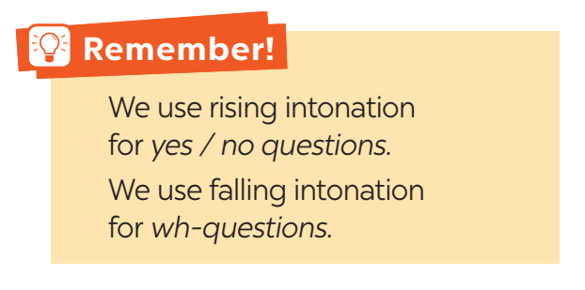


4
Listen and repeat, paying attention to the intonation of the following questions.
1. Can you speak English?
2. Is Australia an island?
3. Will you visit Washington next year?
4. What is the capital of Scotland?
5. How big is Canada?

Slide 18
5
Listen to the sentences and pay attention to the underlined parts. Tick the appropriate sounds. Practise the sentences.
1. Where is Canada?
2. Could you show me Singapore on this map?
3. How many states are there in the USA?
4. Is English an official language in Malaysia?
5. Do you know much about New Zealand?

Slide 19

* PRODUCIATION
* Game:
Notes:
Teacher divides the class into 2 teams.
Students will listen to questions which are made up from the words in the lesson.
Students will have to stand up if it is a yes / no question and sit down if it is a wh-question.
The team will receive minus points equivalent to the number of students who pose incorrect actions (stand up or sit down).
The team with less minus points will be the winner.

Slide 20
CONSOLIDATION
Vocabulary
Use words related to people and places in the English-speaking countries.
Pronunciation
ask questions with the correct rising and falling intonation

Slide 21

* HOMEWORK
- Choose a favourite English-speaking country.
- Find the information about its location and attractions.

Slide 22

Thank you!
Have a nice day!

