Slide 1
Unit 11: OUR GREENER WORLD lesson 2: A closer look 1
Grade 6

Slide 2
Objectives
By the end of the lesson, students can be able to:
pronounce the sounds /a:/ and /æ/ correctly in isolation and in context;
use the lexical items related to the topic Our Greener world;
guess the meaning of new words based on clues including pictures and surrounding words.

Slide 3
Can you list some ways to help the environment?
Review
1
2
3
4
5
Use reusable bags when shopping
Plant trees and flowers
Pick up rubbish
cycle
Walk to school

Slide 4
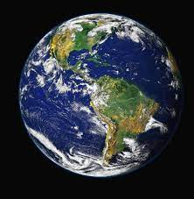
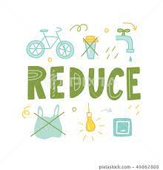

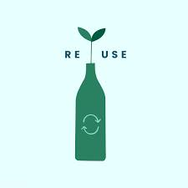


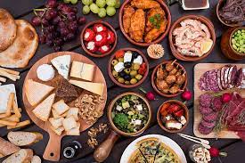

Explore vocabulary
Recycle (v) /ˌriːˈsaɪ.kəl/
Reuse (v)/ˌriːˈjuːz/
Reduce (v) /rɪˈdʒuːs/
Create (v) /kriˈeɪt/
Material (n) /məˈtɪə.ri.əl/
Earth (n) /ɜːθ/
Article (n) /ˈɑː.tɪ.kəl/
Tái chế
Tái sử dụng
Giảm, dùng it đi
Tạo ra
Nguyên liệu
Trái Đất
Bài luận, bài viết

Slide 5
Part 1: Vocabulary

Slide 6
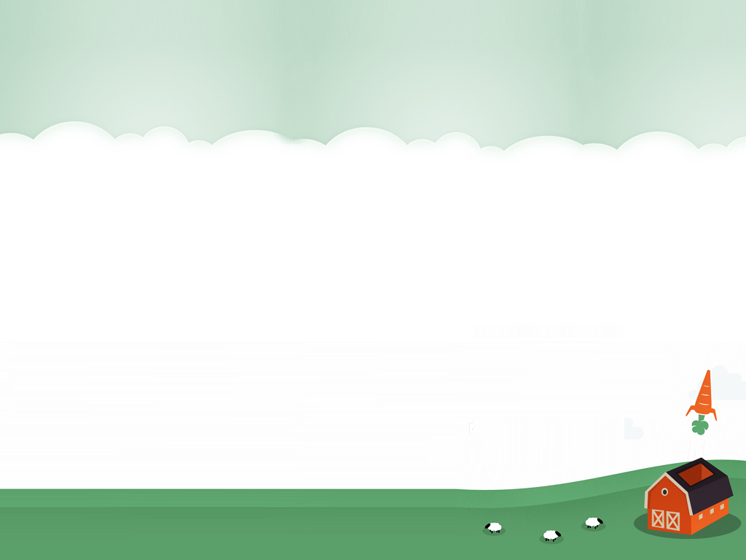
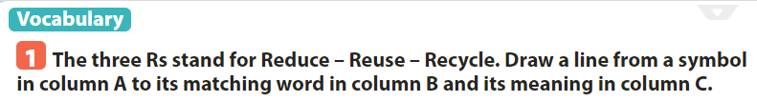
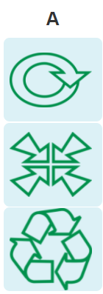
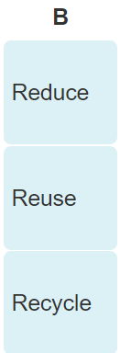
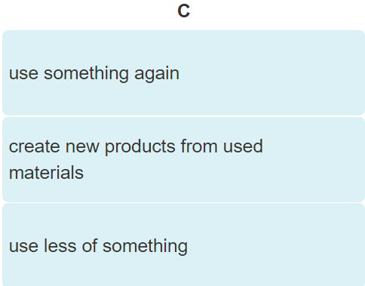

Slide 7


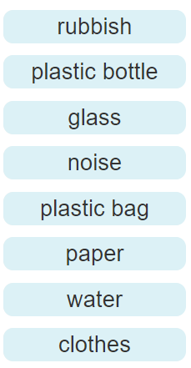

rubbish
Plastic bag
glass
Plastic bottle

Slide 8

noise
paper
water
clothes

Slide 9
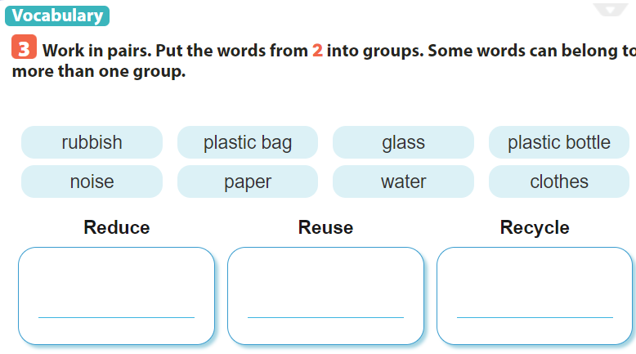
rubbish
plastic bag
glass
plastic bottle
paper
rubbish
plastic bag
noise
plastic bottle
paper
water
plastic bag
glass
plastic bottle
paper
water
clothes

Slide 10
Part 2: Pronunciation

Slide 11
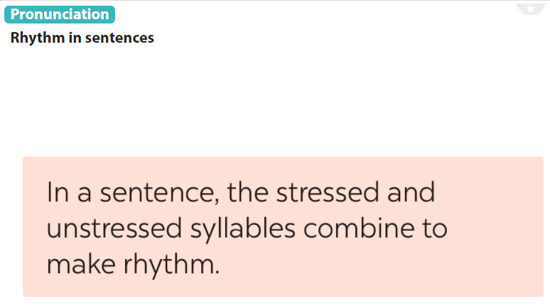

Slide 12
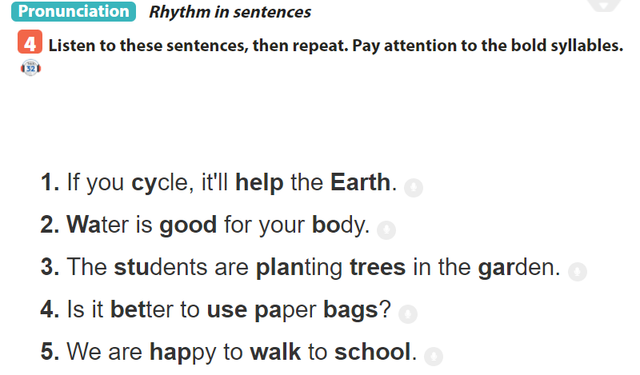

Slide 13
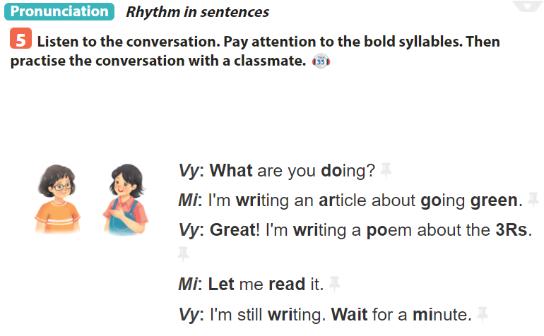

Slide 14
SUM UP
By the end of the lesson, students can be able to:
- pronounce the sounds /a:/ and /æ/ correctly in isolation and in context;
- use the lexical items related to the topic Our Greener world;
- guess the meaning of new words based on clues including pictures and surrounding words.
- Do exercise page ……

