Slide 1
Unit 12: ROBOTS
Lesson 5: Skills 1
Reading and speaking

Slide 2
Objectives
By the end of the lesson, students will be able to:
develop reading skill for general and specific information;
identify different features of different types of robots;
use what they have learnt to practice describing what a robot can do.

Slide 3
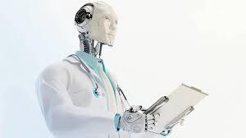
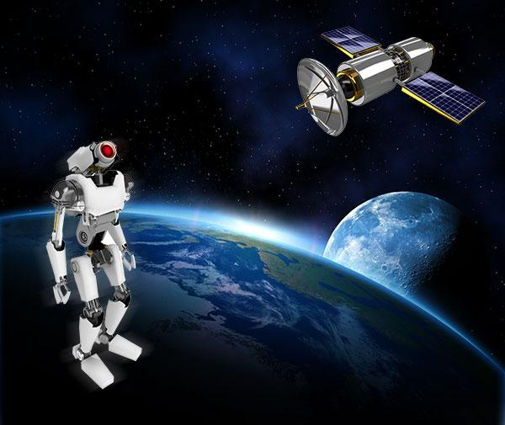
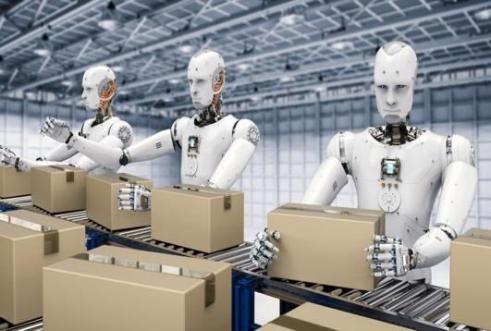
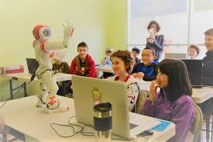
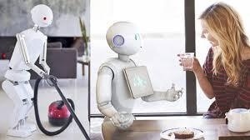
Brainstorming:
What type of robot is that?
A. Home robot
B. Space robot
C. Teacher robot
D. Doctor robot
A. Worker robot
B. Space robot
C. Teacher robot
D. Doctor robot
A. Worker robot
B. Space robot
C. Teacher robot
D. Doctor robot
A. Worker robot
B. Space robot
C. Teacher robot
D. Doctor robot
A. Home robot
B. Space robot
C. Teacher robot
D. Doctor robot

Slide 4
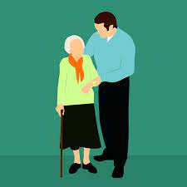


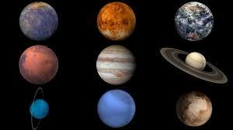

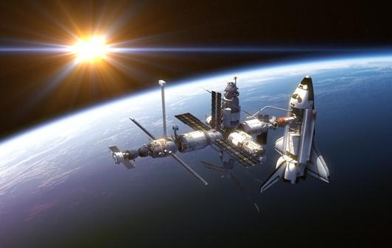
Vocabulary
literature (n)
/ˈlɪtrətʃər/
2. subject (n)
/ˈsʌbdʒekt/
3. planet (n)
/ˈplænɪt/
4. space station (nph)
/ˈspeɪs steɪʃn/
5. improve (v)
/ɪmˈpruːv/
6. look after (phv)
/ˈlʊk æftər/
Văn học, Ngữ văn
Môn học
Hành tinh
Trạm không gian
Cải thiện
Chăm sóc

Slide 5
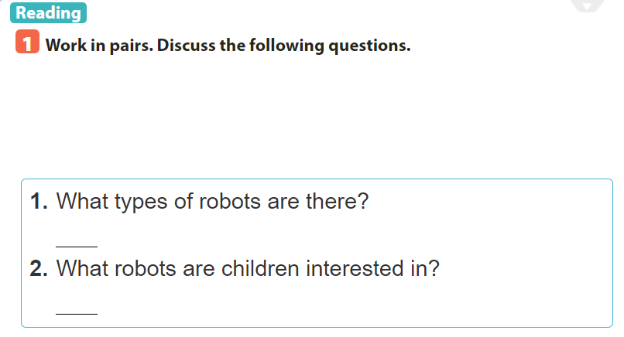
=> They are: home robots, teacher robots, space robots, doctor robots and worker robots.
=> Teacher robots.

Slide 6
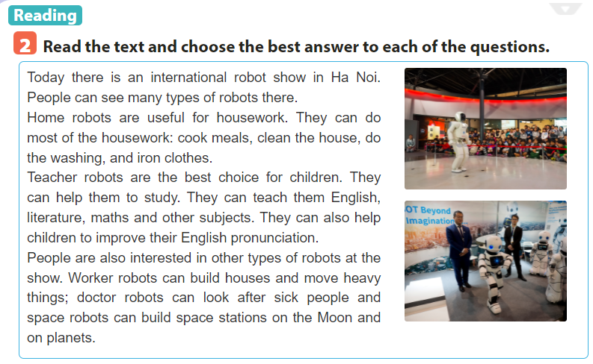
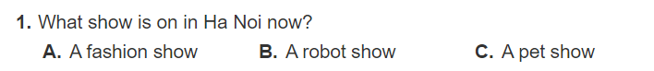

Slide 8


Slide 9
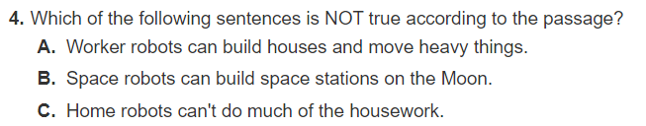

Slide 10

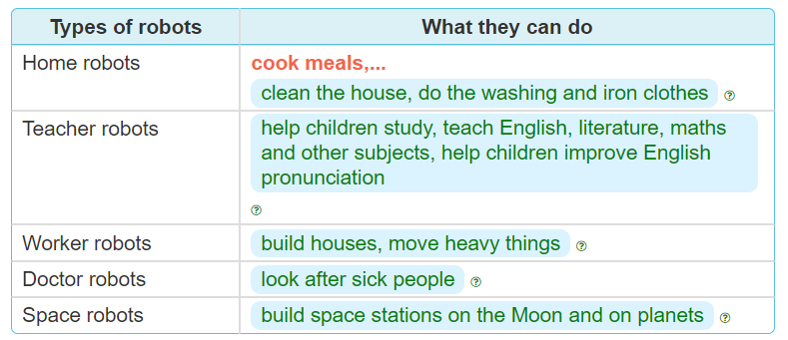
(Paragraph 2)
(Paragraph 3 )
(Paragraph 4)
(Paragraph 4)
(Paragraph 4)

Slide 11
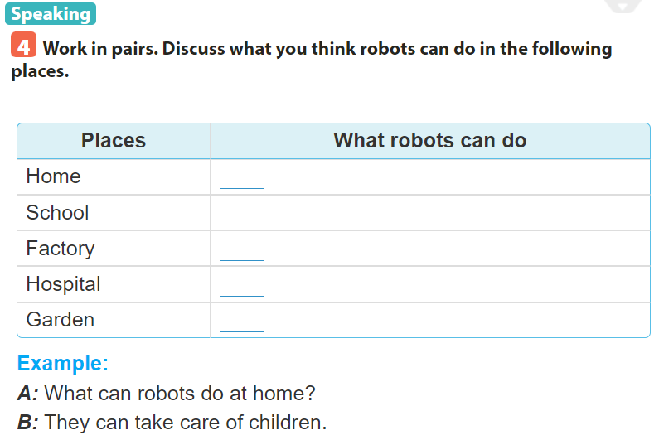

Slide 12
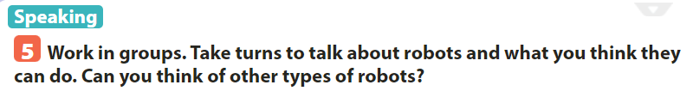

Slide 13
Sum up
By the end of the lesson, students will be able to:
develop reading skill for general and specific information;
identify different features of different types of robots;
use what they have learnt to practice describing what a robot can do.
- Choose a type of robot in reading text and write about what they can do.
- Do exercise page….

Slide 14
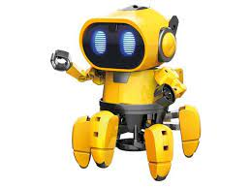
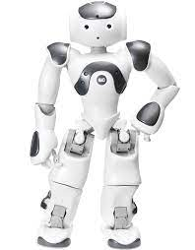
Thank you for your attention
robot

