Slide 1
Unit 12: ROBOTS
Lesson 6: Skills 2
Listening and writing

Slide 2
Objectives
By the end of the lesson, students will be able to:
listen for specific information about what a robot can do;
write a paragraph about the robot they want to have.

Slide 3
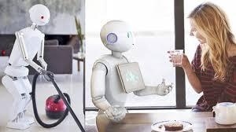
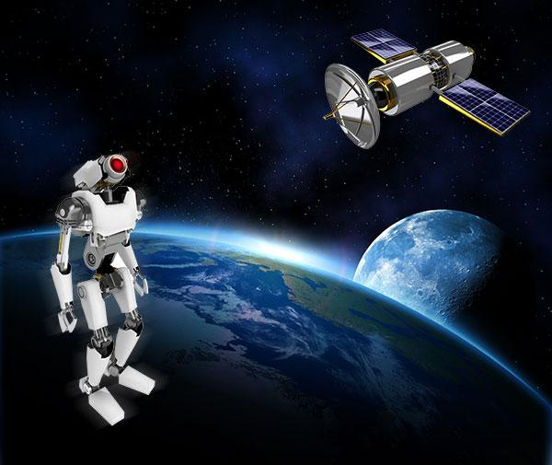
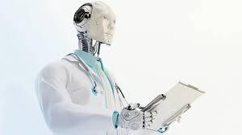
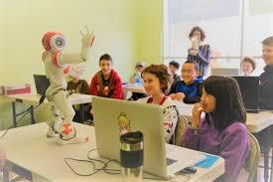
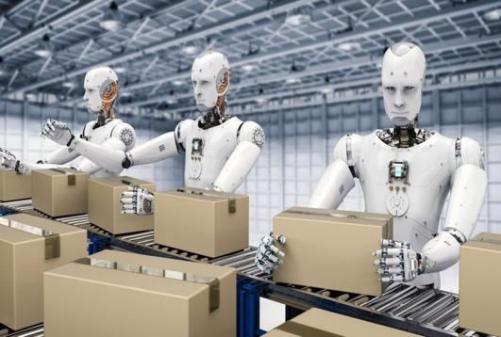
Brainstorming:
What types of robots are these?
What can it do?
home robot
cook meals, clean the house, do the washing, iron clothes
Space robot
teacher robot
build space stations, take measurements, collect samples, take pictures of planets
Doctor robot
worker robot
help children study, teach English, literature, maths and other subjects, help children improve English pronunciation
look after sick people, do the surgery, help the doctors,
build houses, move heavy things

Slide 4
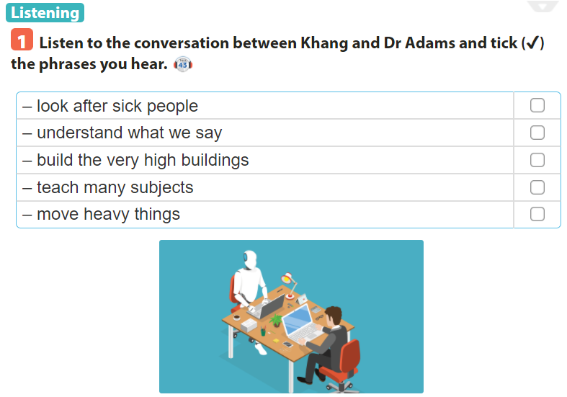



Slide 5
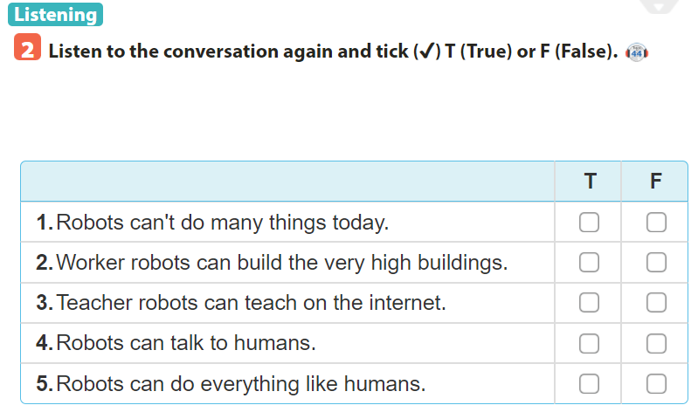

Slide 6

Name of your robot:
Type of your robot:
Miracle
Household robot
Where it can work:
What it can do for you:
Living room, bedroom, kitchen
Cook, do the laundry, vacuum the floor

Slide 7

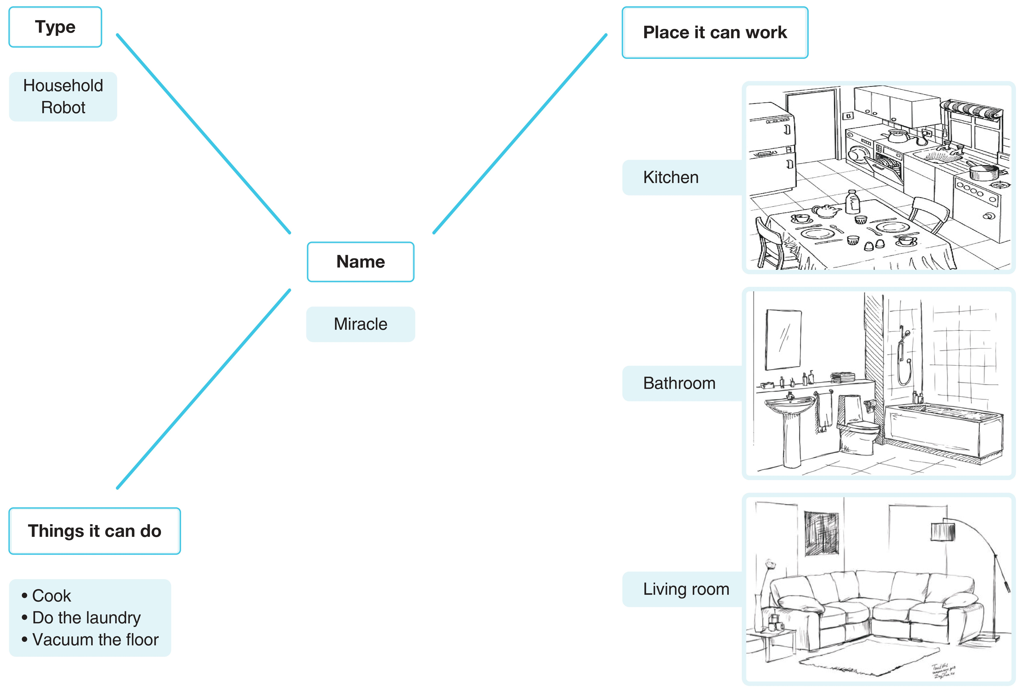

Slide 8
USEFUL LANGUAGE
- household
- to do housework
- do the laundry
- vacuum the floor
WRITING SAMPLE
My robot's name is Miracle.
It is a household robot.
It can work in the kitchen, bathroom or living room. Miracle can do housework. It can cook in the kitchen and do the laundry in the bathroom. It can also vacuum the floor in the living room. In short, Miracle is very useful.

Slide 9
Sum up
By the end of the lesson, students will be able to:
listen for specific information about what a robot can do;
write a paragraph about the robot they want to have.
- Do exercise page….

Slide 10
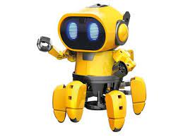
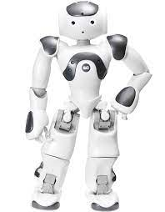
Thank you for your attention
robot

