Slide 1
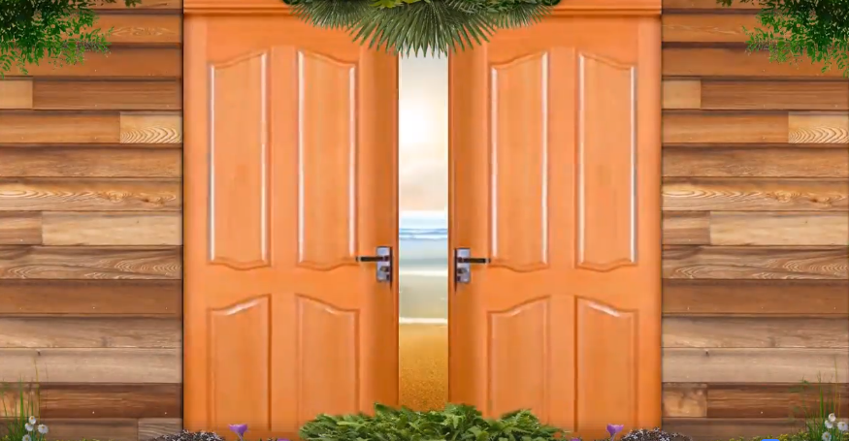
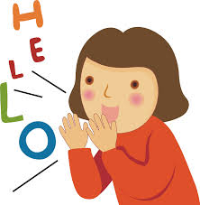

Welcome to our class
Unit 7
TELEVISION
Let’s learn English !
Teacher: Nguyen Thi Thu Ha

Slide 2
What kinds of programme do you watch most?

Slide 3

Unit 7: Television
Lesson 6: Skill 2

Slide 4
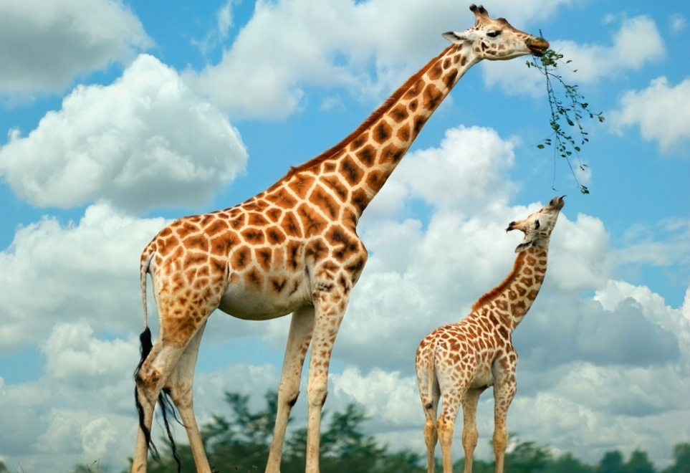
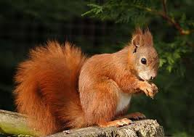
I. Listening.
Activity 1. Listen and tick (v) the correct channels
for each programmes
- giraffe [dʒi'rɑ:f] (n):
Hươu cao cổ
- spotted ['spɔtid] (adj):
lốm đốm
- squirrel ['skwirəl] (n):
Con sóc
- compare [kəm'peə] (v):
So sánh
- habit ['hæbit] (n):
thói quen
- comment ['kɔment](n,v):
Bình luận

Slide 5


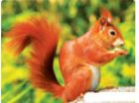

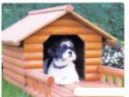
Matching
1/Cartoon:
The Red Spotted Squirrel
2/Home and Garden:
How to Make a Dog House
3/ Our World:
The old Town of Inca
4/ Music:
Green Green Summer
5/ Film:
The Lonely Giraffe

Slide 6



I. Listening.
Activity 1. Listen and tick
Programme | Channel 1 | Channel 2 | Channel 3
Music: Green Green Summer
Cartoon: The Red Spotted Squirrel
Film: The Lonely Giraffe
Home and Garden: How to Make a Dog House
Our World: The old Town of Inca
✓
✓
✓
✓
✓

Slide 7
Activity 2. Listen and tick True or false.
Statements | True | False
1.The first programme starts at seven- thirty. 2.There are two programmes starting at the same time. 3.The Red Spotted Squirrel lasts forty – five minutes. 4.The lonely Giraffe finishes at ten o’clock. 5.The old Town of Inca is in India
✓
✓
✓
✓
✓

Slide 8
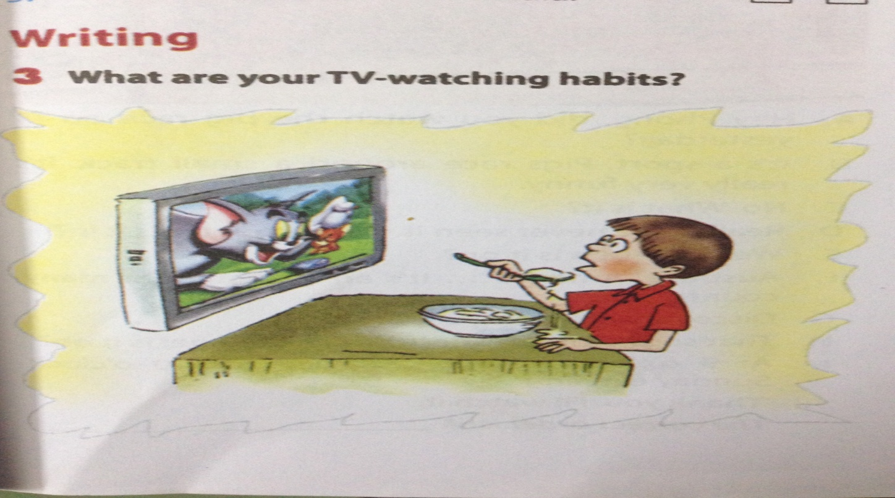
How many hours do you watch TV day?

Slide 9
II. Writing
Activity 3. What are your TV-watching habits?
1. How many hours a day do you watch TV? | 1 hour | 2-3 hours | depends
2. How do you compare the time you spend watching TV to the time you spend on outdoor activities? | more | less | the same
3. Do you watch TV when you are ...? | eating | entertaining | reading
4. What kind of programme do you watch most? | educational | entertaining | sports
5. Do you leave your TV on when you are not watching it? | never | sometimes | often

Slide 10
I like….
I usually watch….( your favourite programme)
I usually leave the TV on…./ turn off the TV ….
I think I have good /bad TV watching habits.

Slide 11
Suggested writing:
I do not watch much TV. I only spend one or two hours a day watching TV. I spend most of my free time on outdoor activities. I usually watch the VTV news on VTV 1 channel. I usually turn off the TV when I do not watch it. I think I have good TV watching habits.

Slide 12
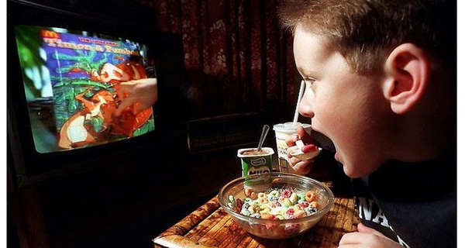
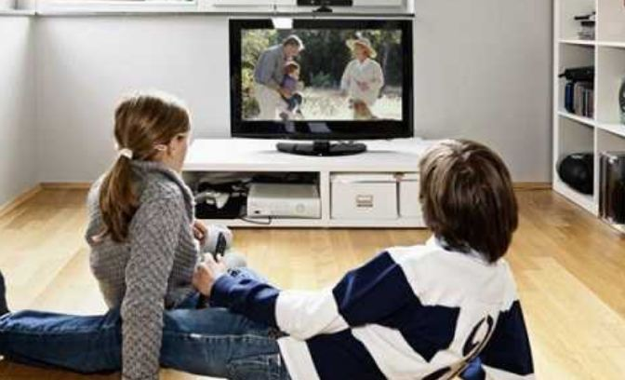
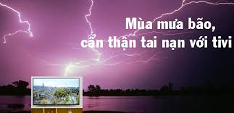
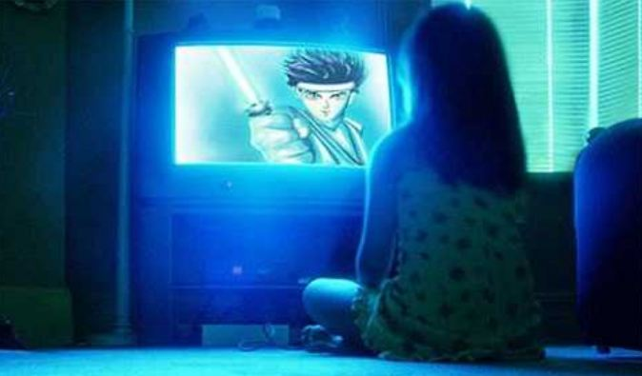

Slide 13

Learn by heart newwords
Do exercises C1,2- P 6,7 workbook
Prepare new lesson:
Unit 2. Lesson 7. Looking back & Project
Home work

Slide 14
THANK YOU FOR ATTENTION!
the end
GOOD BYE!

