Slide 1


Grade 6 Supplementary English course
By Washington English Center

Slide 2
Unit 8: Sports and Games
Lesson 2
Page 72

Slide 3

Vocabulary
activities | aerobics | auto racing | golf
gymnastics | hiking | judo | sailing
skiing | tennis | windsurfing | weight lifting
yoga | board game | hockey | sports nut

Slide 4
LISTEN AND REPEAT
Nghe và đọc theo giáo viên
Activities:
Gymnastics:
Skiing:
Yoga:
Hoạt động
Thể dục dụng cụ
Trượt tuyết
Môn yoga
Notes:
A, B, D: /k/
C: /s/

Slide 5
LISTEN AND REPEAT
Nghe và đọc theo giáo viên
Aerobics:
Hiking:
Tennis:
Board game:
Thể dục nhịp điệu
Đi bộ đường dài
Quần vợt
Trò chơi cờ bàn
Notes:
A, B, D: /k/
C: /s/

Slide 6
LISTEN AND REPEAT
Nghe và đọc theo giáo viên
Auto racing:
Judo:
Windsurfing:
Hockey:
Đua xe
Võ thuật judo
Lướt ván buồm
Khúc côn cầu
Notes:
A, B, D: /k/
C: /s/

Slide 7
LISTEN AND REPEAT
Nghe và đọc theo giáo viên
Golf:
Sailing:
Weight lifting:
Sports nut:
Đánh gôn
Lướt thuyền buồm
Cử tạ
Người đam mê thể thao
Notes:
A, B, D: /k/
C: /s/

Slide 8
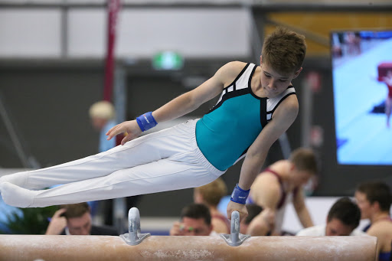
Gymnastics
Thể dục dụng cụ
GUESS THE WORD
Đoán từ

Slide 9
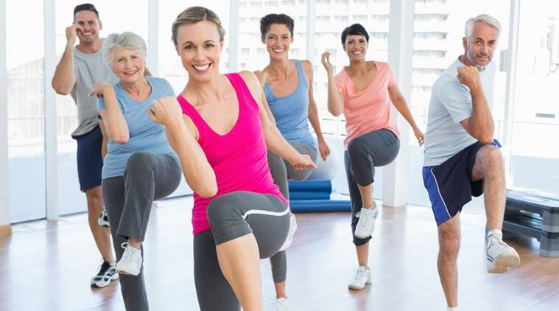
Aerobics: Thể dục nhịp điệu
GUESS THE WORD
Đoán từ

Slide 10
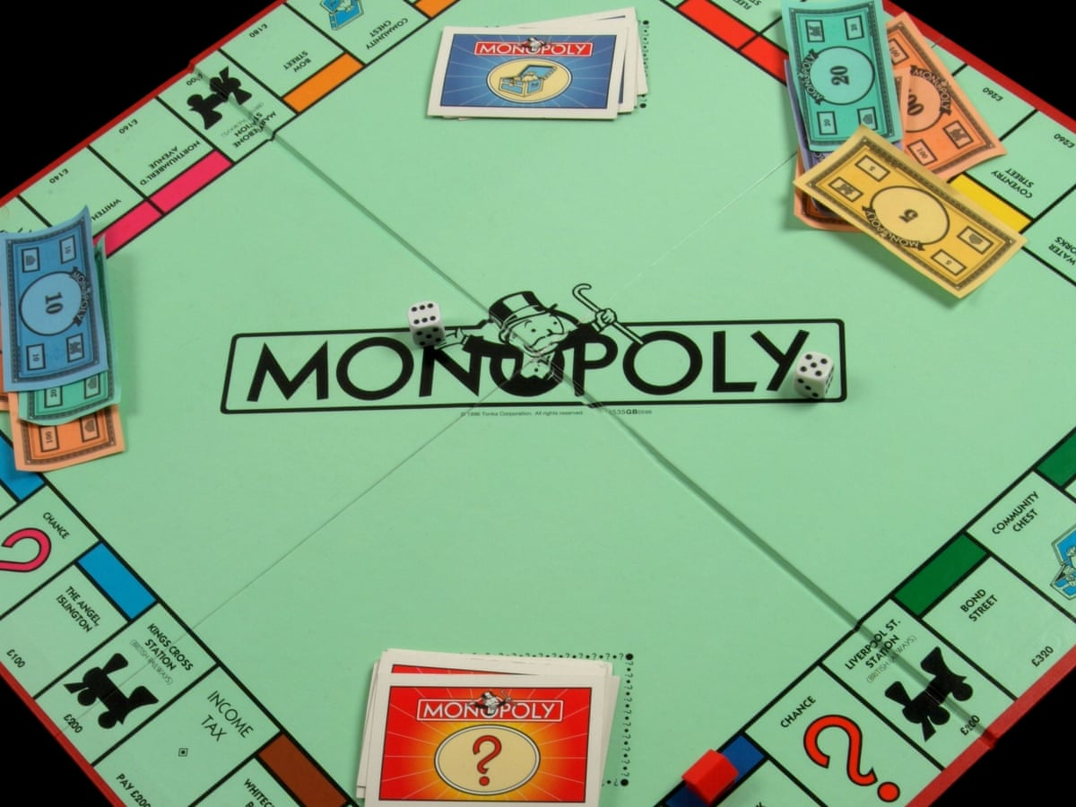
Board game Trò chơi cờ bàn
GUESS THE WORD
Đoán từ

Slide 11
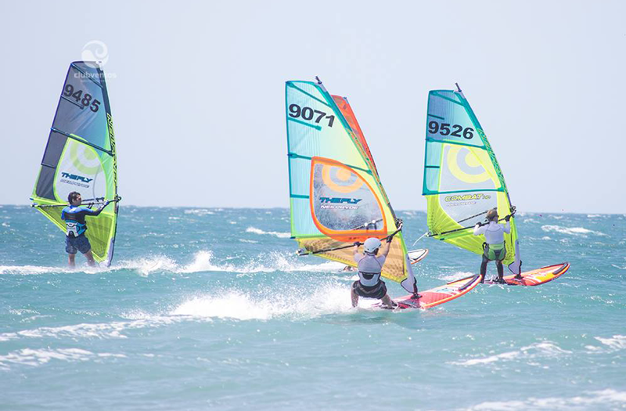
Windsurfing Lướt ván buồm
GUESS THE WORD
Đoán từ

Slide 12
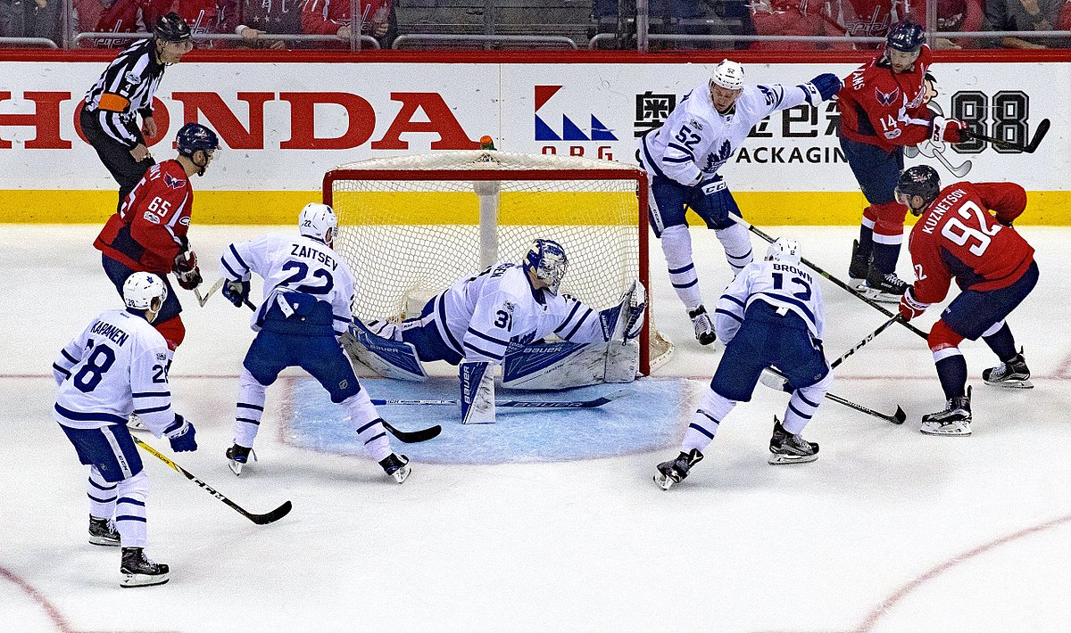
Hockey Khúc côn cầu
GUESS THE WORD
Đoán từ

Slide 13
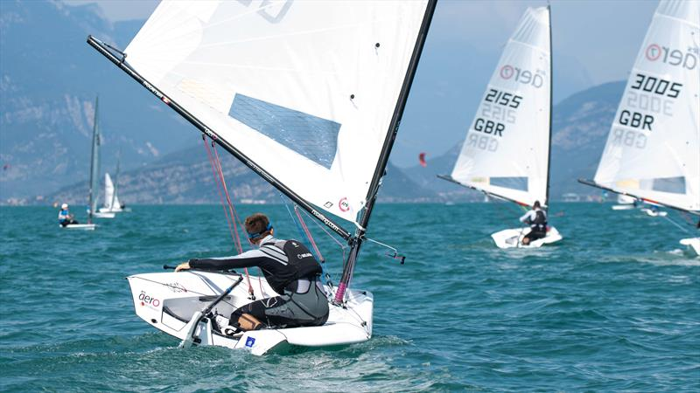
Sailing Lướt thuyền buồm
GUESS THE WORD
Đoán từ

Slide 14
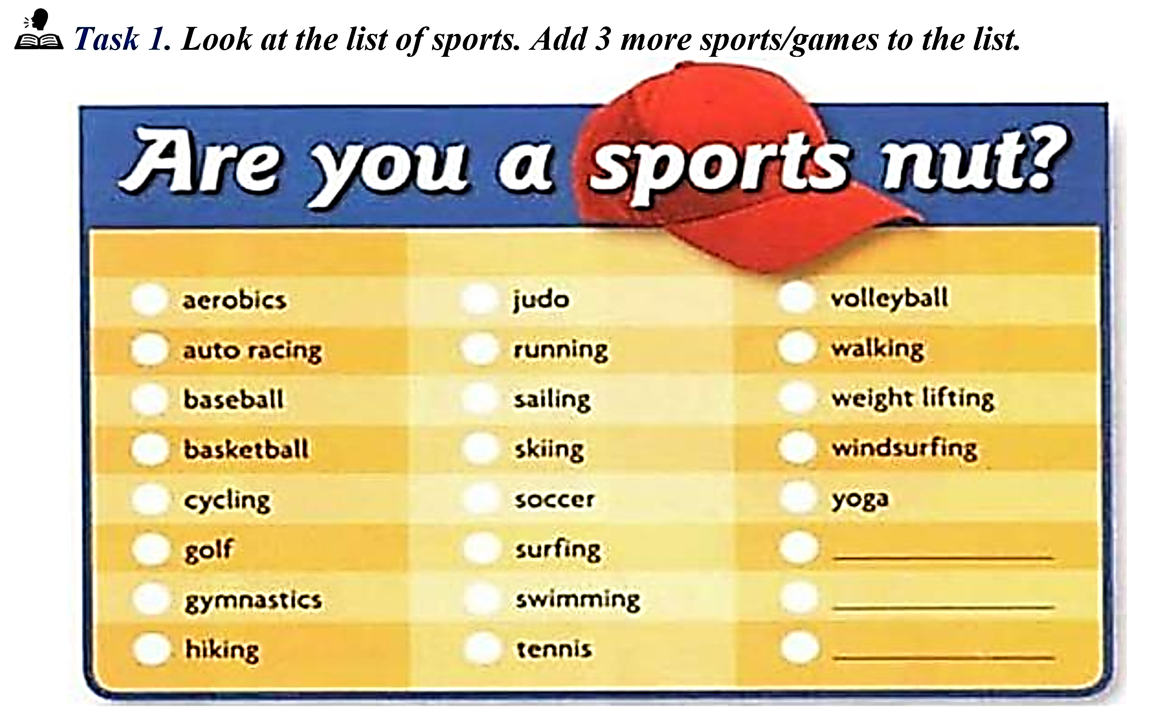
badminton
table tennis
boxing
Notes:
A, C, D: /e/
B: /ɪ/

Slide 15
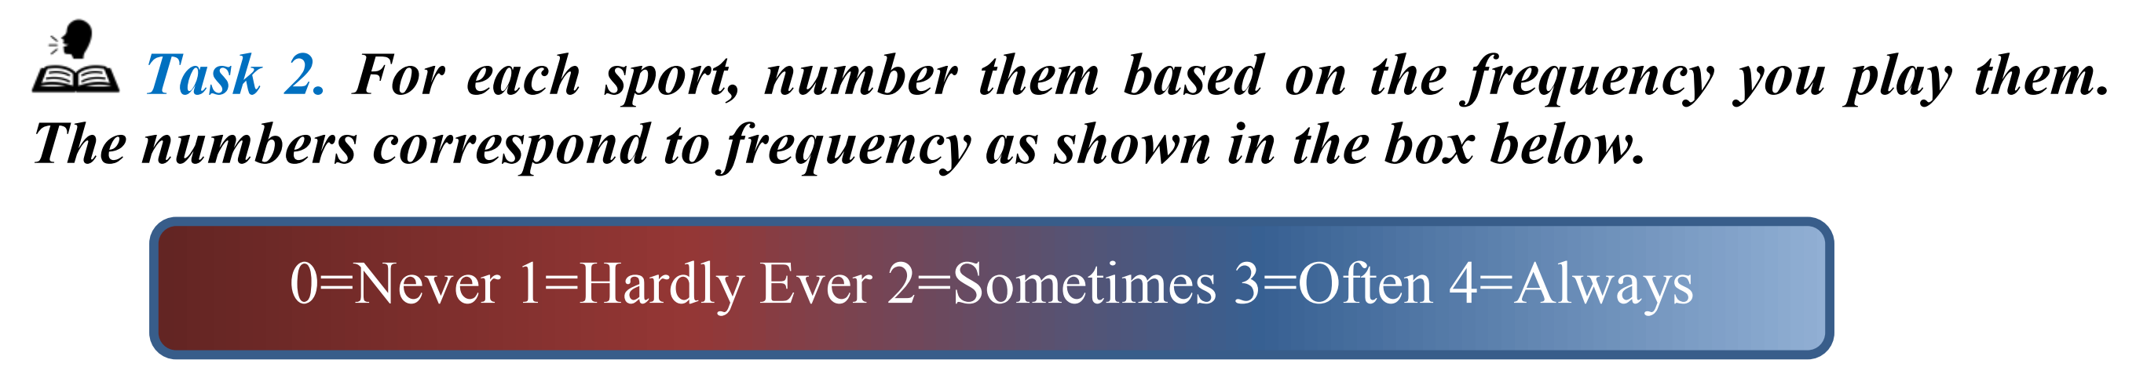
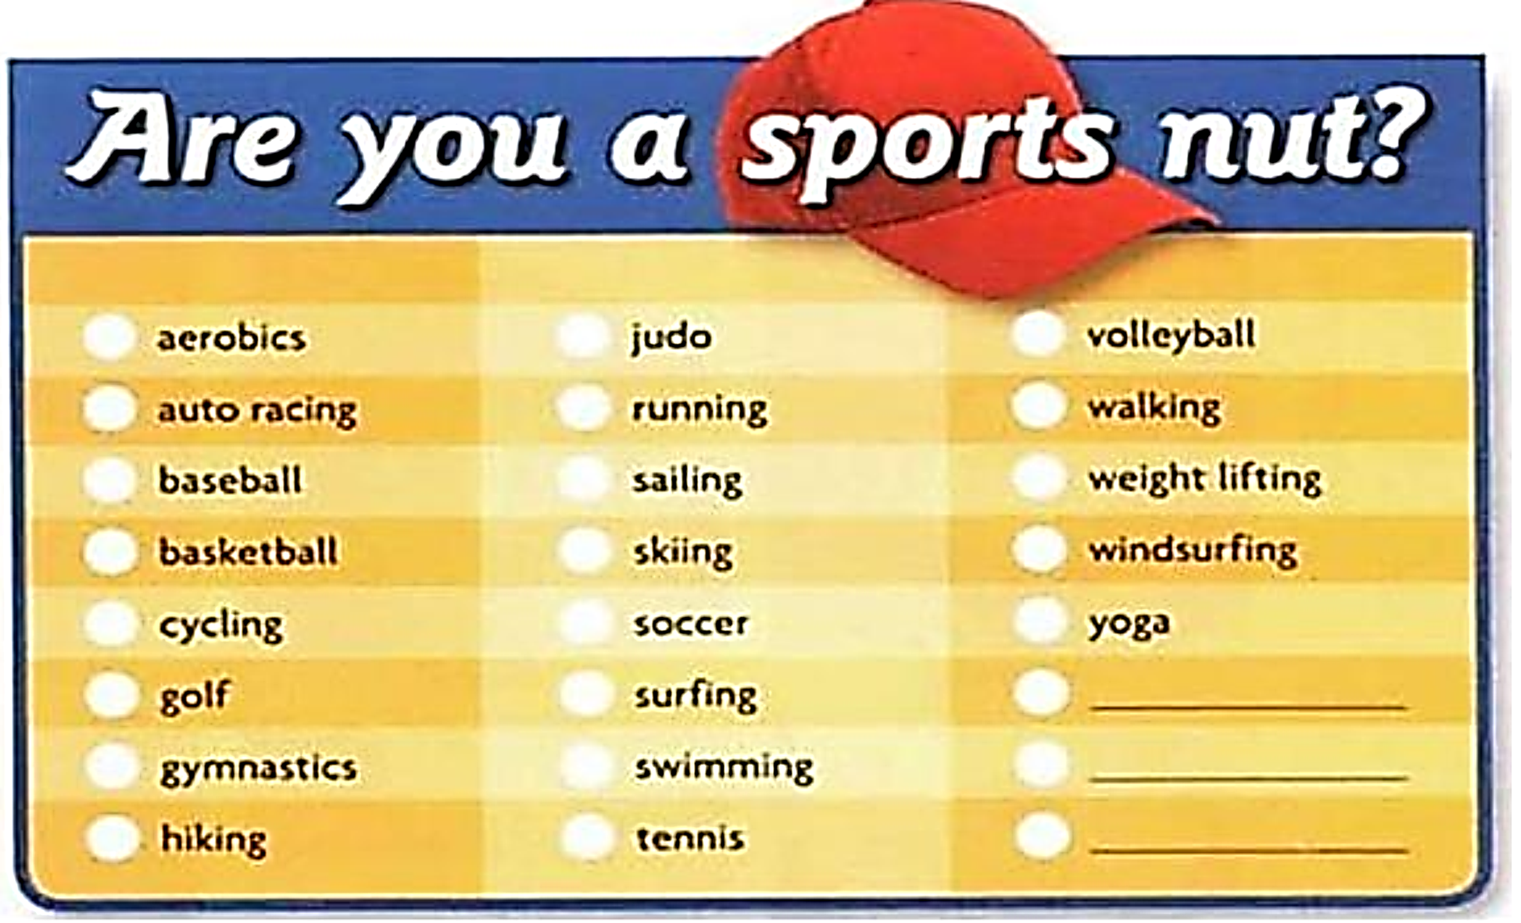
Notes:
A: /s/
B, C, D: /z/

Slide 16
Competitive sports:
Relaxing sports:
Individual sports:
Seasonal sports :
Judo, soccer, basketball, cycling, running, gymnastics, golf, weight lifting, swimming, tennis, auto racing, skiing, boxing
Yoga, aerobics, golf, tennis, swimming, hiking
surfing, skiing, sailing, cycling, golf
soccer, tennis, basketball, golf, baseball, swimming
Notes:
A, B, C: /tʃ/
D: /k/

Slide 17
Indoor sports:
Team sports:
Outdoor sports:
Year-round sports:
basketball, soccer, volleyball, tennis, swimming, weight lifting
baseball, basketball, volleyball, soccer
auto racing, baseball, basketball, golf, hiking, skiing, sailing, running, surfing
baseball, basketball, weight lifting, soccer, aerobics
Notes:
A, B, C: /tʃ/
D: /k/

Slide 18
ring, rope, gloves, hit:
table, paddle, serve, ball:
basket, points, ball, court:
pedals, wheels, ride, race:
ball, kick, goal, referee:
Boxing
Table tennis
Basketball
Cycling
Soccer
Notes:
A, B, C: /tʃ/
D: /k/

Slide 19
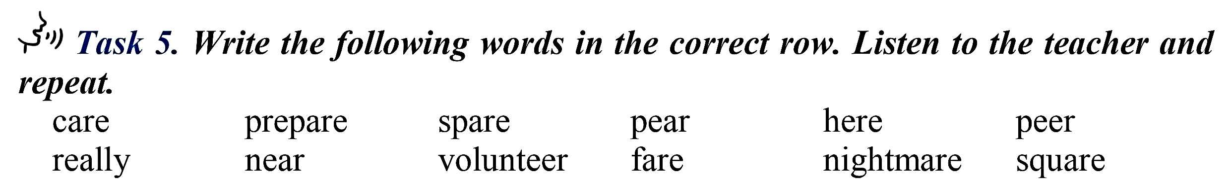
PRONUNCIATION
/ir/
/eə/
Really, near, volunteer, pear, here, peer
Care, prepare, spare, fare, nightmare, square
Notes:
A, B, C: /tʃ/
D: /k/

Slide 20
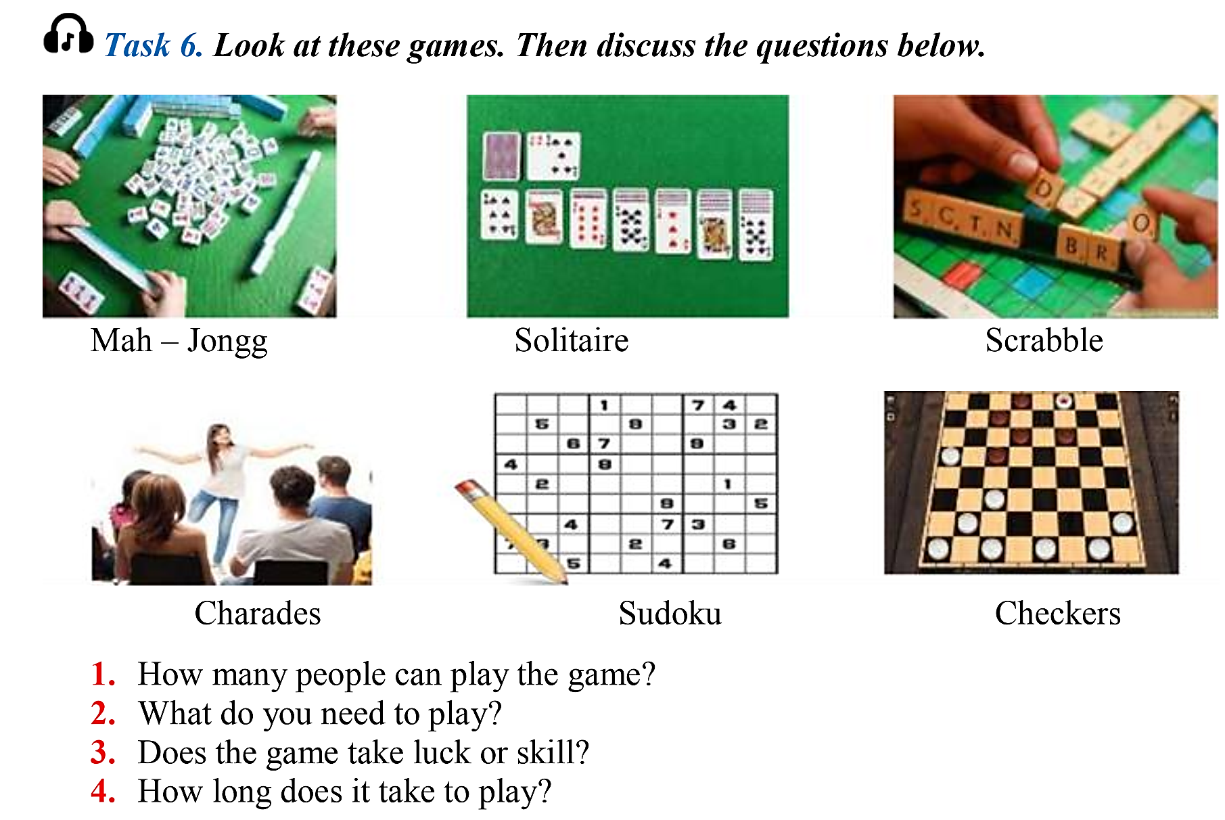
LISTENING
Notes:
A, B, C: /tʃ/
D: /k/

Slide 21
 |  | Terry | Lisa | Claudio
 | How many people can play? | 1
 | 2. What equipment do you need?
 | 3. Does the game involve luck or skill?
 | 4. How long does a game last?
2
2 - 4
Pencil, paper
Chess board, white and black pieces
Board, bag of letters
skill
skill
Skill & luck
20 minutes
30 minutes
1 hour
Notes:
A, B, C: /tʃ/
D: /k/

Slide 22
17th
Michael Jordan was born on February (1)_____, 1963. He is (2)__________one of the best (3)______________ever. He (4)_____the Chicago Bulls to six National Basketball (5)____________championships, and won the NBA's Most Valuable Player (6)______ five times.
Jordan started studying at the University of (7)______Carolina (UNC) in (8)_____He soon became an (9)_________of the school's basketball team. In 1982, with Jordan (10)________the final basket, the team (11)________Georgetown University and became the (12)__________He was the (13)_______________of the Year in 1983 and in 1984.
In 1984, Jordan became a member of the U.S. (14)______________________ The team won the gold (15)_______that year
considered
basketball player
led
Association
Award
North
1981
important
scoring
defeated
champion
College Player
Olympic basketball team
medal

Slide 23
1. What team did Michael Jordan play for?
Chicago Bulls
National Basketball Association
Georgetown University

Slide 24
2. How many times did Michael Jordan win the title “College Player of the Year”?
A. Six times
B. Five times
C. Two times

Slide 25
3. When did Michael Jordan start playing for the University of North Carolina?
A. 1963
B. 1981
C. 1984

Slide 26
4. What does “the team” in paragraph 2 refer to?
A. University of North Carolina
B. Georgetown University
C. College Player

Slide 27
5. What is the best title of this passage?
A. Michael Jordan: life and career
B. Michael Jordan: the best basketball player
C. Michael Jordan: a professional basketball player

Slide 28
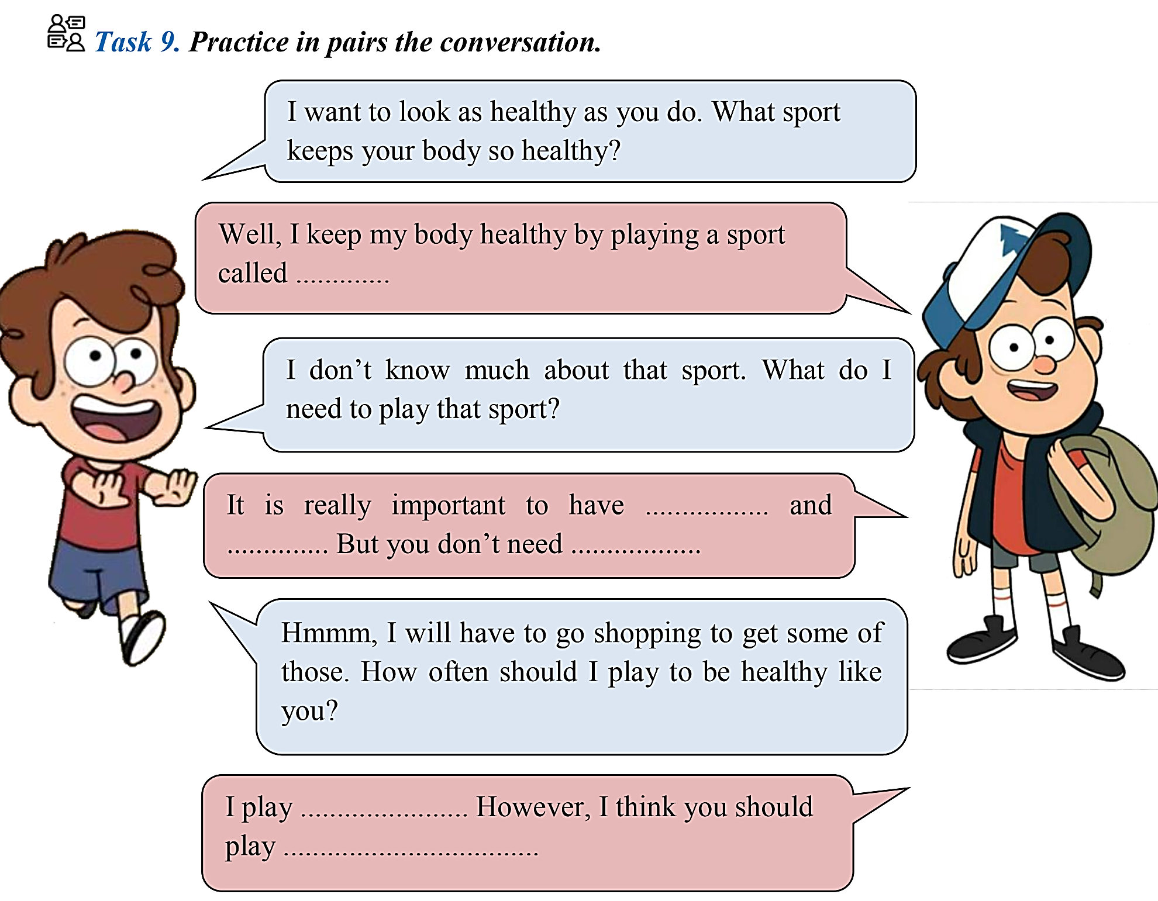
SPEAKING

Slide 29
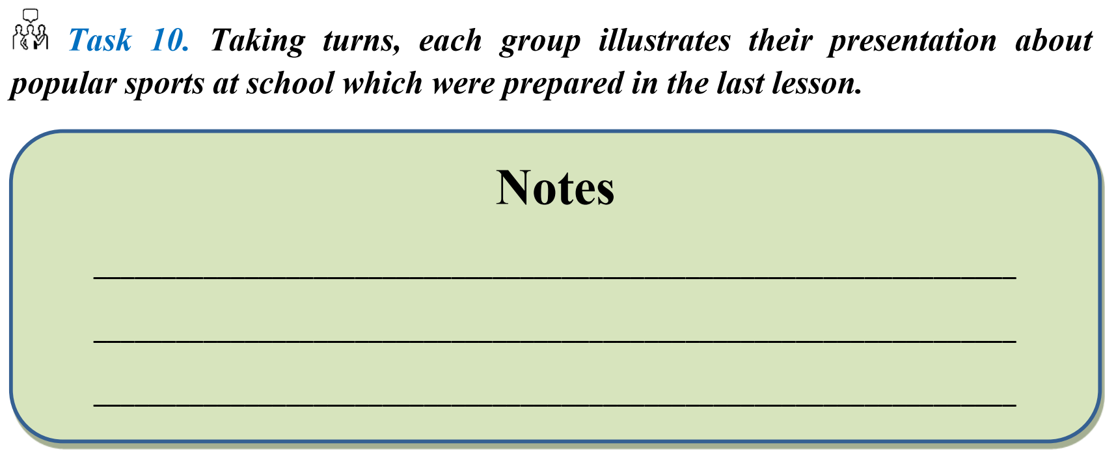
PROJECT

Slide 30
Thank you and see you next Lesson!

