Slide 1


Grade 7 Supplementary English course
By Washington English Center

Slide 2
Unit 8: Films
Lesson 2
Page 68

Slide 3

Vocabulary
awful | character | hated | villain
loved | boring | clever | moving
actor | moving | leading role | emotional
brilliant | main character | supporting character | hilarious

Slide 4
LISTEN AND REPEAT
Nghe và đọc theo giáo viên
Awful:
Loved:
Actor:
Brilliant:
Kinh khủng
Được yêu
Diễn viên
Xuất sắc
Notes:
A, B, D: /k/
C: /s/

Slide 5
LISTEN AND REPEAT
Nghe và đọc theo giáo viên
Character:
Boring:
Moving:
Main character:
Nhân vật
Buồn chán
Cảm động
Nhân vật chính
Notes:
A, B, D: /k/
C: /s/

Slide 6
LISTEN AND REPEAT
Nghe và đọc theo giáo viên
Hated:
Clever:
Leading role:
Supporting character:
Bị ghét
Thông minh
Vai trò lãnh đạo
Nhân vật phụ
Notes:
A, B, D: /k/
C: /s/

Slide 7
LISTEN AND REPEAT
Nghe và đọc theo giáo viên
Villain:
Moving:
Emotional:
Hilarious:
Vai phản diện
Cảm động
Giàu cảm xúc
Vui nhộn
Notes:
A, B, D: /k/
C: /s/

Slide 8

Boring
Buồn chán
GUESS THE WORD
Đoán từ

Slide 9
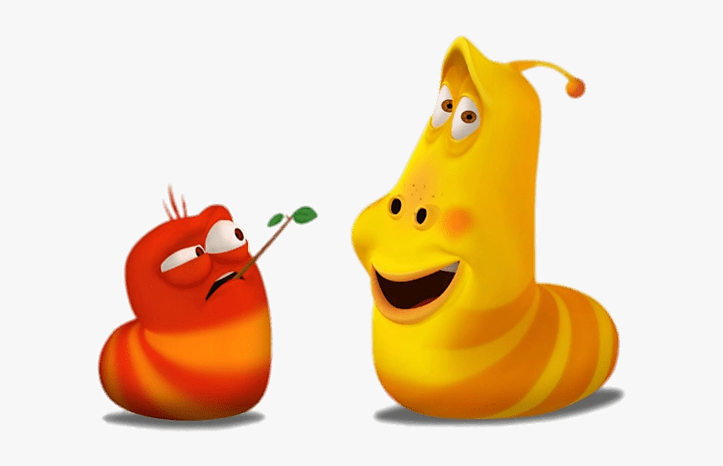
Main character
Nhân vật chính
GUESS THE WORD
Đoán từ

Slide 10
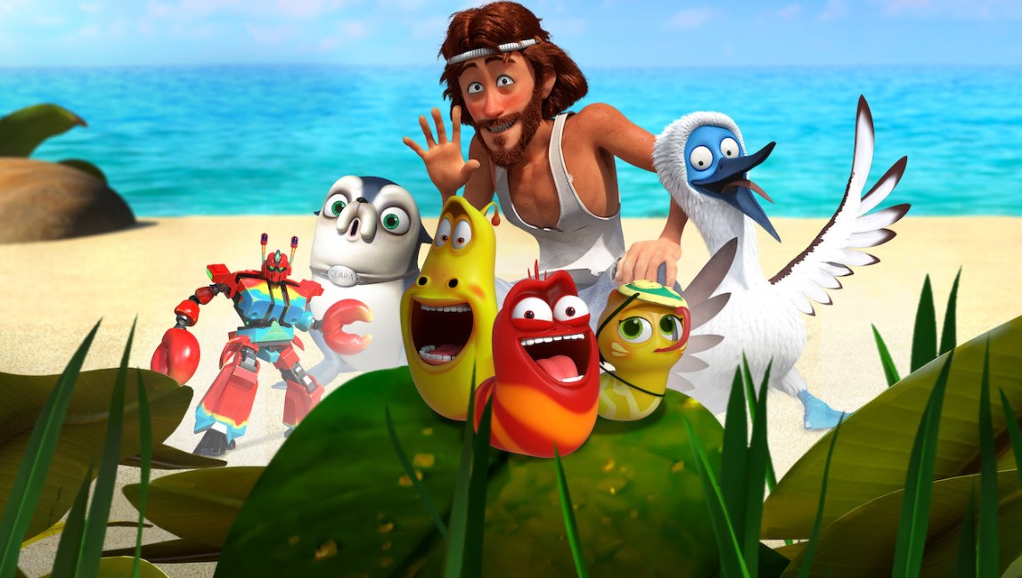
Supporting character
Nhân vật phụ
GUESS THE WORD
Đoán từ

Slide 11
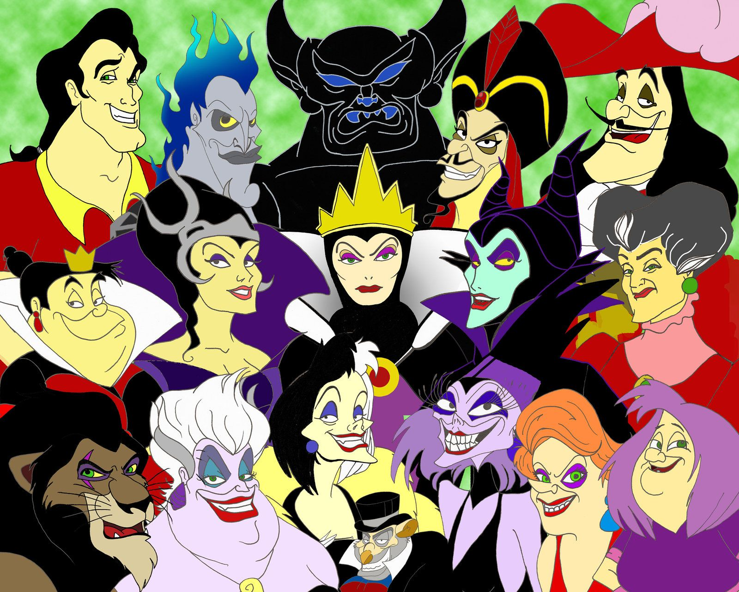
Villain
Vai phản diện
GUESS THE WORD
Đoán từ

Slide 12

Emotional
Giàu cảm xúc
GUESS THE WORD
Đoán từ

Slide 13
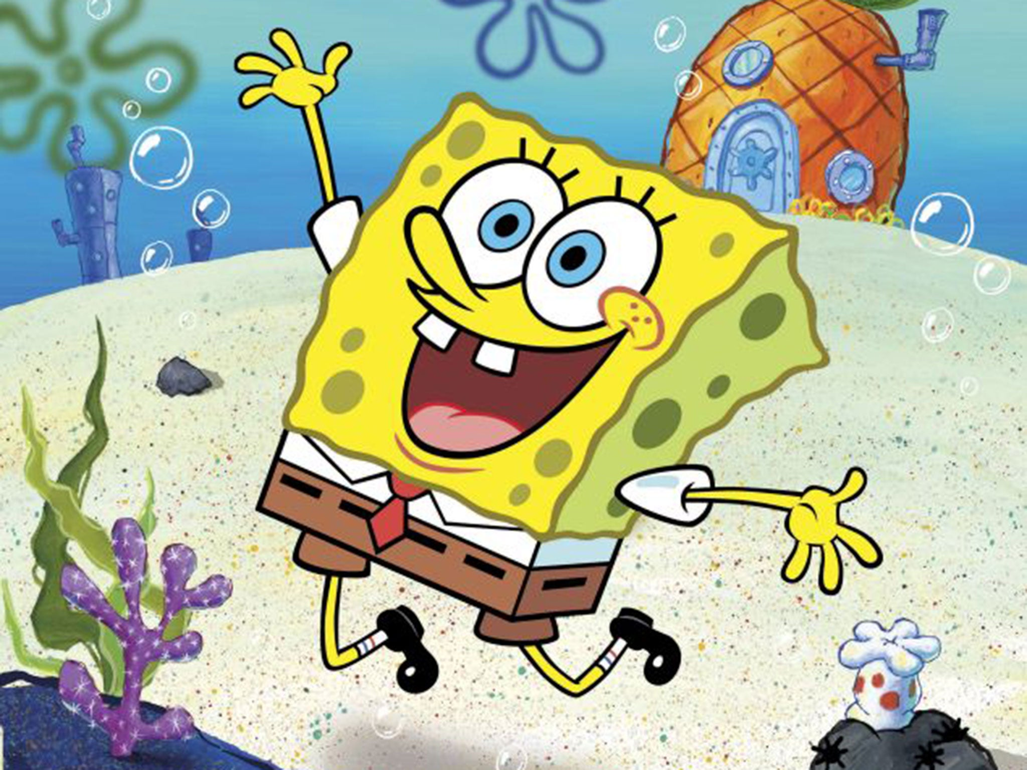
Hilarious
Vui nhộn
GUESS THE WORD
Đoán từ

Slide 14
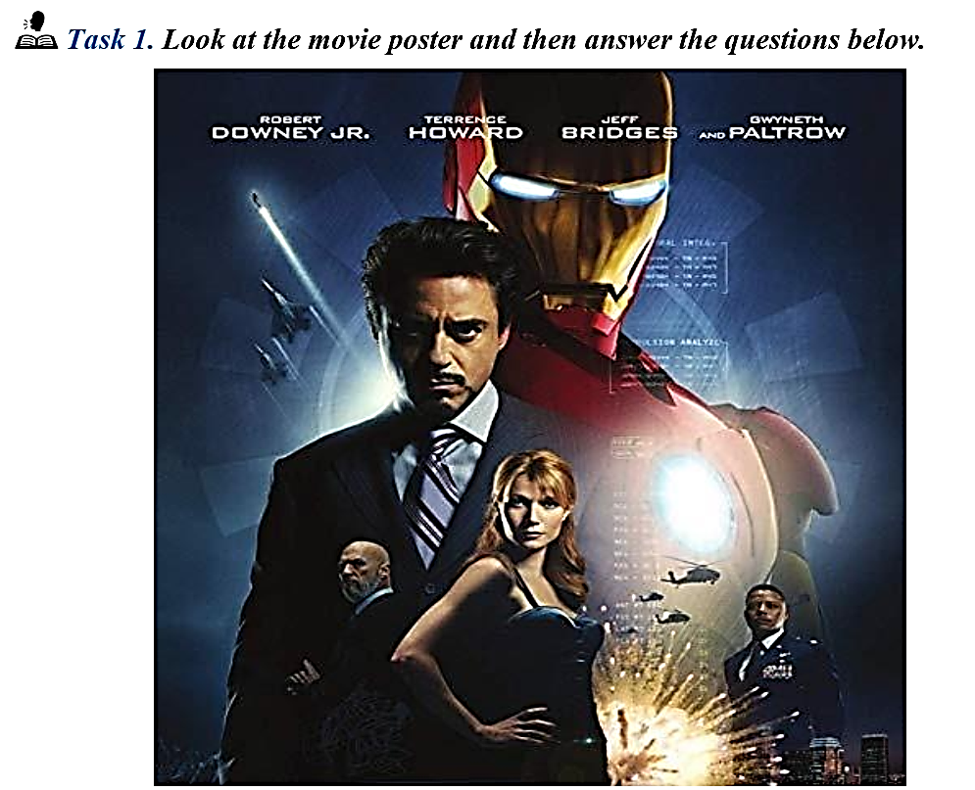
Notes:
A, C, D: /e/
B: /ɪ/

Slide 15
1. What is the name of the movie?
__________________________________________________
2. What kind of movie is this?
_________________________________________________
3. What is the name of the main character?
__________________________________________________
4. What is the name of the actor that plays the main character?
__________________________________________________
5. How would you describe this movie?
____________________________________________________
The name of the movie is Iron man
This is an action movie
The name of the main character is Tony Stark
The name of the actor that plays the main character is Robert Downey
This movie is so emotional.The acting of main character is clever
Notes:
A: /s/
B, C, D: /z/

Slide 16
Description | Kind of Movie | Name of Movie
Awful
Moving
Brilliant
Hated
Loved
Clever
Horror
The Amityville Horror
Romance
Love, Rosie
Documentary
American Factory
Horror
The Devil inside
Romance
Crash landing on you
Sci-Fi
Star War

Slide 17

Make a conversation. Use the words in the box and your own ideas:
Clever | Exciting | Interesting | Romantic | Scary
Educational | Funny | Moving | Sad | Violent
A: I think … looks moving and educational.
B: Maybe. But I don’t think it looks very exciting.

Slide 18
The acting was excellent, and I laughed from beginning to end
➔
2. The scene was so frightening that I closed my eyes
➔
I think this film will be liked by people who are interested in true stories
➔
It is hilarious, and it is really moving too
➔
The special effects are incredible! The robots look real.
➔
Comedy movie
Horror movie
Documentary movie
Animated movie
Science Fiction movie

Slide 19
PRONUNCIATION
1. | A. played | B. closed | C. filled | D. needed
2. | A. frightened | B. amazed | C. disappointed | D. terrified
3. | A. thread | B. beam | C. breath | D. stead
4. | A. parade | B. waste | C. later | D. gravy
5. | A. naked | B. cooked | C. booked | D. walked
/pleɪd/
/kloʊzt/
/fɪld/
/ˈniːdɪd/
/ˈfraɪtnd/
/əˈmeɪzd/
/dɪsəˈpɔɪntɪd/
/ˈtɛrɪfaɪd/
/θrɛd/
/biːm/
/brɛθ/
/stɛd/
/ˈpəˈreɪd/
/weɪst/
/ˈleɪtə/
/ˈgreɪvi/
/ˈneɪkɪd/
/kʊkt/
/bʊkt/
/wɔːkt/

Slide 20
LISTENING
Cinema trip for Gabriel’s Birthday
Name of cinema | 1. Star Cinema
Day we’ll go | 2. ___________
Which film | 3. ___________
Time film begins | 4. ___________pm
Price of ticket | 5. ___________
How we’ll get there | 6. by ___________
Saturday
New Boy
6:45
7 pounds 10
Car of Gabriel’s Dad

Slide 21
model
Emma Watson is a British actress, (1)______ and activist. She has been widely known not only as a (2)_______ young actress, but also a humanitarian. She rose to (3)____ after having her first professional (4)_________ as Hermione Granger in the Harry Potter film series from 2001 to 2011. Other (5)__________ include her acting in The Perks of Being a Wallflower and The Bling Ring. Besides her movie (6)_____ she has also earned a bachelor’s degree in English (7)_______ She was (8)_________ the UN Women Goodwill Ambassador in July 2014. At the age of 26, she has (9)_________ her efforts towards the empowerment of young women and (10)_________ of gender equality (11)________ Emma shared, ‘I still have so much to learn, but as I (12)________ I hope to bring more of my individual knowledge, experience and (13)________ to this role.
talented
fame
acting role
successes
career
literature
appointed
dedicated
promotion
worldwide
progress
awareness

Slide 22
What nationality is Emma Watson?
____________________________________________________
2. What role turned Emma Watson into a famous actress?
____________________________________________________
3. What is her highest qualification?
____________________________________________________
4. What role has she undertaken since 2014?
____________________________________________________
5. Which gender has Emma promoted development for?
____________________________________________________
British
Hermione Granger
Bachelor’s degree (in English literature)
(The) UN Women Goodwill Ambassador
women/female

Slide 23
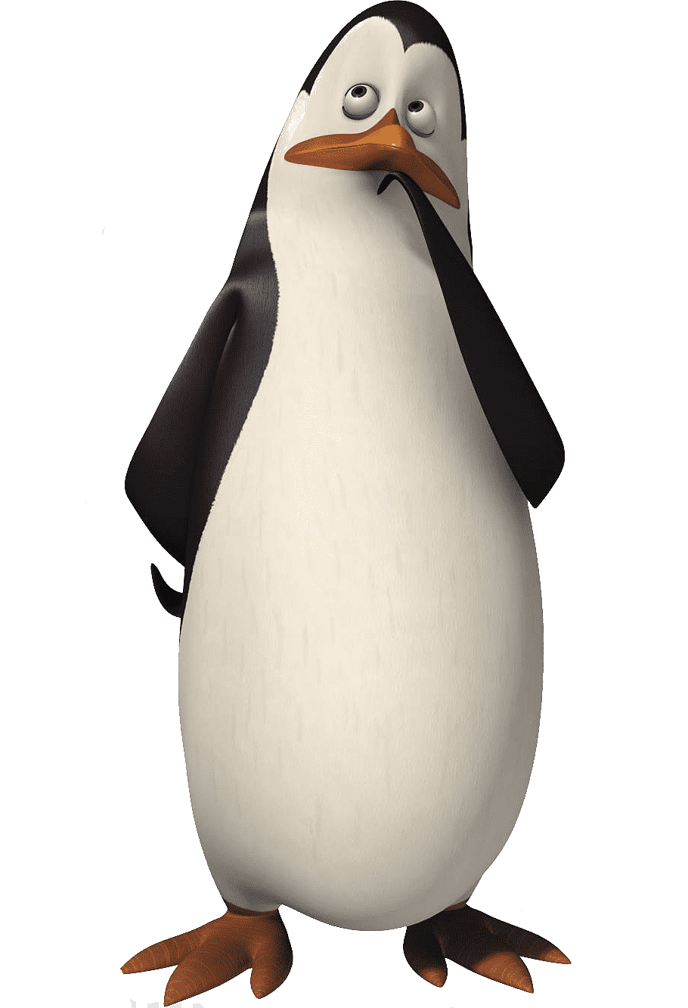

SPEAKING
Have you seen the newest .................. movie? It came out last week.
No, I haven’t seen it yet. What is the name of the movie? Are there any good actors in it?
The movie is called ............ and the lead actor is ........... He is playing a character named .............
Oh, I’m not sure if I’m that interested. I don’t really like that actor. Who else is in it?
Well, the villain is played by ....................... I haven’t seen him/her in many other movies.
Oh my god! I love him/her. I have seen all of his/her movies. Now I definitely need to see it!

Slide 24
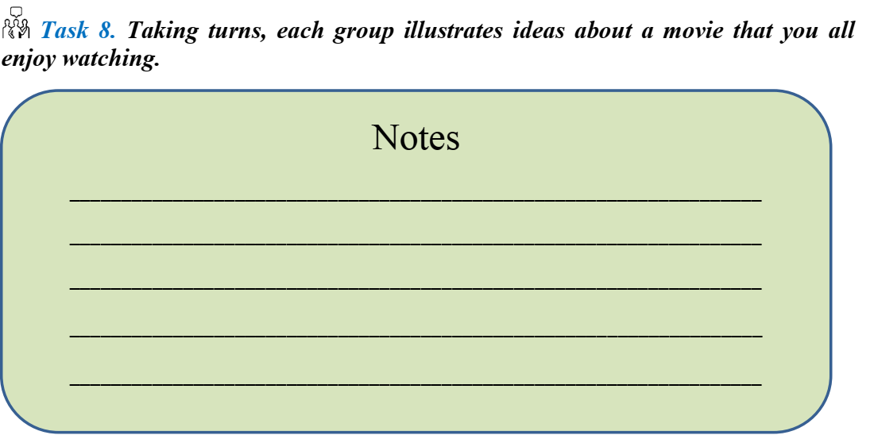
PROJECT

Slide 25
Thank you and see you next LESSON!

