Slide 1








Slide 2


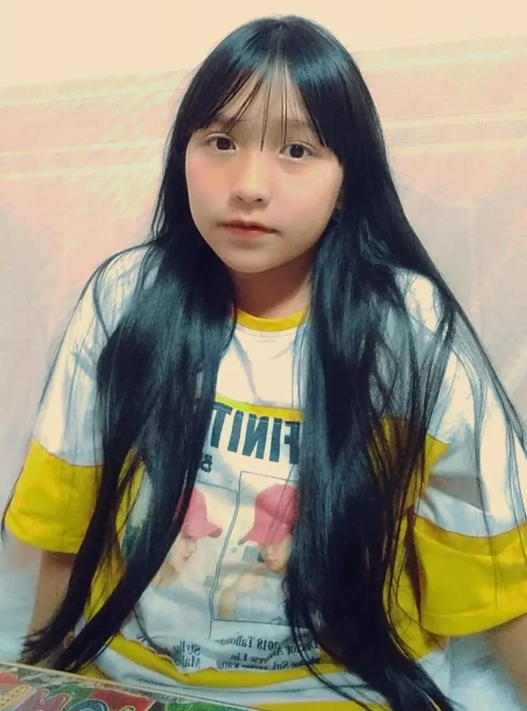
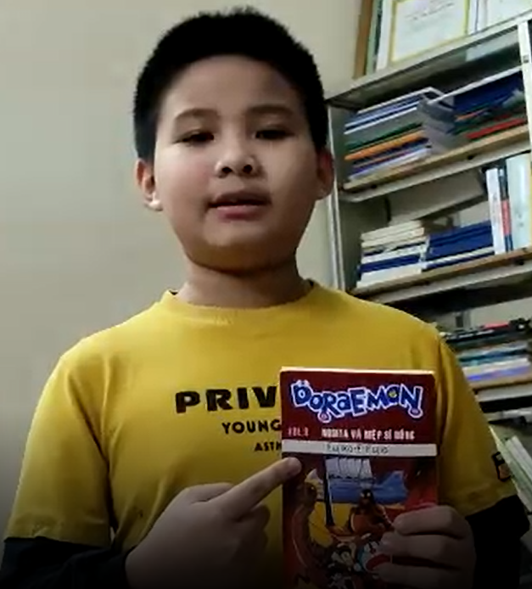
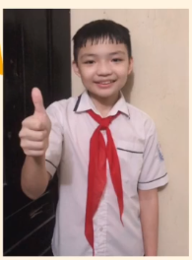
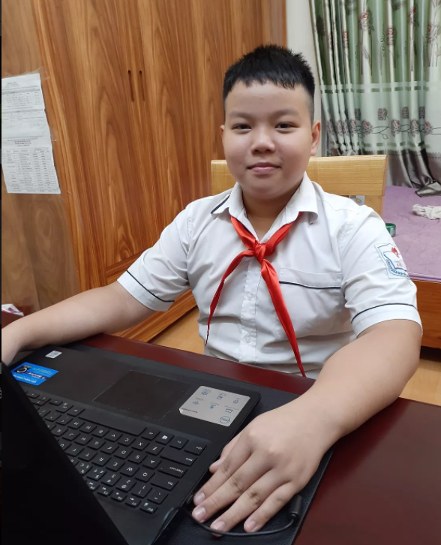
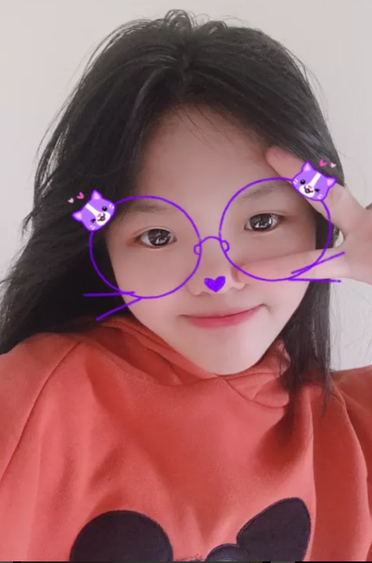
Thursday, October 21 ^{st}, 2021
LESSON 1.1: NEW WORDS + LISTENING – P22

Slide 3

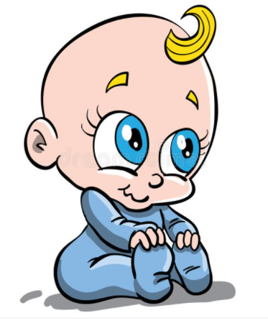
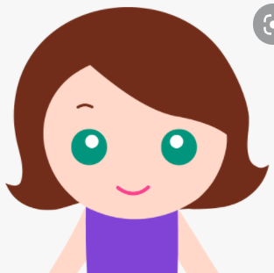
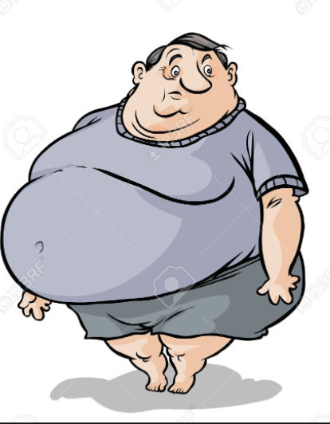



I. Matching
A. brown
B. long
C. short
D. tall
E. black
F. fat
G. blue
1
3
2
4
5
7
6

Slide 4



II. Vocabulary
* New words
1. slim (adj):
gầy, thon thả
2. blond (adj)
/blɔnd/:
vàng hoe
3. ‘glasses:
/ˈɡlæs.ɪz/:
kính mắt
4. (to) wear: /weə/:
đeo, mặc
5. ‘striped(adj)
/'straipt/:
kẻ sọc

Slide 5

* Practice:
Write the words in the table. Listen and repeat
tall 2. blue 3. glasses 4. slim 5. red
6. blond 7. long 8. brown (x2) 9. short (x2)
body | hair | eyes
tall | red | blue

Slide 6

* Practice:
Write the words in the table. Listen and repeat
tall 2. blue 3. glasses 4. slim 5. red
6. blond 7. long 8. brown (x2) 9. short (x2)

Slide 7
* Practice:
Write the words in the table. Listen and repeat
tall 2. blue 3. glasses 4. slim 5. red
6. blond 7. long 8. brown (x2) 9. short (x2)
body | hair | eyes
tall | red | blue
slim
blond
glasses
short
long
brown
brown
short

Slide 8

Lesson 1
* Practice:
Write the words in the table. Listen and repeat
tall 2. blue 3. glasses 4. slim 5. red
6. blond 7. long 8. brown (x2) 9. short (x2)
body | hair | eyes
tall | red | blue
slim
blond
glasses
short
long
brown
brown
short
b. Describe yourself using the new words
Eg: I have black hair. I have blue eyes.
* I/ We/ You/ They + have + adj + hair/ eyes.
Huy/ He// Lan/ She + has
Notes:
Option 1:
- Demonstrate the activity, using the example
- Have Ss write the words in the correct columns of the table
- Divide class into pairs and have them check their answers with their partners
- Play audio (CD1 – Track 29). Have Ss listen and repeat
- Correct Ss’ pronunciation
Option 2:
- Ask Ss to work in pairs to write the words in the correct columns of the table
- Play the audio for Ss to check their answers, let Ss repeat after listening to each word
- Call some Ss to read the words aloud, check pronunciation if necessary

Slide 9
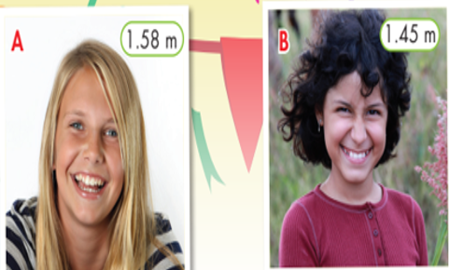
III. Listening

Slide 10
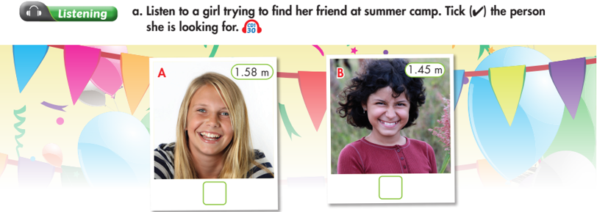

Lesson 1
Notes:
Listen to a girl trying to find her friend at a summer camp. Tick ü the person she is looking for.
- Have Ss look at the pictures
- Play the audio once (CD 1 – Track 30)
- Have Ss listen and tick the correct box
- Play the audio again. Check answers as a whole class

Slide 11
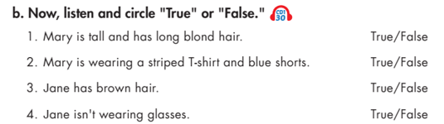
Lesson 1
Notes:
Now, listen and circle “True” or “False”
- Have Ss read the sentences and guess whether they are True or False
- Play the audio. Have Ss listen and choose “True” or “False”
- Check answers as a whole class

Slide 12
IV. Describe the person you like

Slide 13
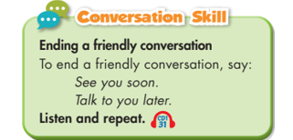
Lesson 1
Notes:
Conversation skill
- Focus attention on the Conversation Skill box
- Explain that we often end conversation y saying: “See you soon” or “Talk to you later”
- Play the audio. Have Ss listen and repeat
- Have some Ss practice the conversation skill in front of the class
- Give feedback, and provide more ways to end a friendly conversation
See you soon
Talk to you later
See you later
Take care
Catch you later
Peace out
…
-Ask Ss to use these sentences / phrases to make up a simple conversation about school or friends and then end it friendly
-Have Ss present
- Give feedback and evaluation

Slide 14
Lesson 1
What we have learnt
* Words to describe body: Tall, short, fat, thin, slim, …
* Words to describe hair: Long, short, brown, blond, curly, …
* Words to describe eyes: Big, small, blue, brown …
* Ways to end a friendly conversation
See you soon
Talk to you later
See you later
Take care
Catch you later
Peace out

Slide 15
Body build: I am tall.
Huy/ He/ Lan/ She is slim.
You/ We/ They are fat.
2. Hair:
I/ We/ You/ They + have + adj (kích thước, màu sắc) + hair.
Huy/ He// Lan/ She + has
Eg: I have long hair. I have long black hair.
She has long hair. She has long blond hair.
He has short hair. He has short black hair.
3. Eyes:
I/ We/ You/ They + have + adj(màu sắc) + eyes.
Huy/ He// Lan/ She + has
Eg: I have blue eyes. a white shirt
She has brown eyes.
4. Clothes: I am wearing a pink blouse and black pants/ trousers/ jeans.
She is wearing a pink blouse and black pants.

Slide 16
Lesson 1
Notes:
Conversation skill
- Focus attention on the Conversation Skill box
- Explain that we often end conversation y saying: “See you soon” or “Talk to you later”
- Play the audio. Have Ss listen and repeat
- Have some Ss practice the conversation skill in front of the class
- Give feedback, and provide more ways to end a friendly conversation
See you soon
Talk to you later
See you later
Take care
Catch you later
Peace out
…
-Ask Ss to use these sentences / phrases to make up a simple conversation about school or friends and then end it friendly
-Have Ss present
- Give feedback and evaluation

Slide 17
Lesson 1
V. Homework
1. Learn by heart the new words (3 lines).
2. Practice describing someone’s personal appearance.
3. Do exercises in Workbook: Lesson 1 - New words and Listening (page 14).
- Prepare: Lesson 1 – Grammar (page 23 – SB).

Slide 18

Thank You Very Much For Your Listening!

