Slide 1

1. Can you name some festivals in Viet Nam? 2. Do you like Mid-Autumn Festival? 3.Do you like Tet holiday? 4. What are some activities you often do just before and during Tet?
Pass the ball game

Slide 2
Unit 5: Our customs and traditions
Lesson 1: Getting Started
(page 50-51)

Slide 3
By the end of this lesson, students will be able to:
01
Knowledge
Objectives
An overview and lexical items about the topic “Our customs and traditions”
02
Core competence
Develop communication skills and cultural awareness.
03
Personal qualities
Self-study skills / students’ awareness of our customs and traditions

Slide 4


VOCABULARY
admire (v)
/ədˈmaɪər/
ngưỡng mộ

Slide 5
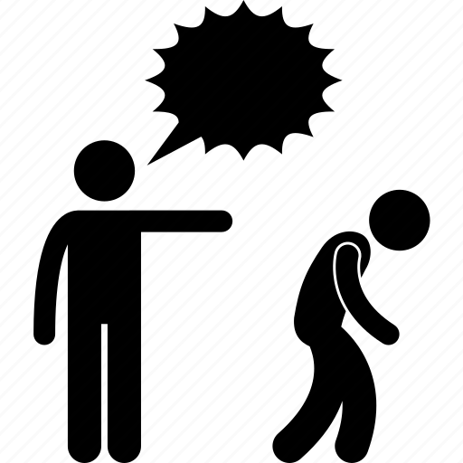
VOCABULARY
chase away (v)
/tʃeɪs əˈweɪ/
xua đuổi

Slide 6
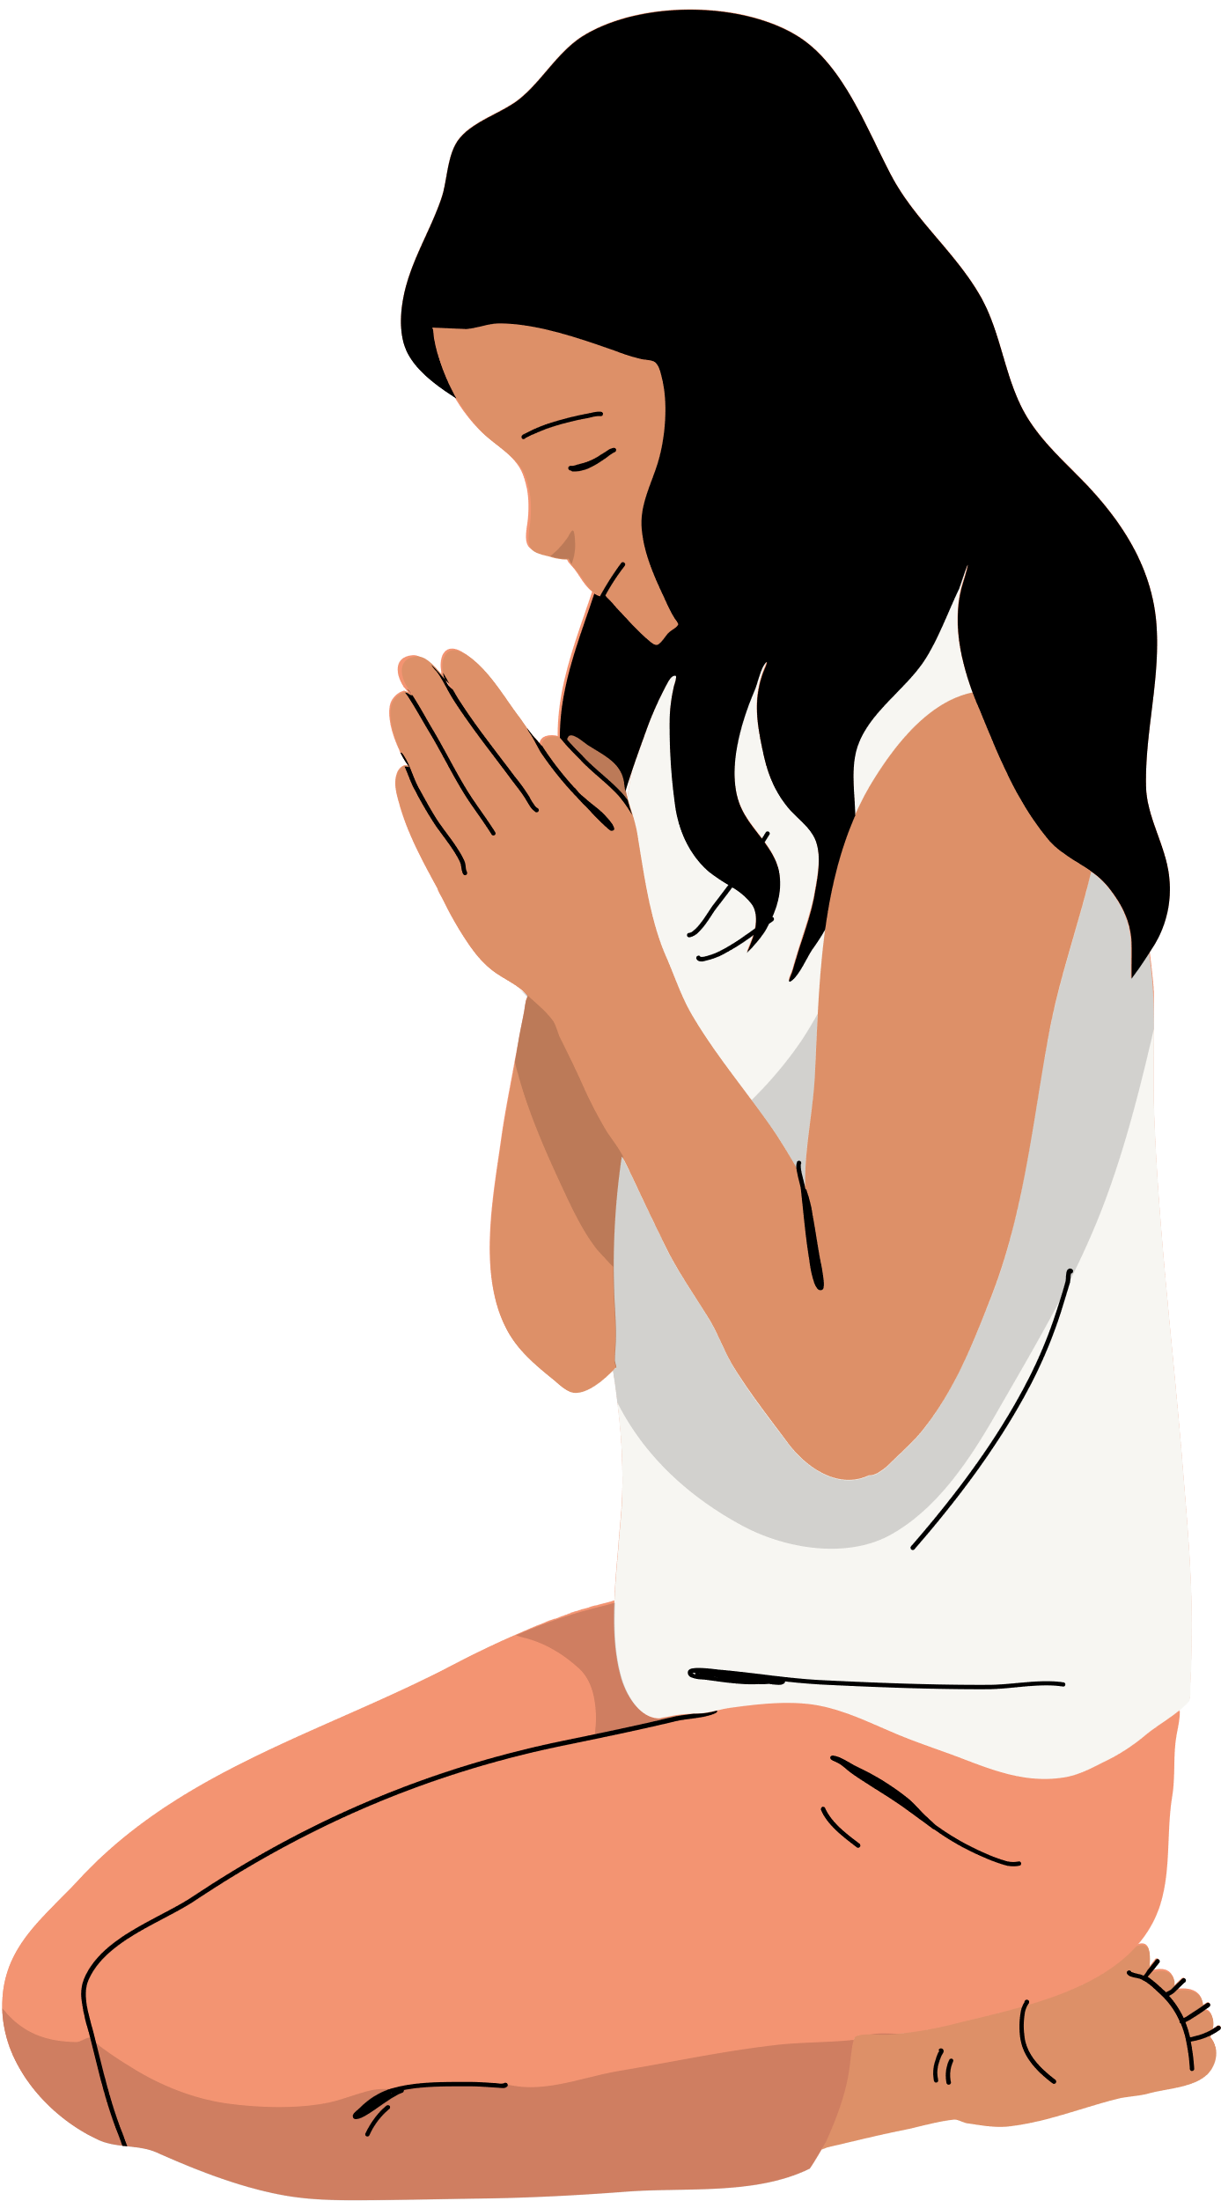
VOCABULARY
For pray (v)
/preɪ/
cầu nguyện

Slide 7
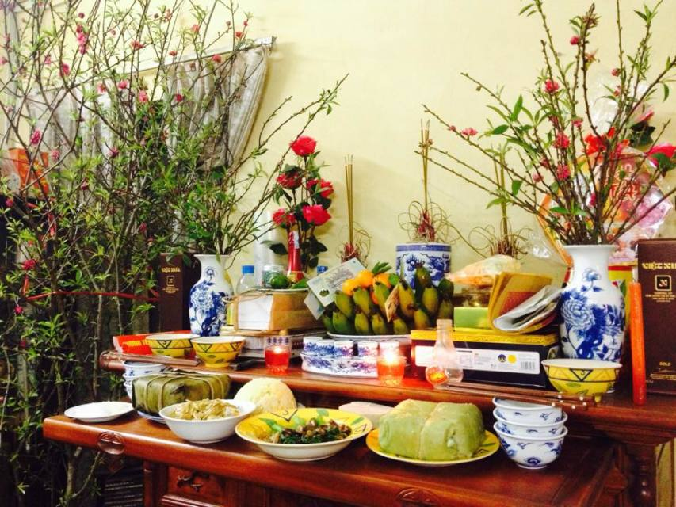
VOCABULARY
offering (n)
/ˈɒfərɪŋ/
đồ thờ cúng

Slide 8
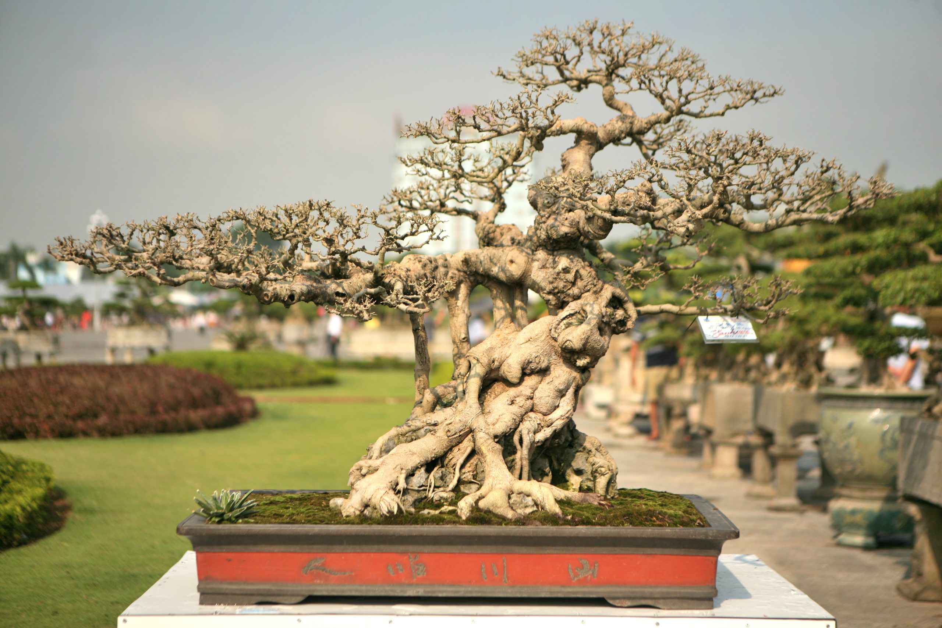
VOCABULARY
ornamental tree (n)
/ɔːnəˈmentl triː/
cây cảnh

Slide 9
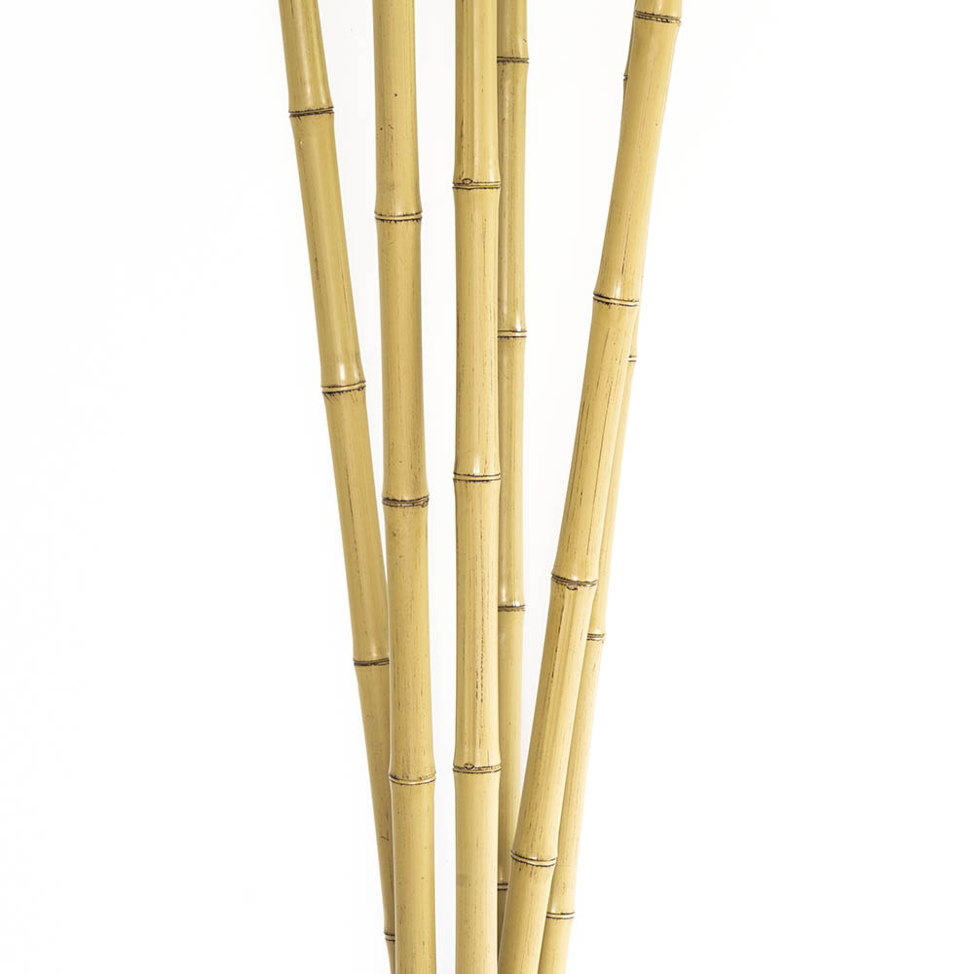

VOCABULARY
Bamboo pole (n)
/ˌbæmˈbuː pəʊl/
Cây sào tre

Slide 10
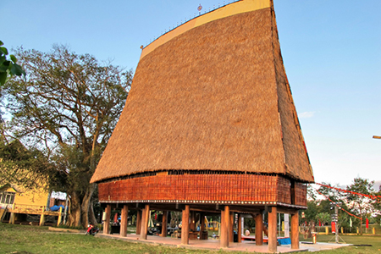
VOCABULARY
Communal house (n)
/kəˈmjuːnl haʊs/
Nhà rông

Slide 11
New words | Pronunciation | Meaning
1. admire (v) | /ədˈmaɪər/ | khâm phục
2. chase away | /tʃeɪs/ | xua đuổi
3. pray (v) | /preɪ/ | cầu nguyện
4. offering (n) | /ˈɒfərɪŋ/ | đồ thờ cúng
5. ornamental tree | /ɔːnəˈmentl triː/ | cây cảnh
4. Bamboo pole (n) | /bæmˈbuː pəʊl/ | Cây sào tre
5. Communal house (n ) | /kəˈmjuːnl haʊs/ | Nhà rông

Slide 12
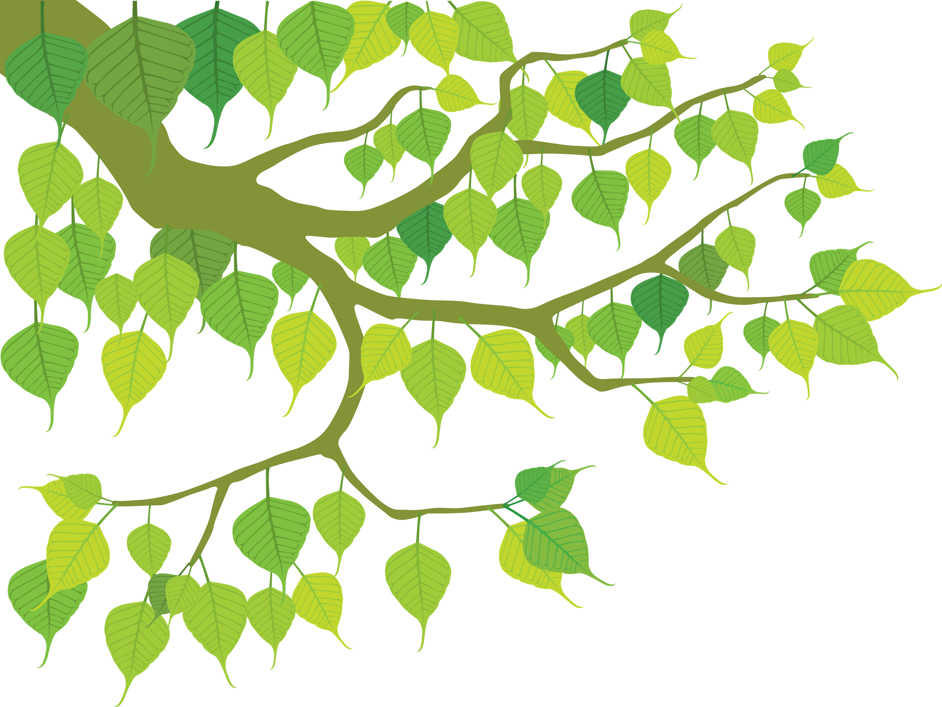
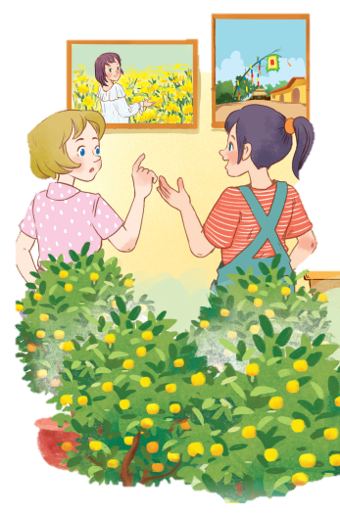
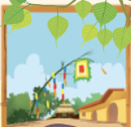
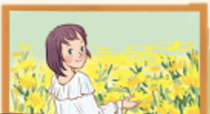
Exercise 1. Listen and read (pg 50)
1. What can you see in each picture?
2. Can you guess the places that the picture show?

Slide 13
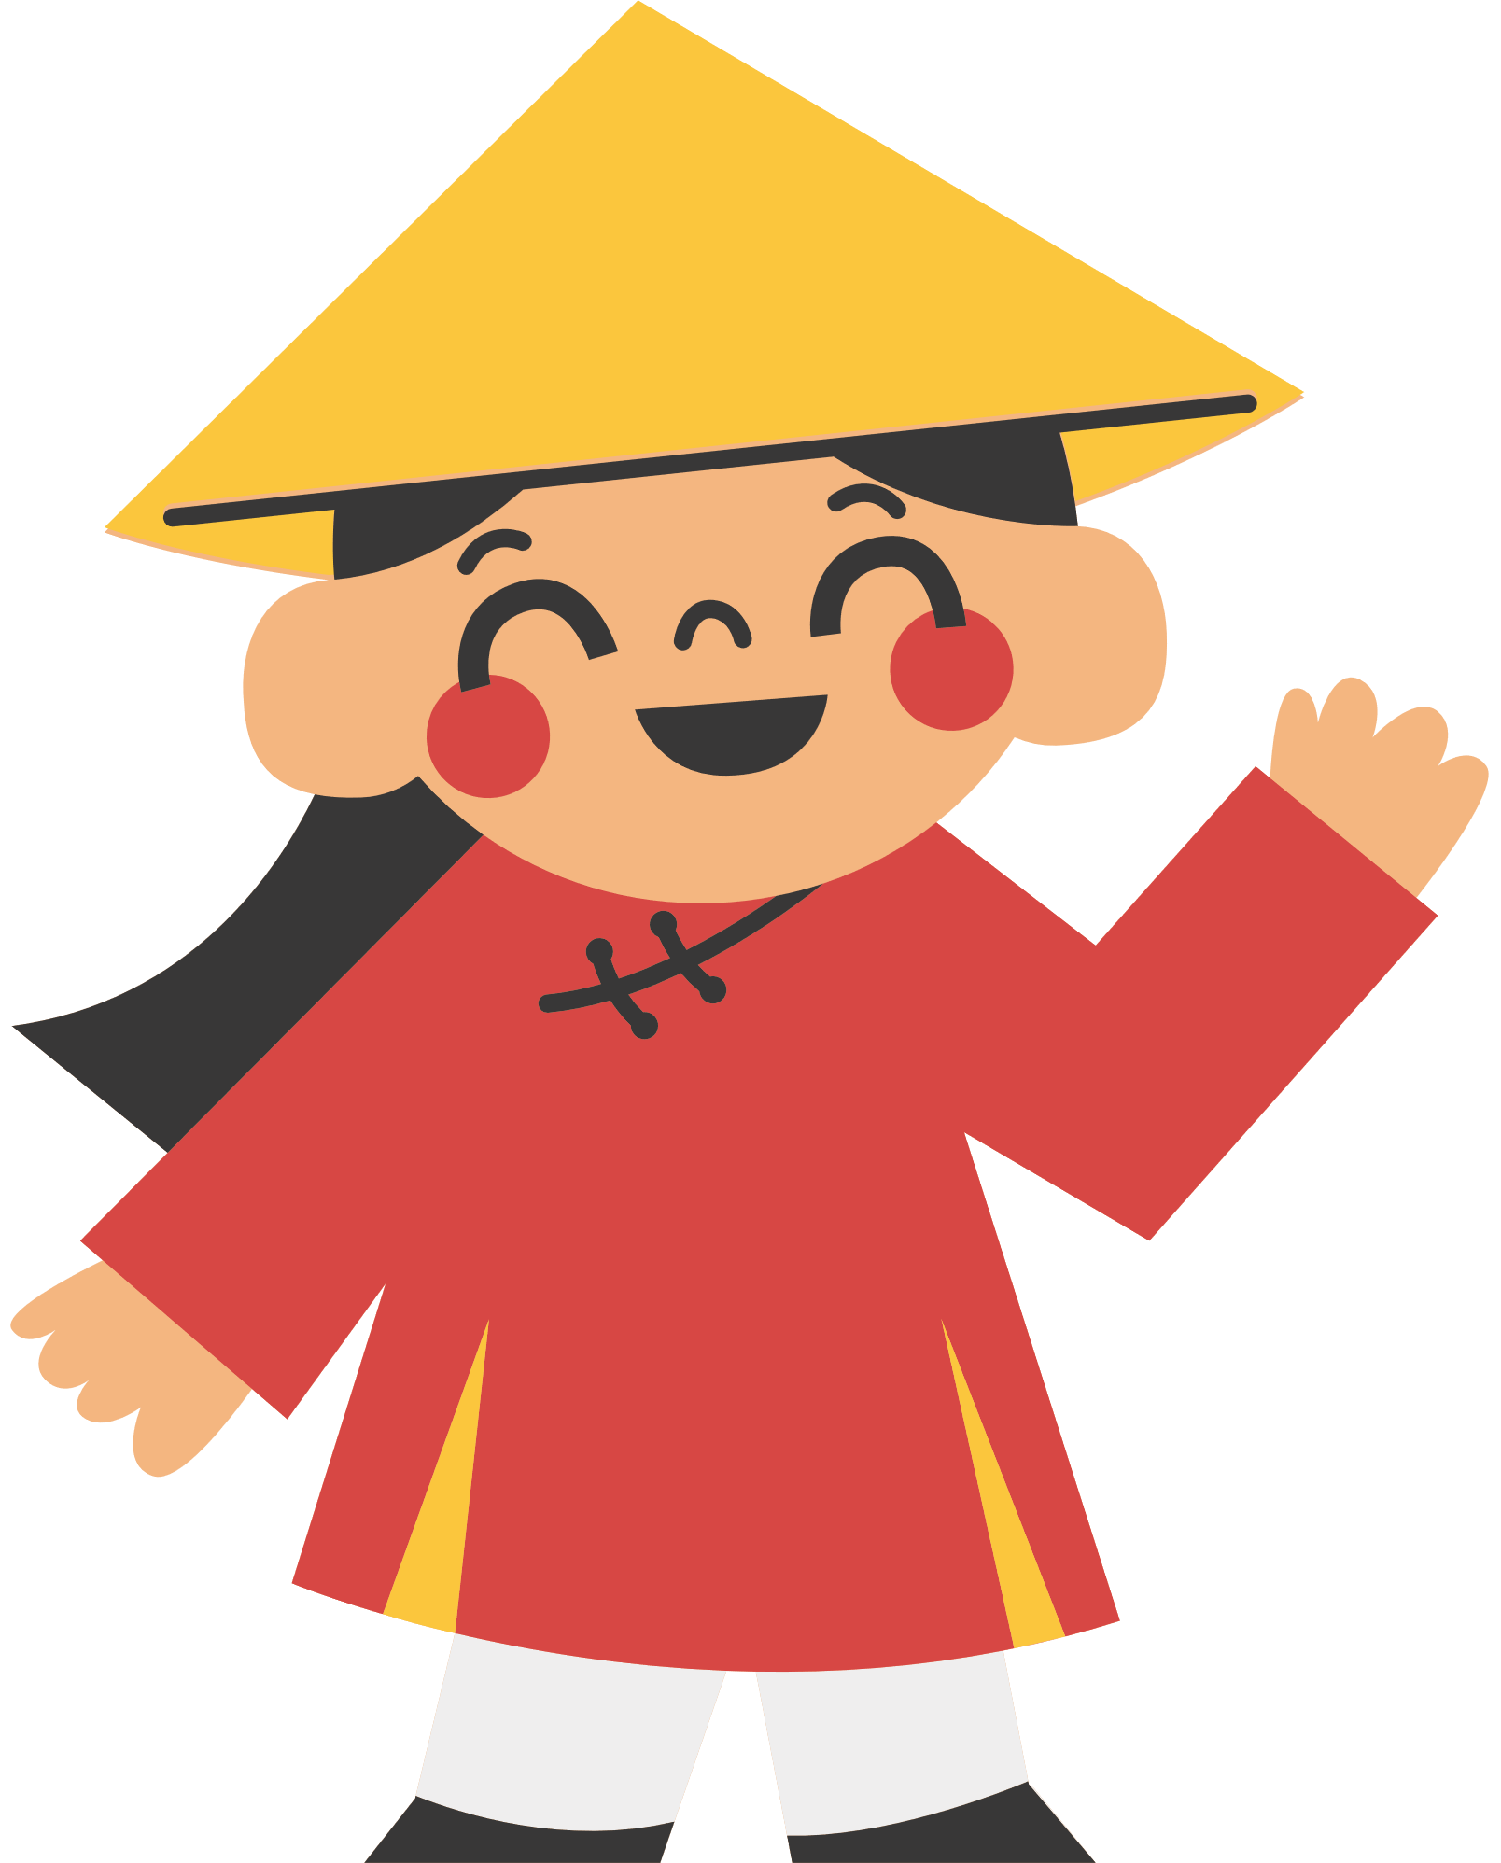
Exercise 1. Listen and read (pg 50)
Elena: Wow, this girl looks so cute.
Trang: Yeah ... She’s my cousin. She’s at Sa Dec Flower Village. Tet is coming soon, so many people visit flower villages to take pictures with the blooming flowers.
Elena: Oh, I’m fond of admiring the flowers. Does your family visit places like this too?
Trang: Yes, we do. We usually visit Nhat Tan Village to buy kumquat trees and peach blossoms.
Elena: I see flowers and ornamental trees everywhere these days. What are they for?

Slide 14
Exercise 1. Listen and read (pg 50)
Trang: We, Vietnamese, use plants and flowers for decorations and for oﬀerings. They are an important part of our Tet tradition.
Elena: And what’s that tall tree in the photo?
Trang: Well, it’s actually a bamboo pole. People place it in the yard of the communal house. They hang decorative items like small bells and lanterns on it. They want to chase away bad luck and pray for a lucky new year.
Elena: Interesting! I didn’t know that.

Slide 15
Exercise 2. Read again and tick T (true) or F (false)
Sentences | True | False
1. Elena and Trang are at Sa Dec Flower Village.
2. Many people visit flower villages to take photos.
3. Trang’s family usually buys kumquat trees and peach blossoms at Nhat Tan village.
4. Flowers are not part of any Vietnamese tradition.
5. People decorate bamboo poles with small bells and lanterns for New Years.

Slide 16

Check your answers.
Sentences | True | False
1. Elena and Trang are at Sa Dec Flower Village.
Elena: Wow, this girl looks so cute.
Trang: Yeah ... She’s my cousin. She’s at Sa Dec Flower Village. Tet is coming soon, so many people visit flower villages to take pictures with the blooming flowers.

Slide 17
Check your answers.
Sentences | True | False
2. Many people visit flower villages to take photos.
Elena: Wow, this girl looks so cute.
Trang: Yeah ... She’s my cousin. She’s at Sa Dec Flower Village. Tet is coming soon, so many people visit flower villages to take pictures (= photos) with the blooming flowers.

Slide 18
Check your answers.
Sentences | True | False
3. Trang’s family usually buys kumquat trees and peach blossoms at Nhat Tan village.
Elena: Wow, this girl looks so cute.Elena: Oh, I’m fond of admiring the flowers. Does your family visit places like this too?
Trang: Yes, we do. We usually visit Nhat Tan Village to buy kumquat trees and peach blossoms.

Slide 19
Check your answers.
Sentences | True | False
4. Flowers are not part of any Vietnamese tradition.
Elena: I see flowers and ornamental trees everywhere these days. What are they for?
Trang: We, Vietnamese, use plants and flowers for decorations and for oﬀerings. They are an important part (> < not part) of our Tet tradition.

Slide 20
Check your answers.
Sentences | True | False
5. People decorate bamboo poles with small bells and lanterns for New Years.
Elena: And what’s that tall tree in the photo?
Trang: Well, it’s actually a bamboo pole. People place it in the yard of the communal house. They hang decorative items like small bells and lanterns on it. They want to chase away bad luck and pray for a lucky new year.

Slide 21
Check your answers
Sentences | True | False
1. Elena and Trang are at Sa Dec Flower Village.
2. Many people visit flower villages to take photos.
3. Trang’s family usually buys kumquat trees and peach blossoms at Nhat Tan village.
4. Flowers are not part of any Vietnamese tradition.
5. People decorate bamboo poles with small bells and lanterns for New Years.

Slide 22
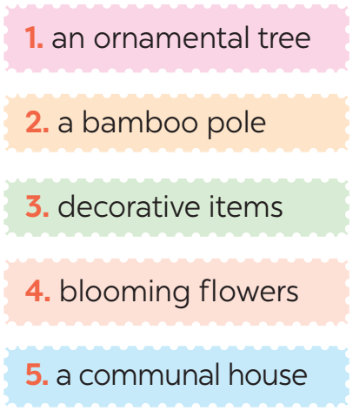
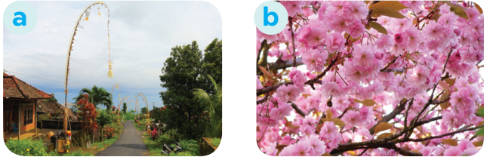
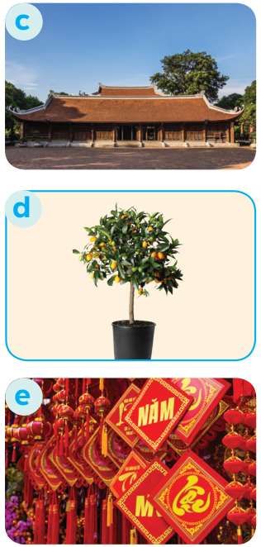
PRACTICE
3
Match the phrases with the correct pictures.

Slide 23
Exercise 4. Complete the sentences with the verbs from the box.
admire chase pray place
1. The British decorate their Christmas trees and ______ presents under them.
2. Tom likes to ______ the view from the hill.
3. In many cultures, knocking on wood is a way to ______ away bad spirits.
4. Many Asians go to Buddhist temples to ______ for good luck.

Slide 24
Exercise 4. Check your answers
admire chase pray place
1. The British decorate their Christmas trees and ______ presents under them.
2. Tom likes to ______ the view from the hill.
3. In many cultures, knocking on wood is a way to ______ away bad spirits.
4. Many Asians go to Buddhist temples to ______ for good luck.
place
admire
chase
pray

Slide 25
QUIZTIME: New Years around the world.
People around the world celebrate New Years differently. Choose the country with each tradition below.
For example:
Questions 0: wear traditional clothing called Hanbok.
A. Viet Nam
B. Korea
=> Team B got 1 point

Slide 26
Round 1. Visiting pagodas
A. The US
B. Vietnam
Round 2. Throwing water at each other
A. Thailand
B. Japan
Round 3. Ringing a bell 108 times
A. Japan
B. Vietnam
Round 4. Giving and receiving lucky money.
A. The US
B. Vietnam
Round 5. Watching a ball drop at midnight in Times Square.
A. Thailand
B. The US

Slide 27
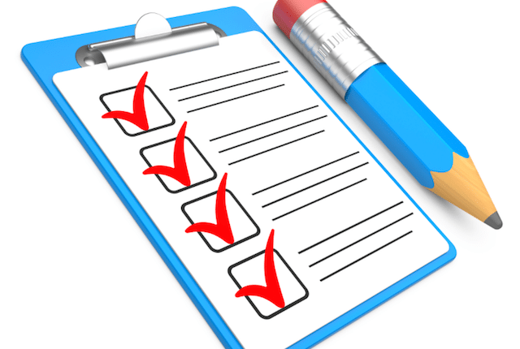
CONSOLIDATION
1
Wrap-up
What have we learnt in this lesson?
identify the topic of the unit
use lexical items related to Tet holiday

Slide 28

Homework
1. Learn by heart new words.
2. Do exercises in Workbook.
3. Choose one festival in Ex 5 to find information about (choose something that you do not know about) or search for a new one on the Internet.

Slide 29
Thanks!
Do you have any questions?

