Slide 1
Warm-up | Stop the bus
- Work in groups
- Think of a word/phrase about topic “Customs and Festivals”, starting with a given letter.
- First student to get a word for each, say “STOP THE BUS!”
For example:
F | food offerings, feast, folk dance, firework, family gathering…

Slide 2
Warm-up | Stop the bus
F | food offerings, feast, folk dance, festival goers, …
E
event, entertainment, exhibition, Easter, …
S
song, symbol, seasonal, supertitious, special,…
T
Thanksgiving, together, traditional, theme, …
I
important, incense, inspiring, …
V
village, valuable, various, vacation,…
A
activity, annual, amazing, …
L
lantern, lucky money, local festival,…
Notes:
VILLAGE

Slide 3
Unit 5
Our customs and traditions
Lesson 5: Skills 1
(page 55,56)

Slide 4
After this unit, students will be able to:
01.
READING
read for general and specific information about a local festival
SPEAKING
02.
talk about a normal family event that they take part in

Slide 5
READING
01.

Slide 6
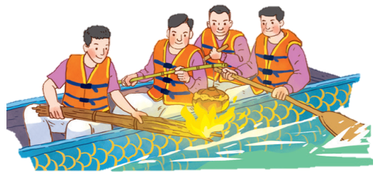
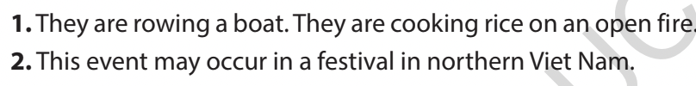
Ex 1. Look at the picture and answer the following questions.
1. What are the men doing?
They are rowing a boat. They are cooking rice on an open fire.
2. When do you think this event occurs?
This event may occur in a festival in northern Viet Nam.

Slide 7
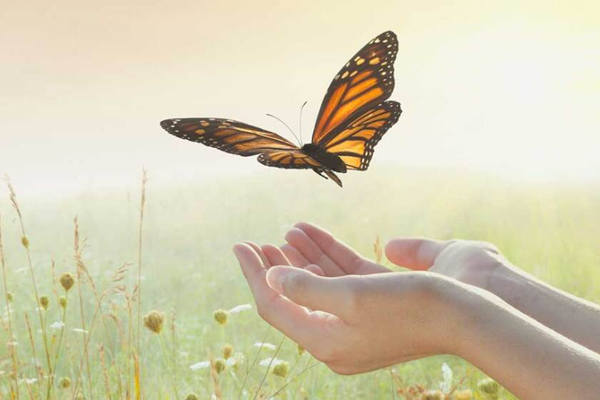

New words
release (v)
/ rɪˈliːs/
thả

Slide 8
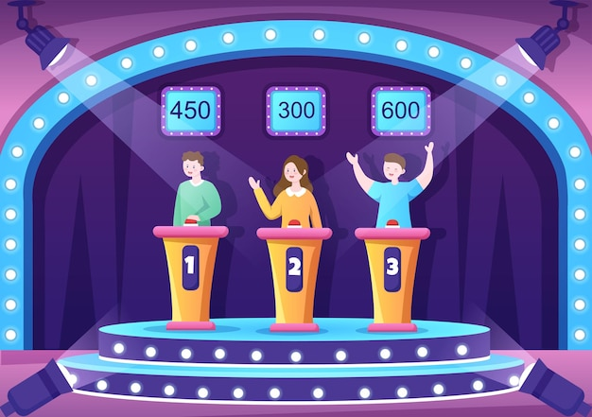
New words
contestant(n)
/kənˈtestənt/
thí sinh,
người thi đấu

Slide 9
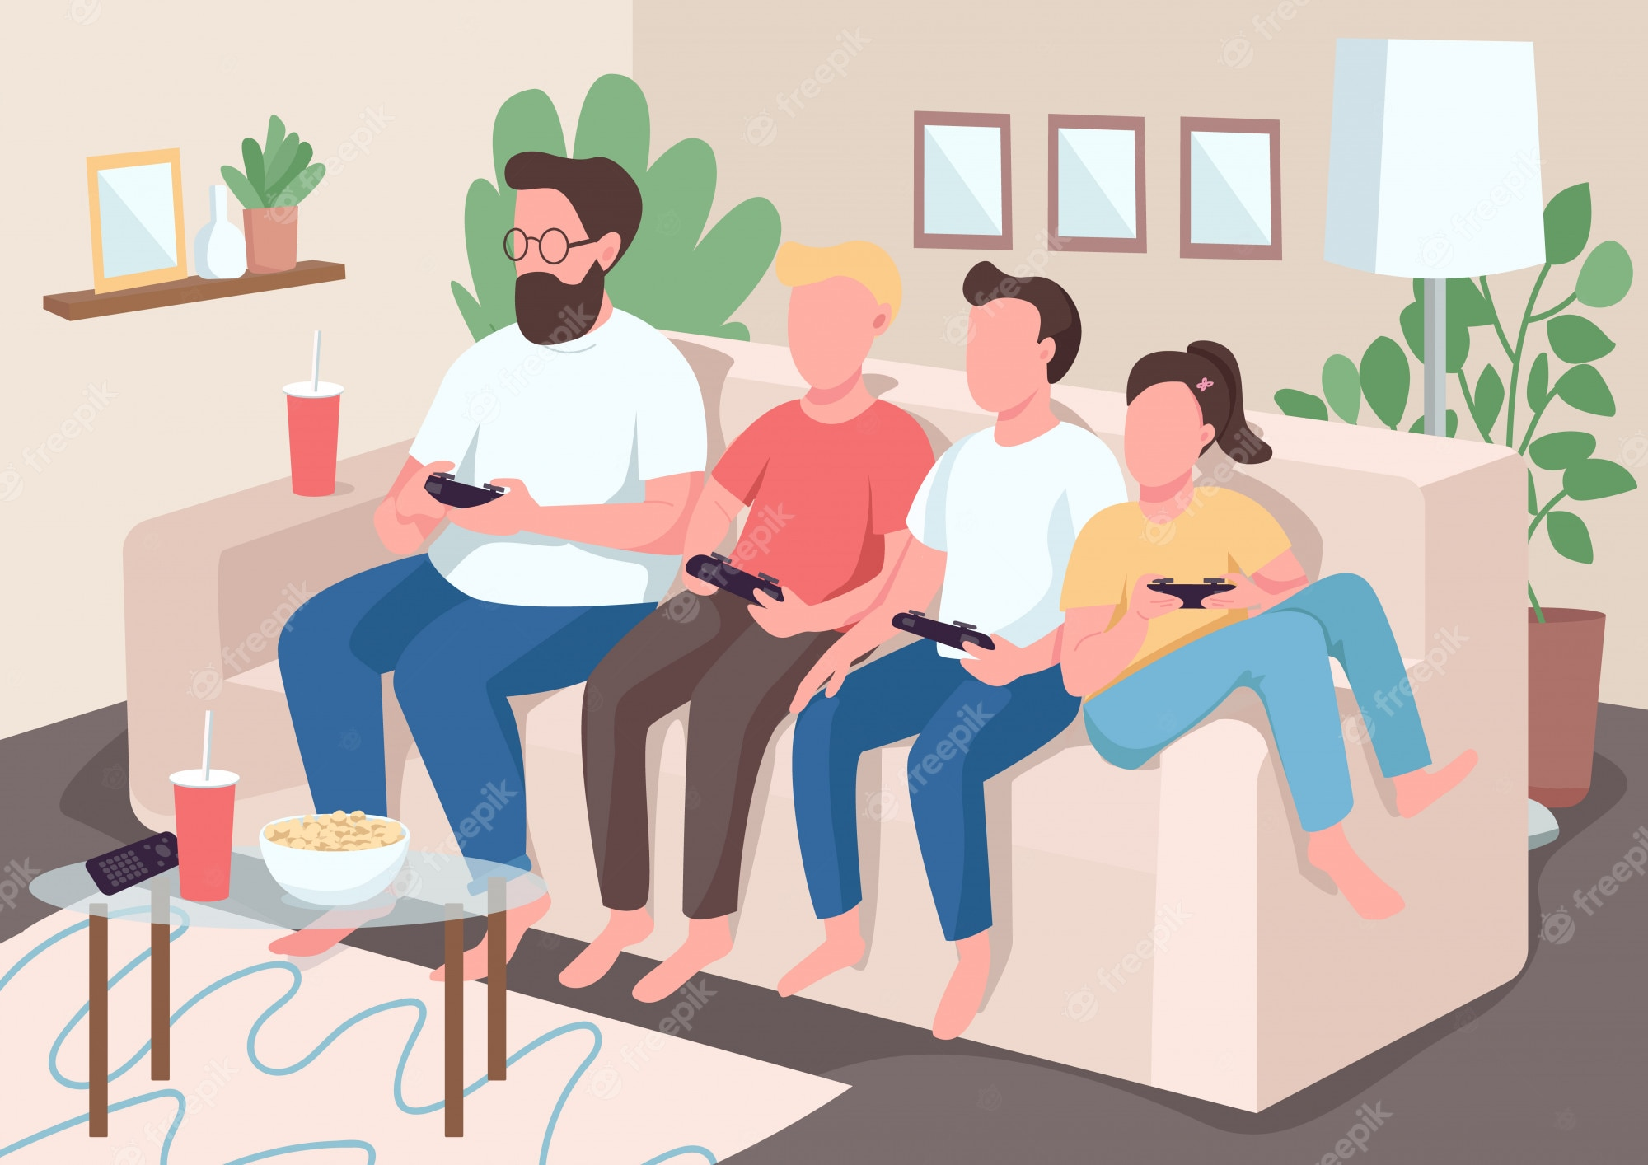
New words
family bonding
/ ˈfæməli ˈbɒndɪŋ /
sự gắn kết
tình cảm gia đình

Slide 10
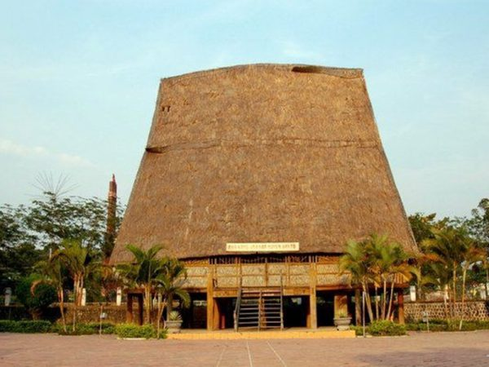
New words
communal house
/kəˈmjuːnl
haʊs/
nhà rông

Slide 11
READING
New words | Pronunciation | Meaning
release (v) | /rɪˈliːs/ | thả
contestant (n) | /kənˈtestənt/ | thí sinh, người thi đấu
family bonding | /ˈfæməli ˈbɒndɪŋ/ | sự gắn kết tình cảm gia đình

Slide 12
Ex 2. Read the text. Choose the correct answer A, B, or C.
I live in a small village in northern Viet Nam. Every year, people in my village look forward to the third day of Tet. It is one of our most important festival days.
In the morning, we gather along the riverside to watch some competitions. First, there is a special boat race. Some team members cook rice on the boat while others row the boat as fast as they can. The fastest team with well-cooked rice wins the race. Then, the referee releases a duck into the middle of the river. Contestants jump into the river to catch it. The atmosphere becomes loud with the sound of drums and cheers of festival goers.
At noon, there is a village party at the communal house for the elders. Each family also holds a home party. We cook traditional dishes like sticky rice and steamed chicken. Sometimes, we include food that children love, such as bun cha or even pizzas!
The village festival helps us maintain our traditions, connect with other people, and strengthen our family bonds.

Slide 13
2
Read the text. Choose the correct answer A, B, or C.
1. What is the text mainly about?
A. A local tradition.
B. A family tradition.
C. A family tradition.
2. To win the boat race, a team must ______.
A. row the boat more quickly than the other teams B. row the boat the fastest and properly cook the rice
C. cook rice properly and catch the duck

Slide 14
2
Read the text. Choose the correct answer A, B, or C.
3. The phrase “releases a duck” in the text means ______.
A. gives it freedom
B. catches it
C. takes it home
4. Why is the festival important?
A. Because it is exciting.
B. Because people win valuable prizes.
C. Because it keeps some village traditions alive.

Slide 15
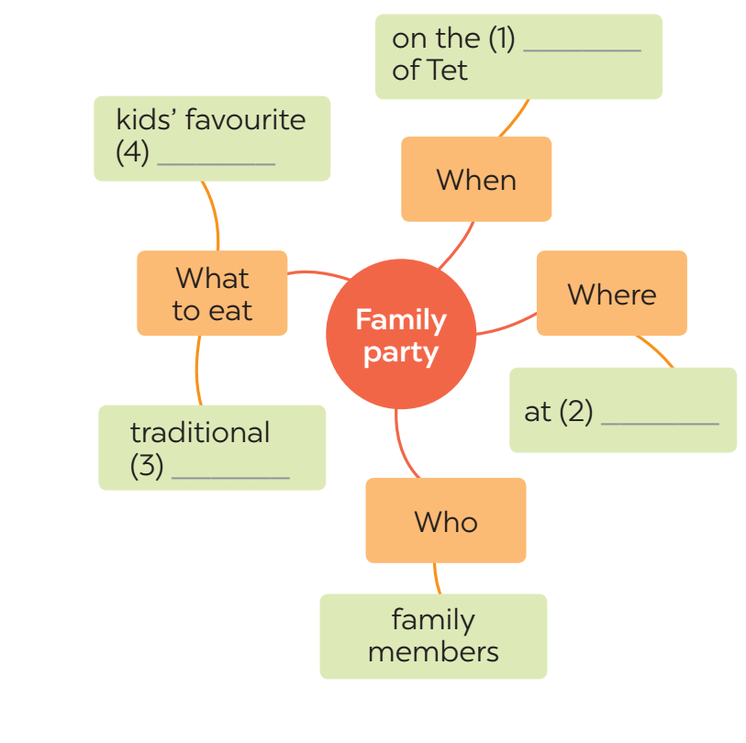
READING
3
Read the text again. Complete the mind map about a family party.

Slide 16

Ex 3. Read the text again and complete the mind map.
I live in a small village in northern Viet Nam. Every year, people in my village look forward to the third day of Tet. It is one of our most important festival days.
In the morning, we gather along the riverside to watch some competitions. First, there is a special boat race. Some team members cook rice on the boat while others row the boat as fast as they can. The fastest team with well-cooked rice wins the race. Then, the referee releases a duck into the middle of the river. Contestants jump into the river to catch it. The atmosphere becomes loud with the sound of drums and cheers of festival goers.
At noon, there is a village party at the communal house for the elders. Each family also holds a home party. We cook traditional dishes like sticky rice and steamed chicken. Sometimes, we include food that children love, such as bun cha or even pizzas!
The village festival helps us maintain our traditions, connect with other people, and strengthen our family bonds.

Slide 17
READING
3
Read the text again. Complete the mind map about a family party.
third day
food
home
dishes

Slide 18
SPEAKING
02.

Slide 19
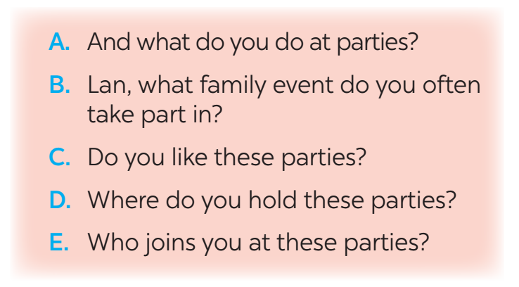
4
Work in pairs. Put the questions (A - E) in the correct blanks (1 - 5) to make a complete dialogue. Then role-play it.
Nick: (1) ______
Lan: Well, I join birthday parties of all my family members.
Nick: (2) ______
Lan: In a Vietnamese restaurant. But sometimes we break with tradition by going to a Western one.
Nick: (3) ______
Lan: Everyone in my family.
Nick: (4) ______
Lan: Well, the birthday person opens the gifts. and everyone has some good food.
Nick: (5) ______
Lan: Yes, I always look forward to them. They are a great time for family bonding.

Slide 20
5
Make notes about a normal family event that you take part in. Use the questions below as cues.
Now work in pairs.
Make a dialogue asking and answering about the event. You can use your notes.
1. What is the event?
2. Where and when does it happen?
3. Who joins with you?
4. What do you often do at that event?
5. Do you like it or not? Why or why not?
Full Moon Festival
On the 15th day of the 8th Lunar Month in Asia
My family, my friends,…
Eat moon cake, hang lantern....
Yes, I do. Because I can celebrate it with my family.

Slide 21
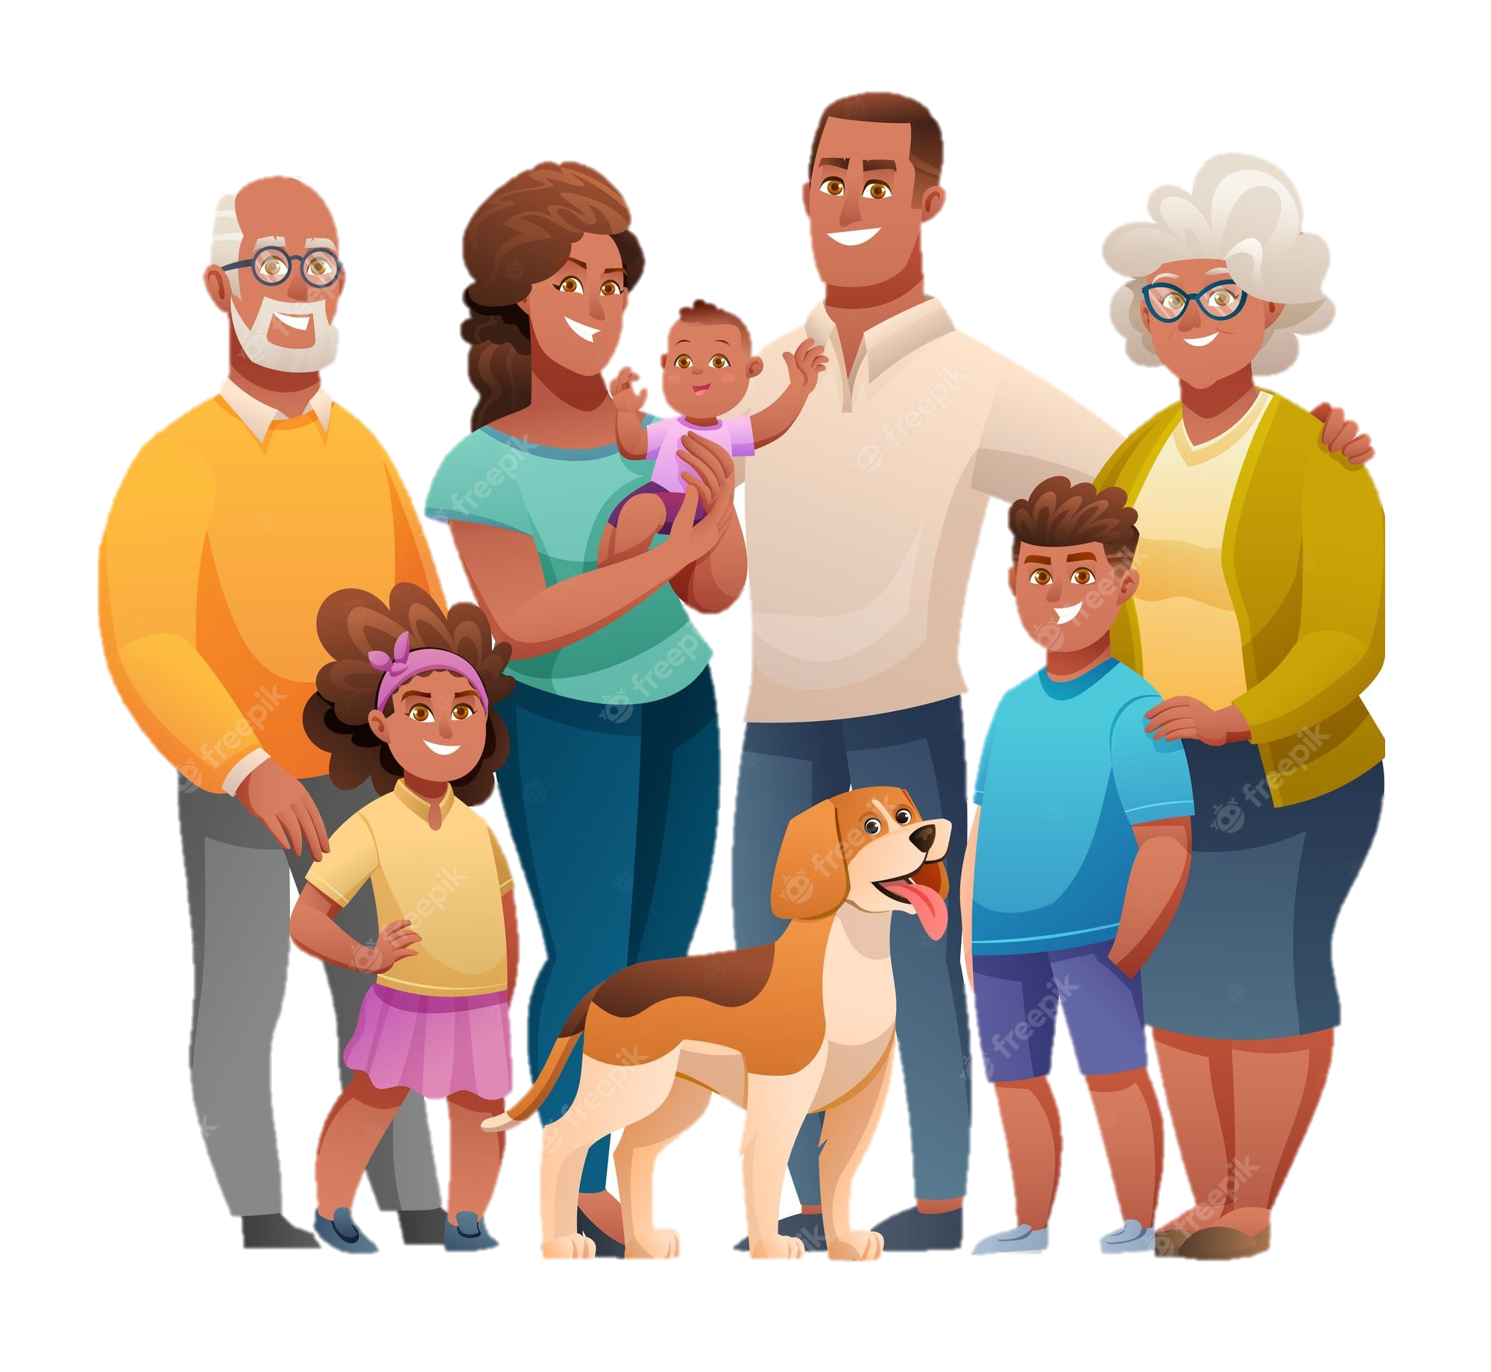
Consolidation / Wrap up
Reading
Speaking
to read about
A village festival
to talk about
A family event

Slide 22

Homework
Do exercises in the workbook.

Slide 23
Thanks!

