Slide 1


Slide 2
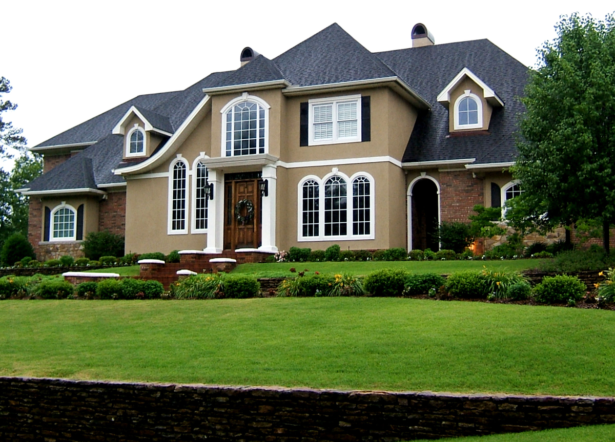
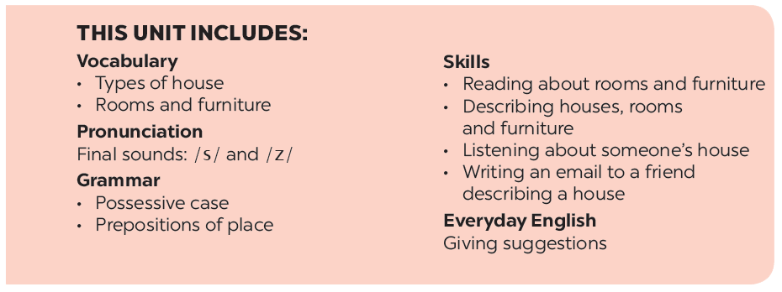
UNIT 2: MY HOUSE
LESSON 2

Slide 3
* CHATTING
How many rooms are there in your house?
What are they?
What is there in each room?
kitchen
Living- room
Rooms in a house
hall
toilet
bathroom
bedroom

Slide 4


UNIT 2: MY HOUSE
LESSON 2
* Vocabulary: Matching
chest of drawers
poster
cupboard
dishwasher
cooker
light
ceiling fan
fridge
sink
- áp phích
- đèn
- tủ đựng ly, chén
- quạt trần
- nồi cơm điện
- máy rửa chén
- bồn rửa tay
- ngăn kéo tủ
-tủ lạnh

Slide 5
* Vocabulary:
- chest of drawers (n):
- poster (n):
- cupboard (n):
- dishwasher (n):
- cooker (n):
- light(n):
- ceiling fan(n):
- fridge(n):
sink(n):
- ngăn kéo tủ
- áp phích
- tủ đựng ly, chén
- máy rửa chén
- nồi cơm điện
- đèn
- quạt trần
tủ lạnh
- bồn rửa tay

Slide 6

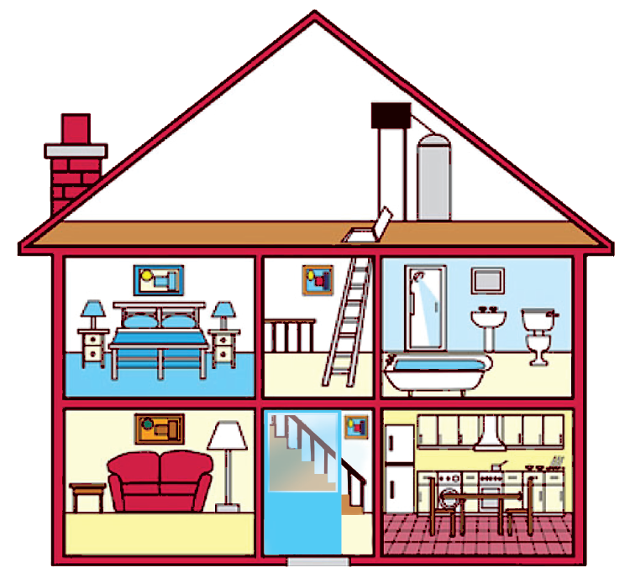





Look at the house. Name the rooms in it.
hall
bathroom
hall
bathroom
living room
kitchen
living room
kitchen
bedroom
bedroom
c.
bedroom
d.
bathroom
b.
living room
e.
kitchen
a.
hall

Slide 7

Name the things in each room in 1. Use the word list below. (You may use a word more than once.)
lamp
toilet
picture
cupboard
dishwasher
sink
fridge
shower
sofa
chest of drawers
hall | kitchen | bedroom | bathroom | living room
picture
fridge
lamp
shower
lamp
cupboard
picture
sink
sofa
dishwasher
chest of drawers
toilet
picture
sink

Slide 8

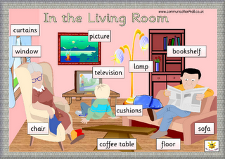
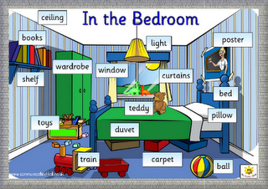
Think of a room in your house. In pairs, ask and answer questions to guess it.
Example:
A: What is in the room?
B: a sofa and a television.
A: Is it the living room?
B: Yes

Slide 9


Listen and repeat these words.
* Pronunciation
Final sounds: /s/ and /z/
lamps
cupboards
sink
sofas
flats
kitchen
toilets
rooms

Slide 10

Listen to the conversation. Underline the final s in the words and put them into the correct column.
Mi: Mum, are you home?
Mum: Yes, honey. I’m in the kitchen. I’ve bought these new bowls and chopsticks.
Mi: They’re beautiful, Mum. Where did you buy them?
Mum: In the department store near our house. They have a lot of things for homes.
Mi: Don’t forget we need two lamps for my bedroom, Mum.
Mum: Let’s go there this weekend.
/s/ | /z/
Now practise the conversation with a partner.
bowls
chopsticks
lamps
things
homes
T

Slide 11
AUDIO SCRIPT
Mi: Mum, are you home? Mum: Yes, honey. I’m in the kitchen. I’ve bought these new bowls
and chopsticks. Mi: They’re beautiful, Mum. Where did you buy them? Mum: In the department store near our house. They have a lot of
things for homes. Mi: Don’t forget we need two lamps for my bedroom, Mum. Mum: Let’s go there this weekend.

Slide 12
Cách đọc”S/ ES”:
Âm cuối | p, k, f, t | x, s, sh, ch, ce, ge | b ,g ,n ,l z, v ,m, r, y, u, e, o, a, I, w
Đọc | /s/ | /iz/ | /z/
Ví dụ | Wants, fits, needs | Washes, watches, misses | Enjoys, loves, plays, tries, arrives

Slide 13
* Practice.
* Matching
Word
Example: chairs
1. beds
2. caps
3. posters
4. clocks
5. villas
6. lights
Sound
/s/
/z/

Slide 14
Homework
Learn by heart vocab.
-
- Prepare “ A closer look 1”

