Slide 1

Welcome to
our class

Slide 2
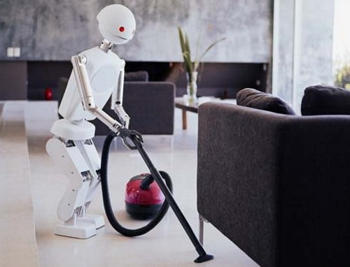
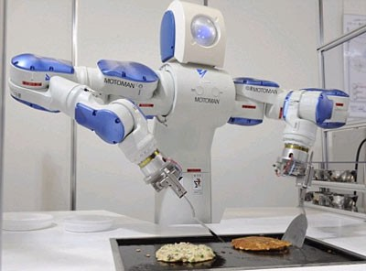
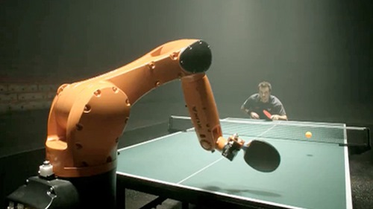
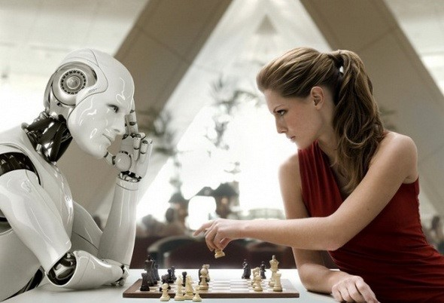
What is robot doing?
1
2
3
4

Slide 3

Unit 11: CHANGING ROLES IN SOCIETY
Lesson 1 : Getting started

Slide 4
Changing the roles in society:
Groups of people | Present roles in society | Changes in the future
teachers
housewives
.....

Slide 5
Changing the roles in society:
Groups of people | Present roles in society | Changes in the future
teachers | information provider | facilitator
housewives | do all the chore | control the domestic robots
.....

Slide 6
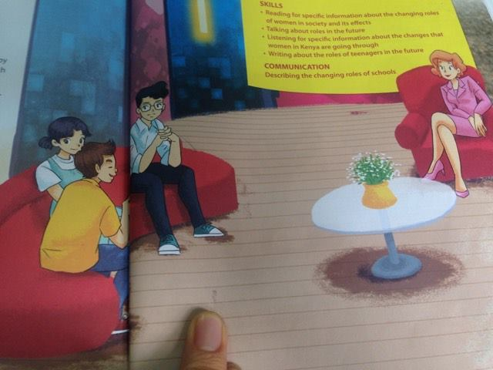
Interviewer
Phong
Mai
Nguyen

Slide 7
NEW WORDS
- vision ''''viʒn'''/ (n): tầm nhìn, cách nhìn
- sense of participation (n): nhận thức về sự tham gia
- breadwinner (n): trụ cột tài chính
- externally (adv) / iks´tə:nəli /: theo bên ngoài, theo bề ngoài

Slide 8
LISTEN AND READ
Interviewer: We have invited some students from Oak Tree School in Happy Valley to this Beyond 2030 forum, and they are going to share with us their vision of the future. Would you like to go first, Phong?
Phong: I believe the biggest change will take place within the school system. Apart from at school, we will also be learning from places which will give us real-life knowledge and experience, such as at a railway station, in a company, or on a farm.
Mai: I agree.This real-life application of learning will give us a sense of participation, a feeling that we are part of the process.
Interviewer: And what about the role of teachers?
Phong: Ah, they will be more like facilitators, rather than information providers.
Interviewer: Fascinating. How else do you see the future, Nguyen?
Nguyen: Well, I think the role of fathers will drastically change.
Interviewer: Oh yes? In what way?
Nguyen: The modern father will not necessarily be the breadwinner of the family. He may be externally employed or he may stay at home to take care his children.
Interviewer: And do the housework?
Nguyen: Yes. It's work, paid or not, isn't it?
Mai: Absolutely. The benefit will be children will see their fathers more often and have a closer relationship with them. I don't see much of dad, but I love every moment I spend with him.
Interviewer: Well, we are certainly covering interesting topics ...

Slide 9
* TICK THE PERSON WHO HAS THIS IDEA
 | Idea | Phong | Nguyen | Mai
1 | Students will learn from a real workplace.
2 | Students love seeing themselves as part of the process.
3 | The teacher will act more like a facilitator.
4 | The father will not necessarily be the breadwinner of the family.
5 | With the in the home, they will develop a closer bond with their chidren.
√
√
√
√
√

Slide 10
LISTEN AND READ
Interviewer: We have invited some students from Oak Tree School in Happy Valley to this Beyond 2030 forum, and they are going to share with us their vision of the future. Would you like to go first, Phong?
Phong: I believe the biggest change will take place within the school system. Apart from at school, we will also be learning from places which will give us real-life knowledge and experience, such as at a railway station, in a company, or on a farm.
Mai: I agree.This real-life application of learning will give us a sense of participation, a feeling that we are part of the process.
Interviewer: And what about the role of teachers?
Phong: Ah, they will be more like facilitators, rather than information providers.
Interviewer: Fascinating. How else do you see the future, Nguyen?
Nguyen: Well, I think the role of fathers will drastically change.
Interviewer: Oh yes? In what way?
Nguyen: The modern father will not necessarily be the breadwinner of the family. He may be externally employed or he may stay at home to take care his children.
Interviewer: And do the housework?
Nguyen: Yes. It's work, paid or not, isn't it?
Mai: Absolutely. The benefit will be children will see their fathers more often and have a closer relationship with them. I don't see much of dad, but I love every moment I spend with him.
Interviewer: Well, we are certainly covering interesting topics ...

Slide 11

* Answer the questions:
1. What is the purpose of the Beyond 2030 forum?
2. Who has been invited to the discussion?
3. What does Phong think about classes in the future?
4. Why might students like having classes outside school?
5. Will the father of the future always stay at home?
6. Does Nguyen feel nagative a man doing housework?

Slide 12
1. What is the purpose of the Beyond 2030 forum?
2. Who has been invited to the discussion?
3. What does Phong think about classes in the future?
4. Why might students like having classes outside school?
It will give them a sense of participation and of being part of the process.
5. Will the father of the future always stay at home?
6. Does Nguyen feel negative about a man doing housework?
It's for people to share their vision of the future.
Some students from Oak Tree school in Happy Valley.
He says that learning will also take place outside school.
No, he won't. He may still go to work.
No, he doesn't.

Slide 13

1. It's is for people to share their vision of the future.
2. Some students from Oak Tree school in Happy Valley.
3. He says that learning will also take place outside school.
4. It will give them a sense of participation and of being part of the lesson.
5. No, he won't. He may still go to work.
6. No, he doesn't.

Slide 14
* Find the meaning of the phrases and sentences
A | B
1. Beyond 2030. | a. Ideas about what life will be in the future.
2. Vision of the future . | b.Both housework and paid work are worthy of respect.
3. It's work, paid or not, isn't it? | c. I love being with my father.
4. I love every moment, I spend with him. | d. after the year 2030.

Slide 15
Words | Explanations
1. facilitator | A. a person who provides facilities like the projector, the interactive whiteboard. B. a person who helps somebody to do something more easily by discussing and giving guidance.
2. information provider | A. a person who gathers information and uses it to teach others. B. a machine which sells newspapers.
3. breadwinner | A. a person who makes bread to feed the family. B. a person who supports the family with the money he/she earns.
B. a person who helps somebody to do something more easily by discussing and giving guidance.
A. a person who gathers information and uses it to teach others.
B. a person who supports the family with the money he/she earns.
.

Slide 16
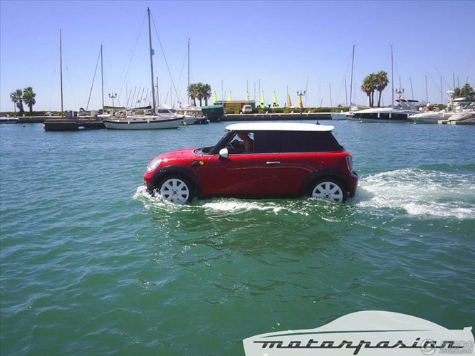
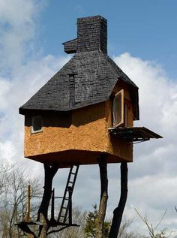
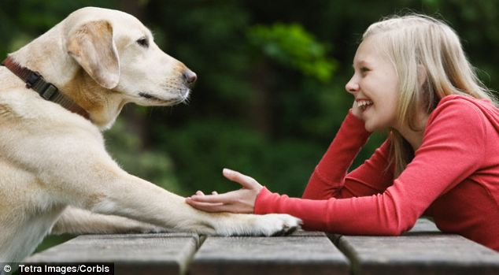
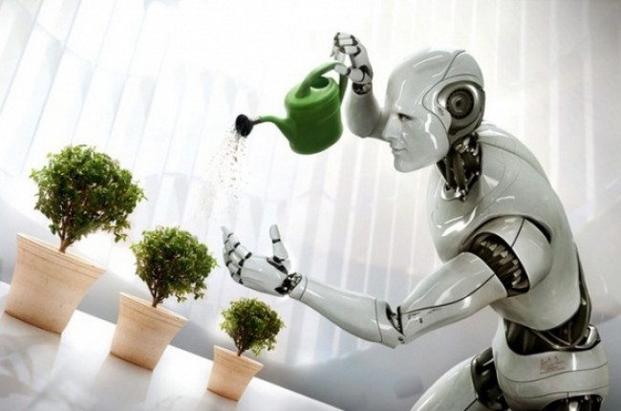
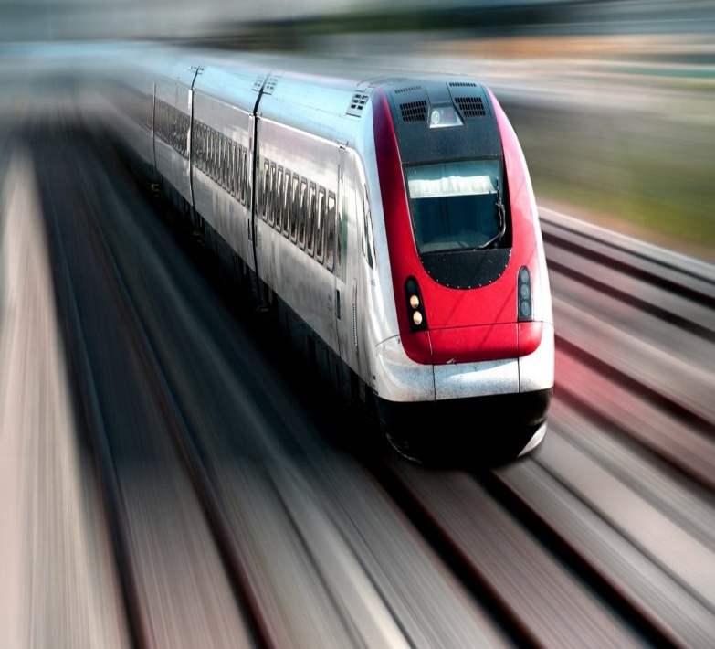
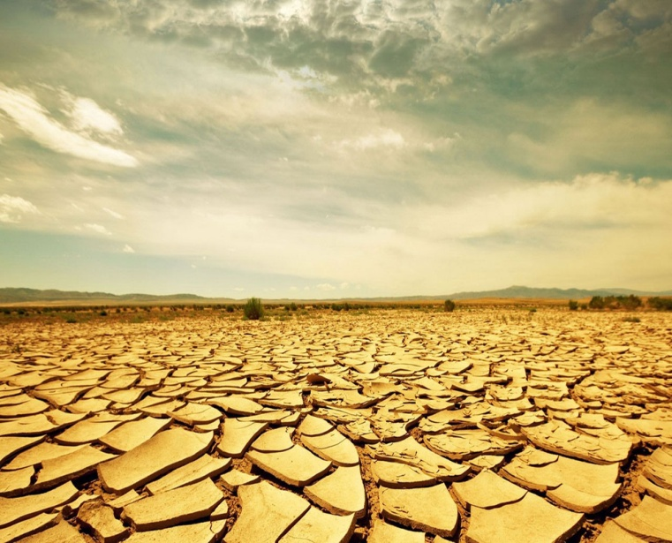
* Work in groups. These pictures represent some visions of the future. Discuss what they may mean.
2
1
3
4
5
6

Slide 17

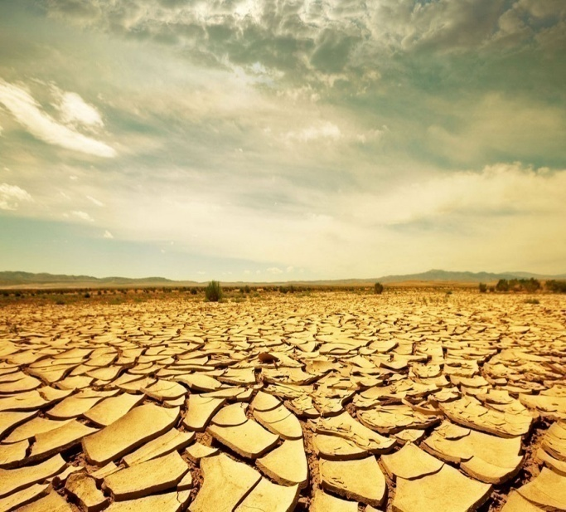
1.Car will be running
on water.
3. People will be able to
talk their pets.
2. People will live in house in the sky.
4. Robots will be doing
the housework.
5. Trains will be running
as fast as 300 km/h.
6. Land will become
barren.

Slide 18
* GAME
One group names a service. The other group gives their vision of that service in the future.
Group A | Group B
Hospitals! | Operations will be performed by robots

Slide 19

HOMEWORK:
- Do activity 2 in notebook.
- Learn newwords by heart.
- Prepare new lesson : A closer look 1.

Slide 20

Thank you very much for attending

