Slide 1



Welcome the Teachers to our class
Teacher: Vu Thi Phuong

Slide 2
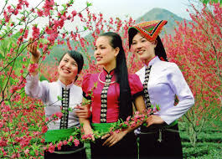
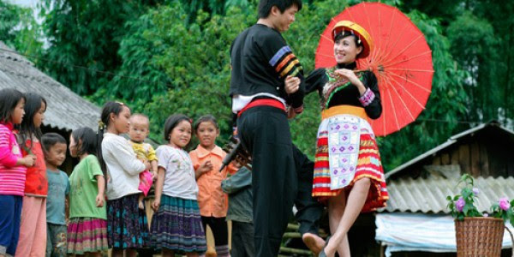
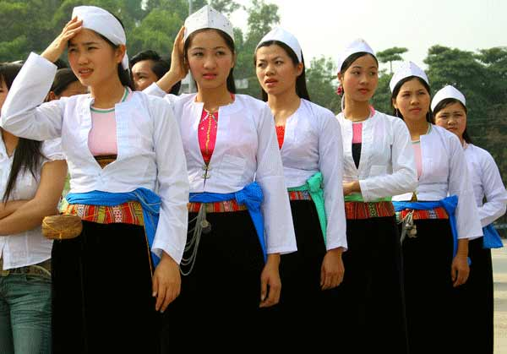
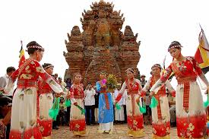
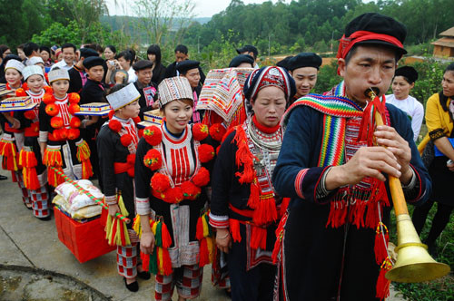
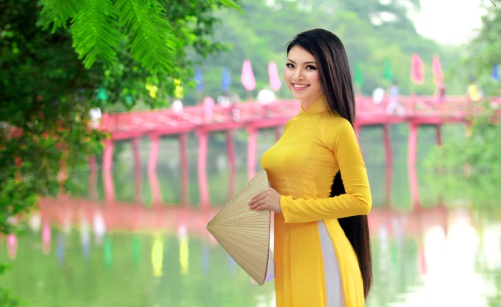
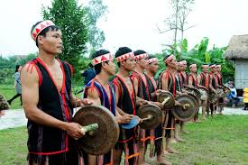
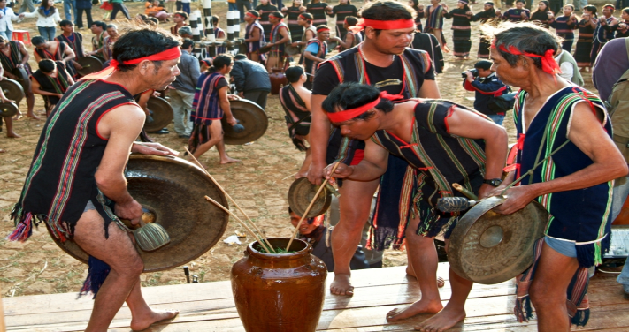
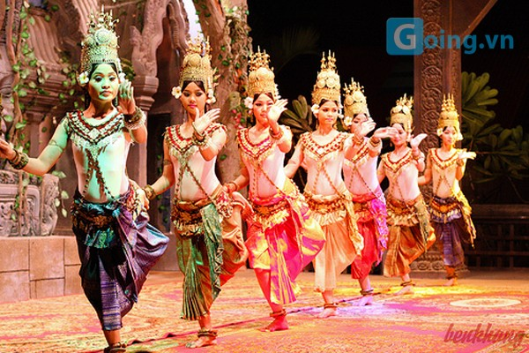
1
2
3
the Thai
the HMong
the Muong
Unit 3: Peoples of Viet Nam
4
5
6
the Yao
the Kinh
the Cham
7
8
9
the Ede
the Bana
the Khmer

Slide 3
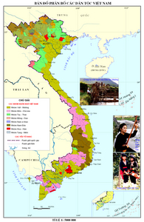

Slide 4

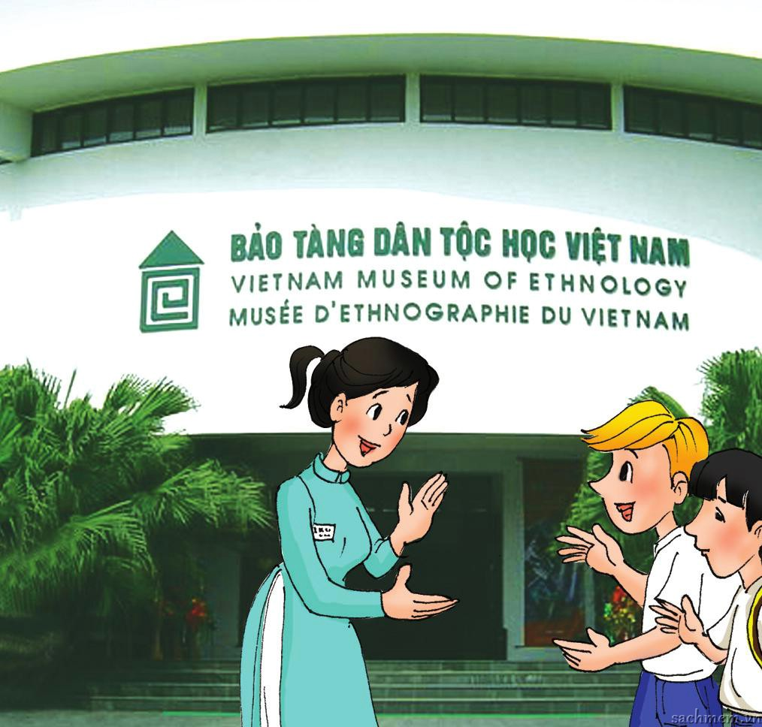
Nick
Duong
a guide
At the museum of Ethnology

Slide 5
Unit 3: Peoples of Viet Nam
Lesson 1- Getting started
At the museum of Ethnology
Unit 3: Peoples of Viet Nam
At the museum of Ethnology

Slide 6
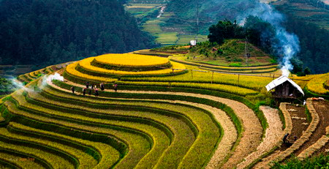
NEW WORDS
terraced fields /ˈte.rəst fiːld/
Ruộng bậc thang

Slide 7
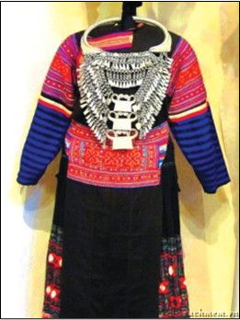
a costume /ˈkɒs.tʃuːm/:
Trang phục

Slide 8
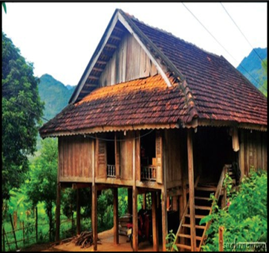
a stilt house:
Nhà sàn

Slide 9
1
2
3
the Thai
the HMong
the Muong
ethnic groups
4
6
the Yao
the Cham
7
8
9
the Ede
the Bana
the Khmer

Slide 10
ethnic groups /ˈeθ.nɪk ɡruːp/:
Dân tộc thiểu số

Slide 11

Listen to the conversation

Slide 12
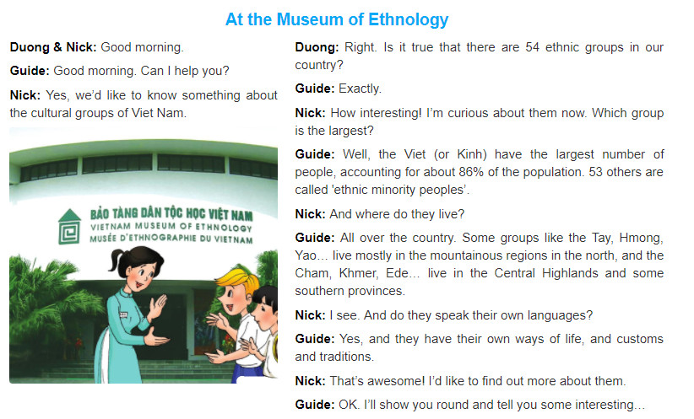

Slide 13
UNIT 3 – PEOPLES OF VIET NAM Period 15: GETTING STARTED: At the museum of Ethnology
1. Listen and read
a. Find the opposite of these words in the conversation.
interesting
boring ><
smallest ><
majority ><
northern ><
largest
minority
southern

Slide 14
1b. Read the conversation again and choose the best answer
Duong and Nick are in the Museum of .........
A. Ethnology B. Ethnic C. History
2. They want to know about the ...................of Viet Nam.
A. landscapes B. ethnic groups C. groups ethnic
3. There are ...................ethnic groups in Viet Nam.
A. 53 B. 86 C. 54
4. The ........................ has the largest population.
A. Kinh B. Thai C. Yao
5. Do the ethnic minority peoples have their own customs and traditions?
A. No information B. No, they don’t C. Yes, they do

Slide 15
UNIT 3 – PEOPLES OF VIET NAM Period 19: GETTING STARTED:At the museum of Ethnology
1. Listen and read.
c. Can you find the following expressions in the conversation? Try to explain what they mean.
1. Exactly =>
2. How interesting! =>
3. I see.=>
4. That’s awesome!=>
used as a reply, agreeing with what sb has just said, or emphasising that it is correct.
used to show a strong reaction to sth.
used to show you understand what someone said.
used to show that you think sth is great.

Slide 16
How interesting!
How amazing!
How beautiful!
How peaceful!
How + adjective!
Role play:
S1: Some groups live in mountainous regions.
S2: How interesting!

Slide 17
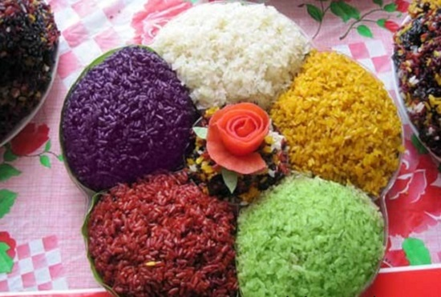
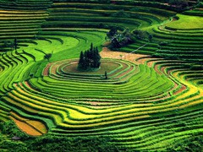
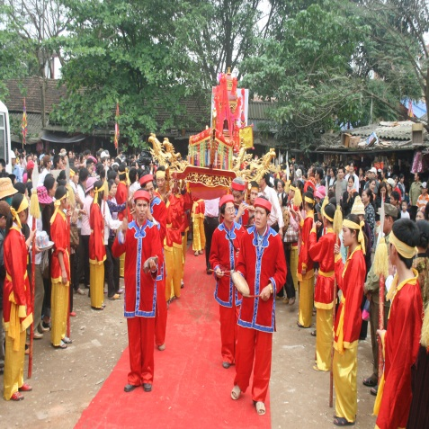
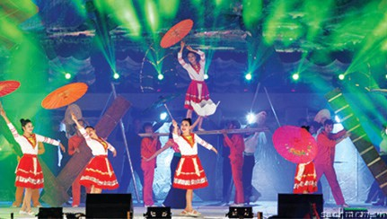
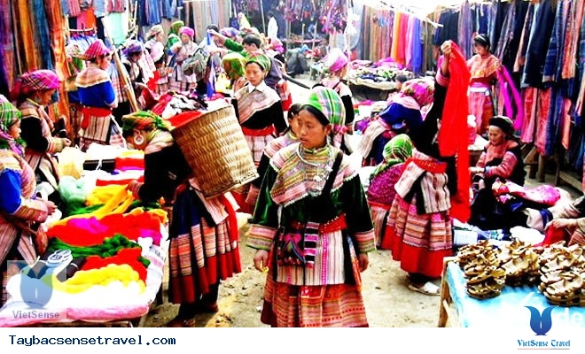
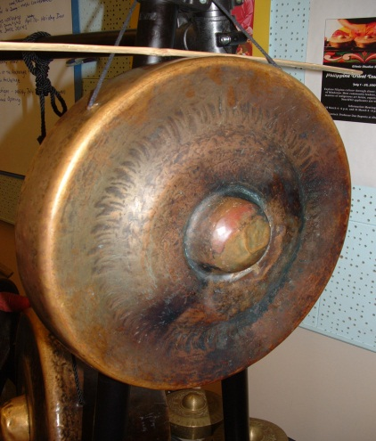
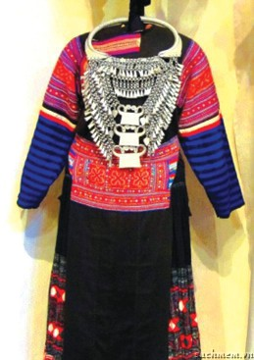
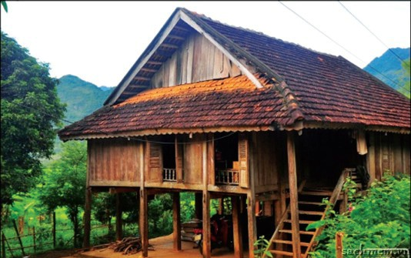
2. Use the words and phrases in the box to label each picture.
costume stilt house terraced fields
open-air market folk dance musical instrument
festival five-coloured sticky rice
1...........................
terraced fields
festival
folk dance
five-coloured sticky rice
2............................
3............................
4............................
open-air market
musical instrument
costume
stilt house
5............................
6............................
7.........................
8............................

Slide 18
3.Complete the following sentences with the words/phrases in the box.
heritage site stilt houses terraced fields member ethnic festivals
1. In our country, it is against the law to discriminate against any __________ or religious group.
2. My Son in Quang Nam Province has been recognised by UNESCO as a world ____________.
3. ____________ have been popular among many of Viet Nam’s ethnic groups for a long time.
4. Lunar January is the time for important __________ in the whole country, especially in the north.
5. The exhibition building of the Museum of Ethnology was designed by the architect Ha Duc Linh, a __________ of the Tay ethnic group.
6. The _______________ of Sa Pa have entered in the Top 11 most beautiful terraces in the world, according to Touropia.
ethnic
heritage site
Stilt houses
festivals
member
terraced fields

Slide 19
UNIT 3 – PEOPLES OF VIET NAM Period 19: GETTING STARTED: At the museum of Ethnology
Note: a. Vocabulary about Ethnology
b. ‘How + Adj/Adv’ to show a strong reaction to sth.
festival
costume
stilt house
open-air market
ETHNOLOGY
Folk dance
musical instrument
terraced fields
Five-colour sticky rice

Slide 20

Homework
1. Learn by heart:
+ Vocabulary about ethnology.
+ ‘How + Adj/Adv’ to show a strong reaction
to sth.
2. Talking about ethnic groups.
3. Prepare for the next lesson: Unit 3 - A closer look 1

Slide 21

UNIT 3 – PEOPLES OF VIET NAM Period 19: GETTING STARTED:At the museum of Ethnology
*People:
is used as the plural of ‘person’ to refer to men, women, and children.
*Peoples:
ethnic groups of people who belong to a particular country, race, or area.

Slide 22
UNIT 3 – PEOPLES OF VIET NAM Period 18: GETTING STARTED: At the museum of Ethnology
4. GAME: QUICK QUIZ
Work in pairs. Ask and answer , using the cues:
1. Which / smallest population ? – The Odu group
2. The Hmong / own language ? - Yes
3. Where / the Coho / live ? – Lam Dong Province
4. What colour / the Nung’s clothing ? – Dark indigo
5. Which / larger population / the Tay or the Thai ?
- The Tay
6. Whose arts / displayed / a museum / Da Nang ?
- The Cham’s

Slide 23
4. GAME: QUICK QUIZ
Work in pairs. Ask and answer, using these cues.
Which/ smallest population?
______________________________________________
- The Odu group.
The Hmong/ own language?
______________________________________________
- Yes.
Where/ the Coho/ live?
______________________________________________
- Lam Dong Province.
What colour/ the Nung’s clothing?
______________________________________________
- Dark indigo.
Which/ larger population/ the Tay or the Thai?
__________________________________________________
- The Tay.
Whose arts/ displayed/ a museum/ Da Nang?
______________________________________________
- The Cham’s.
Which ethnic group has the smallest population?
Do the Hmong have their own language?
Where do the Coho live?
What colour is the Nung’s clothing?
Which group has a larger population, the Tay or the Thai?
Whose arts are displayed at a museum in Da Nang?

Slide 24


