Slide 1


Slide 2



Review
3
UNIT 7 – 8 – 9
LESSON 1: LANGUAGE
Pronunciation review
Vocabulary review
Grammar review
Unit

Slide 3

OBJECTIVES
By the end of the lesson, students will be able to:
Review pronunciation, vocabulary and the grammar points they have learnt in unit 7, 8, 9.

Slide 4
LESSON 1: LANGUAGE
WARM-UP
Mindmap
PRONUNCIATION REVIEW
Task 1: Choose the word in which the underlined part is pronounced differently.
Task 2: Choose the word which has a different stress pattern from that of the others.
Task 3: Write the phrases from the box under the road signs.
Task 4: Fill in each blank with a suitable word from the box.
VOCABULARY REVIEW
Task 5: Which of the underlined parts in each question is incorrect? Find and correct it.
Task 6: Rewrite the sentences so that they have the same meanings as the original ones. Use the words given in brackets.
GRAMMAR
REVIEW
CONSOLIDATION
Wrap-up
Home work

Slide 5

LESSON 7: LOOKING BACK & PROJECT
WARM-UP
Mindmap
Aims of the stage:
To remind students the knowledge that they have learnt in Units 7-8-9.
Unit ..
Notes:
Wordwall link to spin the wheel in real time: https://wordwall.net/resource/27022823

Slide 6

LESSON 1: LANGUAGE
WARM-UP
Mindmap
PRONUNCIATION REVIEW
Task 1: Choose the word in which the underlined part is pronounced differently.
Task 2: Choose the word which has a different stress pattern from that of the others.

Slide 7


PRONUNCIATION REVIEW
1
Choose the word in which the under-lined part is pronounced differently.

Slide 8

PRONUNCIATION REVIEW
2
Choose the word which has a different stress pattern from that of the others.

Slide 9
LESSON 1: LANGUAGE
WARM-UP
Mindmap
PRONUNCIATION REVIEW
Task 1: Choose the word in which the underlined part is pronounced differently.
Task 2: Choose the word which has a different stress pattern from that of the others.
Task 3: Write the phrases from the box under the road signs.
Task 4: Fill in each blank with a suitable word from the box.
VOCABULARY REVIEW

Slide 10
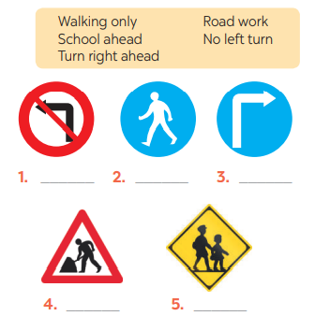
VOCABULARY REVIEW
3
Write the phrases from the box under the road signs.
Aim of the task:
To help students review the words/phrases learnt.
No left turn
Walking only
Turn right ahead
Road work
School ahead

Slide 11
VOCABULARY REVIEW
4
Fill in each blank with a suitable word from the box.
shocking feast Easter fantasy violent
1. A ______________ is a special meal with very good food.
2. This documentary has some _______________ facts about a poor country. I was sad when I watched it last night.
3. Many children like ______________ because they can paint and search for chocolate eggs.
4. In a _______________, you can see fairies, dragons, ghosts, and other unreal characters.
5. You shouldn’t watch this film because it’s ______________. There are many fighting scenes.
feast
shocking
Easter
fantasy
violent

Slide 12
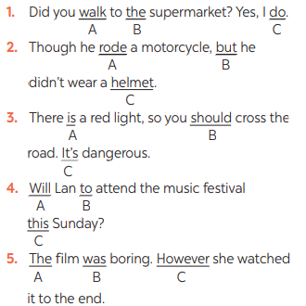
GRAMMAR REVIEW
5
Which of the underlined parts in each question is incorrect? Find and correct it.
→ did
Aim of the task:
To help students review grammar elements taught in the three units
→ X
→ shouldn’t
→ X
→ However,

Slide 13
GRAMMAR REVIEW
6
Rewrite the sentences so that they have the same meanings as the original ones. Use the words given in brackets.
1. The distance from my house to my school is about five kilometres. (IT)
→ ______________________________________________________ .
2. What is the distance between Ha Noi and Hai Phong? (HOW)
→ ______________________________________________________ .
3. He was tired, but he still performed the lion dance. (ALTHOUGH)
→ ______________________________________________________ .
→ ______________________________________________________ .
4. Walking here is dangerous because this lane is for cycling only. (SHOULDN’T)
→ ______________________________________________________.
5. My sister lives far away, but she comes back home every Tet. (THOUGH)
→ ______________________________________________________ .
→ ______________________________________________________.
It’s about five kilometres from my house to my school.
How far is it from Ha Noi to Hai Phong?
Although he was tired, he still performed the lion dance.
He still performed the lion dance although he was tired.
We / You / They shouldn’t walk here be-cause this lane is for cycling only.
Though my sister lives far away, she comes back home every Tet.
My sister comes back home every Tet though she lives far away.

Slide 14
LESSON 1: LANGUAGE
WARM-UP
Mindmap
PRONUNCIATION REVIEW
Task 1: Choose the word in which the underlined part is pronounced differently.
Task 2: Choose the word which has a different stress pattern from that of the others.
Task 3: Write the phrases from the box under the road signs.
Task 4: Fill in each blank with a suitable word from the box.
VOCABULARY REVIEW
Task 5: Which of the underlined parts in each question is incorrect? Find and correct it.
Task 6: Rewrite the sentences so that they have the same meanings as the original ones. Use the words given in brackets.
GRAMMAR
REVIEW
CONSOLIDATION
Wrap-up
Home work

Slide 15
CONSOLIDATION
1
WRAP-UP
Pronunciation review
Vocabulary review
Grammar review

Slide 16
CONSOLIDATION
2
HOMEWORK
Prepare for the next lesson: Review 3 - Skills

Slide 17


