Slide 1


Slide 2



Review
4
UNIT 10- 11 - 12
LESSON 1: LANGUAGE
Pronunciation review
Vocabulary review
Grammar review
Unit

Slide 3

OBJECTIVES
By the end of the lesson, students will be able to:
Review pronunciation, vocabulary and the grammar points they have learnt in unit 10, 11, 12.

Slide 4
LESSON 1: LANGUAGE
WARM-UP
Mindmap
PRONUNCIATION REVIEW
Task 1: Mark (') the stressed syllables in the underlined words. Then listen, check and repeat.
Task 2: Write the words in the box next to their definitions.
Task 3: Complete the sentences with the words below.
VOCABULARY REVIEW
Task 4: Use the correct tense and form of each verb in brackets to complete the sentence.
Task 5: Find and cross (––) ONE incorrect article in each sentence and write the
correct one.
GRAMMAR
REVIEW
CONSOLIDATION
Wrap-up
Home work

Slide 5
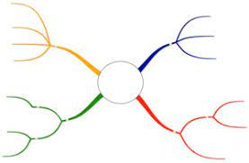
LESSON 7: LOOKING BACK & PROJECT
WARM-UP
Mindmap
Aims of the stage:
To remind students the knowledge that they have learnt in Units 10 -11 - 12.
Unit ..
Notes:
Wordwall link to spin the wheel in real time: https://wordwall.net/resource/27022823

Slide 6

LESSON 1: LANGUAGE
WARM-UP
Mindmap
PRONUNCIATION REVIEW
Task 1: Mark (') the stressed syllables in the underlined words. Then listen, check and repeat.

Slide 7

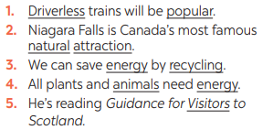
PRONUNCIATION REVIEW
1
Mark (') the stressed syllables in the underlined words. Then listen, check, and repeat.
1. 'Driverless trains will be 'popular.
2. Niagara Falls is Canada’s most famous
‘natural at’traction.
3. We can save 'energy by re'cycling.
4. All plants and ‘animals need ‘energy
5. He’s reading Guidance for ‘Visitors to
Scotland.

Slide 8
LESSON 1: LANGUAGE
WARM-UP
Mindmap
PRONUNCIATION REVIEW
Task 1: Mark (') the stressed syllables in the underlined words. Then listen, check and repeat.
Task 2: Write the words in the box next to their definitions.
Task 3: Complete the sentences with the words below.
VOCABULARY REVIEW

Slide 9
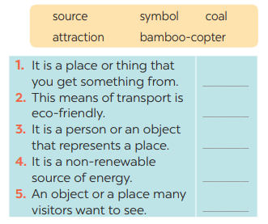
VOCABULARY REVIEW
2
Write the words in the box next to their defini-tions.
Aim of the task:
To help Ss recognize the words through their definitions Units 10 - 11 - 12.
sunlight
bamboo - copter
tour
coal
attraction

Slide 10
VOCABULARY REVIEW
3
Complete the sentences with the words below.
national native renewable electrical public natural
public
1. SkyTrans and driverless buses will be popular ___________ means of transport.
2. Niagara Falls is a ___________ wonder of both the USA and Canada.
3. The colours of the UK’s ____________ flag are red, white, and blue.
4. Solar energy and hydro energy are _____________sources.
5. The kangaroo is ______________ to Australia.
6. We can save electricity by using fewer _____________ appliances.
natural
national
renewable
native
electrical

Slide 11
LESSON 1: LANGUAGE
WARM-UP
Mindmap
PRONUNCIATION REVIEW
Task 1: Mark (') the stressed syllables in the underlined words. Then listen, check and repeat.
Task 2: Write the words in the box next to their definitions.
Task 3: Complete the sentences with the words below.
VOCABULARY REVIEW
Task 4: Use the correct tense and form of each verb in brackets to complete the sentence.
Task 5: Find and cross (––) ONE incorrect article in each sentence and write the
correct one.
GRAMMAR
REVIEW

Slide 12
GRAMMAR REVIEW
4
Use the correct tense and form of each verb in brackets to complete the sentence.
1. At present, our class (do) ____________ a big project on how to save energy in our school.
2. My biggest dream is that I (visit) ____________ Edinburgh one day.
3. At present, my city (build) ______________ stations for skyTrans.
4. In the future, we (use) _______________ more renewable energy in our daily life.
5. I hope that we (have) _____________ flying cars for faster travel soon.
is doing
Aim of the task:
To help Ss revise the use of the pre-sent continuous and the future simple
will visit
is building
will use
will have

Slide 13
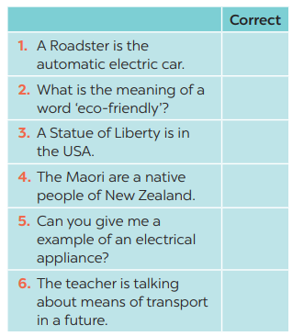
GRAMMAR REVIEW
5
Find and cross (––) ONE incorrect article in each sentence and write the correct one.
the → an
a → the
A → The
a → the
a → an
a → the

Slide 14
LESSON 1: LANGUAGE
WARM-UP
Mindmap
PRONUNCIATION REVIEW
Task 1: Mark (') the stressed syllables in the underlined words. Then listen, check and repeat.
Task 2: Write the words in the box next to their definitions.
Task 3: Complete the sentences with the words below.
VOCABULARY REVIEW
Task 4: Use the correct tense and form of each verb in brackets to complete the sentence.
Task 5: Find and cross (––) ONE incorrect article in each sentence and write the
correct one.
GRAMMAR
REVIEW
CONSOLIDATION
Wrap-up
Home work

Slide 15
CONSOLIDATION
1
WRAP-UP
Pronunciation review
Vocabulary review
Grammar review

Slide 16
CONSOLIDATION
2
HOMEWORK
Prepare for the next lesson: Review 3 - Skills

Slide 17


