Slide 1


Slide 2




Unit
10
ENERGY SOURCES
LESSON 6: SKILLS 2

Slide 3

OBJECTIVES
By the end of the lesson, students will be able to:
+ Listening
use the lexical items related to the topic Energy sources
listen for main ideas and specific information about the topic how to save energy at home.
+ Writing: Write a paragraph of about 70 words about how you save energy at home.

Slide 4
LESSON 5: SKILLS 2
WARM-UP
PASS THE CHALK
* Listening
Task 1: Work in pairs. Answer the questions
Task 2: Listen and circle the phrases you hear
Task 3: Listen again and tick T (True) or F (False) for each sentence
Task 4: Discuss: What is the most effective way to save energy.
LISTENING
* Writing
Task 5: Work in pairs. Read some ways to save energy at home. Choose three ways and write them in your notebook.
Task 6: Write a paragraph of about 70 words about how to save energy at home
WRITING
CONSOLIDATION
Wrap-up
Home work

Slide 5

LESSON 1: GETTING STARTED
WARM-UP
PASS THE CHALK
Aims of the stage:
To activate students’ prior knowledge and vocabulary related to the lesson.

Slide 6
WARM-UP
HOW TO SAVE ENERGY”
TEAM A
TEAM B

Slide 7

LESSON 5: SKILLS 2
WARM-UP
PASS THE CHALK
* Listening
Task 1: Work in pairs. Answer the questions
Task 2: Listen and circle the phrases you hear
Task 3: Listen again and tick T (True) or F (False) for each sentence
Task 4: Discuss: What is the most effective way to save energy.
LISTENING
Aims of the stage:
To help Ss brainstorm the topic and prepare for the listening text

Slide 8
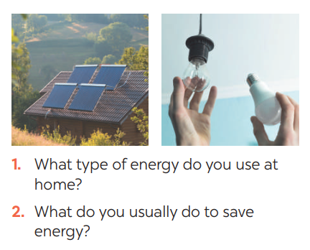

PRE-LISTENING
1
Work in pairs. Answer the questions

Slide 9
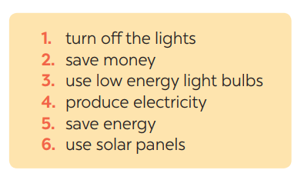
PRE-LISTENING
2
Listen and circle the phrases you hear
Aims of the stage:
To help Ss develop their skill of listening for specific information

Slide 10
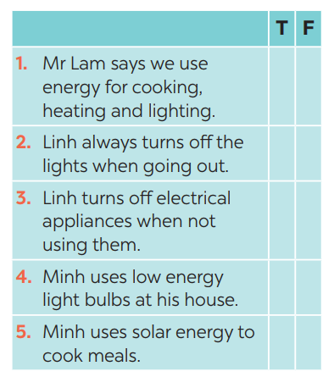
WHILE-LISTENING
3
Listen again and tick T (True) or F (False) for each sentence
Aims of the stage:
To help students develop their skill of listening for details.

Slide 11

POST - LISTENING
4
Discuss: What is the most effective way to save energy?
E.g. The most effective way to save energy is only read and write in day light.

Slide 12

LESSON 5: SKILLS 2
WARM-UP
PASS THE CHALK
* Listening
Task 1: Work in pairs. Answer the questions
Task 2: Listen and circle the phrases you hear
Task 3: Listen again and tick T (True) or F (False) for each sentence
Task 4: Discuss: What is the most effective way to save energy.
LISTENING
* Writing
Task 5: Work in pairs. Read some ways to save energy at home. Choose three ways and write them in your notebook.
Task 6: Write a paragraph of about 70 words about how to save energy at home
WRITING
Aims of the stage:
To help Ss prepare ideas to write a passage.

Slide 13

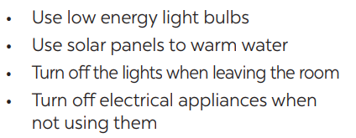
PRE-WRITING
5
Work in pairs. Read some ways to save energy at home. Choose three ways and write them in your notebook.

Slide 14
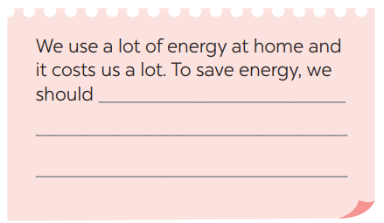
WHILE-WRITING
6
Write a paragraph of about 70 words about how you save energy at home.
We use a lot of energy at home and it costs us a lot. To save energy, we should try making use of natural light more instead of keep the lights unnecessarily in the morning and afternoons. Moreover, we should unplug your electrical gadgets when not in use. These devices consume at least 10% of electricity even when inactive. Therefore, unplug them to save electricity. Most importantly, installing solar panels can help you excessively. They are very economical and help in saving a lot of energy. This can help in getting cheap electricity and protect the environment.

Slide 15

POST - WRITING
Peer check and cross check
Students can:
go and see other’s work
give comments to each other

Slide 16

CONSOLIDATION
1
WRAP-UP
In this lesson, we have learnt to:
use the lexical items related to the topic Energy sources
listen for main ideas and specific information about the topic how to save energy at home.
write a paragraph of about 70 words about how you save energy at home.

Slide 17
CONSOLIDATION
2
HOMEWORK
Prepare for the next lesson: Looking back & Project

Slide 18


