Slide 1


Slide 2



Unit
10
ENERGY SOURCES
LESSON 7: LOOKING BACK & PROJECT
VOCABULARY REVIEW
THE PRESENT CONTINUOUS
GRAMMAR REVIEW
PRODUCTION
PROJECT: SAVING ENERGY AT SCHOOL
SOURCES OF ENERGY
Unit

Slide 3

OBJECTIVES
By the end of the lesson, students will be able to:
review the vocabulary and grammar of Unit 10
apply what they have learnt (vocabulary and grammar) into practice through a project

Slide 4
LESSON 7: LOOKING BACK & PROJECT
WARM-UP
QUICK REVISION CHECK
VOCABULARY REVIEW
Task 1: Match the adjectives in A with the nouns in B to make phrases
Task 2: Complete the sentences, using the phrases in 1
Task 3: Complete the sentences by using the correct form of the present continuous or present simple of the verbs in brackets.
Task 4: Find ONE mistake in each sentence and correct it
GRAMMAR REVIEW
Saving energy at school
Task 5: Discussion: Which tips can be applied in your school.
Task 6: Poster presentation: How to save energy in your school
PROJECT
CONSOLIDATION
Wrap-up
Home work

Slide 5

LESSON 7: LOOKING BACK & PROJECT
WARM-UP
QUICK REVISION CHECK
Aims of the stage:
To help students revise the vocabulary items they have learnt in the unit.To enhance students’ skills of cooperating with team mates.

Slide 6

LESSON 7: LOOKING BACK & PROJECT
WARM-UP
QUICK REVISION CHECK
VOCABULARY REVIEW
Task 1: Match the adjectives in A with the nouns in B to make phrases
Task 2: Complete the sentences, using the phrases in 1

Slide 7
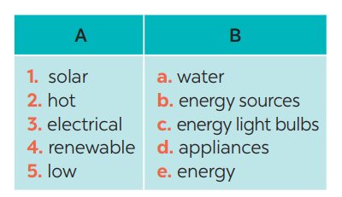
VOCABULARY REVIEW
1
Match the adjectives in A with the nouns in B to make phrases
KEYS
e
a
3. d
4. b
5. c

Slide 8
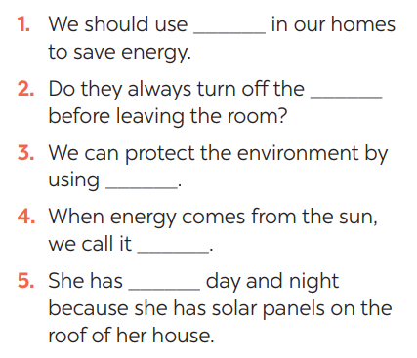
VOCABULARY REVIEW
2
Complete the sentences, using the phrases in 1
KEYS:
1. low energy light bulbs
2. electrical applicances
3. renewable energy sources
4. solar energy
5. hot water

Slide 9
LESSON 7: LOOKING BACK & PROJECT
WARM-UP
QUICK REVISION CHECK
VOCABULARY REVIEW
Task 1: Match the adjectives in A with the nouns in B to make phrases
Task 2: Complete the sentences, using the phrases in 1
Task 3: Complete the sentences by using the correct form of the present continuous or present simple of the verbs in brackets.
Task 4: Find ONE mistake in each sentence and correct it
GRAMMAR REVIEW

Slide 10
GRAMMAR REVIEW
Aim of the task:
To help Ss revise grammar points.
3
Complete the sentences by using the correct form of the present continuous or present simple of the verbs in brackets.
1. Look! It (rain) ______ heavily.
2. Normally they (start) ______ school at eight o’clock in the morning.
3. He hasn’t got a bike at the moment, so he (walk) ______ to school this week.
4. He always (do) ______ his homework in the evening.
5. I’m afraid I have no time to help just now. I (write) ______ an essay.
is raining
starts
is walking
does
am writing

Slide 11
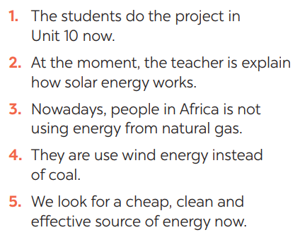
GRAMMAR REVIEW
4
Find ONE mistake in each sentence and correct it
ANSWER KEYS:
1. do -> are doing
2. explain -> explaining
3. is -> are
4. use -> using
5. look -> are looking

Slide 12
LESSON 7: LOOKING BACK & PROJECT
WARM-UP
QUICK REVISION CHECK
VOCABULARY REVIEW
Task 1: Match the adjectives in A with the nouns in B to make phrases
Task 2: Complete the sentences, using the phrases in 1
Task 3: Complete the sentences by using the correct form of the present continuous or present simple of the verbs in brackets.
Task 4: Find ONE mistake in each sentence and correct it
GRAMMAR REVIEW
Saving energy at school
Task 5: Discussion: Which tips can be applied in your school.
Task 6: Poster presentation: How to save energy in your school
PROJECT

Slide 13

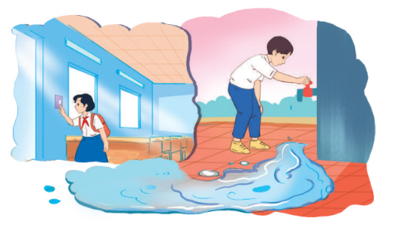
PROJECT
5
5
Discussion: Which tips can be applied in your school.

Slide 14

PROJECT
6
5
Poster presentation: How to save energy in your school

Slide 15
LESSON 7: LOOKING BACK & PROJECT
WARM-UP
QUICK REVISION CHECK
VOCABULARY REVIEW
Task 1: Match the adjectives in A with the nouns in B to make phrases
Task 2: Complete the sentences, using the phrases in 1
Task 3: Complete the sentences by using the correct form of the present continuous or present simple of the verbs in brackets.
Task 4: Find ONE mistake in each sentence and correct it
GRAMMAR REVIEW
Saving energy at school
Task 5: Discussion: Which tips can be applied in your school.
Task 6: Poster presentation: How to save energy in your school
PROJECT
CONSOLIDATION
Wrap-up
Home work

Slide 16
Unit
10
ENERGY SOURCES
LESSON 7: LOOKING BACK & PROJECT
VOCABULARY REVIEW
THE PRESENT CONTINUOUS
GRAMMAR REVIEW
PRODUCTION
PROJECT: SAVING ENERGY AT SCHOOL
SOURCES OF ENERGY
Unit

Slide 17
CONSOLIDATION
2
HOMEWORK
Prepare for the next lesson: Unit 11 – Getting started

Slide 18


