Slide 1


Slide 2



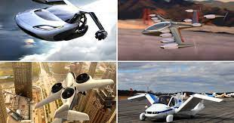
Unit
11
TRAVELLING IN THE FUTURE
LESSON 5: SKILLS 2

Slide 3

OBJECTIVES
By the end of the lesson, students will be able to:
listen for general and specific information about some future means of transport.
write about the advantages of a future means of transport.

Slide 4
LESSON 5: SKILLS 2
WARM-UP
Discussion
Listening
Vocabulary
Task 1: Listen to a talk between Mr Ha and his students. How many means of transport are they talking about? Circle the correct answer.
Task 2: Listen to the talk again and complete each sentence with ONE word.
Task 3: True or False statements.
LISTENING
* Writing
Task 4: Choose one future means of transport in 3 and tick (✓) the words and phrases that describe its advantages. Can you add more words and phrases?
Task 5: Write a paragraph of about 70 words about the advantages of the means of transport you’ve chosen.
WRITING
CONSOLIDATION
Wrap-up
Home work

Slide 5
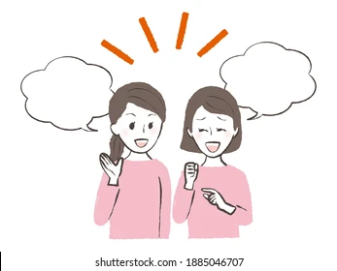
LESSON 1: GETTING STARTED
WARM-UP
Discussion
Aims of the stage:
To prepare Ss for the listening by focusing them on some words / phrases

Slide 6
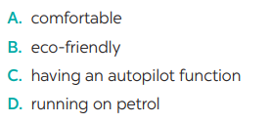
WARM-UP
Which words/ phrases that you think are used to describe the future means of transport?

Slide 7

LESSON 5: SKILLS 2
WARM-UP
Discussion
Listening
Vocabulary
Task 1: Listen to a talk between Mr Ha and his students. How many means of transport are they talking about? Circle the correct answer.
Task 2: Listen to the talk again and complete each sentence with ONE word.
Task 3: True or False statements.
LISTENING
Aims of the stage:
To provide students with some lexical items before listening the text

Slide 8
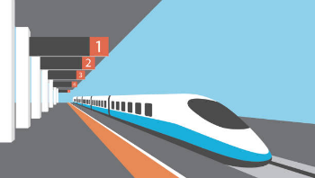
PRE-LISTENING - VOCABULARY
bullet train (n)
/ˈbʊl.ɪt ˌtreɪn/
tàu cao tốc

Slide 9
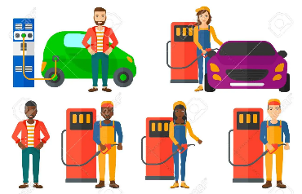
PRE-LISTENING - VOCABULARY
(to) use up
/juz up/
sử dụng hết

Slide 10

PRE-LISTENING - VOCABULARY
comfortable (a)
/ˈkʌm.fə.tə.bəl/
thoải mái

Slide 11
PRE-LISTENING - VOCABULARY
New words | Pronunciation | Meaning
1. bullet train (n) | /ˈbʊl.ɪt ˌtreɪn/ | tàu cao tốc
2. (to) use up | /juz up/ | sử dụng hết
3. comfortable (a) | /ˈkʌm.fə.tə.bəl/ | thoải mái

Slide 12


PRE-LISTENING
1
Listen to a talk between Mr Ha and his students. How many means of transport are they talking about? Circle the correct answer.

Slide 13


WHILE - LISTENING
1
Listen to a talk between Mr Ha and his students. How many means of transport are they talking about? Circle the correct answer.

Slide 14
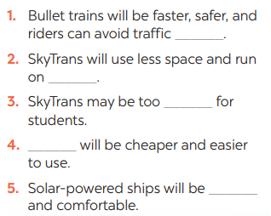
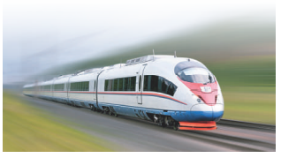
WHILE-LISTENING
2
Listen to the talk again and complete each sentence with ONE word.
accidents
autopilot
expensive
Bamboo - copters
eco- friendly

Slide 15
POST - LISTENING
3
True or False statements
Statements | True | False
1. Tom thinks that bullet trains will be the fastest transport in the future.
2. Lan said that SkyTrans would not use up much space.
3. It may be too expensive for students to use SkyTrans
4. Students will use bamboo – copters to fly to school.
5. Lan thinks solar – power ships will be eco- friendly and uncomfortable.

Slide 16

LESSON 5: SKILLS 2
WARM-UP
Discussion
Listening
Vocabulary
Task 1: Listen to a talk between Mr Ha and his students. How many means of transport are they talking about? Circle the correct answer.
Task 2: Listen to the talk again and complete each sentence with ONE word.
Task 3: True or False statements.
LISTENING
* Writing
Task 4: Choose one future means of transport in 3 and tick (✓) the words and phrases that describe its advantages. Can you add more words and phrases?
Task 5: Write a paragraph of about 70 words about the advantages of the means of transport you’ve chosen.
WRITING
Aims of the stage:
To prepare Ss for the writing activity

Slide 17
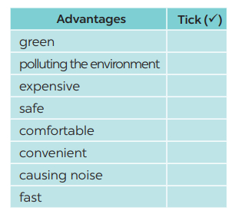
PRE-WRITING
4
Choose one future means of transport in 3 and tick the words and phrases that describe its advantages. Can you add more words and phrases?
Suggested answers: economical, carrying many passengers, avoiding traffic jams, having an autopilot function, driverless, etc.

Slide 18
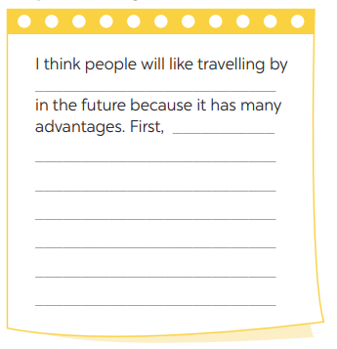
WHILE-WRITING
5
Write a letter to invite someone to a street painting festival, using the following cues.
Suggested answers: economical, carrying many passengers, avoiding traffic jams, having an autopilot function, driverless, etc.

Slide 19

POST - WRITING
Class gallery
Students can:
go and see other’s work
give comments to each other

Slide 20
LESSON 5: SKILLS 2
WARM-UP
Discussion
Listening
Vocabulary
Task 1: Listen to a talk between Mr Ha and his students. How many means of transport are they talking about? Circle the correct answer.
Task 2: Listen to the talk again and complete each sentence with ONE word.
Task 3: True or False statements.
LISTENING
* Writing
Task 4: Choose one future means of transport in 3 and tick (✓) the words and phrases that describe its advantages. Can you add more words and phrases?
Task 5: Write a paragraph of about 70 words about the advantages of the means of transport you’ve chosen.
WRITING
CONSOLIDATION
Wrap-up
Home work

Slide 21

CONSOLIDATION
1
WRAP-UP
In this lesson, we have learnt to:
listen for general and specific information about some future means of transport.
write about the advantages of a future means of transport.

Slide 22
CONSOLIDATION
2
HOMEWORK
Prepare for the next lesson: Looking back & Project

Slide 23


