Slide 1


Slide 2


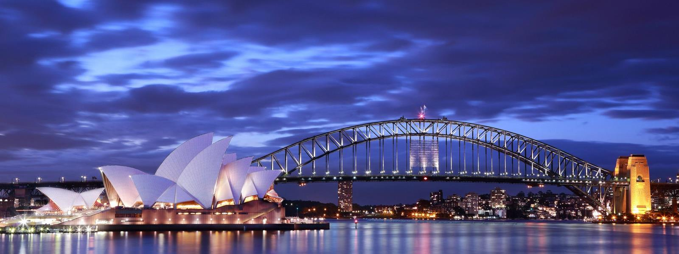

Unit
12
ENGLISH-SPEAKING COUNTRIES
LESSON 1: GETTING STARTED
A holiday in Australia

Slide 3

OBJECTIVES
By the end of the lesson, students will be able to:
an overview about the topic “English-speaking countries”
lexical items related to people and places in English-speaking countries
identify the language features that are covered in the unit.

Slide 4
LESSON 1: GETTING STARTED
WARM-UP
Flags matching
PRESENTATION
Vocabulary
Task 1: Listen and read (p. 124).
Task 2: What are Phong and Mark talking about? (p. 125).
Task 3: Read again and tick the information you can find in the conversation. (p. 125)
Task 4: Complete the sentences with the words and phrases from the box. (p. 125)
PRACTICE
PRODUCTION
Task 5: Matching game: What’s its capital city? (p. 125)
CONSOLIDATION
Wrap-up
Home work

Slide 5

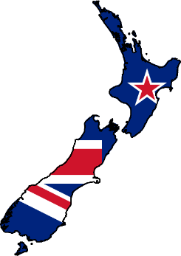



LESSON 1: GETTING STARTED
WARM-UP
Flags matching

Slide 6
WARM-UP
Flags matching
New Zealand
Canada
The USA
The UK
Australia

Slide 7
LESSON 1: GETTING STARTED
WARM-UP
Flags matching
PRESENTATION
Vocabulary

Slide 8


PRESENTATION
island (n)
/ˈaɪ.lənd/
Hòn đảo

Slide 9

PRESENTATION
sunset (n)
/ˈsʌn.set/
Hoàng hôn

Slide 10

PRESENTATION
landscape (n)
/ˈlænd.skeɪp/
Phong cảnh

Slide 11

PRESENTATION
penguin (n)
/ˈpeŋ.ɡwɪn/
Chim cánh cụt

Slide 12
PRESENTATION
New words | Pronunciation | Meaning
island (n) | /ˈaɪ.lənd/ | Hòn đảo
sunset (n) | /ˈsʌn.set/ | Hoàng hôn
landscape (n) | /ˈlænd.skeɪp/ | Phong cảnh
penguin (n) | /ˈpeŋ.ɡwɪn/ | Chim cánh cụt

Slide 13
LESSON 1: GETTING STARTED
WARM-UP
Flags matching
PRESENTATION
Vocabulary
Task 1: Listen and read (p. 124).
Task 2: What are Phong and Mark talking about? (p. 125).
Task 3: Read again and tick the information you can find in the conversation. (p. 125)
Task 4: Complete the sentences with the words and phrases from the box. (p. 125)
PRACTICE

Slide 14
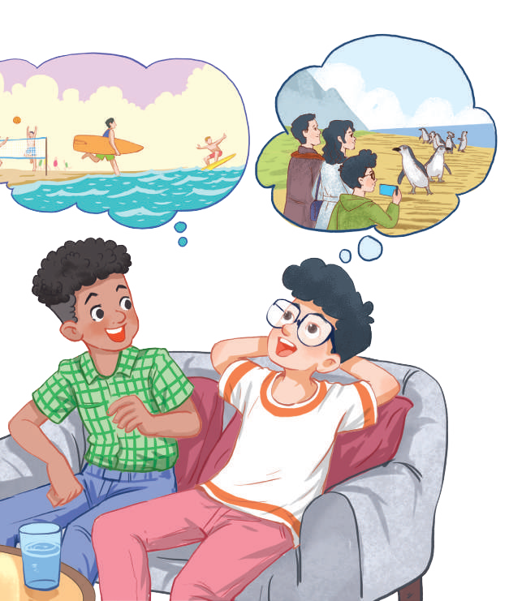
PRACTICE
1
Listen and read.
Mark: How was your holiday in Australia, Phong?
Phong: It was fantastic! I got to use my English in real life: asking for directions, reading maps, talking to local people ...
Mark: Oh … Your English is much better.
Phong: Thanks.
Mark: Did you travel a lot?
Phong: Just around Melbourne, the city with four seasons in a day.
Mark: Wow ... I didn’t know that. How was it?
Phong: It was great! We took a tour to Phillip Island.
Mark: What did you see?
Phong: We went penguin watching.
Mark: It sounds pretty exciting.
Phong: It was. Australia has amazing landscapes.
Mark: Yes, and Australians love outdoor activities.
Phong: Right. There were plenty of people enjoying the parks and beaches.
Mark: I’m glad that you had a wonderful time there.
Phong: Thanks, Mark.

Slide 15
PRACTICE
2
What are Phong and Mark talking about?
A. Phong’s holiday in Australia
B. English-speaking countries
C. The tour to Phillip Island

Slide 16

PRACTICE
3
Read again and tick the information you can find in the conversation.
1. In Australia, Phong used English in real life.
2. Phong visited some museums.
3. Phillip Island is far from Melbourne.
4. Australia is beautiful.
5. Australians love outdoor activities.

Slide 17
PRACTICE
4
Complete the sentences with the words and phrases from the box.
island, sunset, landscape, Australians, penguin watching
1. This is a picture of the __________________ in my village.
2. – Where did you go _________________________?
– On the beach.
3. – Is Phu Quoc a(n) __________________?
– Yes, it is.
4. We had dinner on the beach after __________________.
5. Most __________________ like outdoor sports and games.
landscape
penguin watching
island
sunset
Australians

Slide 18
LESSON 1: GETTING STARTED
WARM-UP
Flags matching
PRESENTATION
Vocabulary
Task 1: Listen and read (p. 124).
Task 2: What are Phong and Mark talking about? (p. 125).
Task 3: Read again and tick the information you can find in the conversation. (p. 125)
Task 4: Complete the sentences with the words and phrases from the box. (p. 125)
PRACTICE
PRODUCTION
Task 5: Matching game: What’s its capital city? (p. 125)

Slide 19
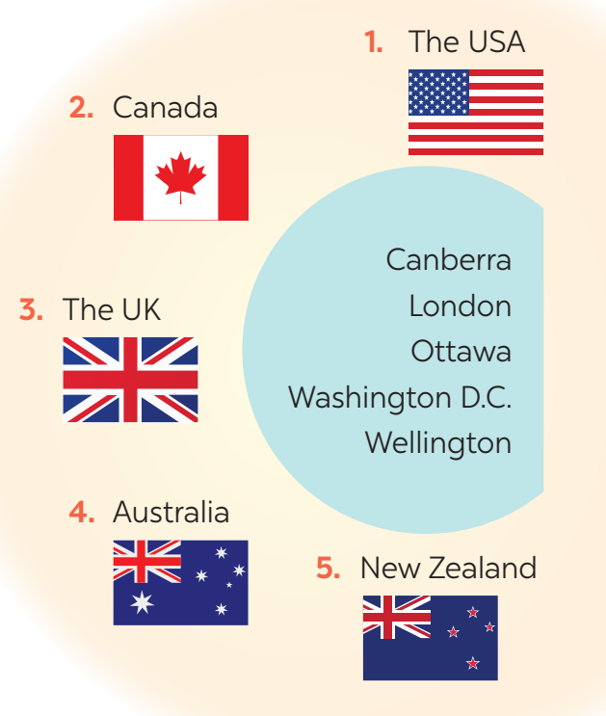
PRODUCTION
5
Matching game: What’s its capital city?
1. Washington D.C.
2. Ottawa
3. London
4. Canberra
5. Wellington

Slide 20
LESSON 1: GETTING STARTED
WARM-UP
Flags matching
PRESENTATION
Vocabulary
Task 1: Listen and read (p. 124).
Task 2: What are Phong and Mark talking about? (p. 125).
Task 3: Read again and tick the information you can find in the conversation. (p. 125)
Task 4: Complete the sentences with the words and phrases from the box. (p. 125)
PRACTICE
PRODUCTION
Task 5: Matching game: What’s its capital city? (p. 125)
CONSOLIDATION
Wrap-up
Home work

Slide 21

CONSOLIDATION
1
WRAP-UP
What have we learnt in this lesson?
identify the topic of the unit
lexical items related to people and places in English-speaking countries
identify the language features that are covered in the unit.

Slide 22
CONSOLIDATION
2
HOMEWORK
Find more English-speaking countries.

Slide 23


