Slide 1


Slide 2



Unit
12
ENGLISH-SPEAKING COUNTRIES
Vocabulary
Use words related to people and places in the English-speaking countries.
Pronunciation
ask questions with the correct rising and falling intonation
LESSON 2: A CLOSER LOOK 1
Unit
HOBBIES

Slide 3

OBJECTIVES
By the end of the lesson, students will be able to:
Use words related to people and places in the English-speaking countries.
ask questions with the correct rising and falling intonation.

Slide 4
LESSON 2: A CLOSER LOOK 1
WARM-UP
Homework checking
Vocabulary
Task 1: Write the words or phrases under the correct pictures. (p. 126)
Task 2: Use the words in the box to complete the sentences. (p. 126)
Task 3: Work in pairs. Discuss and write the word or phrase in the box next to its explanation. (p. 126)
VOCABULARY
Pronunciation
Task 4: Listen and repeat, paying attention to the intonation of the following questions. (p. 126)
Task 5: Circle the correct intonation. Then listen and repeat. (p. 126)
Game: Up or Down?
PRONUNCIATION
CONSOLIDATION
Wrap-up
Homework

Slide 5

LESSON 2: A CLOSER LOOK 1
WARM-UP
Homework checking
How many English-speaking countries can you find?

Slide 6
LESSON 2: A CLOSER LOOK 1
WARM-UP
Homework checking
Vocabulary
Task 1: Write the words or phrases under the correct pictures. (p. 126)
Task 2: Use the words in the box to complete the sentences. (p. 126)
Task 3: Work in pairs. Discuss and write the word or phrase in the box next to its explanation. (p. 126)
VOCABULARY

Slide 7

VOCABULARY
something is native to a place = a place is the home of something
native (adj)
/ˈneɪ.tɪv/
bản ngữ, nguyên quán

Slide 8
VOCABULARY
= wonderful, beautiful
amazing (adj)
/əˈmeɪ.zɪŋ/
tuyệt vời

Slide 9
VOCABULARY
= rare,
not many
unique (adj)
/juːˈniːk/
độc nhất

Slide 10
VOCABULARY
local (adj)
= belonging to a place
/ˈləʊ.kəl/
thuộc về địa phương

Slide 11
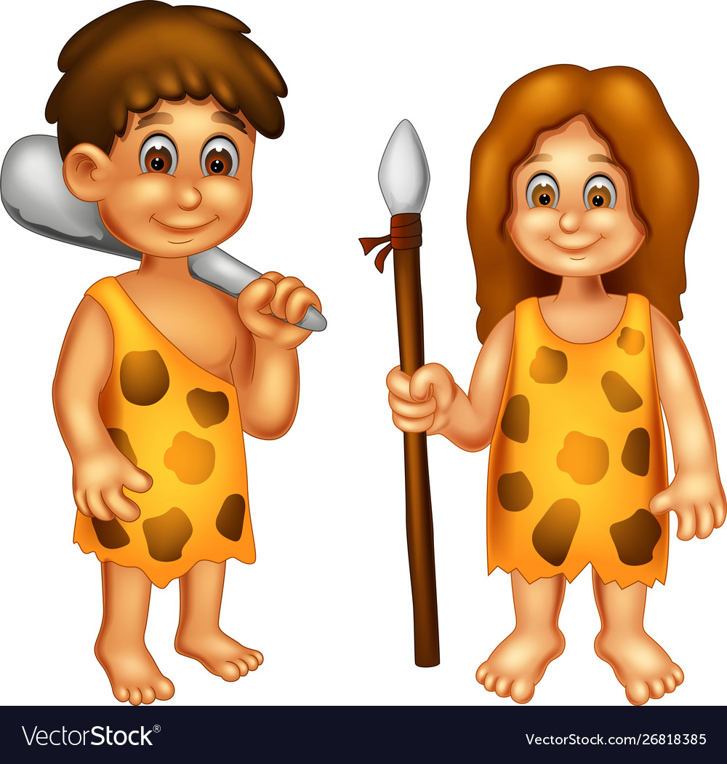
VOCABULARY
ancient (adj)
/ˈeɪn.ʃənt/
cổ, xưa

Slide 12
PRESENTATION
New words | Pronunciation | Meaning
native (adj) | /ˈneɪ.tɪv/ | Bản ngữ, nguyên quán
amazing (adj) | /əˈmeɪ.zɪŋ/ | Tuyệt vời
unique (adj) | /juːˈniːk/ | Độc nhất
local (adj) | /ˈləʊ.kəl/ | Thuộc về địa phương
ancient (adj) | /ˈeɪn.ʃənt/ | Cổ, xưa

Slide 13
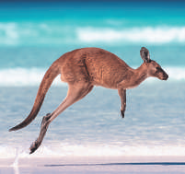
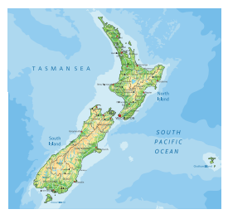
VOCABULARY
1
Write the words or phrases under the correct pictures.
island country, Scottish kilt, tattoo castle, kangaroo, coastline
kangaroo
island country
1. ____________________
2. ____________________
Notes:
Wordwall game: https://wordwall.net/resource/27241481

Slide 14

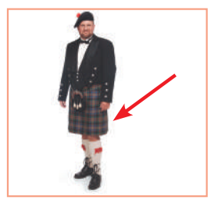
VOCABULARY
1
Write the words or phrases under the correct pictures.
island country, Scottish kilt, tattoo castle, kangaroo, coastline
tattoo
Scottish kilt
3. ____________________
4. ____________________
Notes:
Wordwall game: https://wordwall.net/resource/27241481

Slide 15
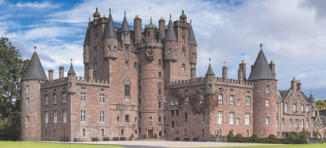
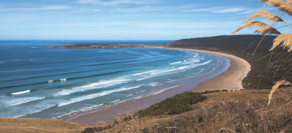
VOCABULARY
1
Write the words or phrases under the correct pictures.
island country, Scottish kilt, tattoo castle, kangaroo, coastline
castle
coastline
5. ____________________
6. ____________________
Notes:
Wordwall game: https://wordwall.net/resource/27241481

Slide 16
VOCABULARY
2
Use the words in the box to complete the sentences.
native, amazing,unique, local, ancient
amazing
1. From the top of the mountain, we had a(n) _______________ view of the valley below.
2. Scotland is famous for its long history and _______________ castles.
3. The long fences around the sheep farms in Australia are _______________. You can’t find them anywhere else in the world.
4. When you visit a new place, talk to the _______________ people.
5. Kangaroos are _______________ to Australia. It is their home
ancient
unique
local
native

Slide 17
VOCABULARY
3
Work in pairs. Discuss and write the word or phrase in the box next to its explanation.
symbol, boat ride, capital, tower
1. a tall narrow building with a small top
2. an object representing a place
3. the most important city of a country
4. a tour on a river
tower
……………………………………
symbol
……………………………………
capital
……………………………………
boat ride
……………………………………

Slide 18
LESSON 2: A CLOSER LOOK 1
WARM-UP
Homework checking
Vocabulary
Task 1: Write the words or phrases under the correct pictures. (p. 126)
Task 2: Use the words in the box to complete the sentences. (p. 126)
Task 3: Work in pairs. Discuss and write the word or phrase in the box next to its explanation. (p. 126)
VOCABULARY
Pronunciation
Task 4: Listen and repeat, paying attention to the intonation of the following questions. (p. 126)
Task 5: Circle the correct intonation. Then listen and repeat. (p. 126)
Game: Up or Down?
PRONUNCIATION

Slide 19

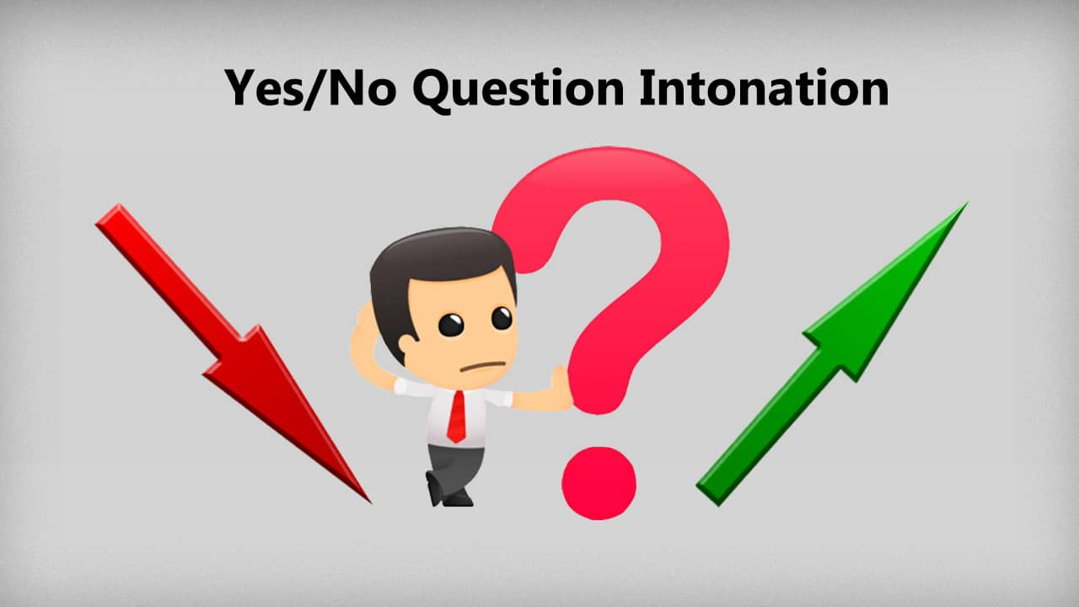
PRONUNCIATION
Rising and falling intonation for questions

Slide 20

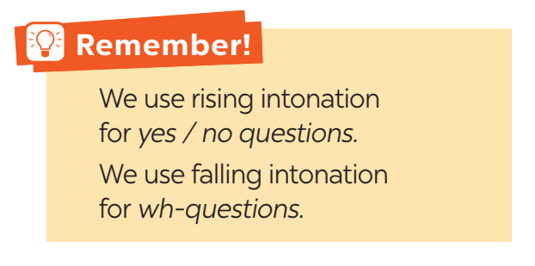

PRONUNCIATION
4
Listen and repeat, paying attention to the intonation of the following questions.
1. Can you speak English?
2. Is Australia an island?
3. Will you visit Washington next year?
4. What is the capital of Scotland?
5. How big is Canada?

Slide 21
PRODUCIATION
5
Listen to the sentences and pay attention to the underlined parts. Tick the appropriate sounds. Practise the sentences.
1. Where is Canada?
2. Could you show me Singapore on this map?
3. How many states are there in the USA?
4. Is English an official language in Malaysia?
5. Do you know much about New Zealand?

Slide 22

PRODUCIATION
Game:
Notes:
Teacher divides the class into 2 teams.
Students will listen to questions which are made up from the words in the lesson.
Students will have to stand up if it is a yes / no question and sit down if it is a wh-question.
The team will receive minus points equivalent to the number of students who pose incorrect actions (stand up or sit down).
The team with less minus points will be the winner.

Slide 23
LESSON 2: A CLOSER LOOK 1
WARM-UP
Homework checking
Vocabulary
Task 1: Write the words or phrases under the correct pictures. (p. 126)
Task 2: Use the words in the box to complete the sentences. (p. 126)
Task 3: Work in pairs. Discuss and write the word or phrase in the box next to its explanation. (p. 126)
VOCABULARY
Pronunciation
Task 4: Listen and repeat, paying attention to the intonation of the following questions. (p. 126)
Task 5: Circle the correct intonation. Then listen and repeat. (p. 126)
Game: Up or Down?
PRONUNCIATION
CONSOLIDATION
Wrap-up
Homework

Slide 24
CONSOLIDATION
1
WRAP-UP
Vocabulary
Use words related to people and places in the English-speaking countries.
Pronunciation
ask questions with the correct rising and falling intonation

Slide 25

CONSOLIDATION
2
HOMEWORK
Choose a favourite English-speaking country.
Find the information about its location and attractions.

Slide 26


