Slide 1


Slide 2




Unit
12
ENGLISH-SPEAKING COUNTRIES
LESSON 4: COMMUNICATION
Unit

Slide 3

OBJECTIVES
By the end of the lesson, students will be able to:
express amazement
know interesting facts about English-speaking countries

Slide 4
LESSON 4: COMMUNICATION
WARM-UP
Guessing the remaining of the picture
How to express amazement
Task 1: Listen and read the conversations, paying attention to the highlighted parts. (p. 128)
PRESENTATION
Everyday English
Task 2: Work in pairs. Make similar dialogues with the following situations, using expressions of amazement.
Interesting facts about English-speaking countries
Task 3: Work in groups. Discuss and write the name of the country next to the fact. (p. 129)
Task 4: Work in pairs. Read some facts about English-speaking countries and tick the column true for you. Then role play by one person saying one statement aloud and the other responding to it.
PRACTICE
PRODUCTION
Task 5: Work in groups. Share with your group some interesting facts you know about English-speaking countries. The group takes notes and presents its findings to the class.
CONSOLIDATION
Wrap-up
Home work

Slide 5

LESSON 4: COMMUNICATION
WARM-UP
Guessing the remaining of the picture

Slide 6
LESSON 4: COMMUNICATION
WARM-UP
Guessing the remaining of the picture

Slide 7
LESSON 4: COMMUNICATION
WARM-UP
Guessing the remaining of the picture
How to express amazement
Task 1: Listen and read the conversations, paying attention to the highlighted parts. (p. 128)
PRESENTATION

Slide 8

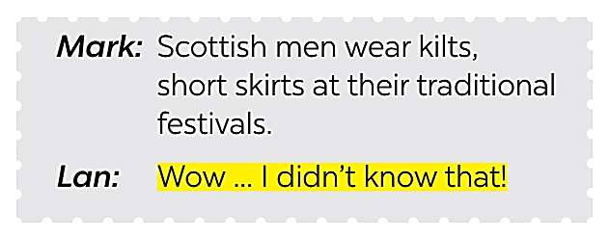

PRESENTATION
1
Listen and read the conversations, paying attention to the highlighted parts.
2 ways to express amazement:
Wow ... I didn’t know that!
Amazing!

Slide 9
LESSON 4: COMMUNICATION
WARM-UP
Guessing the remaining of the picture
How to express amazement
Task 1: Listen and read the conversations, paying attention to the highlighted parts. (p. 128)
PRESENTATION
Everyday English
Task 2: Work in pairs. Make similar dialogues with the following situations, using expressions of amazement.
Interesting facts about English-speaking countries
Task 3: Work in groups. Discuss and write the name of the country next to the fact. (p. 129)
Task 4: Work in pairs. Read some facts about English-speaking countries and tick the column true for you. Then role play by one person saying one statement aloud and the other responding to it.
PRACTICE

Slide 10

PRACTICE
2
Work in pairs. Make similar dialogues with the following situations, using expressions of amazement.
1. New Zealand has the cleanest and safest air on the planet. 2. There are no snakes in New Zealand. 3. More than half of all the lakes in the world are in Canada.

Slide 11
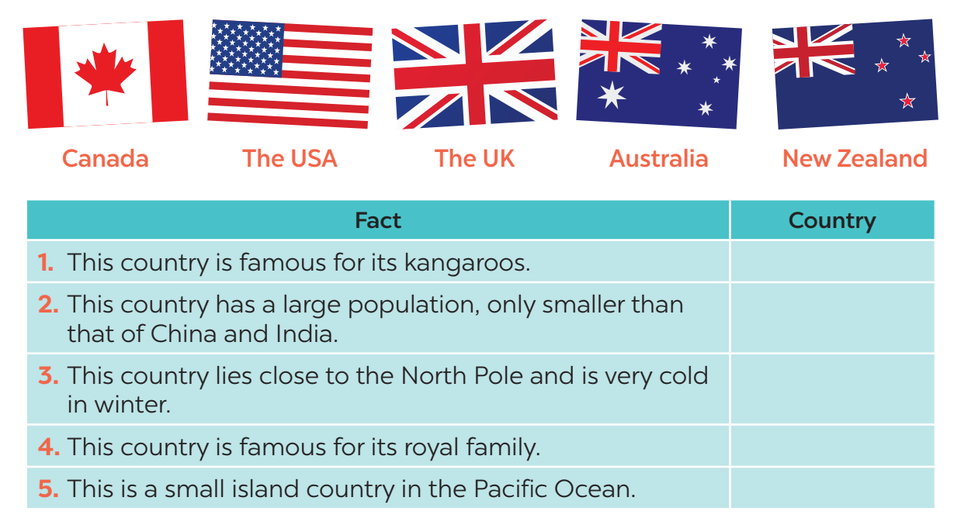
PRACTICE
3
Work in groups. Discuss and write the name of the country next to the fact.
Australia
The USA
Canada
The UK
New Zealand

Slide 12
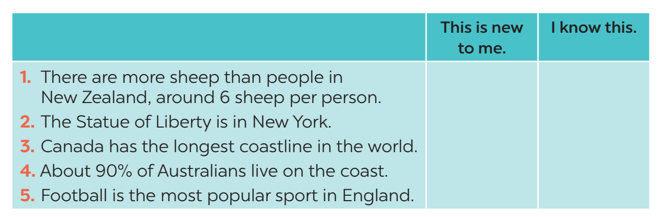
PRACTICE
Work in pairs. Read some facts about English-speaking countries and tick the column true for you. Then role play by one person saying one statement aloud and the other responding to it.
4

Slide 13
PRACTICE
Work in pairs. Read some facts about English-speaking countries and tick the column true for you. Then role play by one person saying one statement aloud and the other responding to it.
4
Example:
A: New York is the biggest city but not the capital of the USA.
B: I know this.
A: The state of Alaska in the USA has over 2,600 islands.
B: This is new to me.

Slide 14
LESSON 4: COMMUNICATION
WARM-UP
Guessing the remaining of the picture
How to express amazement
Task 1: Listen and read the conversations, paying attention to the highlighted parts. (p. 128)
PRESENTATION
Everyday English
Task 2: Work in pairs. Make similar dialogues with the following situations, using expressions of amazement.
Interesting facts about English-speaking countries
Task 3: Work in groups. Discuss and write the name of the country next to the fact. (p. 129)
Task 4: Work in pairs. Read some facts about English-speaking countries and tick the column true for you. Then role play by one person saying one statement aloud and the other responding to it.
PRACTICE
PRODUCTION
Task 5: Work in groups. Share with your group some interesting facts you know about English-speaking countries. The group takes notes and presents its findings to the class.

Slide 15

PRODUCTION
5
Work in groups. Share with your group some interesting facts you know about English-speaking countries. The group takes notes and presents its findings to the class.

Slide 16

CONSOLIDATION
1
WRAP-UP
In this lesson, we have learn to:
express amazement
know interesting facts about English-speaking countries

Slide 17

CONSOLIDATION
2
HOMEWORK
Prepare some photos of your favourite English-speaking country.

Slide 18


