Slide 1


Slide 2



Unit
12
ENGLISH-SPEAKING COUNTRIES
LESSON 5: SKILLS 2
Listening
  a tour of a city
Writing
  a diary entry about a tour of a city

Slide 3

OBJECTIVES
By the end of the lesson, students will be able to:
listen for specific information about a tour of a city;
write a diary entry about a tour of a city.

Slide 4
LESSON 5: SKILLS 2
WARM-UP
Guessing game: What city is it?
* Listening
Task 1: Work in groups. Match the phrases to the pictures (p. 131)
Task 2: A tour guide is talking about the schedule for a day trip in London. Listen and fill in the times. (p. 131)
Task 3: Listen again and complete each sentence with ONE word. (p. 131)
LISTENING
* Writing
Task 4: Work in pairs. Fill in the table with information about the London tour. (p. 131)
Task 5: Imagine that you took the tour of London. Write a diary entry of about 70 words about your tour, based on the table in 4 or use your imagination. (p. 131)
WRITING
PRODUCTION
(Post-Listen and Write)
Class gallery.
CONSOLIDATION
Wrap-up
Home work

Slide 5

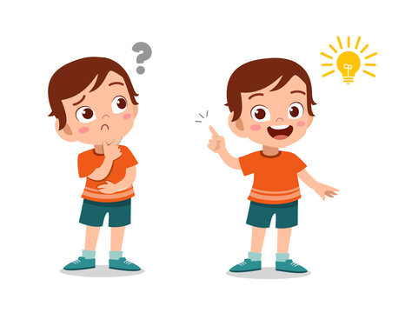
LESSON 5: SKILLS 2
WARM-UP
Guessing game: What city is it?

Slide 6
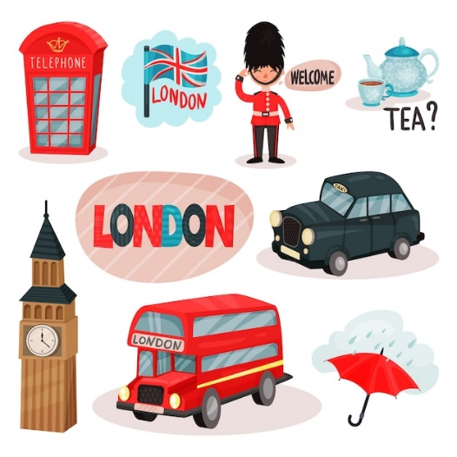

WARM-UP

Slide 7

WARM-UP

Slide 8
LESSON 5: SKILLS 2
WARM-UP
Guessing game: What city is it?
* Listening
Task 1: Work in groups. Match the phrases to the pictures (p. 131)
Task 2: A tour guide is talking about the schedule for a day trip in London. Listen and fill in the times. (p. 131)
Task 3: Listen again and complete each sentence with ONE word. (p. 131)
LISTENING

Slide 9
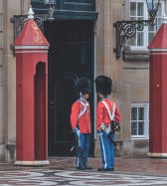
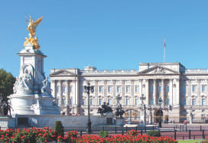
PRE-LISTENING
1
Work in groups. Match the phrases to the pictures.
Changing of the Guard
Buckingham Palace
1. _________________________
2. _________________________

Slide 10


WHILE-LISTENING
2
A tour guide is talking about the schedule for a day trip in London. Listen and fill in the times.
Go to Buckingham Palace: 9:30 a.m.
Watch the Changing of the Guard: (1) ________________
Lunch: (2) ________________
The boat ride: (3) ________________
Back to the hotel: (4) ________________
11:30 a.m.
1:00 p.m.
3:15 p.m.
5:00 p.m.

Slide 11
WHILE-LISTENING
3
Listen again and complete each sentence with ONE word.
1. The ________________ and her family live in Buckingham Palace.
2. At the Palace, you can see the Queen’s beautiful ________________.
3. Another name for Big Ben is the ________________ Tower.
4. After lunch, you can go around and take ________________.
5. On the boat ride, you can see historic ________________ along the river.
Queen
garden
Clock
photos
attractions

Slide 12
LESSON 5: SKILLS 2
WARM-UP
Guessing game: What city is it?
* Listening
Task 1: Work in groups. Match the phrases to the pictures (p. 131)
Task 2: A tour guide is talking about the schedule for a day trip in London. Listen and fill in the times. (p. 131)
Task 3: Listen again and complete each sentence with ONE word. (p. 131)
LISTENING
* Writing
Task 4: Work in pairs. Fill in the table with information about the London tour. (p. 131)
Task 5: Imagine that you took the tour of London. Write a diary entry of about 70 words about your tour, based on the table in 4 or use your imagination. (p. 131)
WRITING

Slide 13
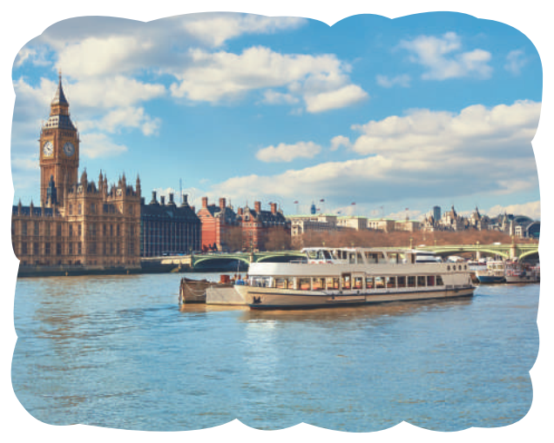
PRE-WRITING
4
Work in pairs. Fill in the table with information about the London tour.
Time | Place | Activity
9:30 a.m. | Buckingham Palace | – visiting the Queen’s garden – ....

Slide 14
PRE-WRITING
4
Work in pairs. Fill in the table with information about the London tour.
Time | Place | Activity
9:30 a.m. | Buckingham Palace | – see the Queen’s garden – see the Queen’s collection of artworks
11:30 a.m. | Buckingham Palace | – watch the Changing of the Guard
1 p.m. | Around Big Ben | – have lunch – tour the place and take photos
3:15 p.m. | The River Thames | – take a boat ride
5:00 p.m. | return to the hotel
Suggested answers

Slide 15
WHILE-WRITING
5
Imagine that you took the tour of London. Write a diary entry of about 70 words about your tour, based on the table in 4 or use your imagination.
Suggested answers:
The tour of London began at 9:30 a.m. First, we went to Buckingham Palace. We visited the Queen’s Garden and saw her collection of artworks. At 11:30 a.m. we watched the Changing of the Guard. We then went to Big Ben. We took a lot of photos there. At 3:15 p.m., we took a boat ride on the River Thames. We saw many historic attractions along the river. I enjoyed the tour very much.

Slide 16
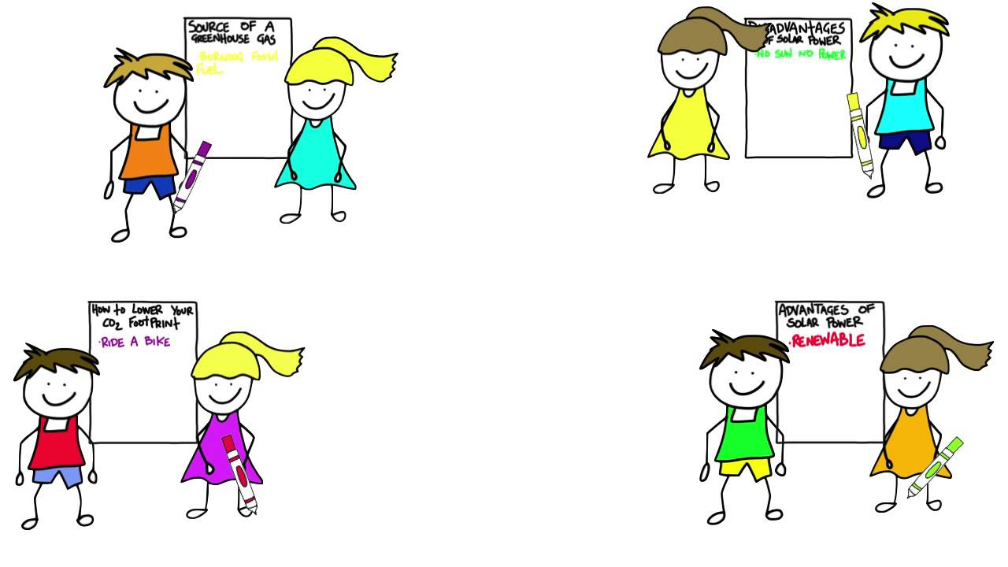
PRODUCTION
Class gallery
Students can:
go and see other’s work
give comments to each other

Slide 17

CONSOLIDATION
1
WRAP-UP
In this lesson, we have learnt to:
listen for specific information about a tour of a city;
write a diary entry about a tour of a city.

Slide 18
CONSOLIDATION
2
HOMEWORK
Prepare for the next lesson: Looking back & Project

Slide 19


