Slide 1

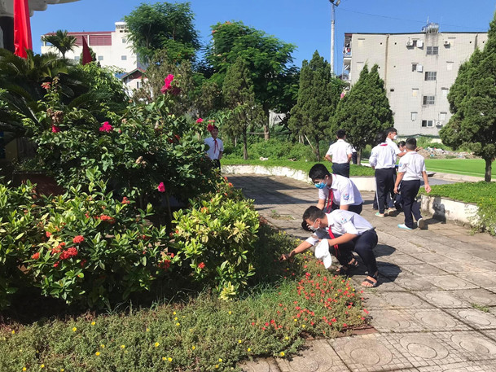
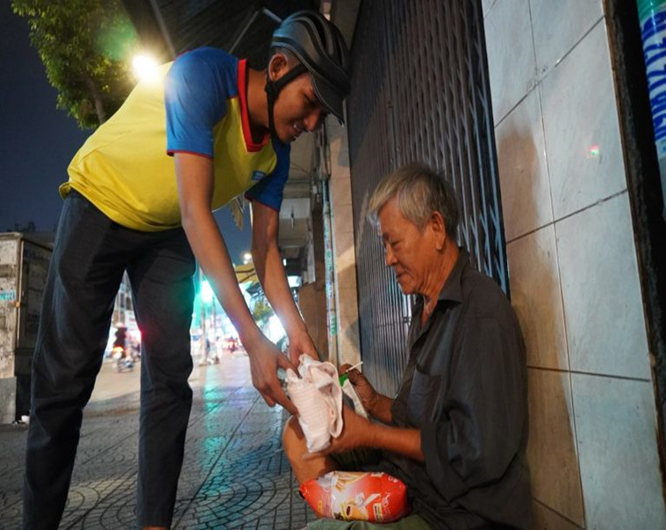
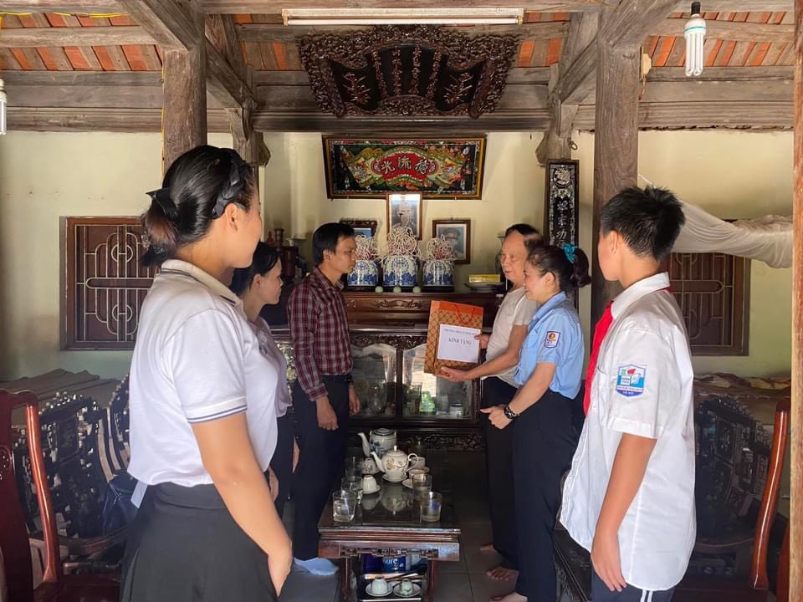
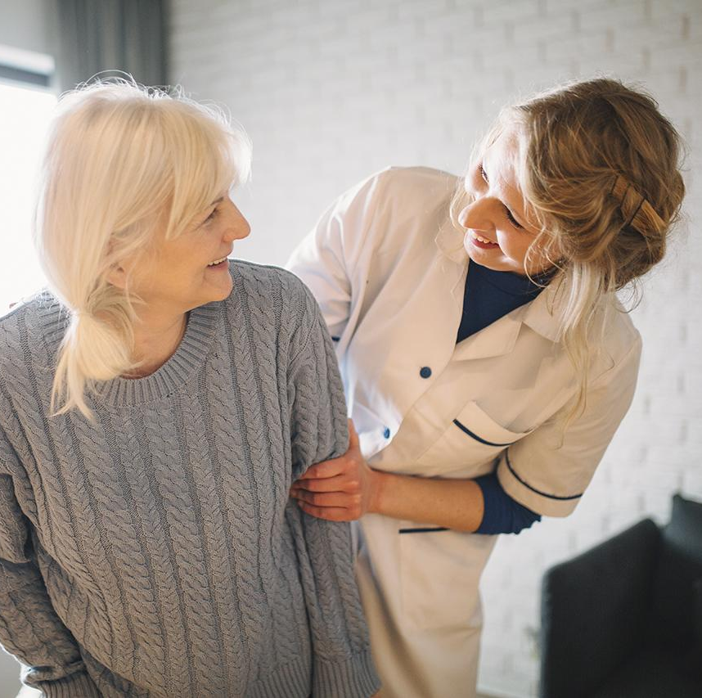
Unit 3
Community Service
Lesson 1: Getting started
Sounds like great work!

Slide 2


Slide 3
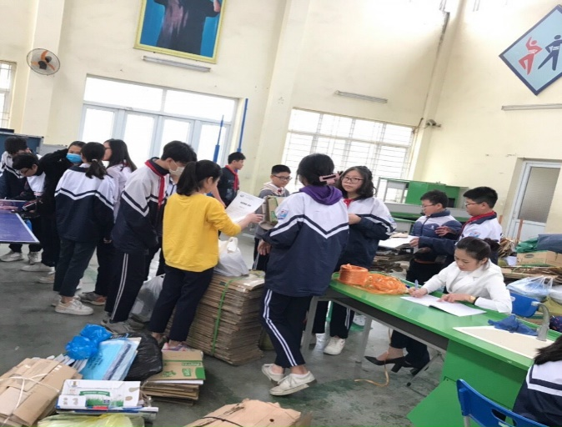

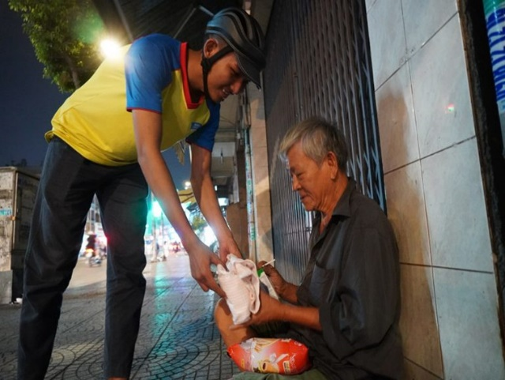
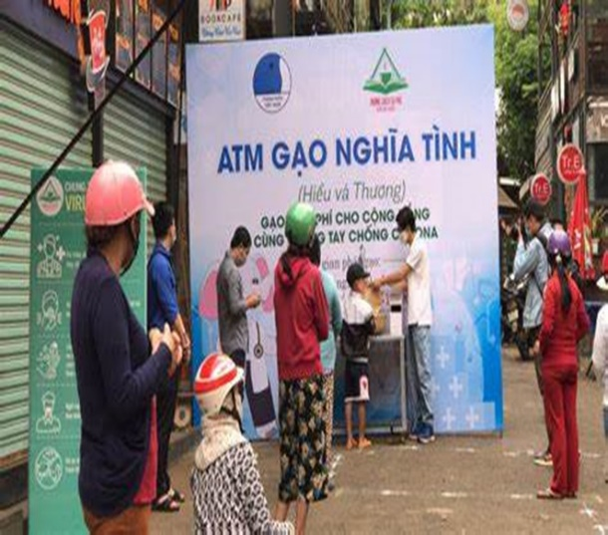
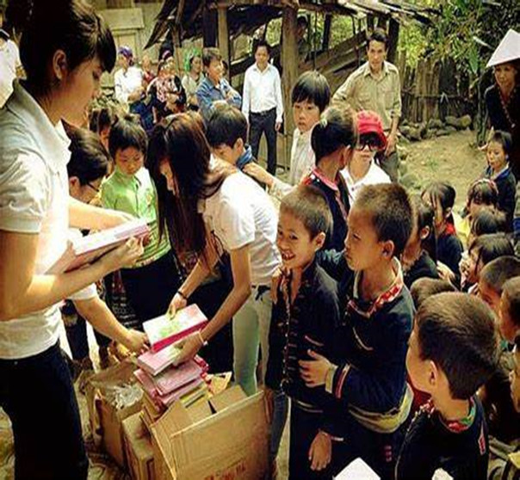
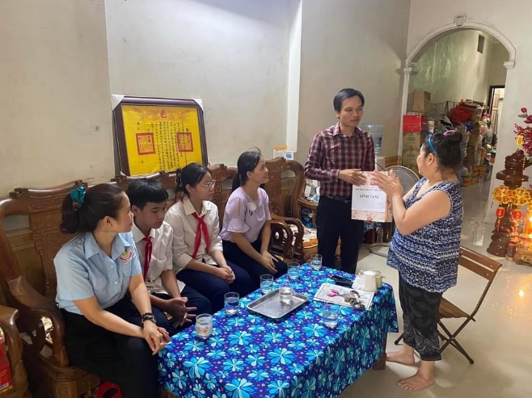
collect used paper
pick up litter
donate food
donate money
donate rice
give old books

Slide 4
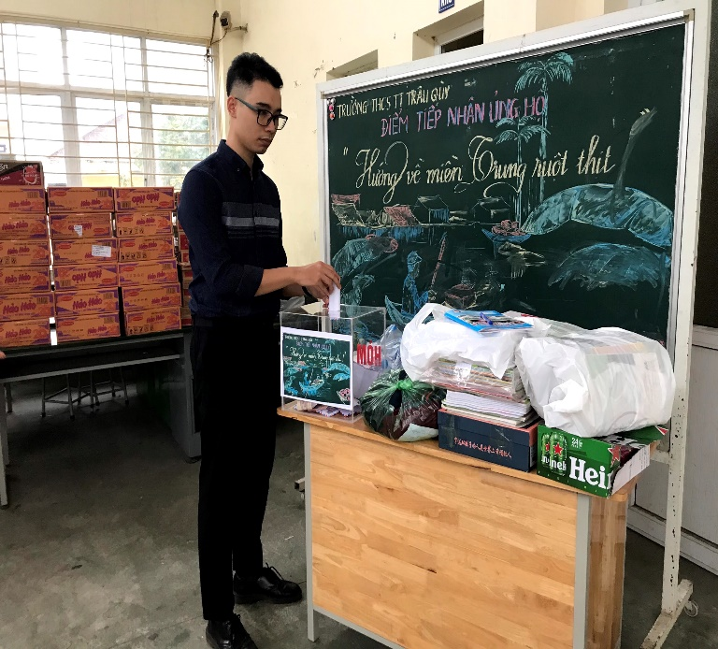
Community service

Slide 5
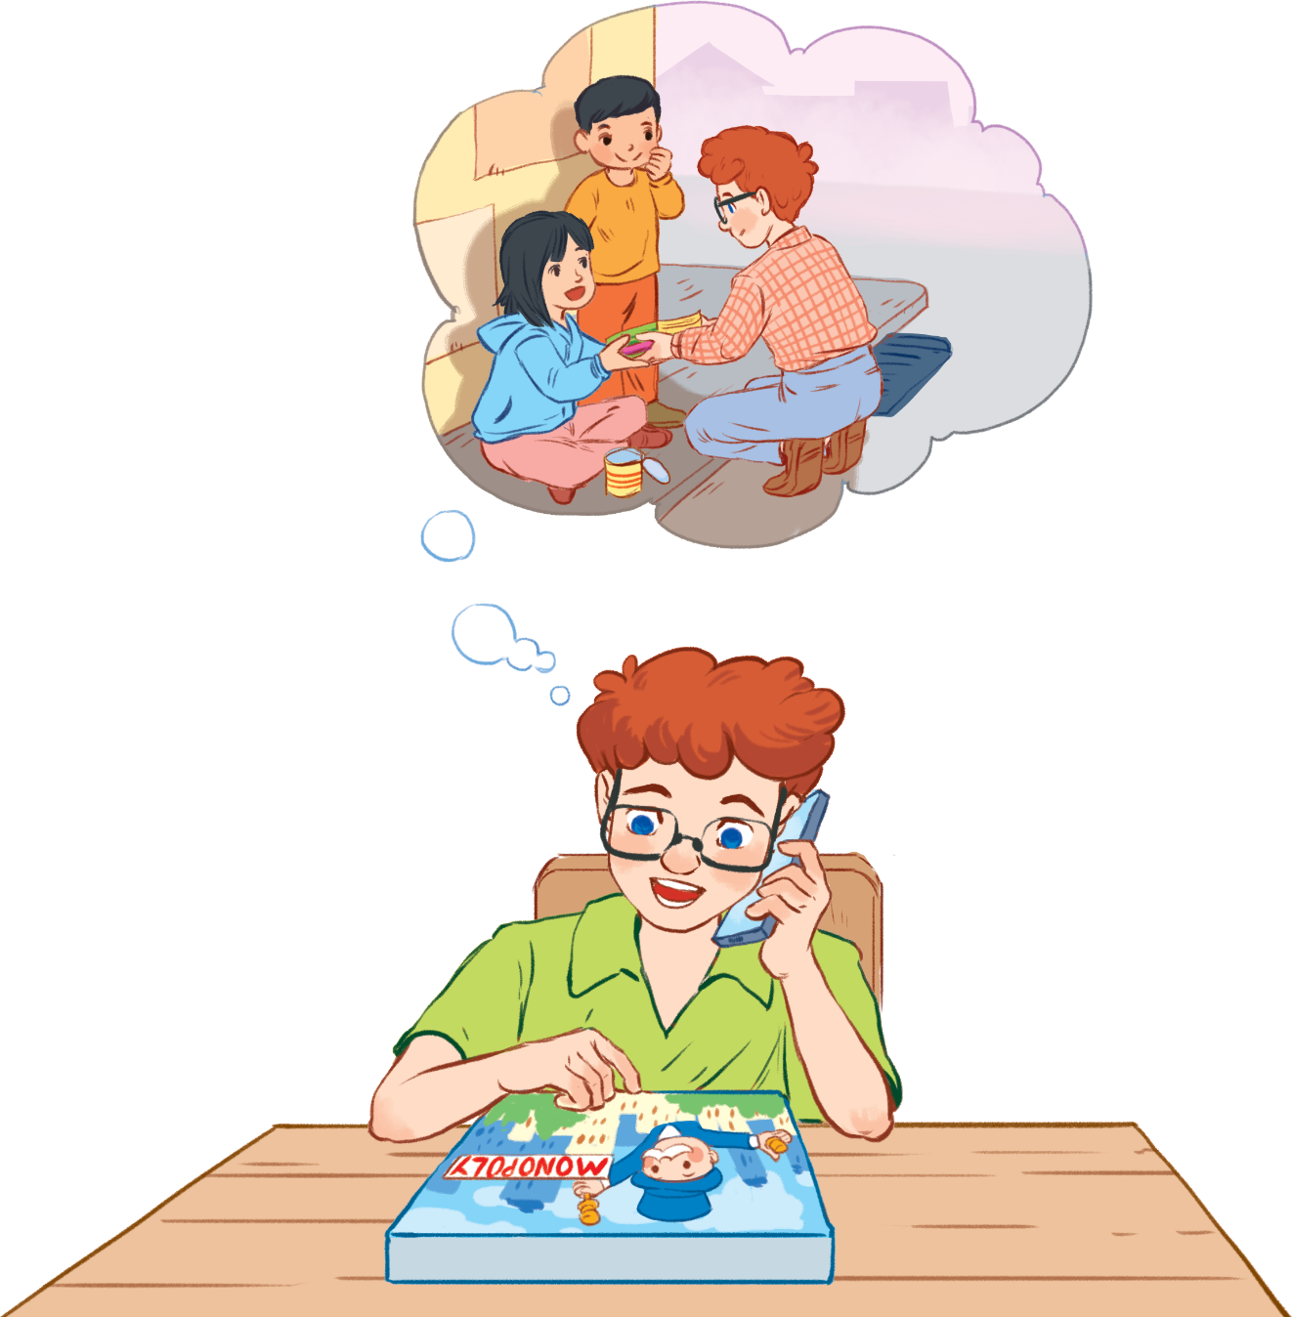
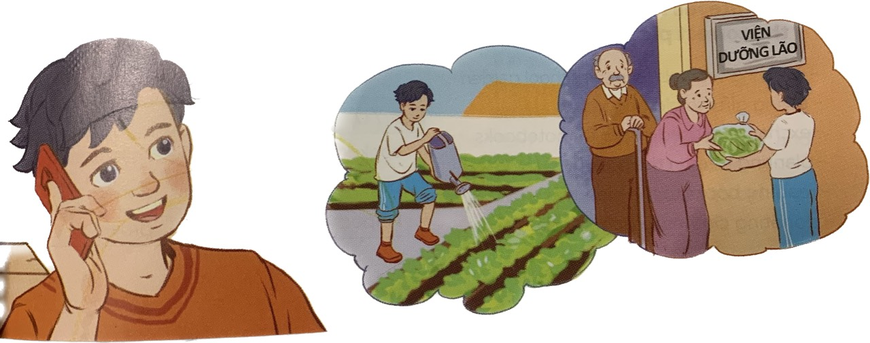

Slide 6

recycle (v)
/ˌriːˈsaɪ.kəl/
tái chế

Slide 7
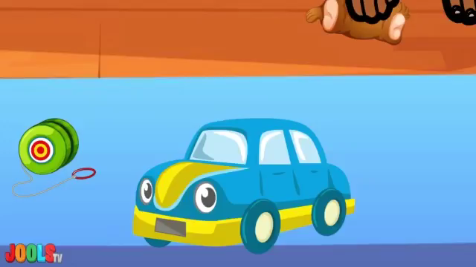
pick up (phr.v)
/pik/ /ʌp/
nhặt

Slide 8

donate (v)
/dəʊˈneɪt/
quyên góp, ủng hộ

Slide 9
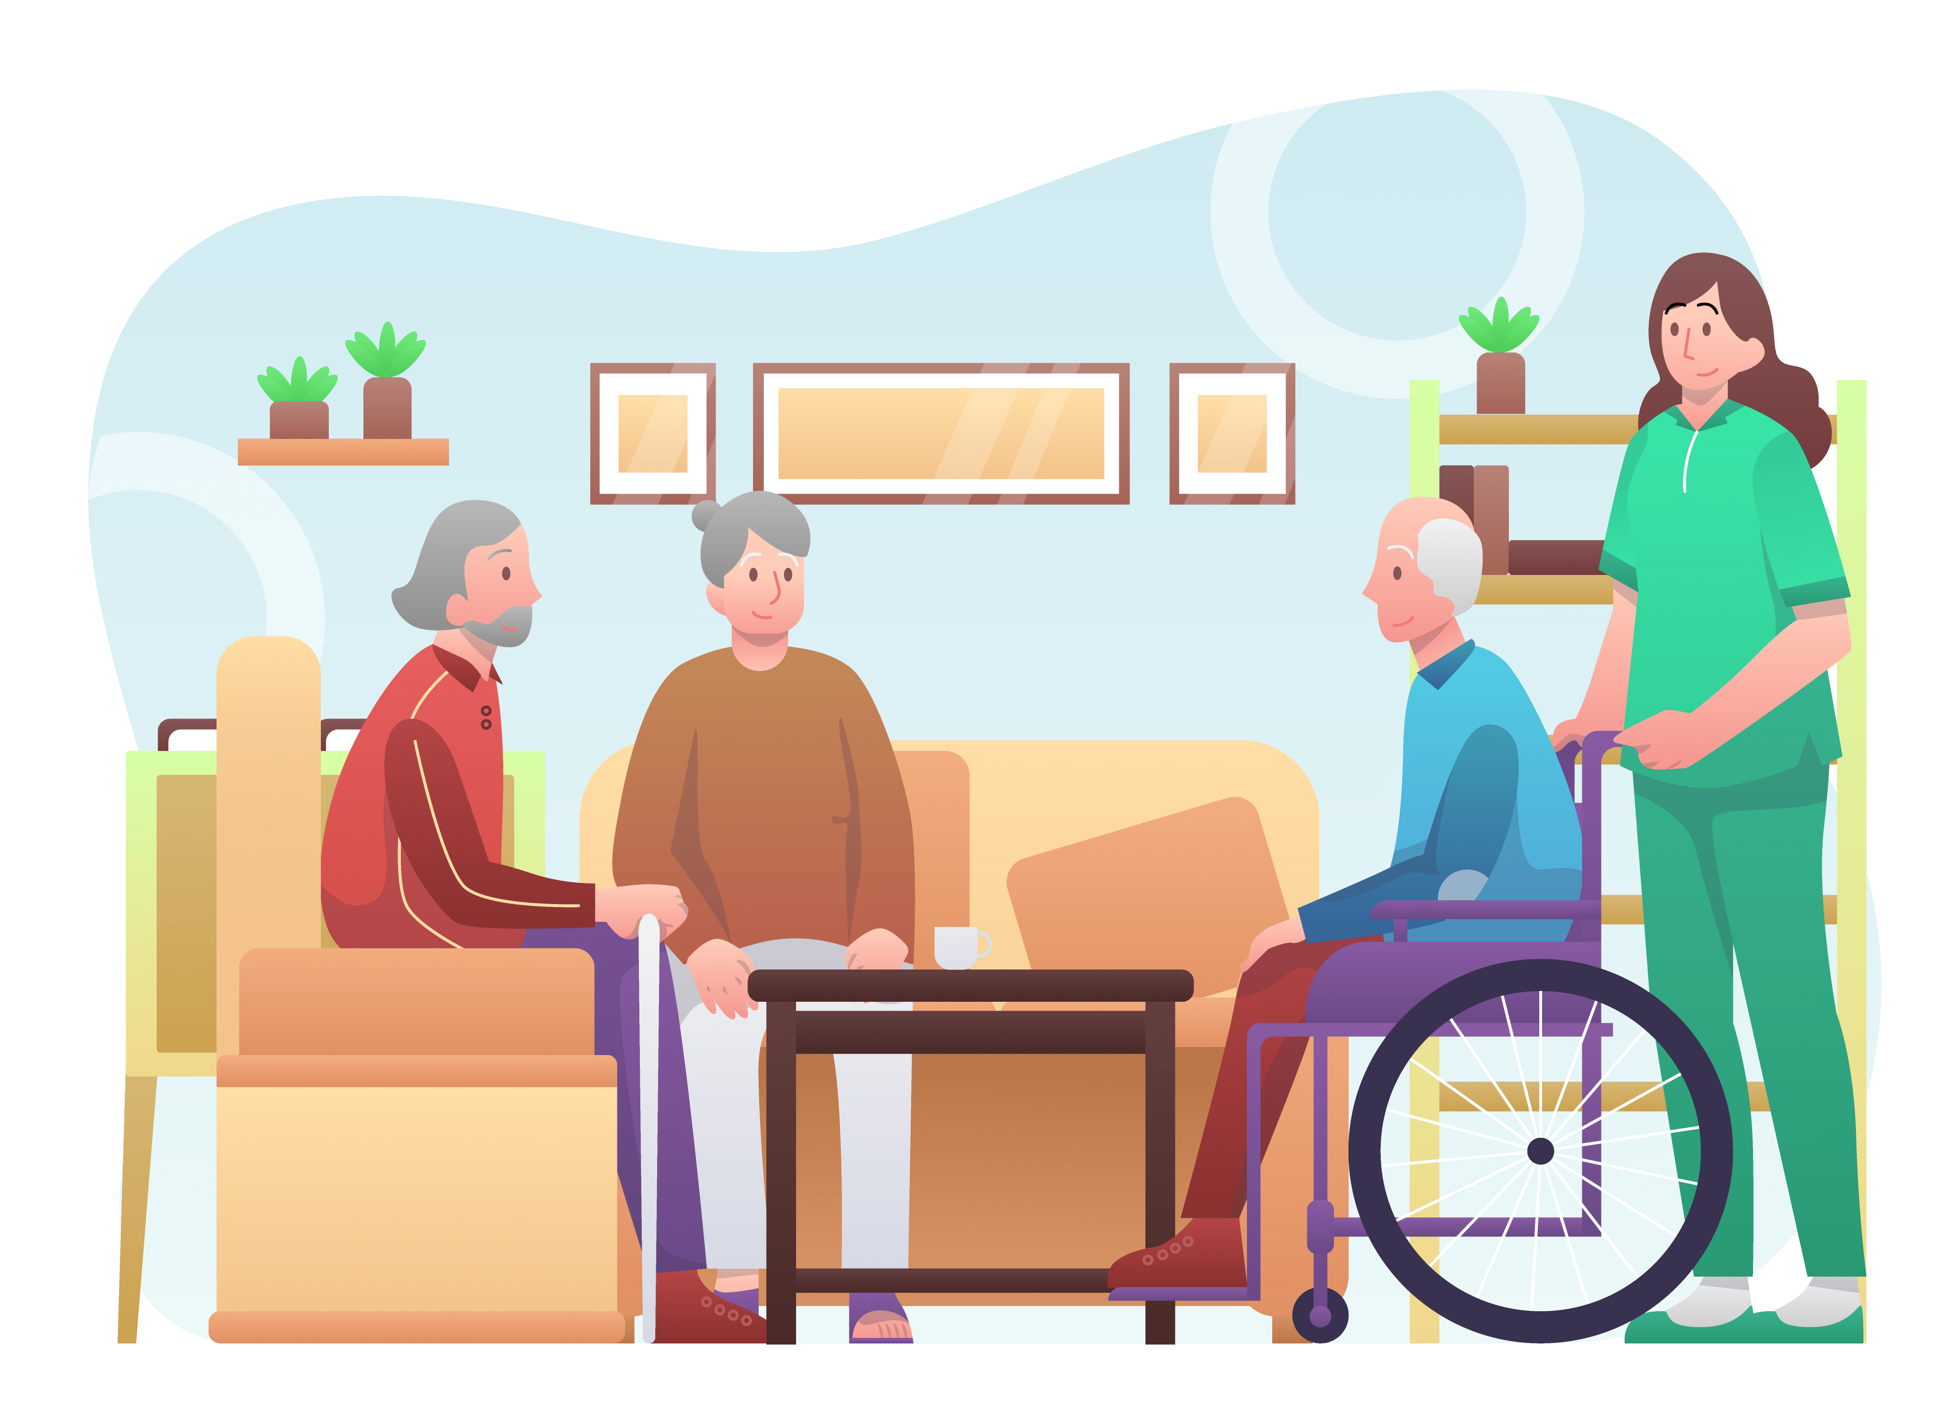
nursing home (n.phr.)
/ˈnɜːsɪŋ həʊm/
viện dưỡng lão

Slide 10
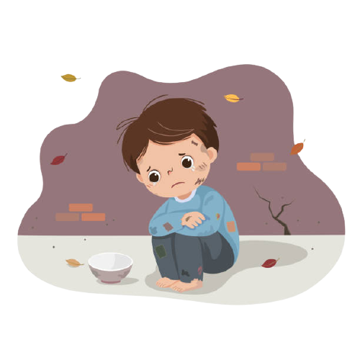
homeless (adj)
/ˈhəʊmləs/
vô gia cư
Eg: People don’t have home. →…people

Slide 11
recycle | /ˌriːˈsaɪ.kəl/ | Tái chế
pick up | /pik/ /ʌp/ | nhặt
donate | /dəʊˈneɪt/ | quyên góp, ủng hộ
nursing home | /ˈnɜːsɪŋ həʊm/ | viện dưỡng lão
homeless | /ˈhəʊmləs/ | vô gia cư

Slide 12
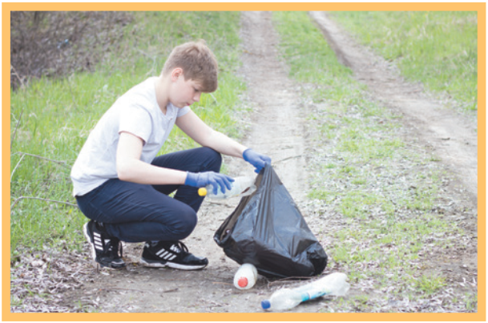
What’s missing?
5
1
3
2
4

Slide 14

Listen and read.
Minh: Hi, Tom. Are you back in Ha Noi?
Tom: Yes. I came back yesterday. Can we meet up this Sunday morning? I bought you a board game.
Minh: Sure, I can’t wait! But our Green School Club will have some community activities on that morning.
Tom: What activities does your club do?
Minh: Well, we pick up litter around our school and plant vegetables in our school garden.
Tom: School gardening? That’s fantastic!
Minh: Yes. We donate the vegetables to a nursing home. Does your school have any activities like these?
Tom: Yes. We donate books to homeless children. We also have English classes. Last summer, we taught English to 30 kids in the area.
Minh: Sounds like great work!
Tom: Thanks.
Minh: ... So, let’s meet in the afternoon then.

Slide 15

Listen and read.
Minh: Hi, Tom. Are you back in Ha Noi?
Tom: Yes. I came back yesterday. Can we meet up this Sunday morning? I bought you a board game.
Minh: Sure, I can’t wait! But our Green School Club will have some community activities on that morning.
Tom: What activities does your club do?
Minh: Well, we pick up litter around our school and plant vegetables in our school garden.
Tom: School gardening? That’s fantastic!
Minh: Yes. We donate the vegetables to a nursing home. Does your school have any activities like these?
Tom: Yes. We donate books to homeless children. We also have English classes. Last summer, we taught English to 30 kids in the area.
Minh: Sounds like great work!
Tom: Thanks.
Minh: ... So, let’s meet in the afternoon then.
Pick up litter

Slide 16
PRACTICE
Minh: Hi, Tom. Are you back in Ha Noi?
Tom: Yes. I came back yesterday. Can we meet up this Sunday morning? I bought you a board game.
Minh: Sure, I can’t wait! But our Green School Club will have some community activities on that morning.
Tom: What activities does your club do?
Minh: Well, we pick up litter around our school and plant vegetables in our school garden.
Tom: School gardening? That’s fantastic!
Minh: Yes. We donate the vegetables to a nursing home. Does your school have any activities like these?
Tom: Yes. We donate books to homeless children. We also have English classes. Last summer, we taught English to 30 kids in the area.
Minh: Sounds like great work!
Tom: Thanks.
Minh: ... So, let’s meet in the afternoon then.
1
Notes:
40 giay

Slide 17

Read the conversation again and tick the appropriate box.
Community activity | Minh’s club | Tom’s club
1. picking up litter
2. planting vegetables
3. donating books
4. donating vegetables
5. teaching English

Slide 18
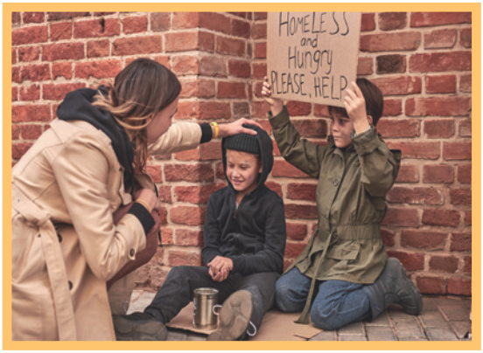
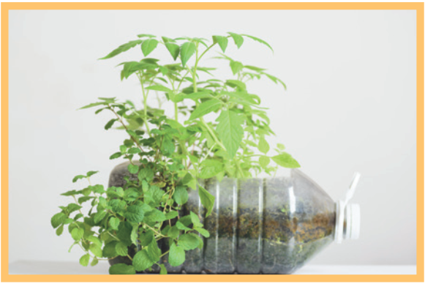
Complete the phrases under the pictures with the verbs below.
pick up clean donate recycle help
pick up
help
recycle
2. ______ homeless children
3. _______ plastic bottles
1. ________ litter

Slide 19
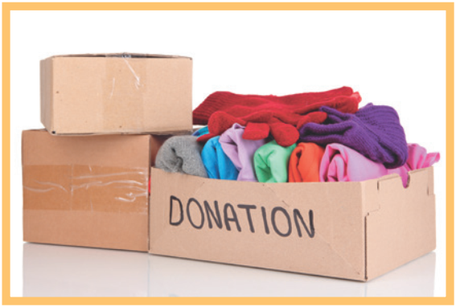
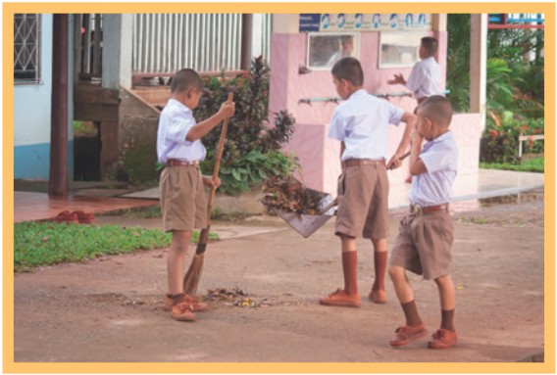
Complete the phrases under the pictures with the verbs below.
pick up clean donate recycle help
donate
4. _________clothes
clean
5. ________ the playground

Slide 20
recycle
pick up
help
_______ plastic bottles
________ litter
______ homeless children
_________ clothes
donate
clean
________ the playground

Slide 21



Complete the sentences with the correct words or phrases below.
old people homeless children planted litter taught
1. We collected clothes and gave them to _________________.
2. Those students picked up all the __________ on the street.
3. We helped ____________ in the nursing home last Sunday.
4. The club members ________ maths to primary students during school holidays.
5. We __________ a lot of trees in the park last summer.
homeless children
litter
old people
taught
planted

Slide 22
4
Complete the sentences with the correct words or phrases below.
1. We ………. clothes and gave them to homeless children.
1. We ……… clothes and gave them to ……….. children.
1. We ……….. clothes and gave them to ………… ………….
2. street the on litter all up picked students those.
3. We / help old people / nursing home / last Sunday.
4. The club members/ during school holidays/ to primary students/ taught maths/./
5. We planted a lot of trees in the park last summer.

Slide 23
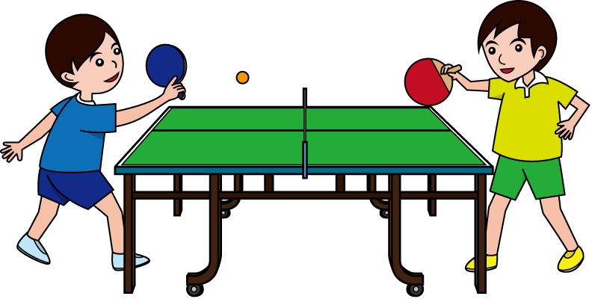

Game: Vocabulary Ping-pong
Work in two teams.
Team A provides a cue word.
Team B makes up a sentence with it.
Then switch roles.
Example:
Team A: pick up
Team B: We often pick up litter in the park. plant
Team A: We plant trees in our school every year. Book
Team A: …

Slide 24
HOMEWORK
-Learn new words by heart, write 3 lines each word.
- Make 3 sentences using the words/ phrases you have learnt today about community activities.
- Prepare A closer look 1: /ed/ sound.

Slide 25

Thank You

