Slide 1


Slide 2
WARM UP: QUESTION WORDS
Students list all question words that they have learnt in chat box.

Slide 3
Monday, October 18th, 2021. Unit 3: Peoples of Vietnam Period 19: Practice: Articles and Questions

Slide 4
QUESTIONS Ex1: Use the right question words to complete the following questions.
1. ………………. do the Pathen people live?
– In Ha Giang and Tuyen Quang.
2. ……………….of your parents speak Tay language in your family ?
– My father can.
3..……………….is the costume of the Lolo people?
– I’m not sure. But I think it’s quite expensive.
4.……………….is it from the town centre to the nearest Chut village?
– About 35 kilometres.
5..……………….musical instruments are on display in the museum?
– The Coho’s

Slide 5



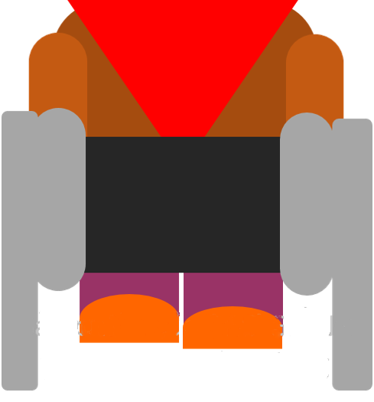
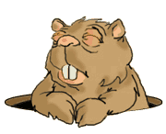

Treasure hunt
Start

Slide 6
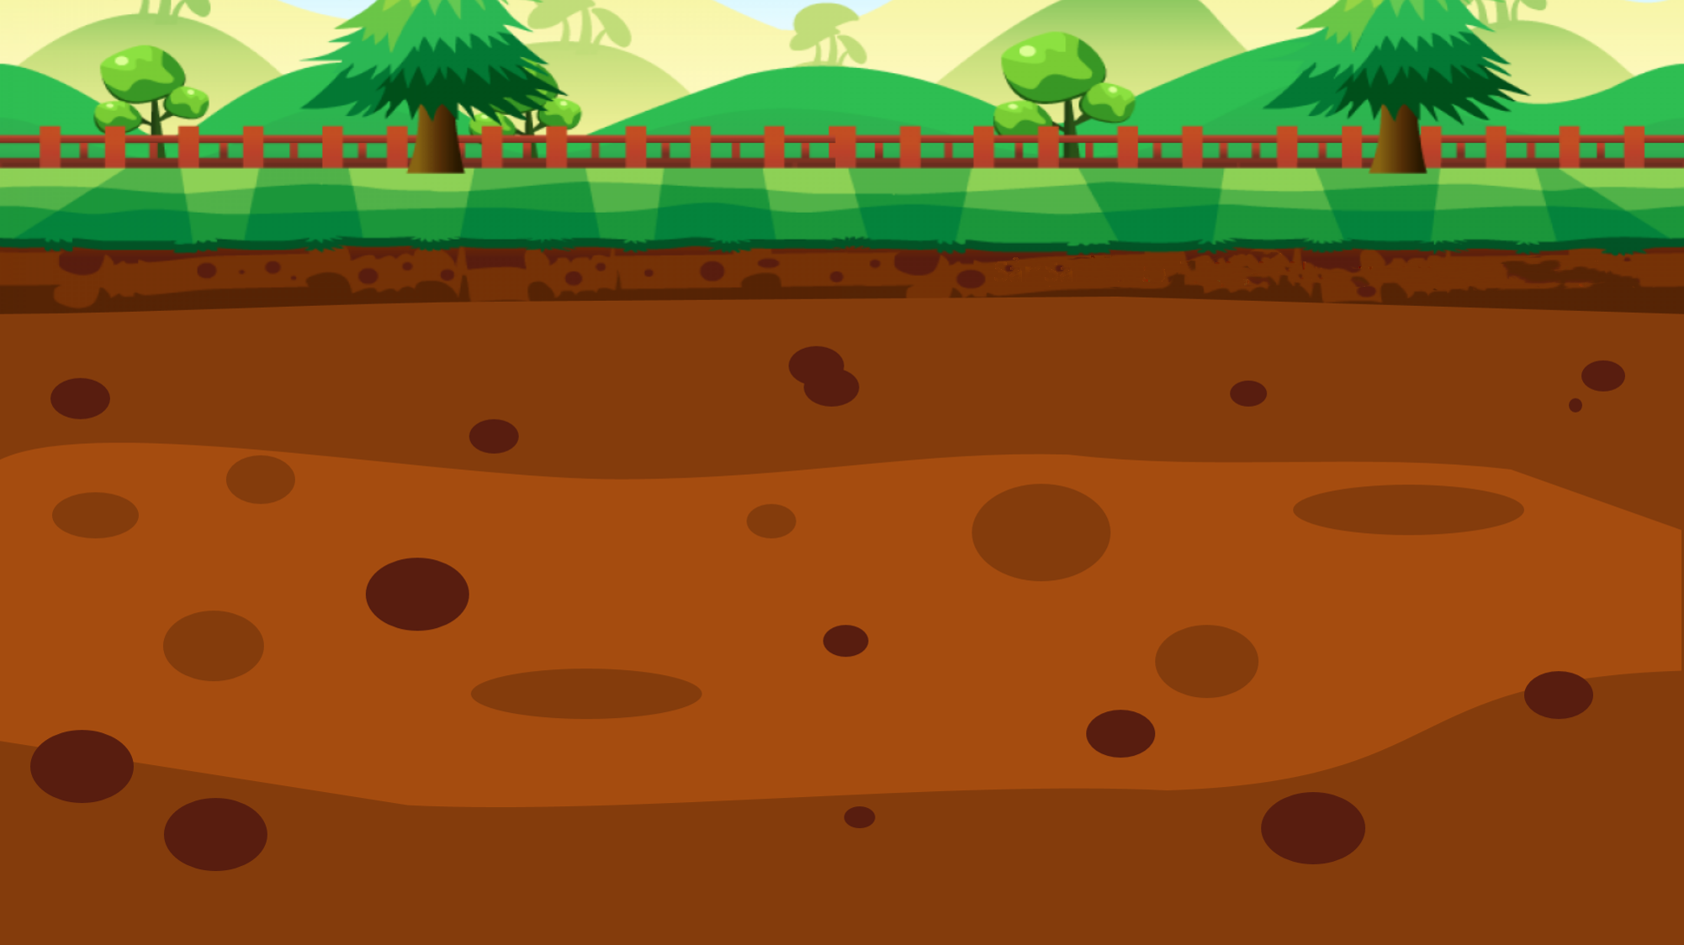


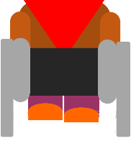



CORRECT
100$
150$
50$
20$
10$
100$
10$
150$
50$
20$
FINISH

Slide 7
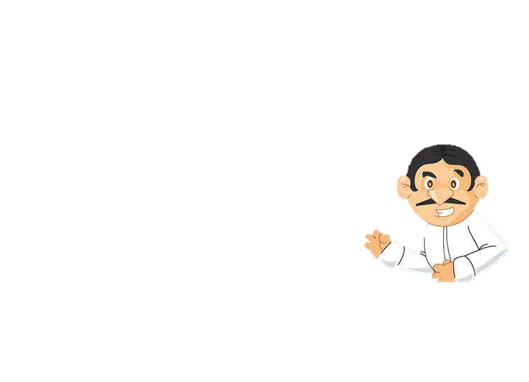
3..……………….is the costume of the Lolo people?
– I’m not sure. But I think it’s quite expensive.
A: How much
B: How long
C: How
D: How many
Incorrect! Try again!

Slide 8
1. ……………….of your parents can speak Tay language ?
– My father can.
A:What
B: Who
C: Whose
D: Which
Incorrect! Try again!

Slide 9
2. ………………. do the Pathen people live?
– In Ha Giang and Tuyen Quang
A: How
B: What
C: Where
D: Who
Incorrect! Try again!

Slide 10
5.………….musical instruments are on display in the museum?
– The Coho’s
A: Which
B: Whose
C: What
D: Where
Incorrect! Try again!

Slide 11
4..………is it from the town centre to the nearest Chut village?
– About 35 kilometres.
A: What
B: How long
C: How
D: How far
Incorrect! Try again!

Slide 12
Ex2: Write questions for the underlined parts of the following sentences.
1.Mr.Pha goes cutting wood in the forests once a month.
2. Artists from the Central Highlands will give cong performances in the festival.
3. My father bought a costume of the Bahnar at an open-air market in Kon Tum.
4. The Hani people live in Lai Chau and Lao Cai.
5. The Coho celebrate their New Year holidays in December.
6. The visitors got to the Sila village on foot.
7. My uncle has been to Quang Nam to write an article about the Sedang.

Slide 13
Ex2: Write questions for the underlined parts of the following sentences.
1.Mr.Pha goes cutting wood in the forests once a month.
How often does Mr.Pha go cutting wood in the forest?
2. Artists from the Central Highlands will give cong performances in the festival.
Who will give cong performances in the festival ?
3. My father bought a costume of the Bahnar at an open-air market in Kon Tum.
What did your father buy at an open-air market in Kon Tum?
4. The Hani people live in Lai Chau and Lao Cai.
Where do the Hani people live?
5. The Coho celebrate their New Year holidays in December.
When do the Coho celebrate their New Year holidays?
6. The visitors got to the Sila village on foot.
How did the visitors get to the Silla village?
7. My uncle has been to Quang Nam to write an article about the Sedang.
Why has your uncle been to Quang Nam?

Slide 14
ARTICLES: A, AN, THE
1. A, An : đứng trước DT đếm được số ít và DT đó được nhắc tới lần đầu
- A: được dùng với nghĩa giống từ “any” (bất kì), “every” (mọi, mỗi)
-An: - đứng trước từ bắt đầu bằng 1 nguyên âm (dựa vào phát âm)
E.g: an hour, an unimportant book
a uniform , a university
2. The:
Đứng trc DT đã đc nhắc trước đó, hoặc cả ng nói và ng nghe đều biết rõ.
A: I have a cat.
B: The cat is so pretty.
Đứng trước DT chỉ sự vật là duy nhất: the sun, the moon, ………
Dùng trong câu so sánh nhất

Slide 15
Ex3. Insert a correct article (a, an, the) to complete the following sentences.
the
1. Among 54 ethnic groups in Viet Nam, the Odu group has …………..…. smallest population.
2. There is ………………stilt house in my grandparents’ village.
3. In Tay families, old people usually stay at home to look after………….house.
4. Although Phong is a member of the Nung Ethnic group, he wears……………..….uniform when he goes to school.
5. This is ……………….old costume of the Pu peo people.
6. The chapi is …………….….unique musical instrument of the Raglai people.
7. Gathering and hunting still play ……..important role in the ecomony of the Laha.
8. Recently, Thai men prefer to wear …………….Kinh’s style of dress.
a
the
a
an
a
an
the

Slide 16
HOMEWORK
Revise the use of question words, how to make questions and the uses of articles
Prepare next lesson: Skills 1

Slide 17


