Slide 1
VAN DUC LOWER SECONDARY SCHOOL
UNIT 5
NATURAL WONDERS OF VIETNAM
Lesson 3 A closer look 2
Grammar
Countable and uncountable nouns

Slide 2
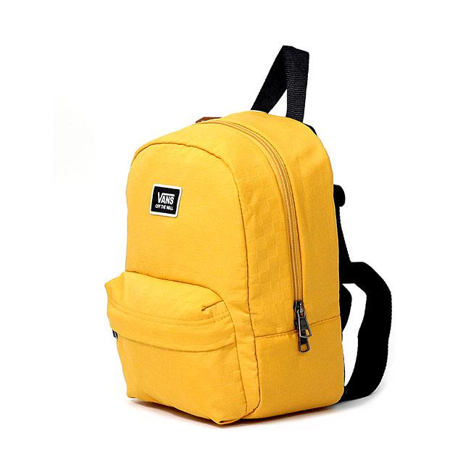
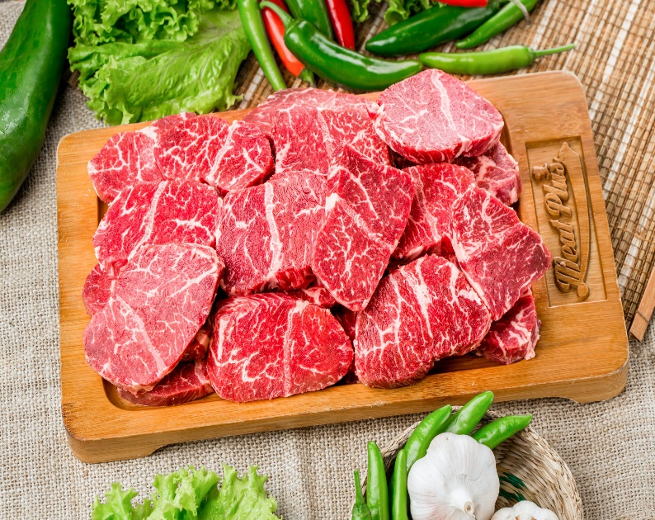
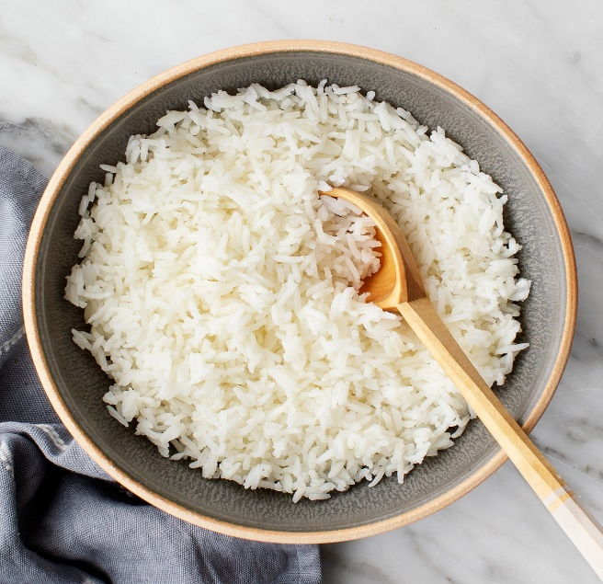
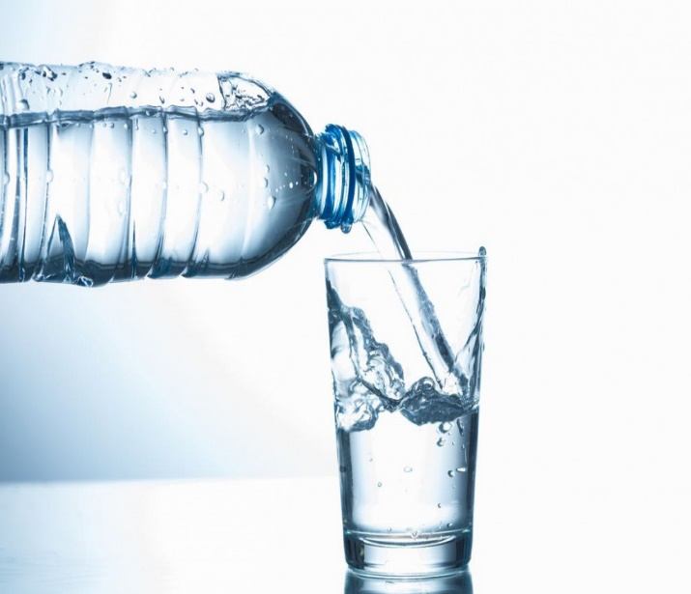


Countable or uncountable?

Slide 3



Countable or uncountable noun?
Uncountable
Countable

Slide 4


Grammar
1. Countable and uncountable nouns (Group 1)
- Countable nouns are for the people and things we can count using numbers. Countable nouns can be singular: a rock, an island ..., or plural: rocks, islands ...
Ex: There is an island in my country.
There are two islands in my country.
- Uncountable nouns are for the things that we cannot count with numbers. They usually do not have a plural form: cream, chocolate ...
Ex: I have some chocolate.

Slide 5


Is the underlined noun countable or uncountable? Write C (countable) or U (uncountable).
1.
The children are very tired after a day of fun.
C
2.
Be careful! The water is deep.
U
3.
My mother uses real butter in the cakes she bakes.
U
4.
Remember to bring the necessary travel items.
C
5.
How about meeting in the canteen for some tea?
Sue. What time?
U

Slide 6

Grammar
Countable and uncountable nouns (Group 2)
We use some, many, a few with countable nouns.
Ex: Lan has many books.
Some children enjoy sports.
I see a few glasses in the cupboard.
- We use some, much, a little with uncountable nouns.
Ex: Would you like some tea?.
She doesn't eat so much food everyday.
I have a little money.

Slide 7

Choose the correct option for each sentence.
1.
I have questions to ask you.
A.
a few
B.
a little
2.
Australia is very nice. It has natural wonders.
A.
much
B.
many
3.
This is a difficult lesson, so only students can understand it.
A.
a few
B.
many
4.
It is a very dry area. There isn’t rain in summer.
A.
a little
B.
much
5.
We’ve got very time before our train leaves.
We must hurry up!
A.
little
B.
much

Slide 8

Fill each blank with a, any, some, much or many.
How books are there in your bag?
1.
many
any
2.
There isn’t milk in the fridge.
It’s empty.
much
3.
How sugar do you need for your tea, Mum?
4.
We need to buy new furniture for the house.
some
5.
There is
a
big cave in this area.
big cave in this area.

Slide 9
Grammar
Modal verb: must / mustn’t
Let’s recall the conversation from GETTING STARTED

Slide 10
Geopraphy Club
Alice: Hello, welcome to our Geography Club.
(Knock at door)
Alice: Come in, Elena. We’re just starting now.
But remember you must always be on time.
Elena: Sure. Sorry.
Alice: Today I’m going to talk about some natural wonders of Viet Nam.
Nick: Great! What’s that in the first picture?
Alice: It’s Ganh Da Dia in Phu Yen.
Elena: Wow. It looks amazing!
Nick: Is picture 2 Ha Long Bay?
Alice: Right. What do you know about it?
Nick: It has many islands.
Alice: Yeah! The scenery is wonderful. This picture shows Tuan Chau, a large island.
Tommy: How about picture 3?
…

Slide 11
Grammar
Modal verb: must / mustn’t (Group 3
- We use must to say that something is very necessary or very important:
- We use mustn’t to say that doing something is not allowed:
S + must + V (bắt buộc phải làm gì)
Ex: She must do her homework every day.
S + mustn’t V (không được phép làm gì)
Ex: We mustn't make any noise.

Slide 12

Fill each blank with must or mustn’t.
You leave the hotel room before 12 o’clock.
1.
must
mustn’t
2.
You make lots of noise in the museum.
3.
My mum says you
must
always tell the truth.
always tell the truth.
mustn’t
4.
You know you go to bed with your shoes on.
5.
I want to speak English better.
I
practice more.
must
practice more.

Slide 13

Read the classroom rules below. Write some more rules for you and your classmates.
1.
We must arrive on time.
2.
We mustn’t pick flowers in the school garden.
3.
We must .
4.
We mustn’t .
5.
.

Slide 14
Homework
Summarise the main points of the lesson.
Ask Ss to make sentences, using must/mustn’t.
Homework
Learn the theory by heart.
Do the exercises on your notebook.

Slide 15
Thanks for your attention

