Slide 1
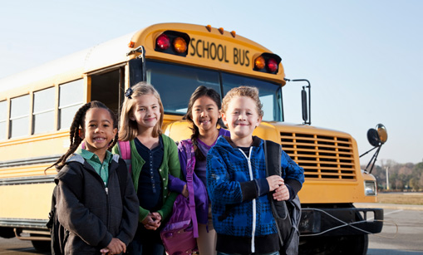
WELCOME TO GROUP 2

Slide 2
UNIT 1
Monday, October 15th , 2012
MY NEW SCHOOL
LESSON 4
COMMUNICATION

Slide 4

WELCOME TO MY CLASS
Good morning Everybody

Slide 5
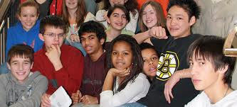
Chatting:
1. Warm-up :
Do you have many friends?
b. Do you have any new friends?
c. Do you love them? Why? Or why not?

Slide 6
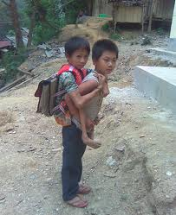
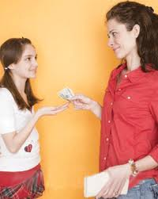
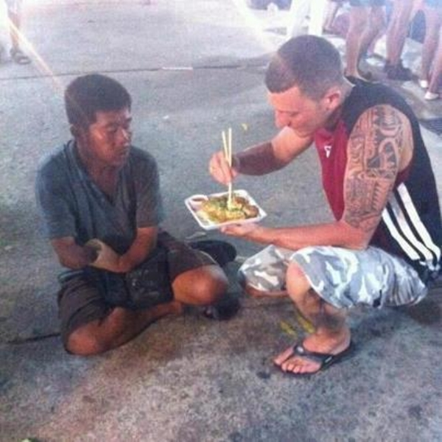


Monday, October 15th,2012
Unit 1: My New School
Lesson 4 : Communication
New words:
- (to) remember :
(to) help :
(to) share :
a classmate :
pocket money (n):
nhớ
giúp đỡ
chia sẻ
helps
He his friend go to school every day.
shares
This man his food with the beggar.
bạn cùng lớp
tiền tiêu vặt

Slide 7


What and Where
remember
remember
1
share
share
2
classmate
classmate
3
help
4
help
pocket money
pocket money
5

Slide 8

Guiding Questions:
How do you often make friends ?
b. What do you often say when you first meet a new friends ?
c. What questions do you often make ?

Slide 9
2. Game: Making Friends
√
Are you from around here?
Do you like pop music?
How much pocket money do you get?
What’s your favorite subject at school?
Are you hungry?
Do you play football?
How do you get to school every day?
Where do you go shopping?
√
√
√
√

Slide 10
Work in groups of four
Write two more questions on a piece of paper:
Example:
Where do you live?
- What’s your telephone number?

Slide 11
3. Frienship Quiz:
A good friend must be:
kind,
friendly,
helpful,
honest,
faithful,....

Slide 12
4.Interview:
Yes
No
1.Do you remember all your new
classmate’s name?
2.Do you help your teacher in the class?
3.Do you share things with your classmates?
4.Do you keep quiet when your teacher is
talking?
5.Do you play with your classmate at break time?
6.Do you help your classmates with their
homework?
7.Do you travel to school with your classmates?
8.Do you listen when your classmates are talking?

Slide 13

Work in groups of four.
Take turns to interview the others.
Write "Y" or "N"

Slide 14
1. Do you remember all your new classmates’ names? | ... | ... | ...
2. Do you help your teacher in the class?
3. Do you share things with your classmates?
4. Do you keep quiet when your teacher is talking?
5. Do you play with your classmates at break time?
6.Do you help your classmates with their homework?
7. Do you travel to school with your classmates?
8.Do you listen when your classmates are talking?

Slide 15
1. Do you remember all your new classmates’ names? |  | ... | ...
2. Do you help your teacher in the class?
3. Do you share things with your classmates?
4. Do you keep quiet when your teacher is talking?
5. Do you play with your classmates at break time?
6.Do you help your classmates with their homework?
7. Do you travel to school with your classmates?
8.Do you listen when your classmates are talking?
Lan
Ha
Van
Y
Y
Y

Slide 16
Class Presentation:
Example:
1. Lan remembers all her new classmates’ names, shares things with her classmates, helps them with their homework.
2. Ha…….
3. Van …….

Slide 17







Thank you
for
your attention !

