Slide 1













An Tay A Primary School
Welcome to our class !
Teacher: Bui Tran Anh Thu

Slide 2


AN TAY A PRIMARY SCHOOL
An Tay A Primary School
Welcome to our class!
Teacher: Bui Tran Anh Thu

Slide 3


WARM UP

Slide 4



Saturday, January 19th ,2013
REVIEW

Slide 5
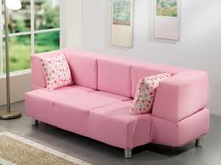
What’s this?
a sofa

Slide 6
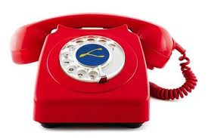
What’s this?
a telephone

Slide 7
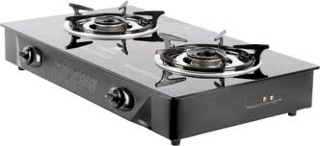
What’s this?
a stove

Slide 8

What’s this?
a bed

Slide 9
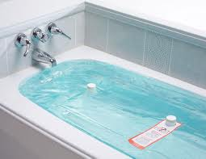
What’s this?
a bathtub

Slide 10
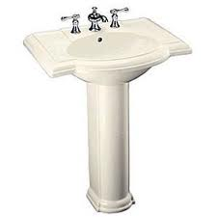
What’s this?
a sink

Slide 11
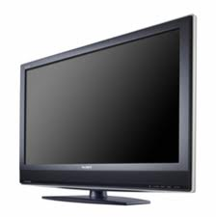
What’s this?
a TV

Slide 12
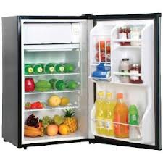
What’s this?
a refrigerator

Slide 13

What’s this?
a lamp

Slide 14
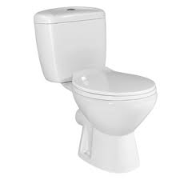
What’s this?
a toilet

Slide 16
Saturday, January 19th ,2013
NEW LESSON

Slide 17

Saturday, January 19th ,2013
Unit 3: MY HOUSE
LET’S LEARN
(Part 2, page 22)
B. Practice the sentence.

Slide 18

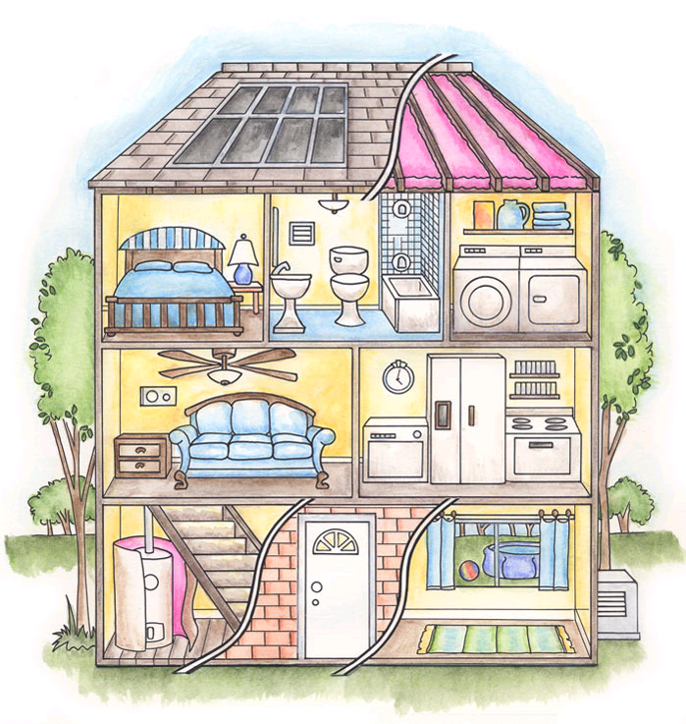
Wednesday, October 31st , 2012
Unit 2:MY HOUSE
Let’s Learn (page 22)
1
This is my ……………
house

Slide 19
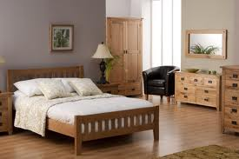
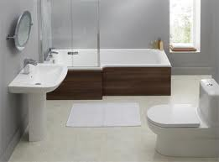
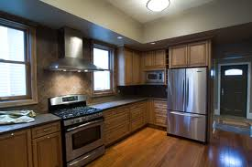
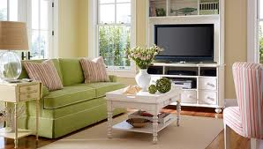
Wednesday, October 31st , 2012
Unit 2:MY HOUSE
Let’s Learn (page 22)
Match the picture with the word:
living room
bathroom
bedroom
kitchen

Slide 20
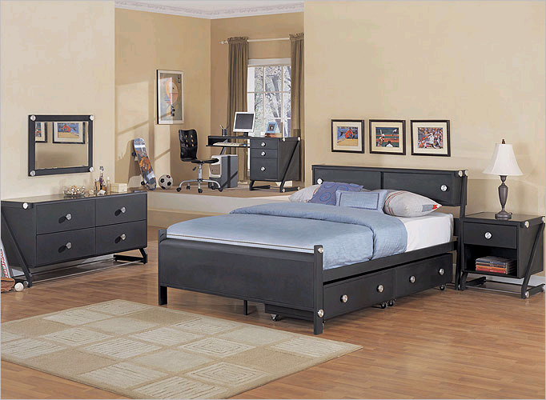
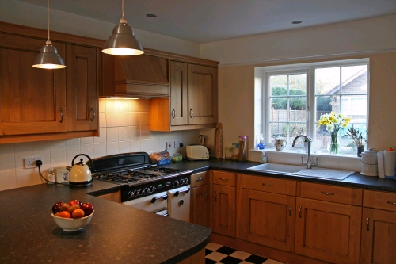
Wednesday, October 31st , 2012
Unit 2:MY HOUSE
Let’s Learn (page 22)
Answer the question:
What is it?
1
2
It’s a bedroom.
It’s a kitchen.

Slide 21
Wednesday, October 31st , 2012
Unit 2:MY HOUSE
Let’s Learn (page 22)
Answer the question:
Is it a living room?
3
No, it isn’t. It’s a bathroom.

Slide 22


Very good!

Slide 23
Wednesday, October 31st , 2012
Unit 2:MY HOUSE
Let’s Learn (page 22)
Answer the question:
bedroom
the
is
bed
a
.
There
in

Slide 24

Supply the suitable words:
bedroom
The bed is in the ………………….

Slide 25
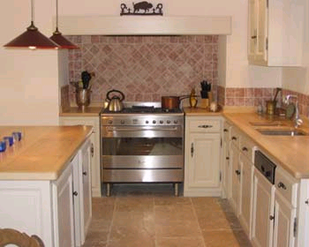
Supply the suitable words:
kitchen
The stove is in the …………………….

Slide 26
Supply the suitable words:
bedroom
The bed is in the ………………….

Slide 27
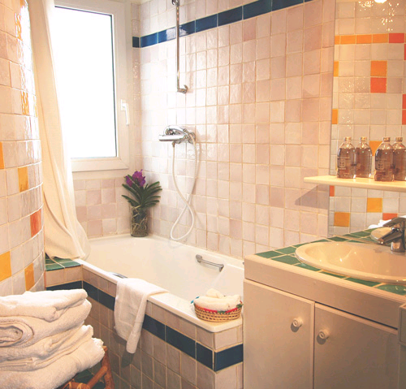
Match and say the sentences:
1
2
3
a) bathtub
b) stove
c) bed

Slide 28
Wednesday, October 31st , 2012
Unit 2:MY THINGS
Let’s Learn (page 12)
1. Activity 1: Say the sentense.
There is
= There’s
There is _____ in the__________.
a sofa
living room
There’s _____ in the__________.
a TV
living room

Slide 29
Wednesday, October 31st , 2012
Unit 2:MY THINGS
Let’s Learn (page 12)
There’s a picture in the bedroom.
There’s bed in the bedroom.
There’s a lamp in the bedroom.

Slide 30
Wednesday, October 31st , 2012
Unit 2:MY THINGS
Let’s Learn (page 12)
There’s a refrigerator in the kitchen.
There’s a stove in the kitchen.

Slide 31
Wednesday, October 31st , 2012
Unit 2:MY THINGS
Let’s Learn (page 12)
There’s a sink in the bathroom.
There’s a bathtub in the bathroom.
There’s a toilet in the bathroom.

Slide 32
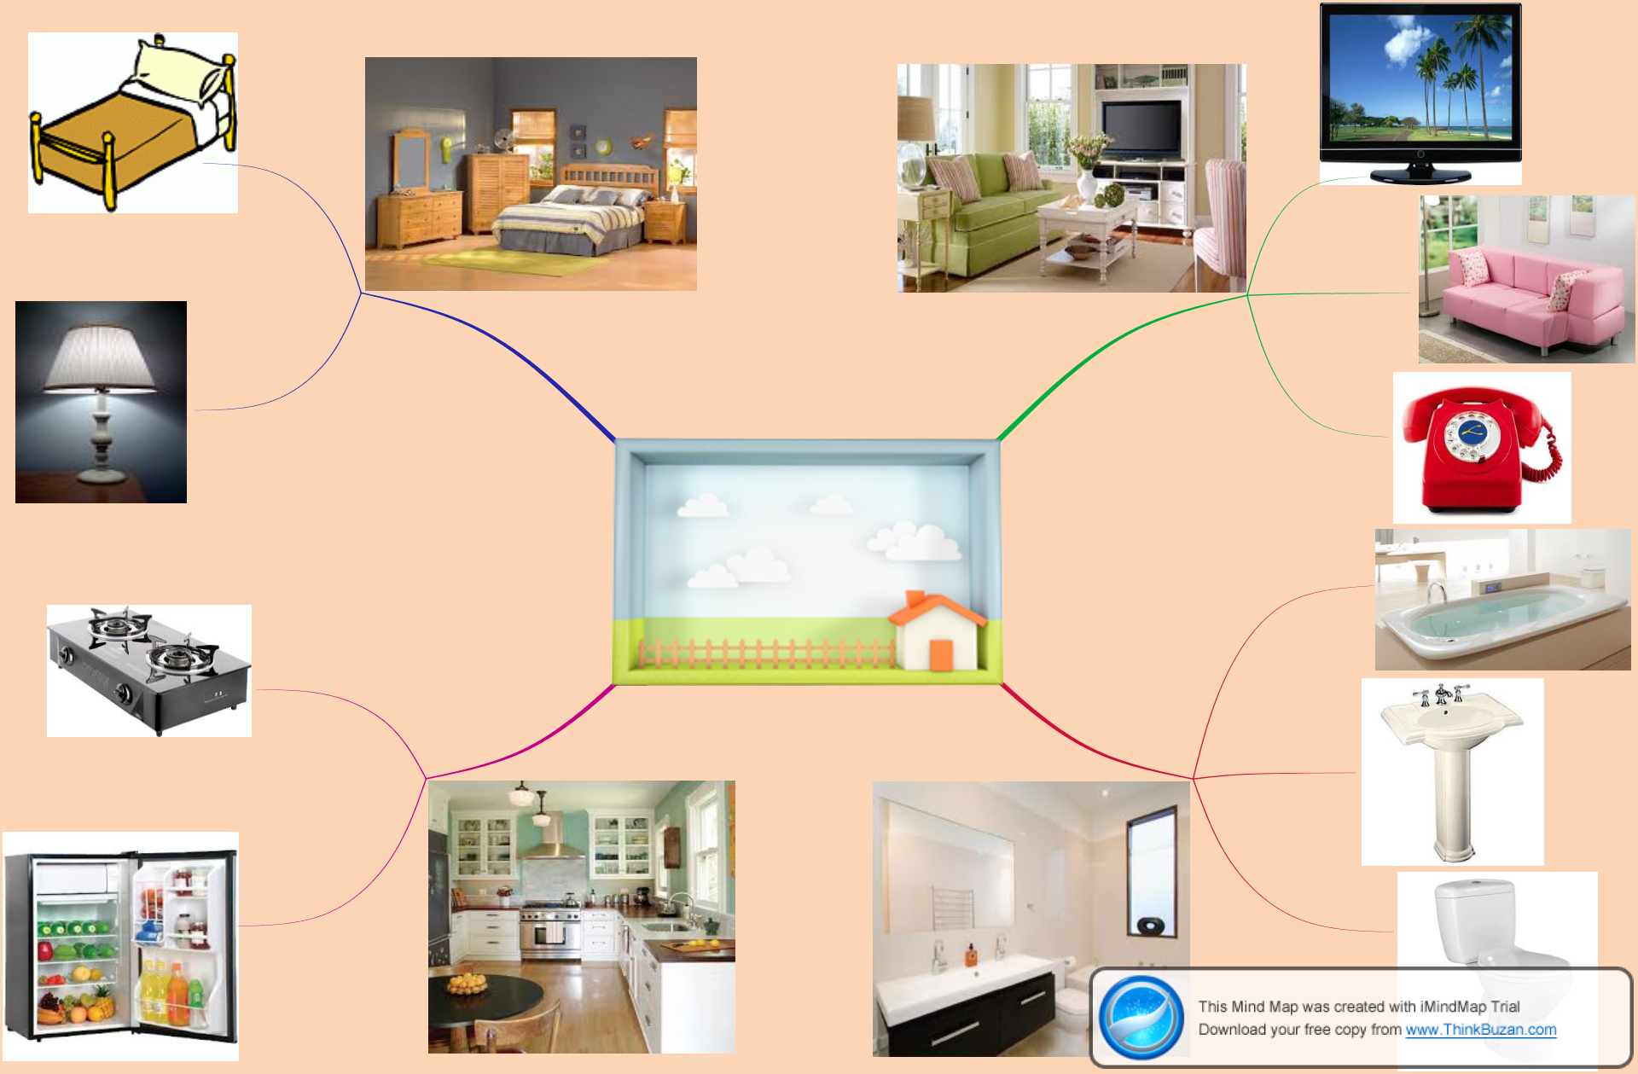

Slide 33
Wednesday, October 31st , 2012
Unit 2:MY THINGS
Let’s Learn (page 12)
1. Activity 2: Write the sentences:
Open your book page 22 part B.

Slide 34
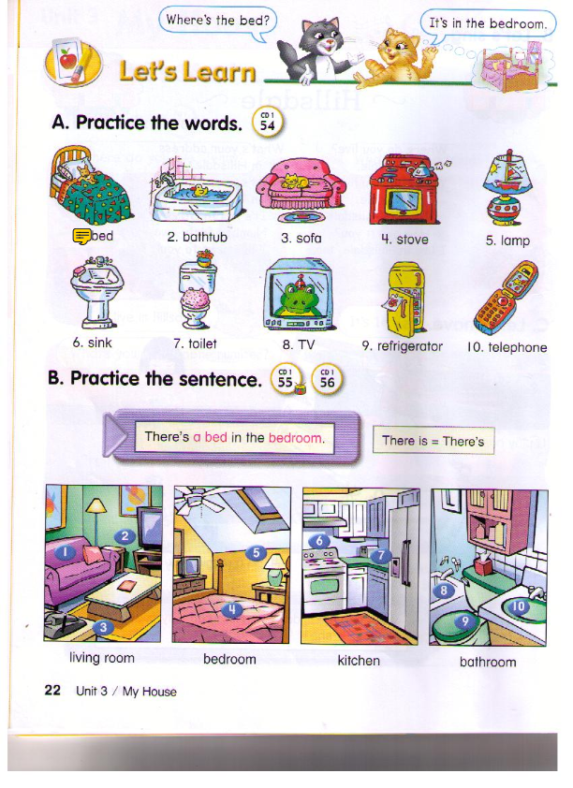
Wednesday, October 31st , 2012
Unit 2:MY THINGS
Let’s Learn (page 12)
1. Activity 2: Say the sentense.

Slide 35

Wednesday, October 31st , 2012
Unit 2:MY THINGS
Let’s Learn (page 12)
1. Activity 4: Consolidation
GAME

Slide 36







GOLDEN BELL

Slide 37


There ___ a sofa in the living room.
1
are
A
B
is
C
in
aren’t
D

Slide 38
There ___ a sofa in the living room.
1
A
B
is
C
D

Slide 39
There is a toilet in the ________.
1
living room
A
B
bathroom
C
bedroom
kitchen
D

Slide 40
There is a toilet in the ________.
1
A
B
bathroom
C
D

Slide 41
There is ________in the kitchen.
1
a sink
A
B
a toilet
C
a bathtub
a stove
D

Slide 42
There is ________in the kitchen.
1
A
B
C
a stove
D

Slide 43
1
Which one is correct?
There is a bed in the living room.
A
B
There is a sofa in the living room.
C
There is a toilet in the living room.
D
There is a stove in the living room.

Slide 44
1
Which one is correct?
A
B
C
D
There is a stove in the living room.

Slide 45
1
There is a refrigerator _____ the kitchen.
under
A
B
in
C
on
D
by

Slide 46
1
There is a refrigerator _____ the kitchen.
A
B
in
C
D

Slide 47

Binh ...Boong...
Binh ...Boong...

Slide 48
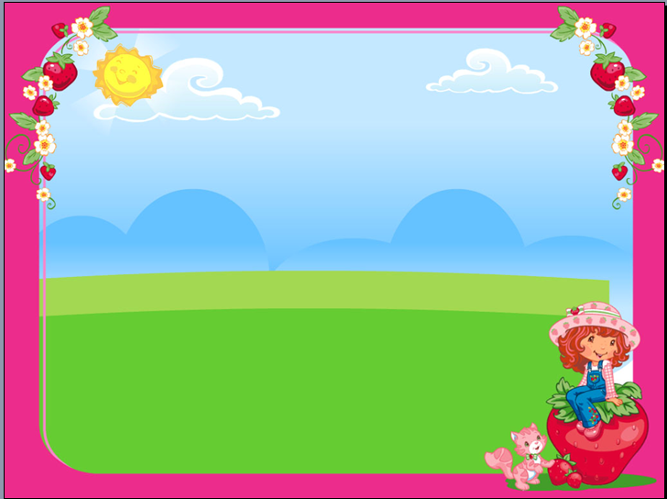

HOMEWORK
Practice the lesson again
Prepair new lesson (part 1, page 23)

Slide 49

COMMENT

Slide 50





Goodbye
Have a nice day !
SEE YOU NEXT TIME!

