Slide 1


Slide 2



Slide 3


Lesson 1

Slide 4

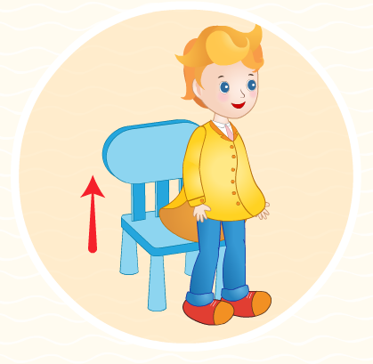
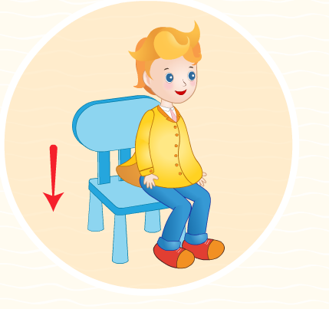
Unit Welcome: Lesson 1
Set the classroom language
stand up
sit down

Slide 5
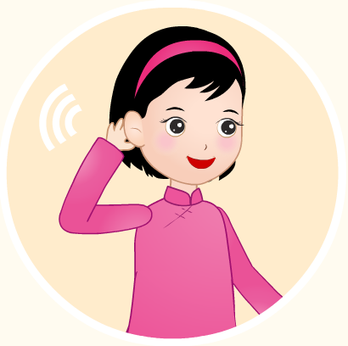
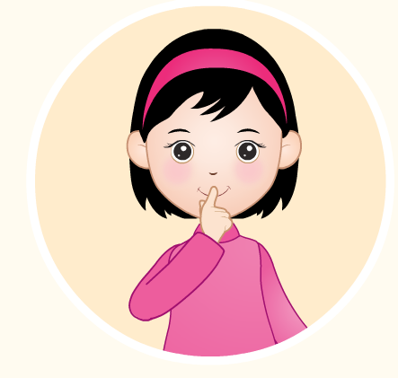
Unit Welcome: Lesson 1
Set the classroom language
listen
be quiet

Slide 6


Unit Welcome: Lesson 1
Set the classroom language
open your book
close your book

Slide 7
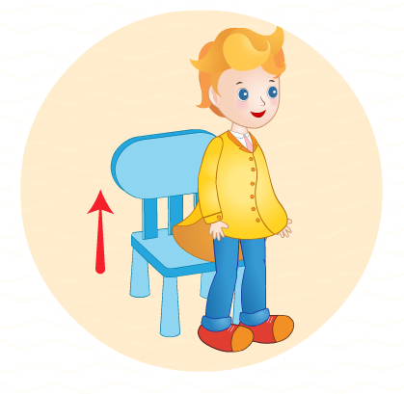
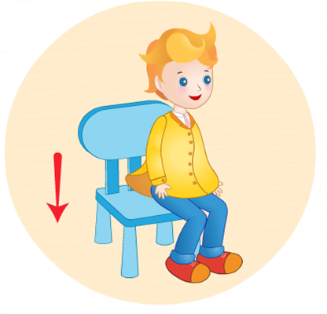
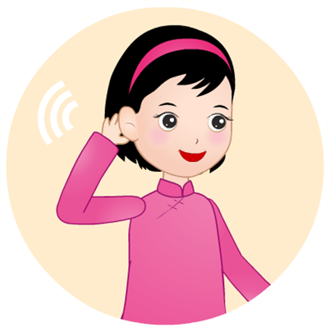



Unit Welcome: Lesson 1
Set the classroom language
Game
Speed up

Slide 8
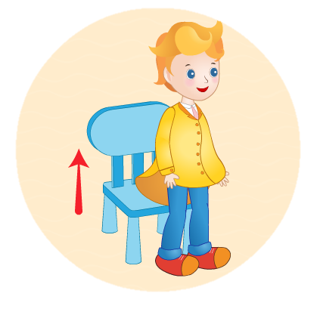
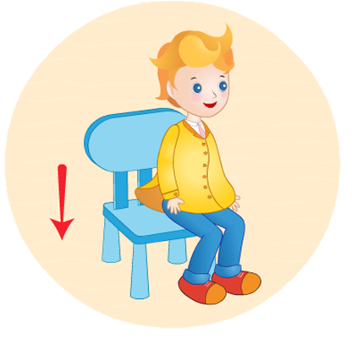


Speed up game
stand up
sit down
be quiet
sit down

Slide 9

Speed up game
stand up
be quiet
be quiet
listen
listen

Slide 10


Speed up game
stand up
be quiet
listen
close your book
open your book
open your book

Slide 11
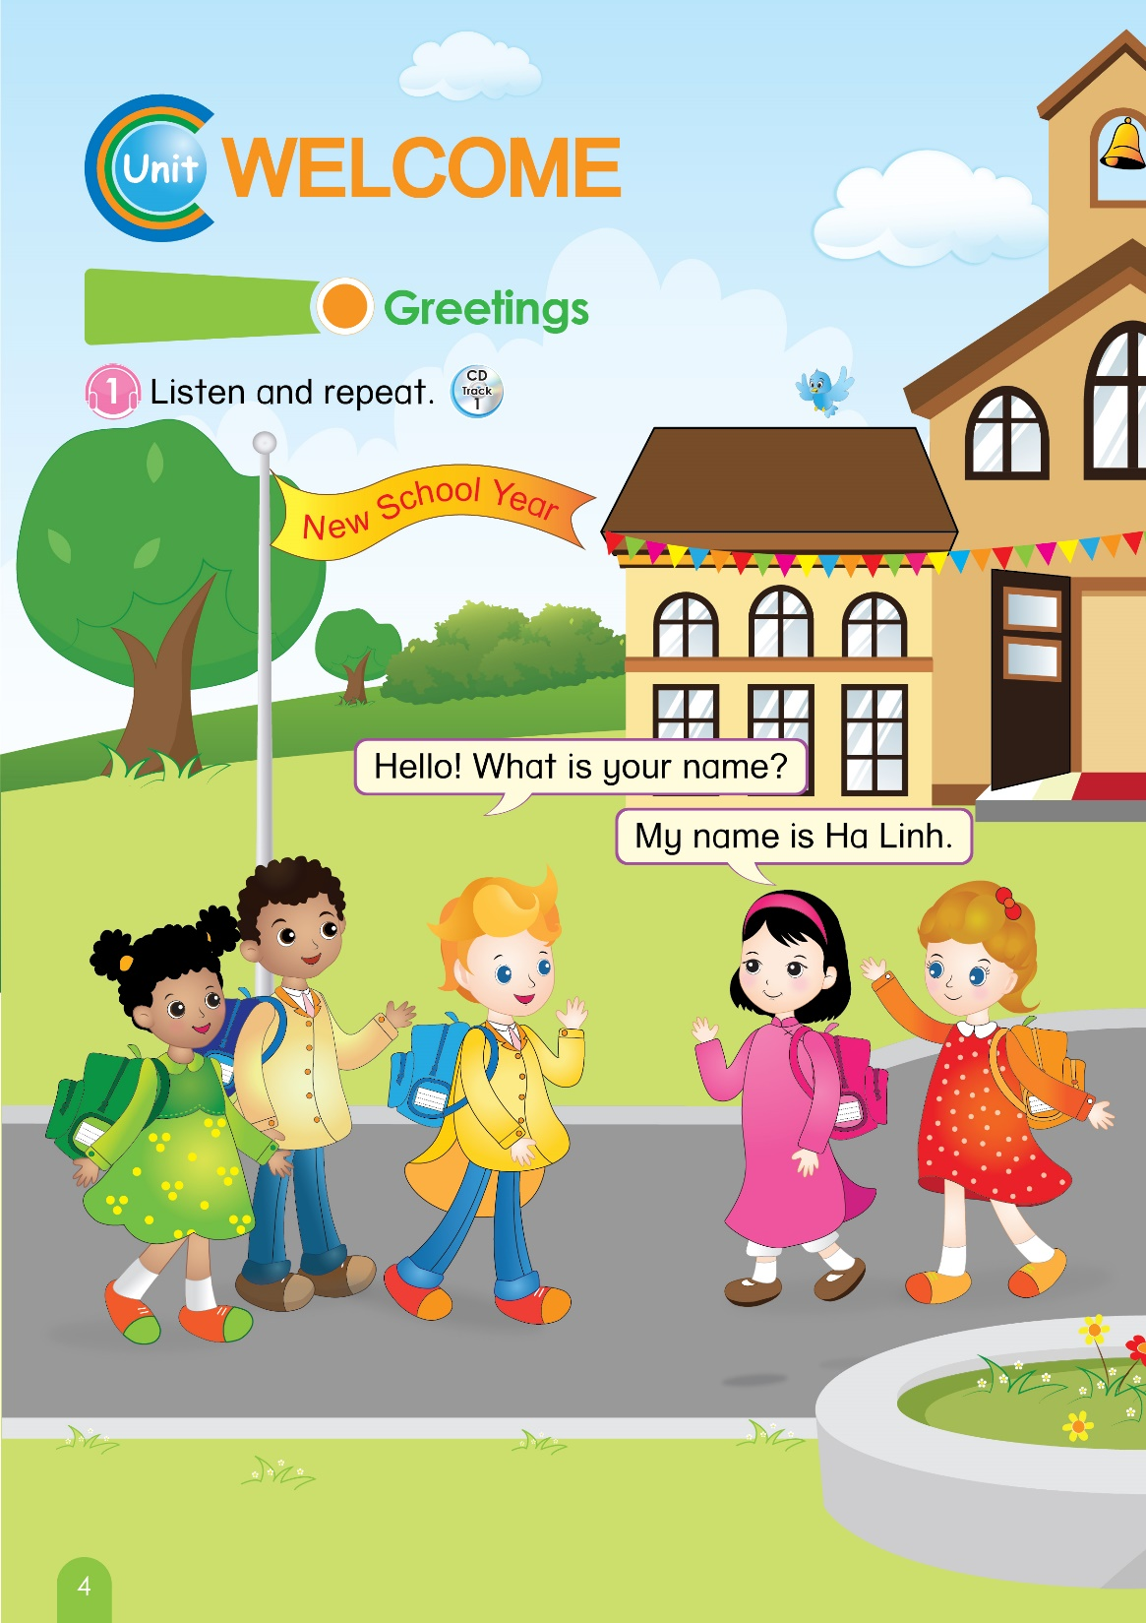

4
Look at page 4

Slide 12

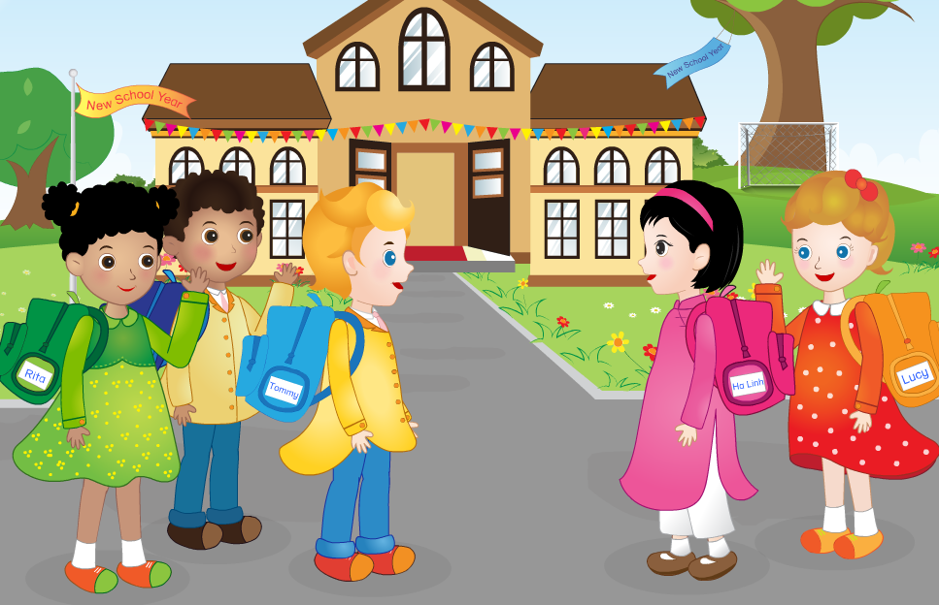
Unit Welcome: Lesson 1:
Greetings
1. Listen and repeat.

Slide 13


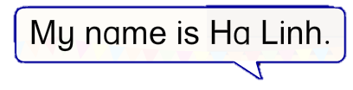
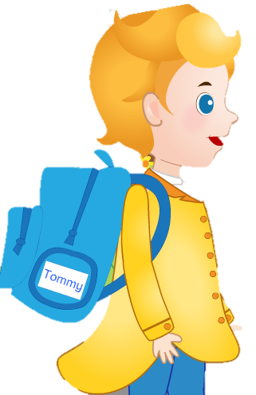
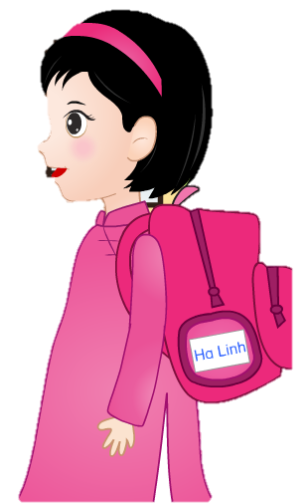
Unit Welcome: Lesson 1:
Greetings
1. Listen and repeat.

Slide 14
Unit Welcome: Lesson 1:
Greetings
1. Listen and repeat.
Role- play Activity

Slide 15

Unit Welcome: Lesson 1
Set the classroom language
Revision
Notes:
- Audio: letter A, /a/, apple, ant

Slide 16

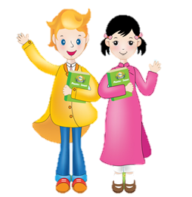

Unit Welcome: Lesson 1:
Greetings
Hello! What is your name?
My name is Ha Linh.

Slide 17




