Slide 1
Story telling The story of a Mother
GRADE: 3rd grade

Slide 2


Slide 4
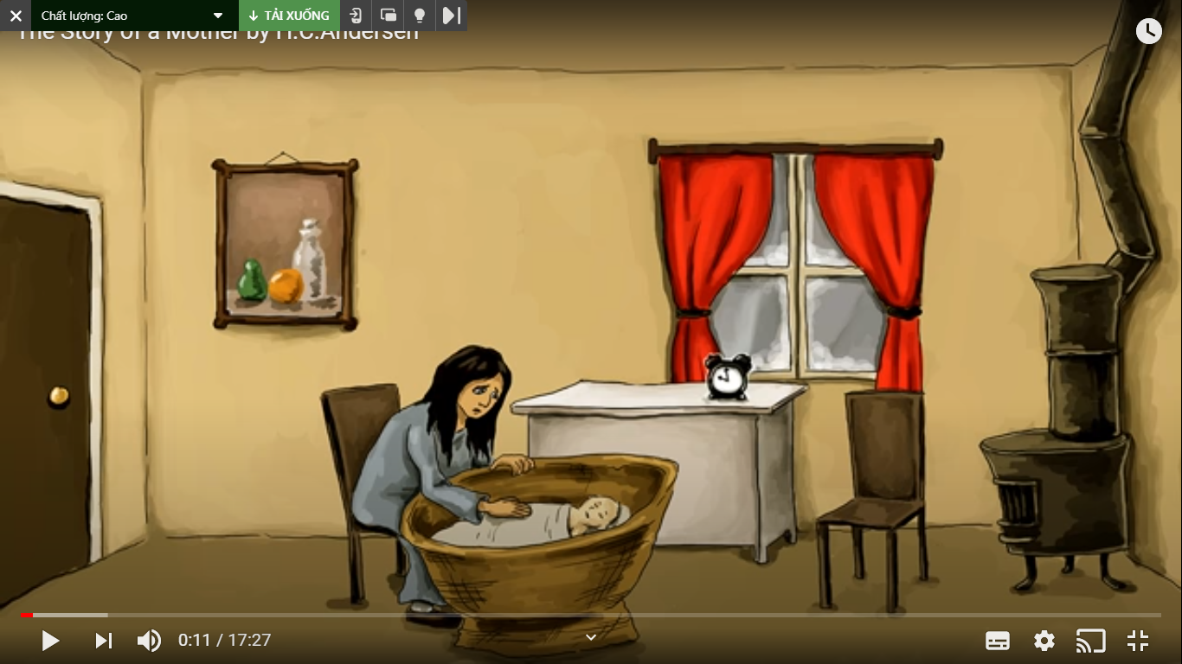
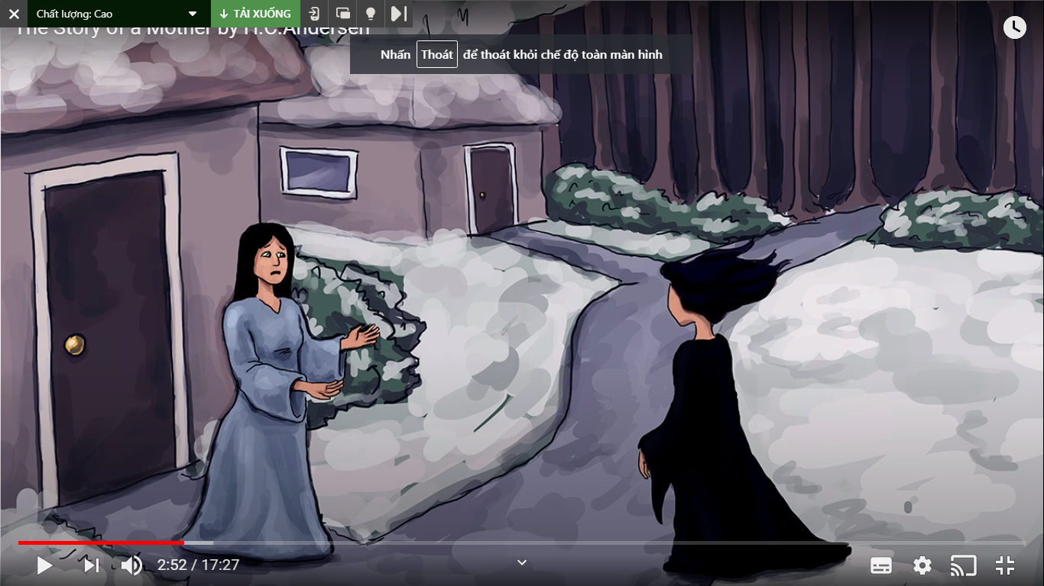
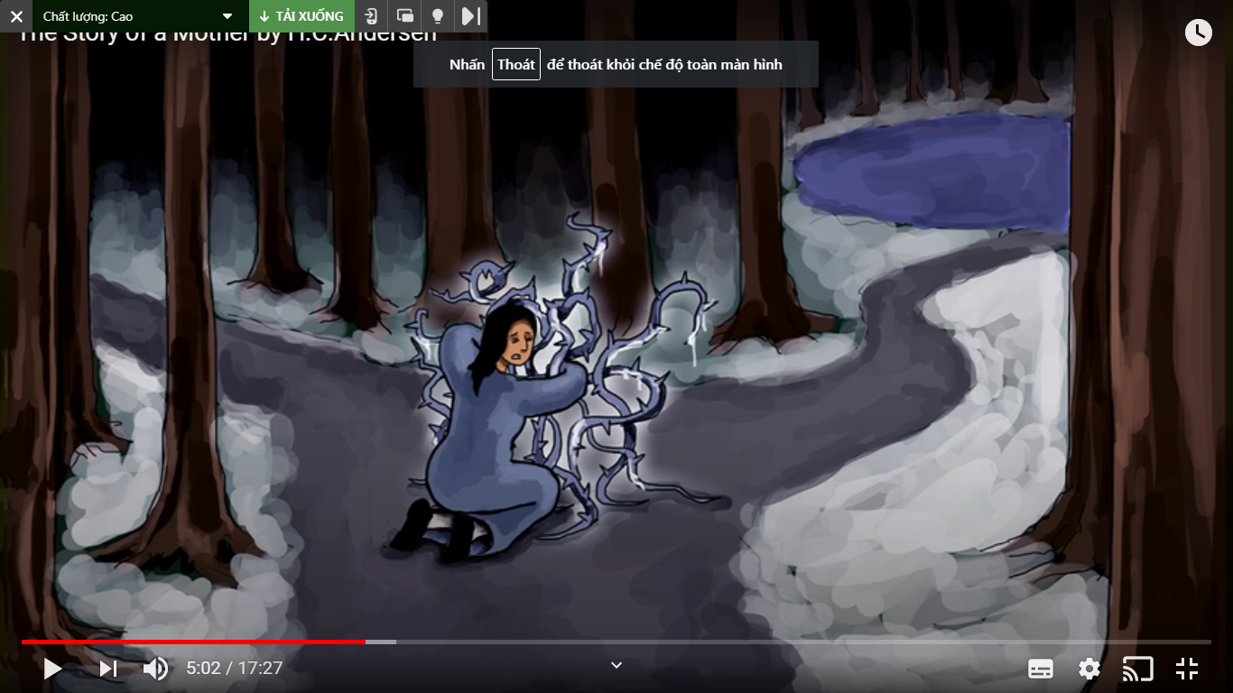
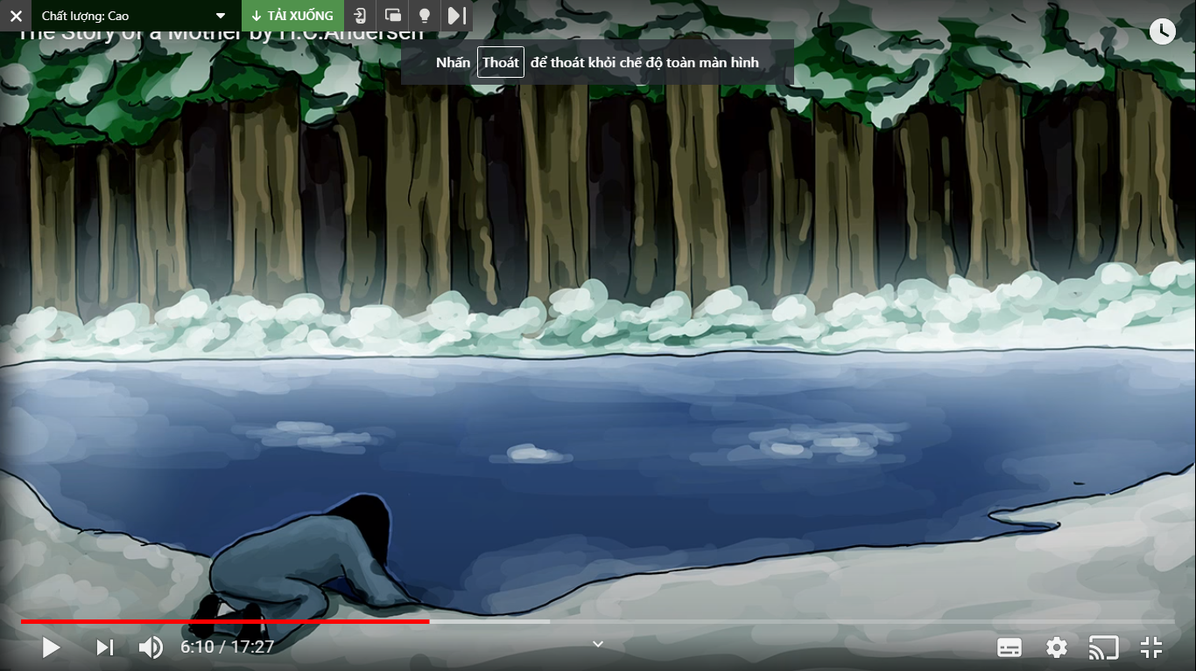
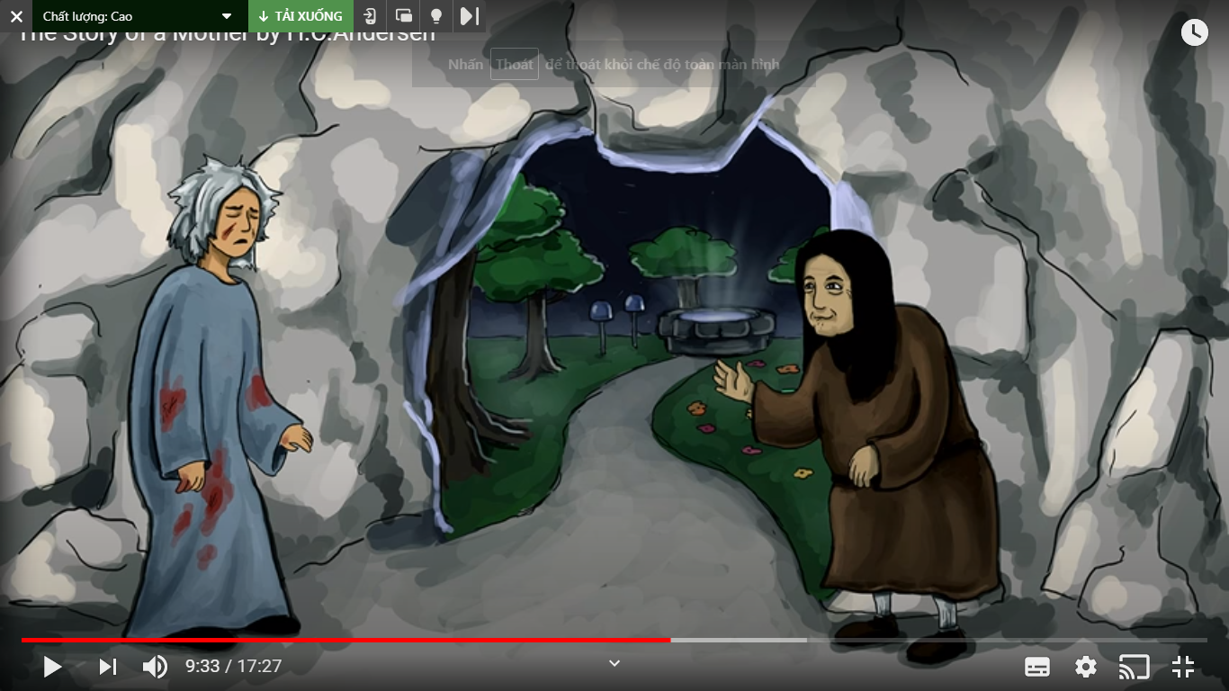
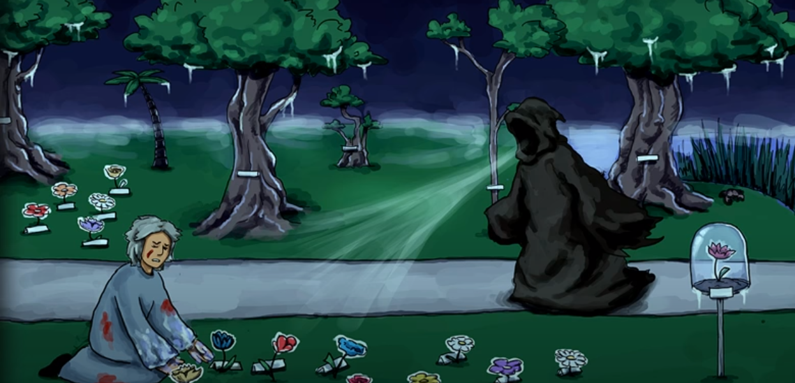

Slide 5
1

Slide 6
2

Slide 7
3

Slide 8
4

Slide 9
5

Slide 10
6

Slide 11
03
Role-play
The story of a Mother

Slide 13
THANKS

