Slide 1
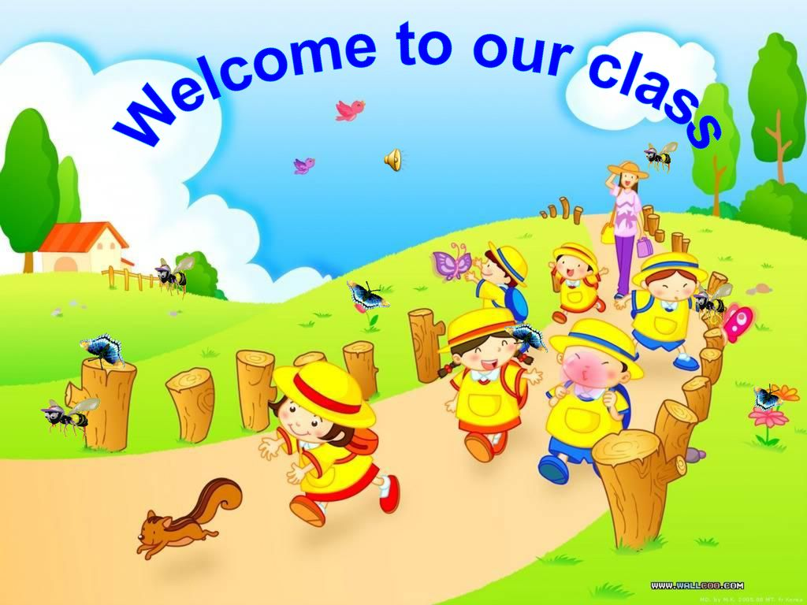

Slide 2

Unit 13:
WOULD YOU LIKE SOME MILK?
Lesson 1

Slide 3
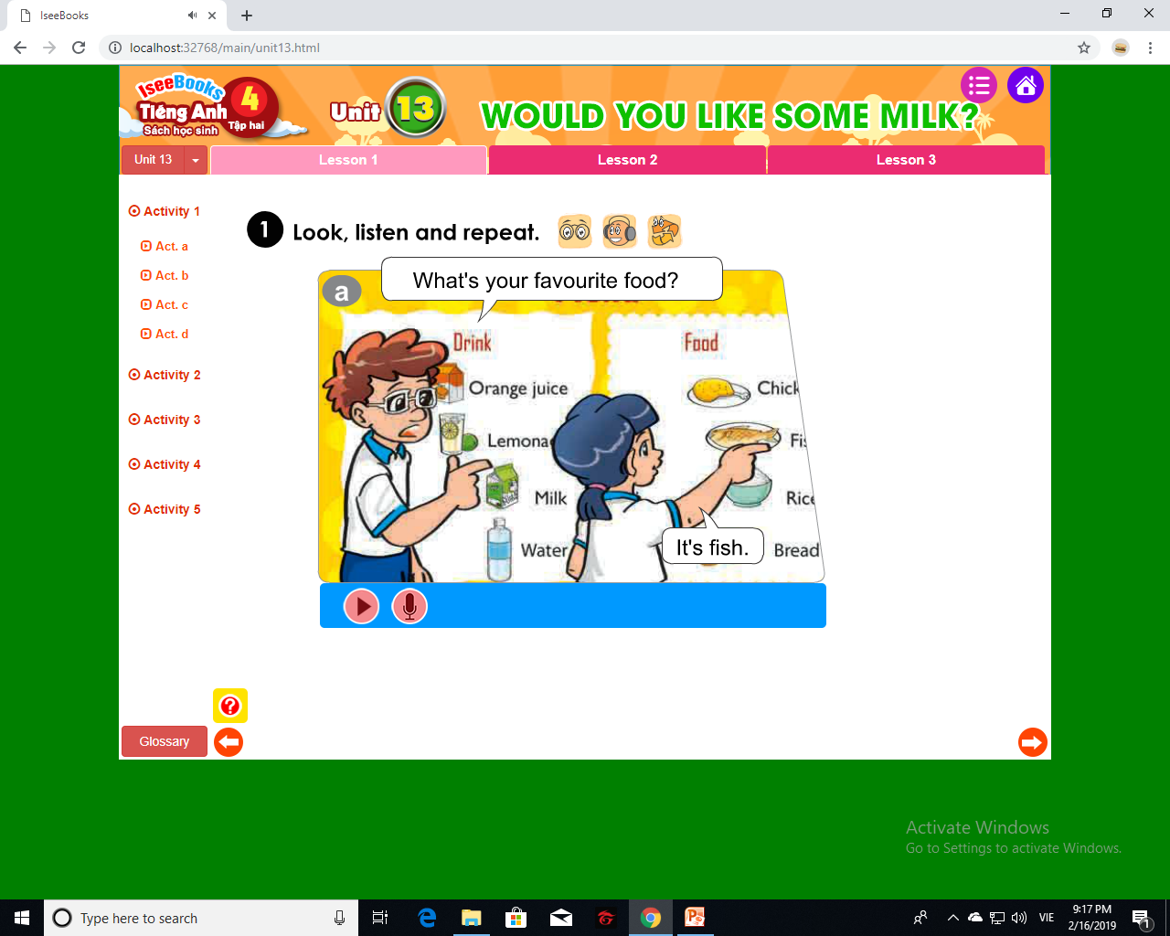

Unit 13:
WOULD YOU LIKE SOME MILK?
Lesson 1

Slide 4
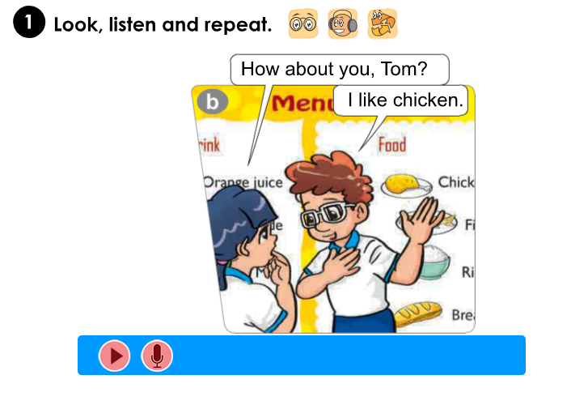
Unit 13:
WOULD YOU LIKE SOME MILK?
Lesson 1

Slide 5
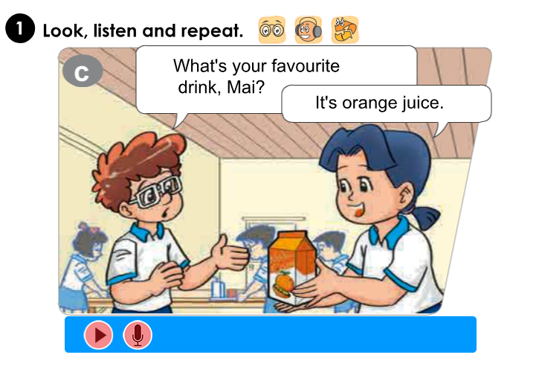
Unit 13:
WOULD YOU LIKE SOME MILK?
Lesson 1

Slide 6
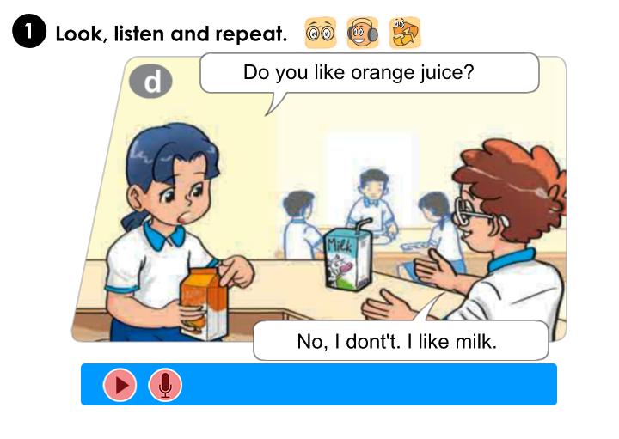
Unit 13:
WOULD YOU LIKE SOME MILK?
Lesson 1

Slide 7
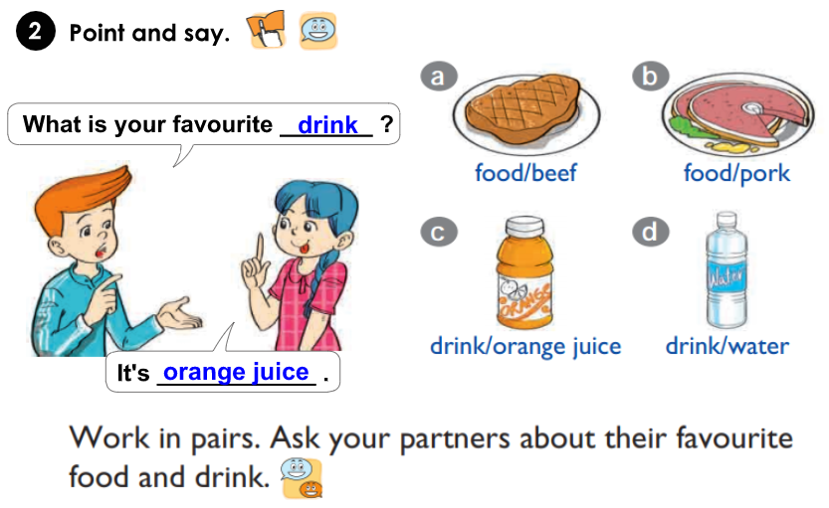
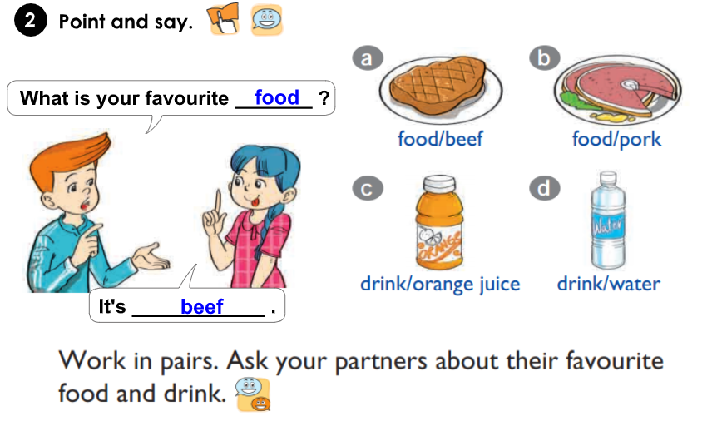
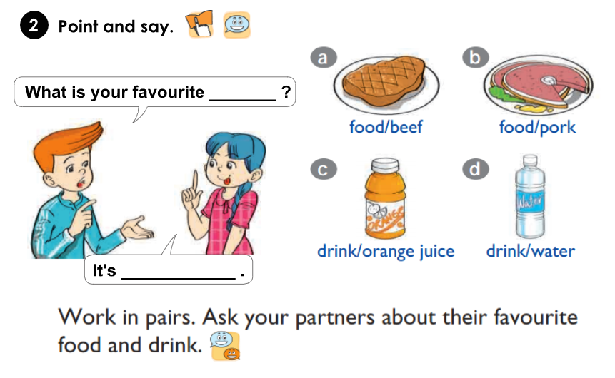
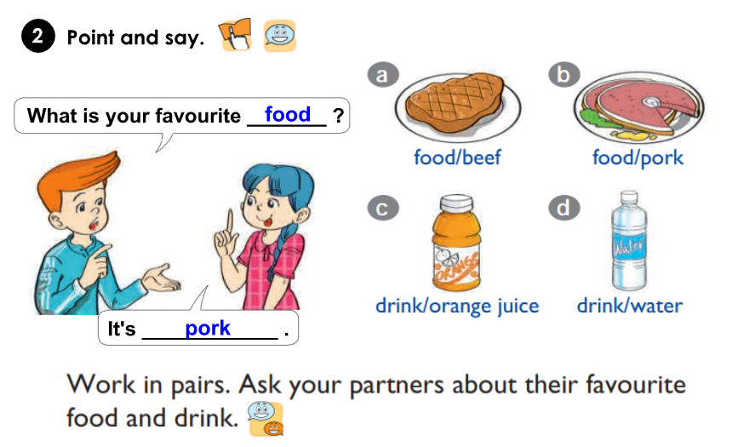
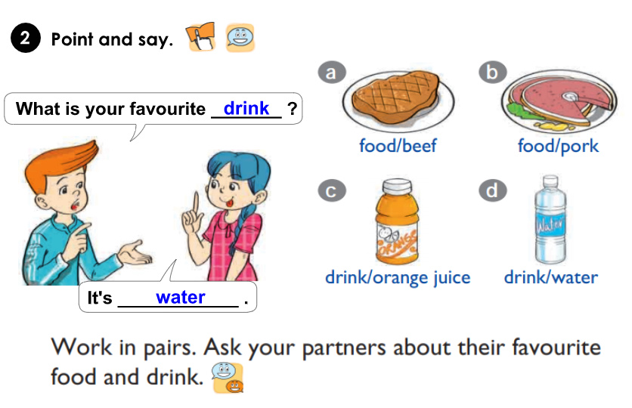
Unit 13:
WOULD YOU LIKE SOME MILK?
Lesson 1

Slide 8

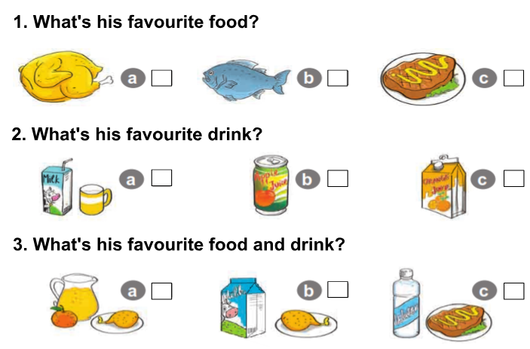


Unit 13:
WOULD YOU LIKE SOME MILK?
Lesson 1

Slide 9

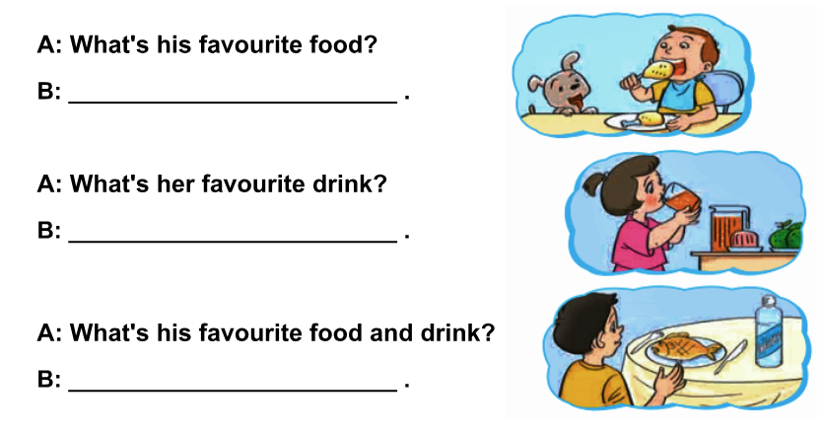
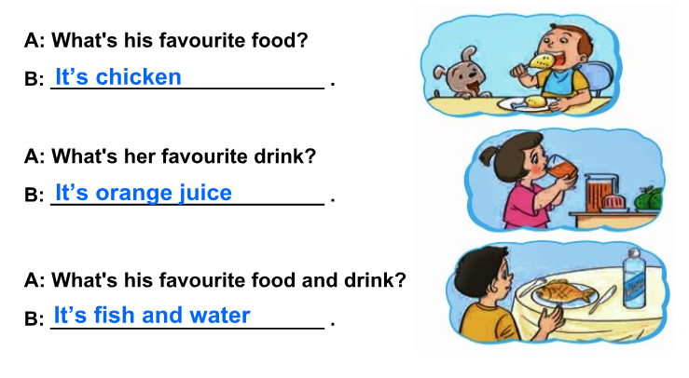
Unit 13:
WOULD YOU LIKE SOME MILK?
Lesson 1

Slide 10
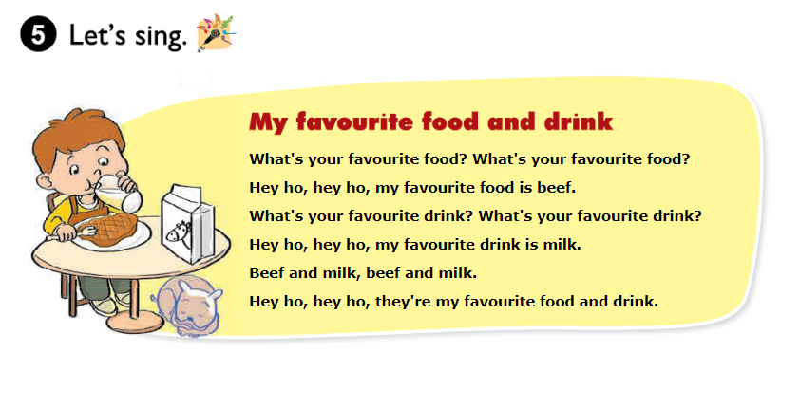
Unit 13:
WOULD YOU LIKE SOME MILK?
Lesson 1

