Slide 1



phudong PRIMARY SCHOOL
Welcome
to my class

Slide 2

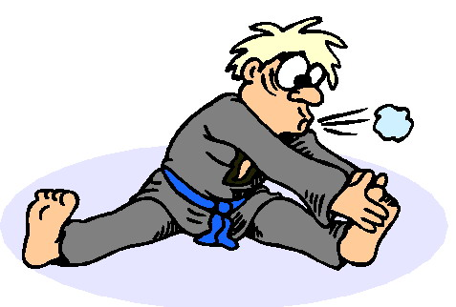

Slide 3


Slide 4
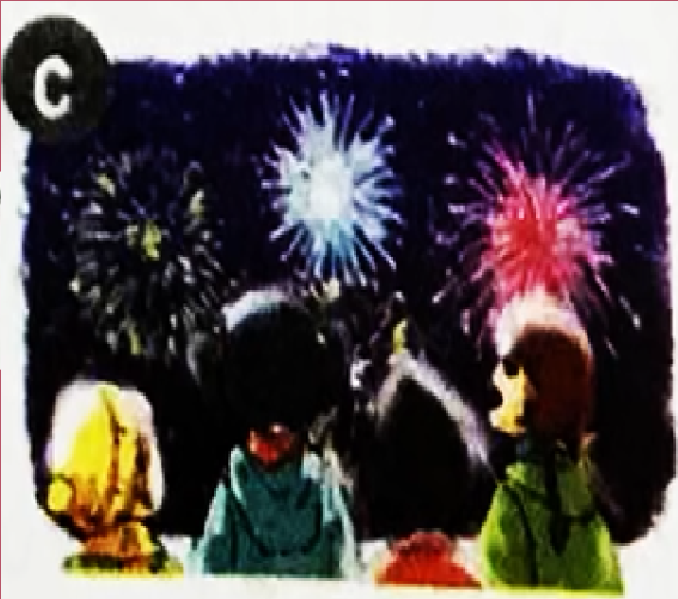
watch firework displays: xem bắn pháo hoa

Slide 5
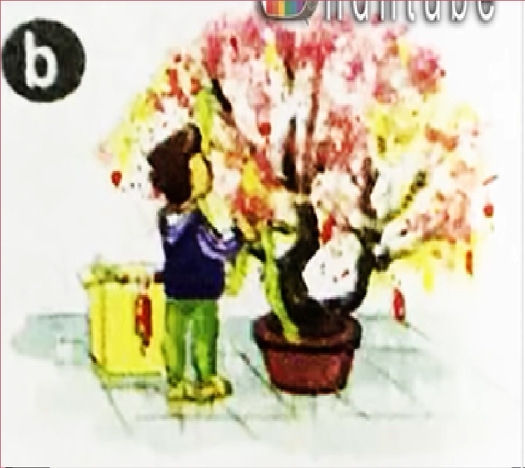
decorate the house: trang trí nhà cửa

Slide 6
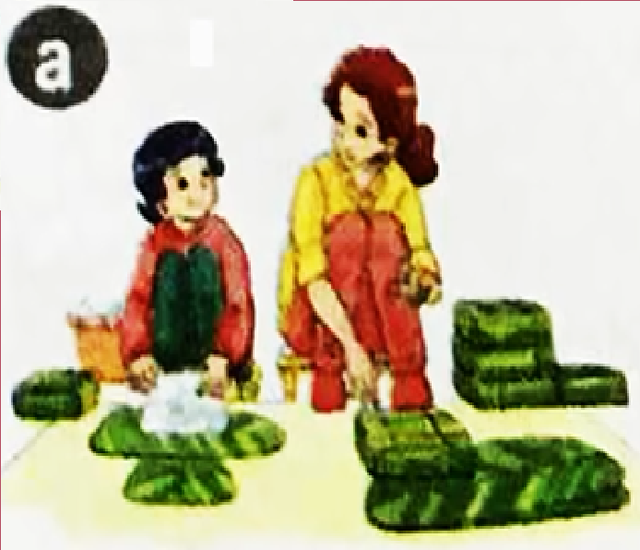
make banh chung: làm bánh chưng

Slide 7
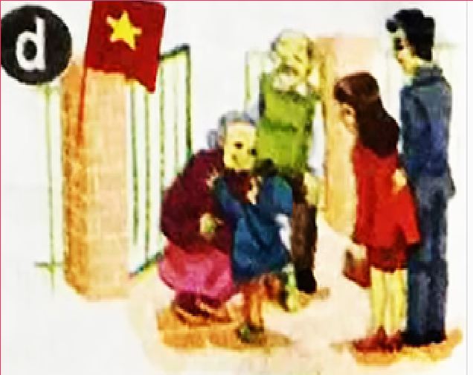
visit grandparents: thăm ông bà

Slide 8

UNIT 16:
Let’s go to the bookshop
LESSON 1:
1 – 2 – 3

Slide 9

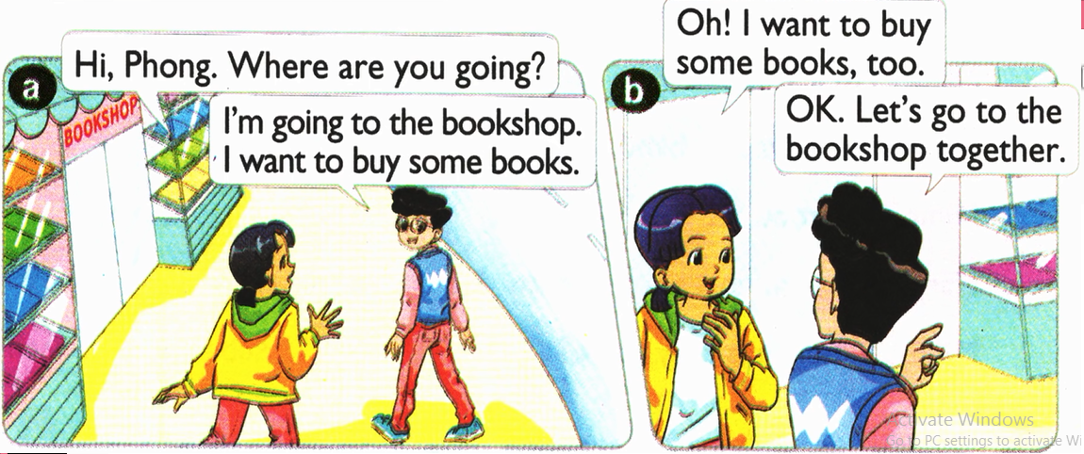
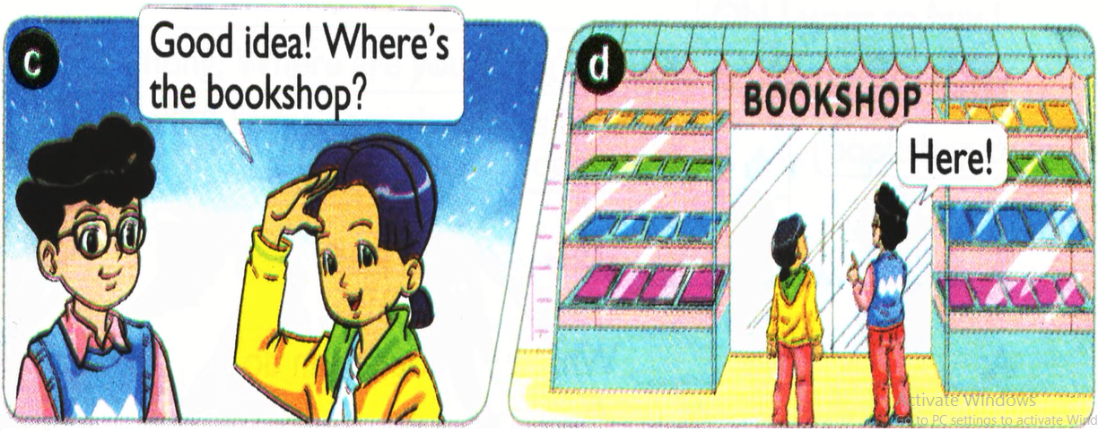
1. Look, listen and repeat.

Slide 10
1. Look, listen and repeat.

Slide 11
1. Look, listen and repeat.

Slide 13


Slide 14



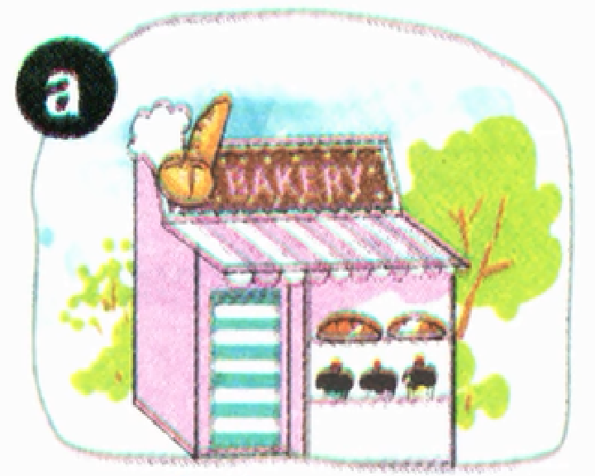
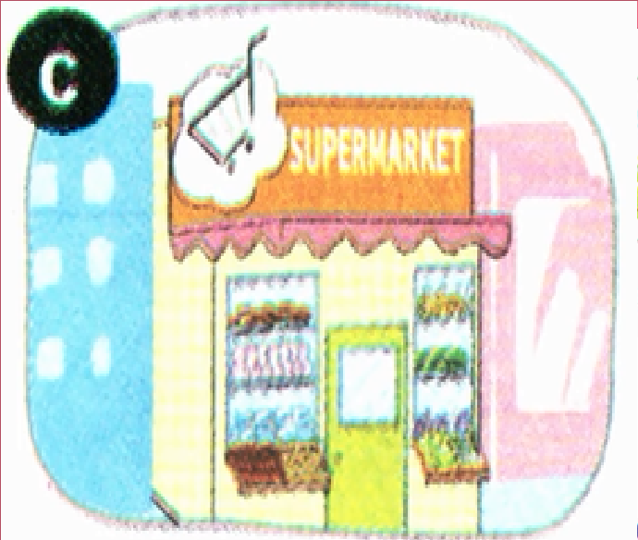
bakery: tiệm bánh
sweet shop: tiệm kẹo
buy some: mua cái gì đó
pharmacy: nhà thuốc
supermarket: siêu thị

Slide 15

- bakery: tiệm bánh
- pharmacy: nhà thuốc
- supermarket: siêu thị
- sweet shop: tiệm kẹo
- buy some: mua cái gì đó

Slide 16

Check vocabulary:
“Slap the board”

Slide 17


Slide 19
Sentence pattern:
Let’s go to the ………..
- I want to………
- Great idea
- I’m sorry. I’m busy.

Slide 20
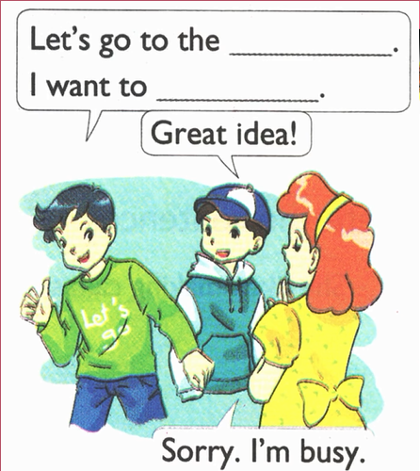
bakery
buy some bread

Slide 21
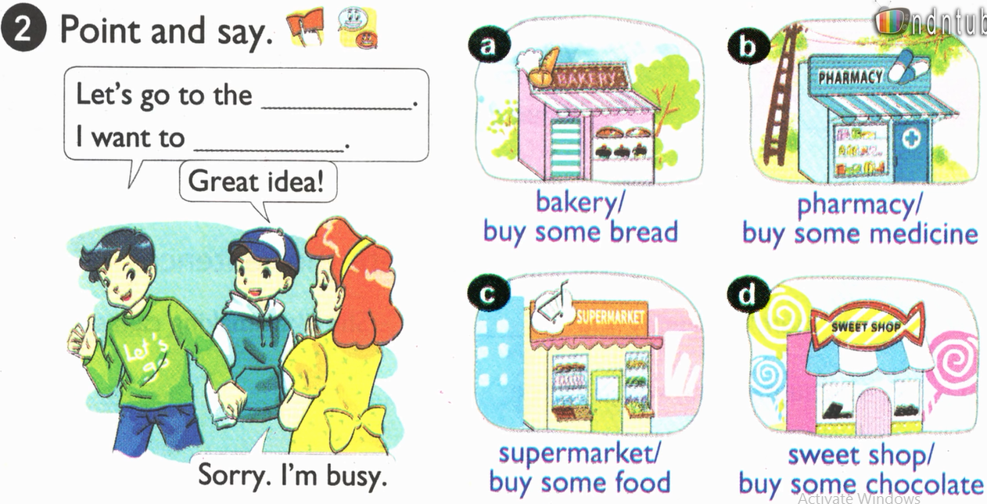

Slide 22
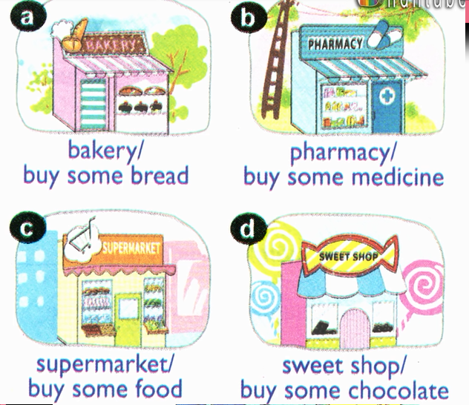

Slide 23
Homework:
Do exercises in workbook
- Learn by heart the new words.

Slide 24


THANK YOU
FOR YOUR Listen!
GOOD BYE

