Slide 1





















Unit 1 My family Lesson 3 – Task 7,8,9
Notes:
Để nguyên trang bìa như này, chỉ thay đổi tên bài trong quá trình làm. Logo của sách Wonderful World

Slide 2




Slide 3






Warm up

Slide 4

Notes:
Sing or say, “Head, shoulders, knees and toes,” as follows:
“Head, shoulders, knees and toes, knees and toes. Head, shoulders, knees and toes, knees and toes. Eyes and ears, and mouth and nose. Head, shoulders, knees and toes, knees and toes.”
Have the children touch the body part as it is named. Start off slowly and increase speed as you sing it over and over.

Slide 5
Game family tree
Notes:
Let the sts look at the family tree and choose the correct answers to get points

Slide 6








START

Slide 7

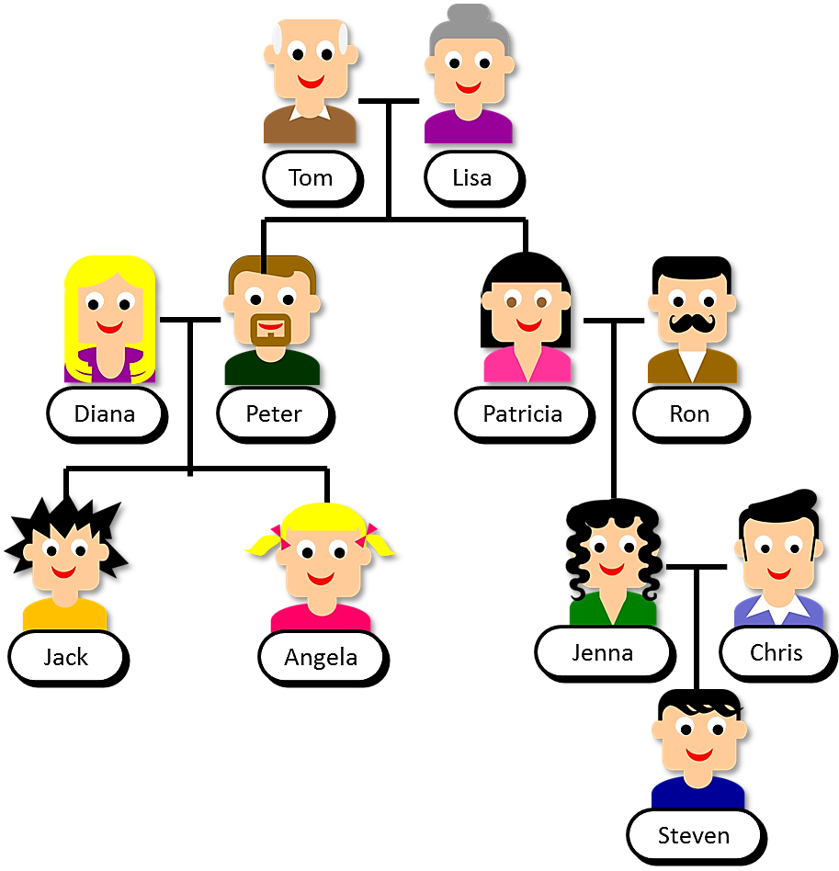


Look at Steven’s family tree and click on the right name
Tom
Lisa
Diana
Peter
Patricia
Ron
Jack
Angela
Jenna
Chris
Who is Peter’s dad?
NEXT
Steven
1/7
Notes:
THIẾT KẾ HOẠT ĐỘNG TƯƠNG TÁC TỪ SLIDE 7-21. HS XEM SƠ ĐỒ FAMILY TREE VÀ ĐỌC CÂU MÔ TẢ ĐỂ TÌM ĐÚNG TÊN NGƯỜI TRONG SƠ ĐỒ.
ĐÁP ÁN LÀ TÊN CỦA NHÂN VẬT CÓ DẤU TICK MÀU XANH.
TOM

Slide 8

Click on the right name
Tom
Lisa
Diana
Peter
Patricia
Ron
Jack
Angela
Jenna
Chris
Who is Jack’s aunt?
NEXT
Steven
2/7
Notes:
Patricia

Slide 9

Click on the right name
Tom
Lisa
Diana
Peter
Patricia
Ron
Jack
Angela
Jenna
Chris
Who is Jenna’s cousin?
NEXT
Steven
3/7
Notes:
Angela

Slide 10

Click on the right name
Tom
Lisa
Diana
Peter
Patricia
Ron
Jack
Angela
Jenna
Chris
Who is Jenna’s uncle?
NEXT
Steven
4/7
Notes:
Peter

Slide 11

Click on the right name
Tom
Lisa
Diana
Peter
Patricia
Ron
Jack
Angela
Jenna
Chris
Who is Chris’ cousin?
NEXT
Steven
5/7
Notes:
Angela

Slide 12

Click on the right name
Tom
Lisa
Diana
Peter
Patricia
Ron
Jack
Angela
Jenna
Chris
Who is Steven’s mum?
NEXT
Steven
6/7
Notes:
Jenna

Slide 13

Click on the right name
Tom
Lisa
Diana
Peter
Patricia
Ron
Jack
Angela
Jenna
Chris
Who is Steven’s dad?
NEXT
Steven
7/7
Notes:
Chris

Slide 14

Presentation
Task 7: Listen and repeat.

Slide 15


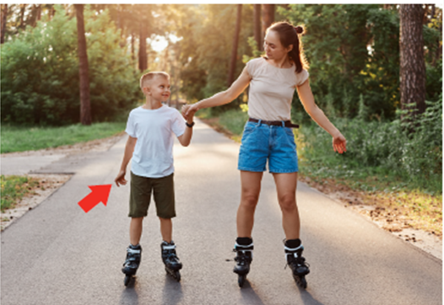
s
seven
sh
short
I’m seven. I’m short.
Notes:
Ask sts to listen and repeat (individual, group, whole class)
Ask sts to find more words with “sh” and “s”
-Write s on the board. Ask students to say the name of this letter. Then write seven on the board. Ask students to pronounce the sound for s in the word.
-Write sh on the board. Ask students to say these letters. Then write short on the board.
STOP HERE

Slide 16


short
s
seven
sh
Notes:
Game: Listen and choose!
Play the audio and let the sts tick on the correct one.
This can be played as “slap the board game”: Teacher says a word/sound for sts to slap to the correct one.
SHORT

Slide 17
short
s
seven
sh
Notes:
Game: Listen and choose!
Play the audio and let the sts tick on the correct one.
This can be played as “slap the board game”: Teacher says a word/sound for sts to slap to the correct one.
S

Slide 18
short
s
seven
sh
Notes:
Game: Listen and choose!
Play the audio and let the sts tick on the correct one.
This can be played as “slap the board game”: Teacher says a word/sound for sts to slap to the correct one.
SEVEN

Slide 19
short
s
seven
sh
Notes:
Game: Listen and choose!
Play the audio and let the sts tick on the correct one.
This can be played as “slap the board game”: Teacher says a word/sound for sts to slap to the correct one.
Sh

Slide 20

Practice
Task 8 and task 9

Slide 21
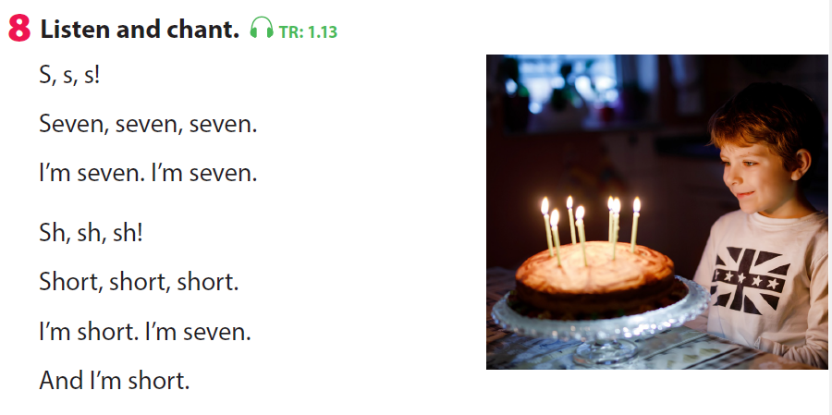
Notes:
Ask sts to clap when they hear “s” and “sh”
Ask sts to chant in teams

Slide 22
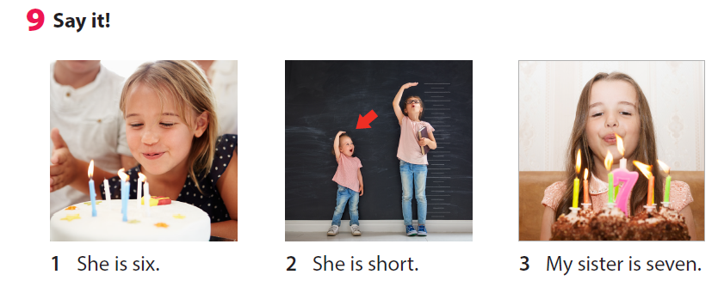
Notes:
T says the sentences first
Ask sts to practice 1 by 1

Slide 23

Look and guess. Then say!
Notes:
Game: Look and guess. Then say!
Teacher shows a picture which is hidden. Sts look and guess what it is. Then say the sentence.

Slide 24
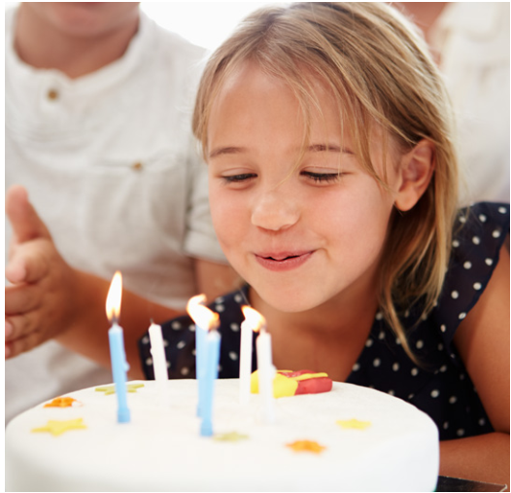

Slide 25


Slide 26


Slide 27


Slide 28
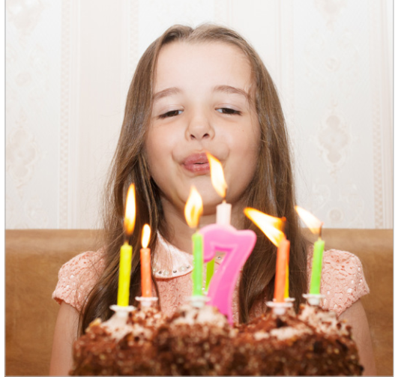

Slide 29


Slide 30

Production

Slide 31
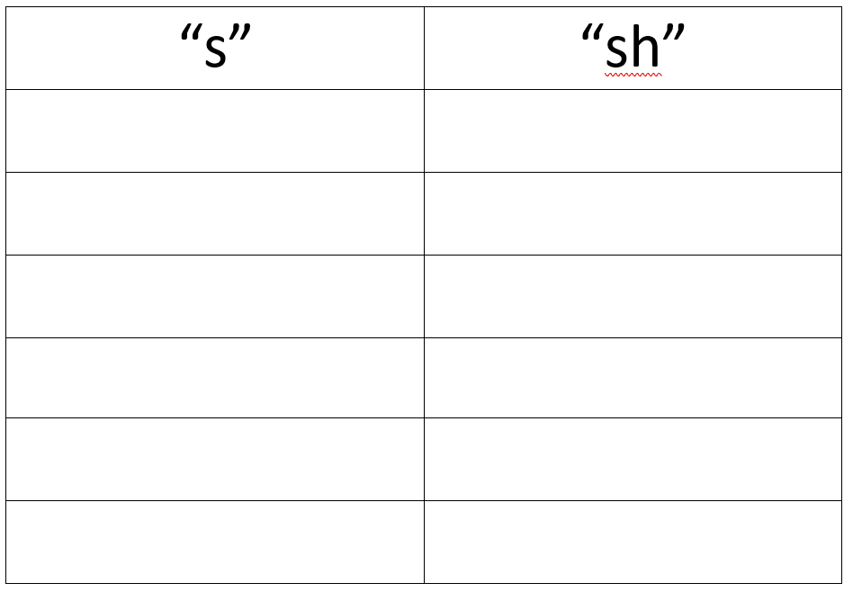
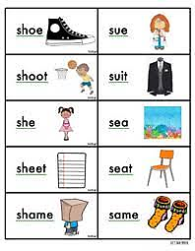
sh
s
Notes:
Divide the class into 4 groups.
-T turns on the music while the sts move around.
-Sts move around the class and ask their friends more words of “s” and ”sh” and write in the worksheet.
-Sts have to freeze when the music stops and continue when the music is on.

Slide 32

Notes:
-T turns on the music while the sts move around
-Sts move around the class and ask their friends more words of “s” and ”sh” and write in the worksheet
-Sts have to freeze when the music stops and continue when the music is on

Slide 33

sh
s
Notes:
Divide the class into 4 groups.
-T turns on the music while the sts move around.
-Sts move around the class and ask their friends more words of “s” and ”sh” and write in the worksheet.
-Sts have to freeze when the music stops and continue when the music is on.

Slide 34
Notes:
Teacher says the words and focus on the differences between them.
Ask sts to read s.the words and say the difference

Slide 35

Assessment

Slide 36
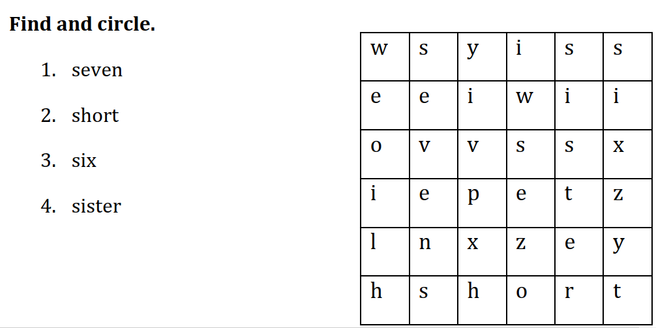
Notes:
THIẾT KẾ HOẠT ĐỘNG TƯƠNG TÁC: HS TÌM TỪ ĐÃ CHO TRONG Ô CHỮ.
Find and circle:
Sts look at the letters then find the words.
Ask sts to say them out loud. (individual, group, whole class work)

Slide 37




Good bye.
See you again!

