Slide 1

Tuesday, October 3rd 2023
Unit 4
Did you go to
the party?
Lesson 1

Slide 2
VOCABULARY

Slide 3
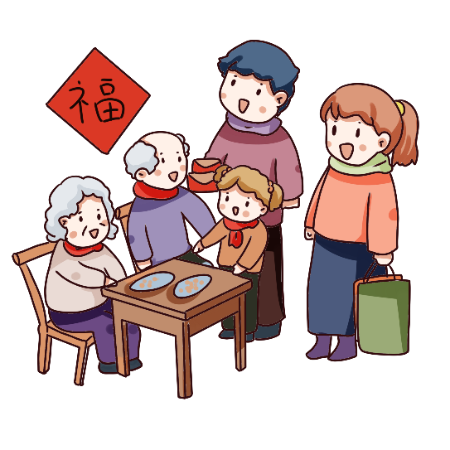
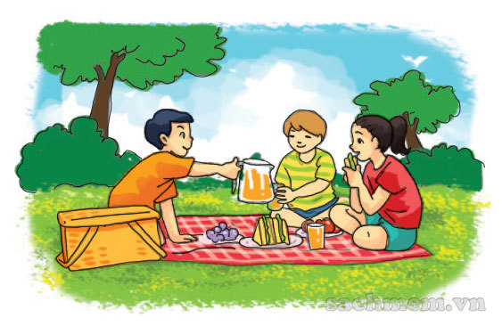
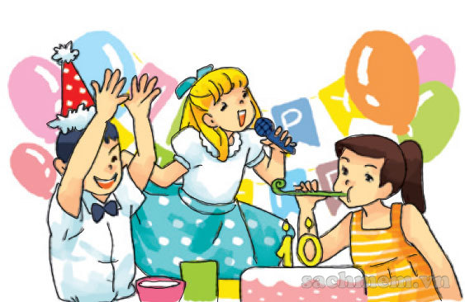
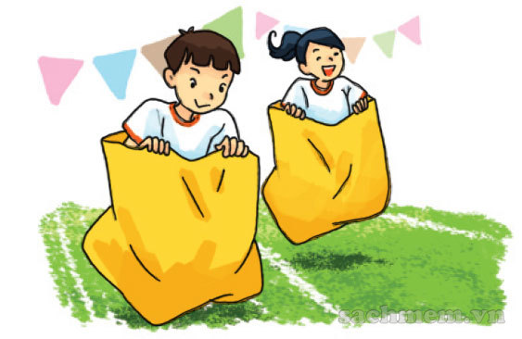
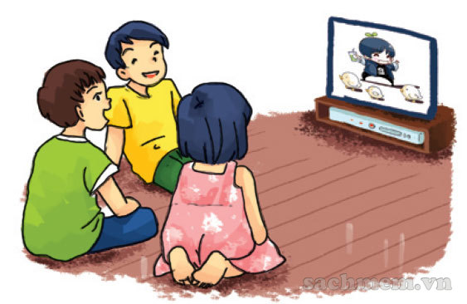
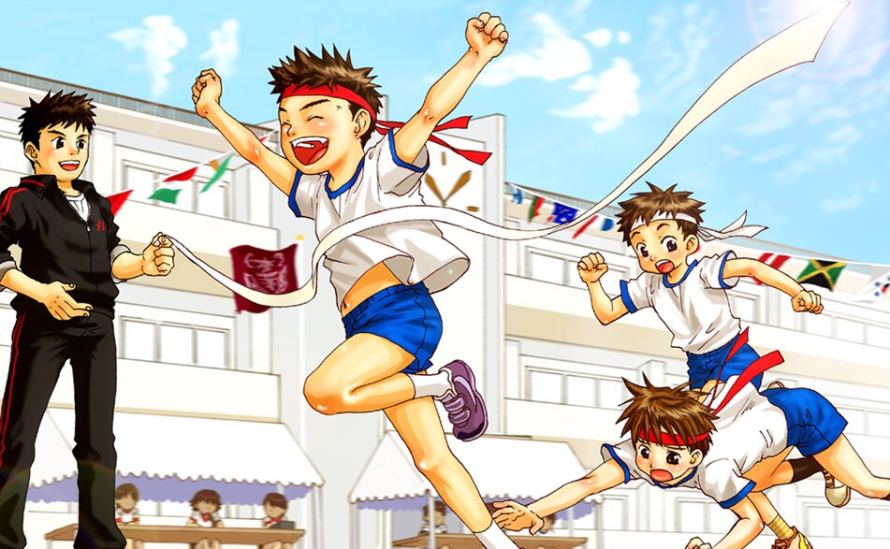
A. Vocabulary
visit my
grandparents
go on a picnic
enjoy the party
Đi dã ngoại
Thích bữa tiệc
Đi thăm ông bà
join the funfair
watch cartoons
sports festival
Tham gia hội trại
Xem hoạt hình
Lễ hội thể thao

Slide 4
Fill the blanket
visit my
grandparents
sports festival
_____
_____
watch cartoons
_____
Lễ hội thể thao
Xem hoạt hình
Đi thăm ông bà
go on a picnic
enjoy the party
___
_____
join the funfair
_____
Đi dã ngoại
Thích bữa tiệc
Tham gia hội trại

Slide 5
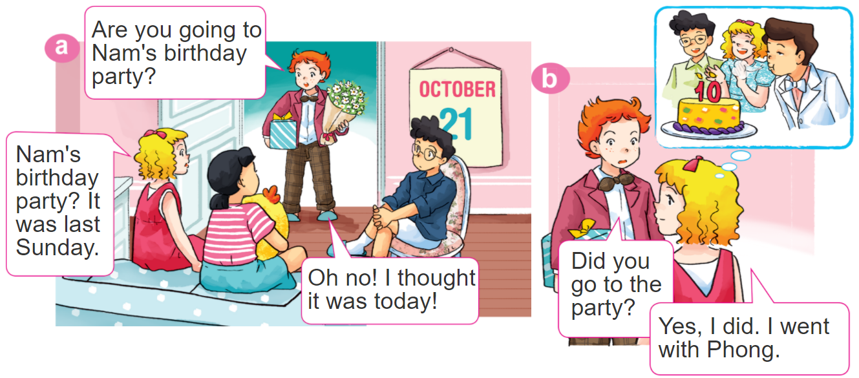

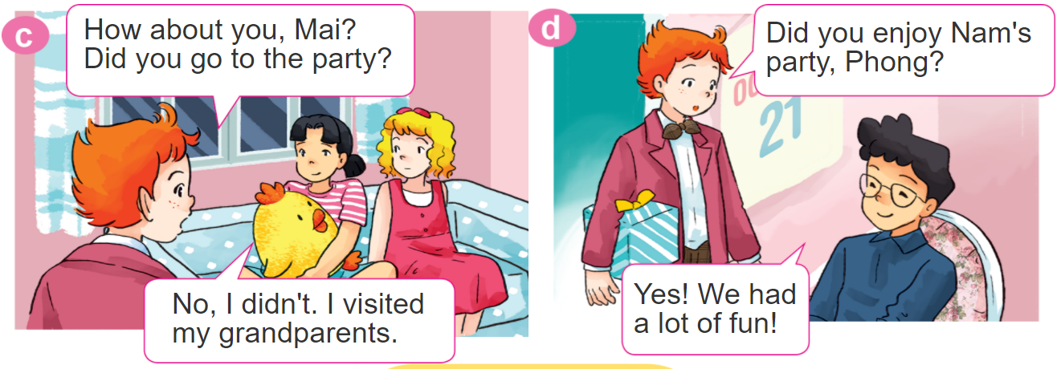
1. Look, listen and repeat.

Slide 6
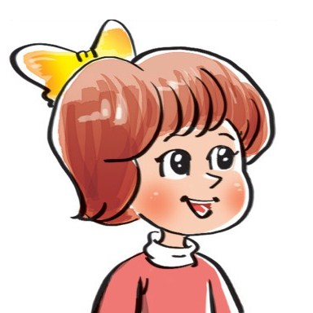

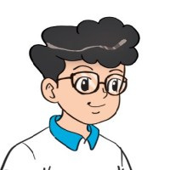

2. Point and say
Yes. I did.
Did you _________?
No, I didn't.
go on a picnic
watch TV
enjoy the party
join the funfair

Slide 7

3. Let’s talk
Did you go on a picnic?
Yes. I did.
Did you enjoy the weekend?
No, I didn't.
Did you watch TV?

Slide 8
B. Model sentence.
Hỏi và đáp bạn đã làm gì đó phải không:
Did you ___________?
+ activity
Yes. I did.
No, I didn't.

Slide 9




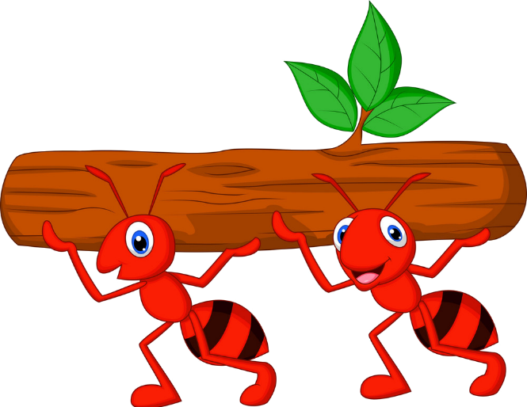



Kiến chăm chỉ
PLAY

Slide 10

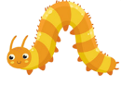





Did you join the festival?
Yes, I did.
Next
Notes:
Ms Huyền Phạm - 0936.082.789 – YOUTUBE: MsPham. Facebook: Dạy và học cùng công nghệ.

Slide 11
Did you visit your grandparents?
Yes, I did.
Next
Notes:
Ms Huyền Phạm - 0936.082.789 – YOUTUBE: MsPham. Facebook: Dạy và học cùng công nghệ.

Slide 12
Did you watch cartoon
No, I didn’t.
Next
Notes:
Ms Huyền Phạm - 0936.082.789 – YOUTUBE: MsPham. Facebook: Dạy và học cùng công nghệ.

Slide 13
Did you join the funfair?
No, I didn’t.
Next
Notes:
Ms Huyền Phạm - 0936.082.789 – YOUTUBE: MsPham. Facebook: Dạy và học cùng công nghệ.

Slide 14
Did you enjoy a party?
Yes, I did.
Next
Notes:
Ms Huyền Phạm - 0936.082.789 – YOUTUBE: MsPham. Facebook: Dạy và học cùng công nghệ.

Slide 15
Did you go on the picnic?
Yes, I did.
Next
Notes:
Ms Huyền Phạm - 0936.082.789 – YOUTUBE: MsPham. Facebook: Dạy và học cùng công nghệ.

Slide 16
Did you go to school
yesterday?
No, I didn’t.
Next
Notes:
Ms Huyền Phạm - 0936.082.789 – YOUTUBE: MsPham. Facebook: Dạy và học cùng công nghệ.

Slide 17
Did you get up early
this morning?
Yes, I did.
Next
Notes:
Ms Huyền Phạm - 0936.082.789 – YOUTUBE: MsPham. Facebook: Dạy và học cùng công nghệ.

Slide 18
WELL DONE!
EXIT
Notes:
Ms Huyền Phạm - 0936.082.789 – YOUTUBE: MsPham. Facebook: Dạy và học cùng công nghệ.

Slide 19
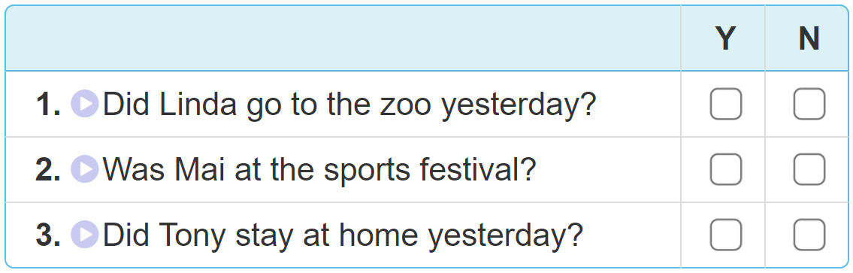

4. Listen and tick Yes (Y) or No (N).

Slide 20
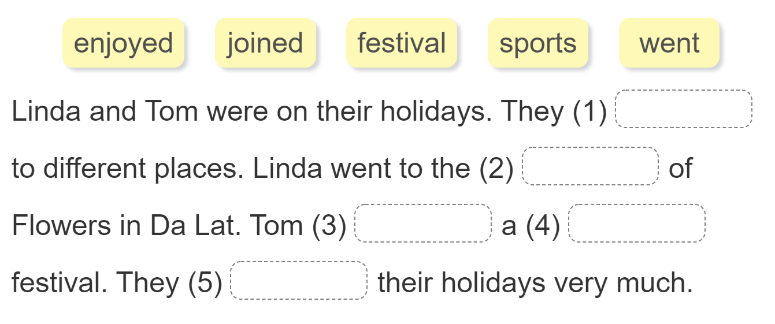
5. Read and complete.
went
festival
joined
sports
enjoyed

Slide 21
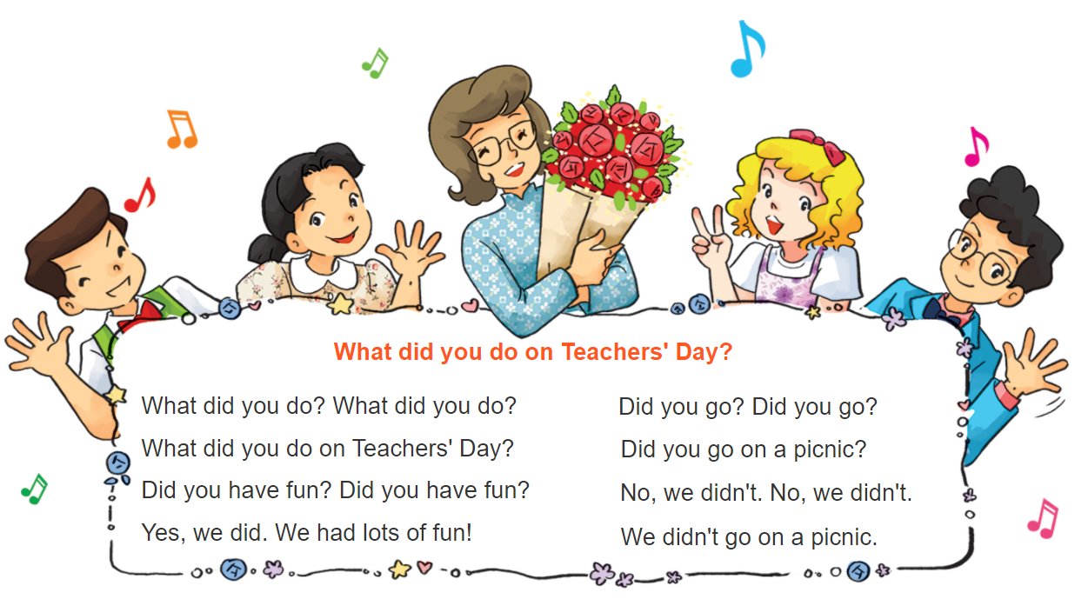



6. Let’s sing

