Slide 1


Unit 6
HOW MANY LESSONS
DO YOU HAVE TODAY?
Lesson 1

Slide 2

Let’s learn!
Tieng Anh 5 (p. 41)

Slide 3
SUPPLEMENTARY MATERIAL TASK
Task 1, 2 (page 16)

Slide 4
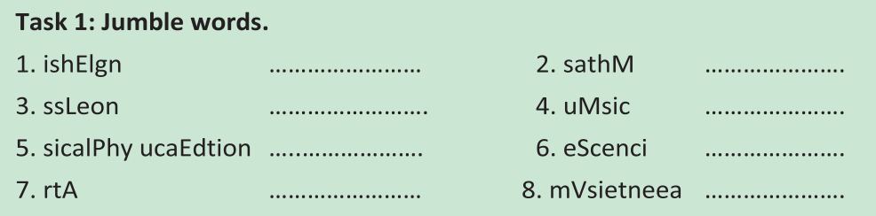
English
Maths
Lesson
Music
Physical Education
Science
Art
Vietnamese

Slide 5
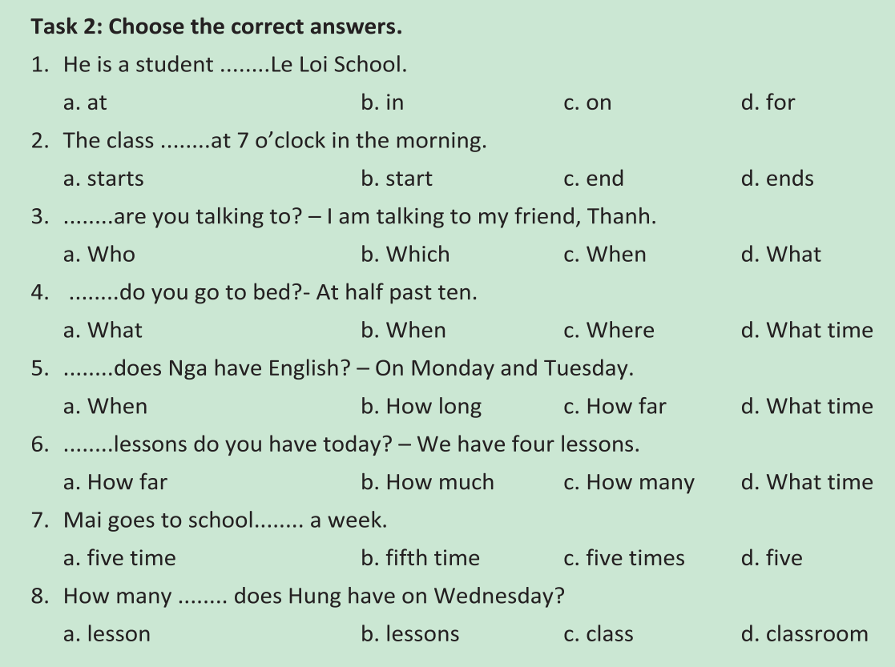

Slide 7
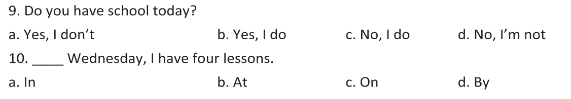

Slide 8
Homework
- Do exercise in the workbook.
- Prepare next lesson

Slide 9



THANK YOU!
INTERNATIONAL
ENGLISH CENTER
Address
Khu Gò Mèo, Xã Đan Phượng, Huyện Đan Phượng , Hà Nội
Website
dcenglish.edu.vn
Facebook
facebook.com/dcenglishcenter
Phone
024.37953333
YouTube
Youtube.com/dcenglishcenter
E-Mail
dcenglishhanoi@gmail.com

