Slide 1


ENGLISH 5 - Unit 6
HOW MANY LESSONS
DO YOU HAVE TODAY?
Lesson 3

Slide 2


WARM UP

Slide 3

SUPPLEMENTARY MATERIAL Listening and Speaking (page 18)

Slide 4
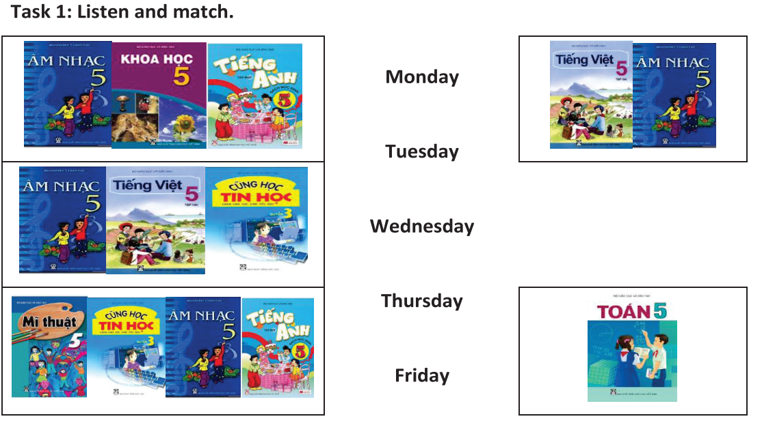


Slide 5
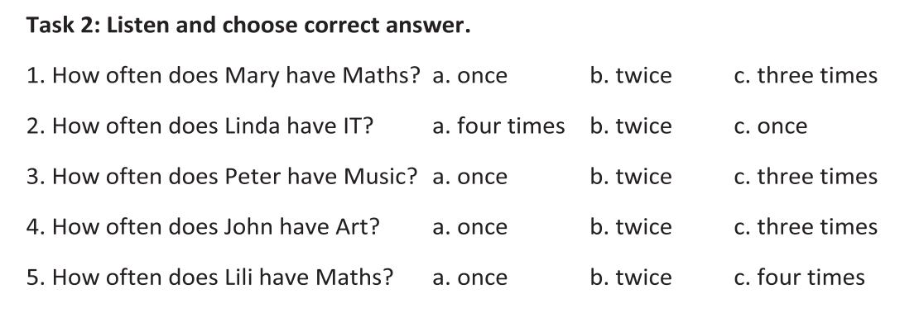

Slide 6
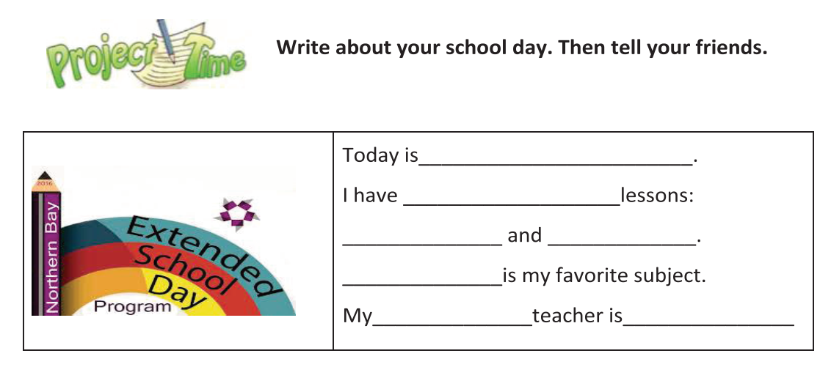

Slide 7
Homework -Do exercises in the workbook

Slide 8



THANK YOU!
INTERNATIONAL
ENGLISH CENTER
Address
Khu Gò Mèo, Xã Đan Phượng, Huyện Đan Phượng , Hà Nội
Website
dcenglish.edu.vn
Facebook
facebook.com/dcenglishcenter
Phone
024.37953333
YouTube
Youtube.com/dcenglishcenter
E-Mail
dcenglishhanoi@gmail.com

