Slide 1
Unit 17 – Lesson 1
HOW MUCH IS THE T-SHIRT ?

Slide 2
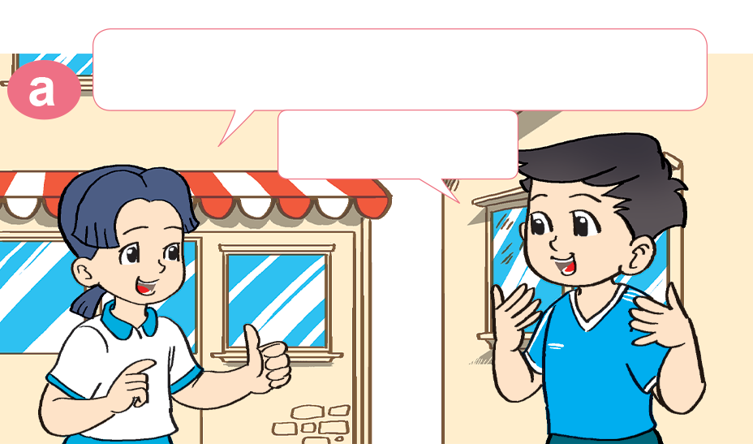
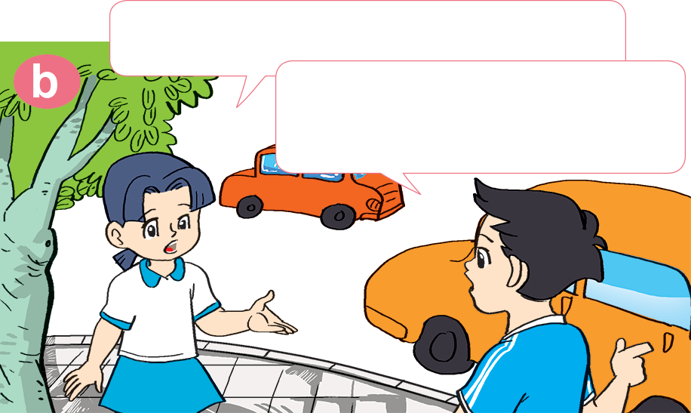

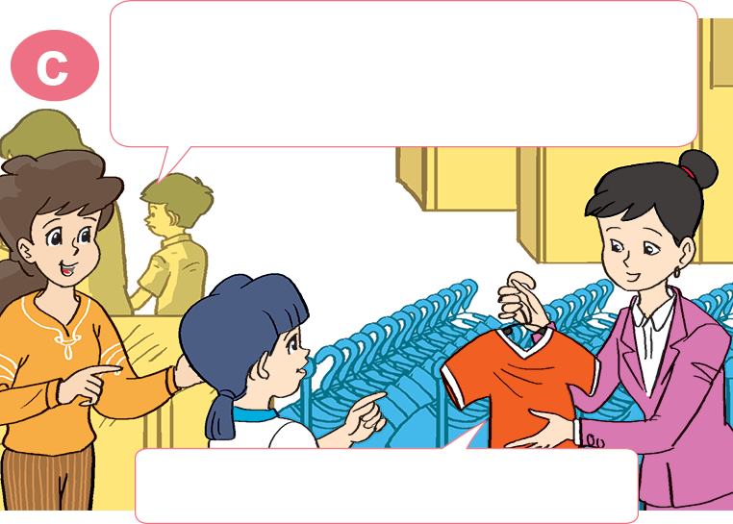
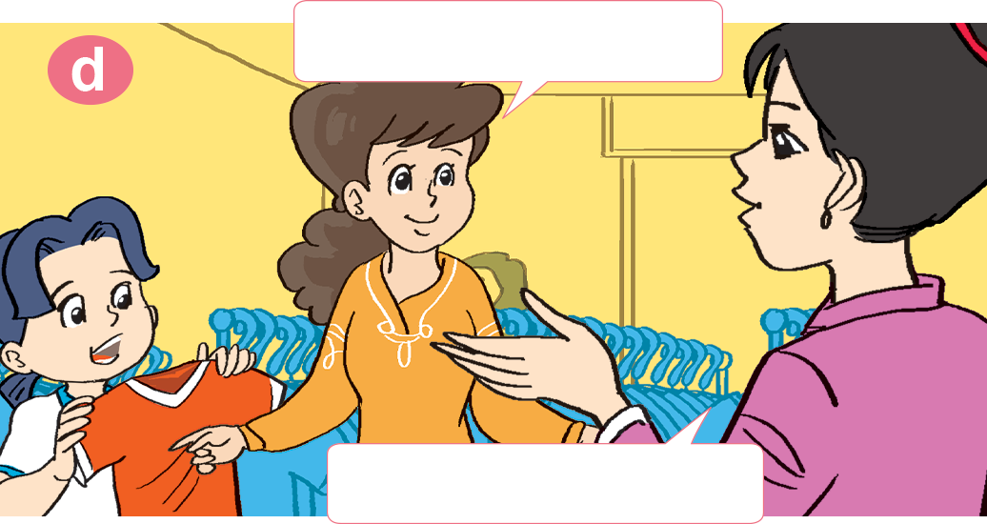
1. Look, listen and repeat
I want a T-shirt like that.
Oh, your T-shirt is very nice!
You can buy it in the supermarket.
Thank you.
Excuse me. Can I have a look at that T-shirt?
How much is it?
Sure. Here you are.
It's 50,000 dong.

Slide 3

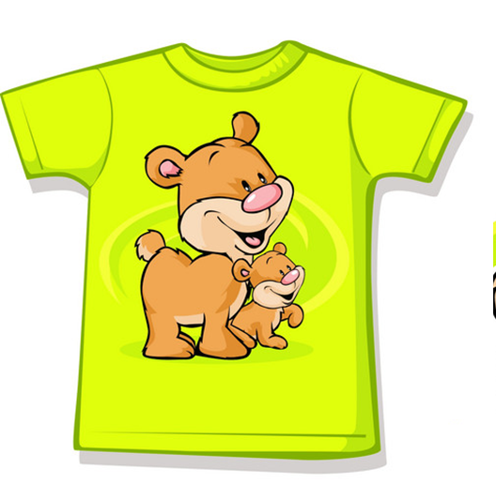
Vocabulary
shirt
T-shirt
/ʃɜːrt/
/ˈtiː ʃɜːrt/

Slide 4
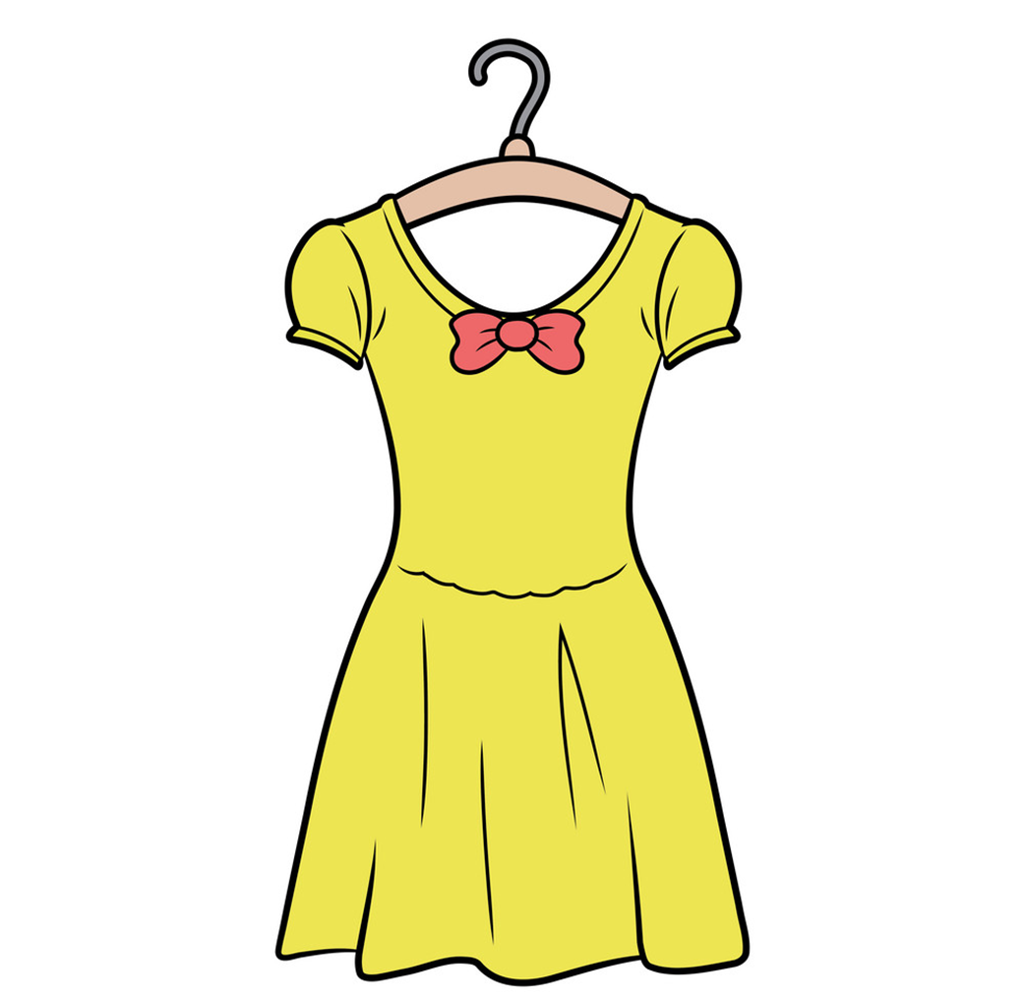

Vocabulary
skirt
dress
/skɜːrt/
/dres/

Slide 5
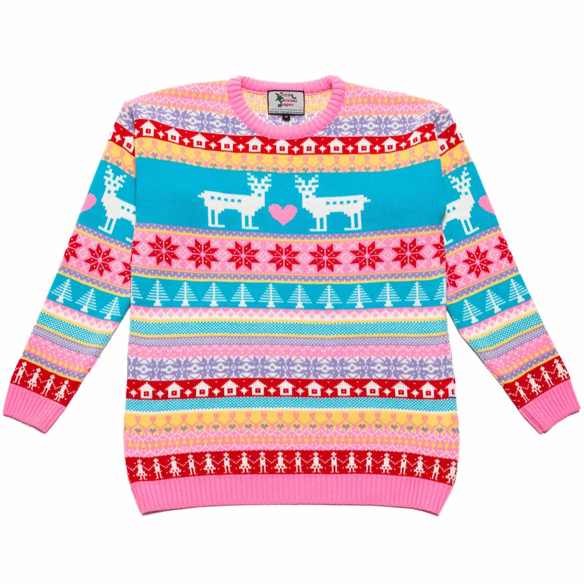
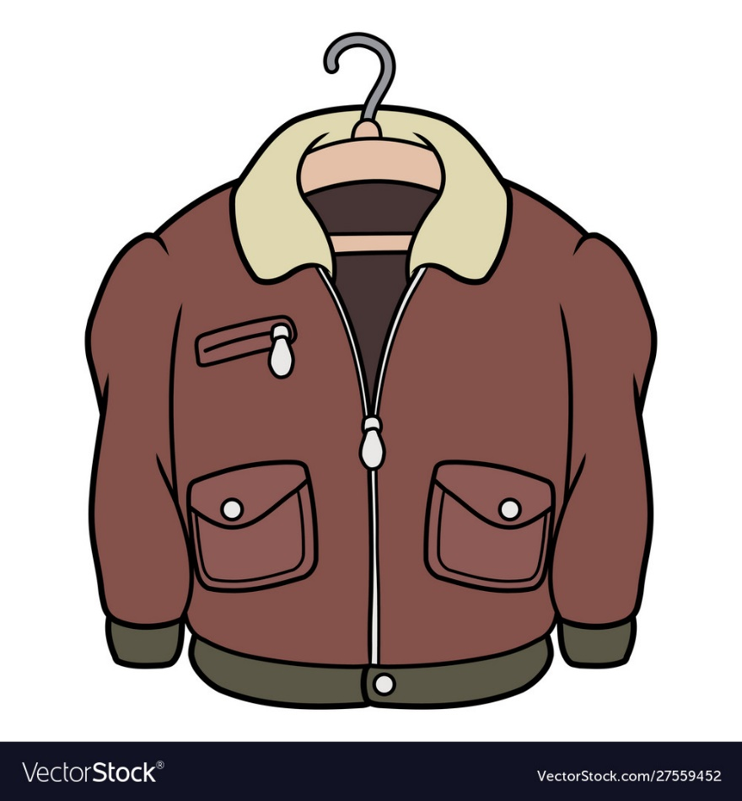
Vocabulary
jacket
jumper
/ˈdʒækɪt/
/ˈdʒʌmpər/

Slide 6
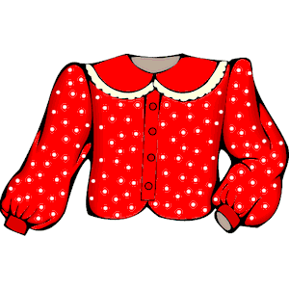

Vocabulary
blouse
scarf
/blaʊs/
/skɑːrf/

Slide 7
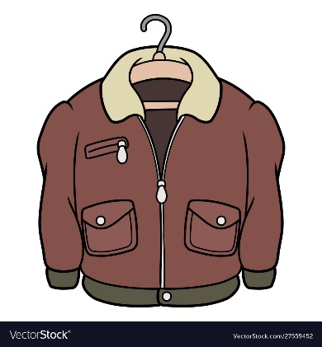
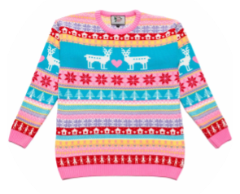
Vocabulary
blouse
scarf
jacket
T-shirt
shirt
skirt
dress
jumper

Slide 8


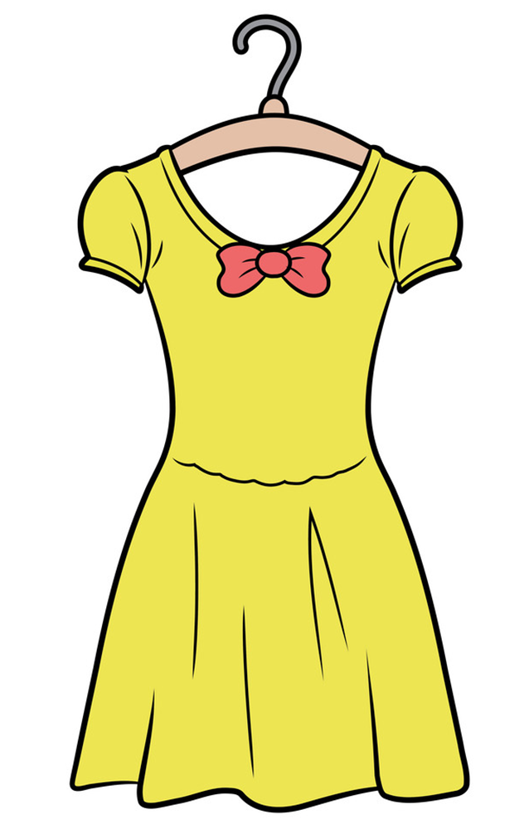
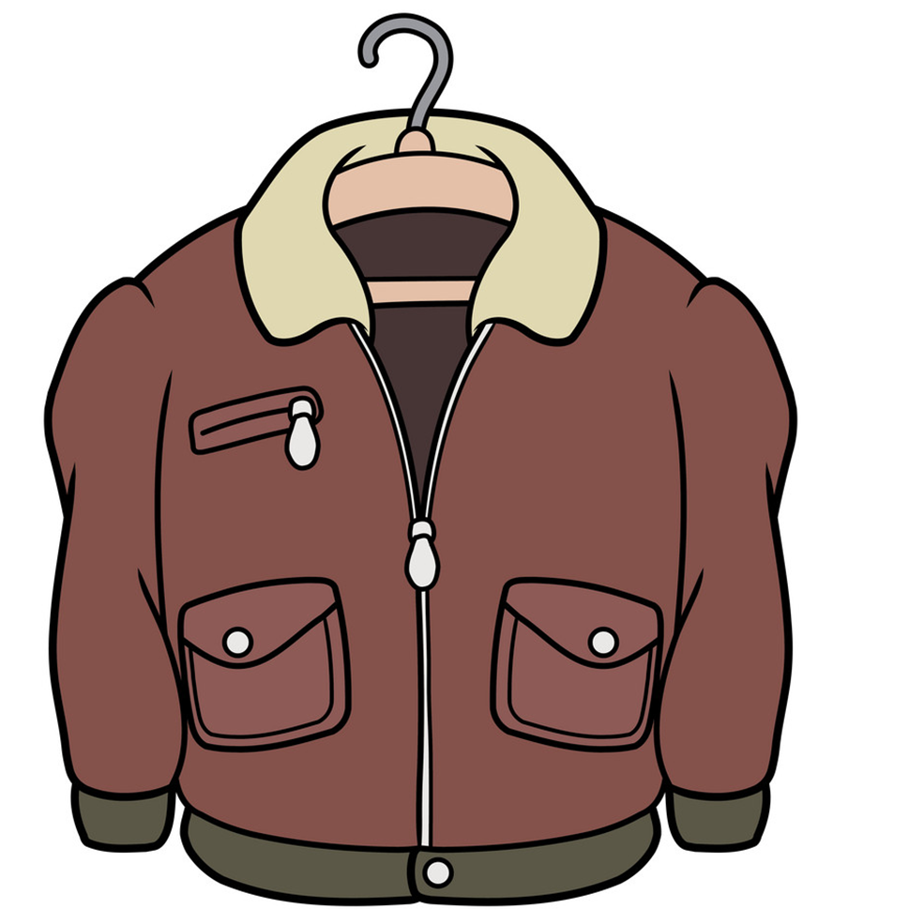
2. Point and say
How much is the _______?
It’s ______________.
70.000 DONG
10.000 DONG
80.000 DONG
50.000 DONG
jumper
90.000 DONG
scarf
60.000 DONG
skirt
jacket
blouse
dress
Ms. Huyền Phạm

Slide 9


2. Point and say
jumper
How much is the _________?
It's _____________________.
80.000 dong

Slide 10
skirt
How much is the _________?
It's _____________________.
60.000 dong

Slide 11
blouse
How much is the _________?
It's _____________________.
10.000 dong

Slide 12
shirt
How much is the _________?
It's _____________________.
40.000 dong

Slide 13
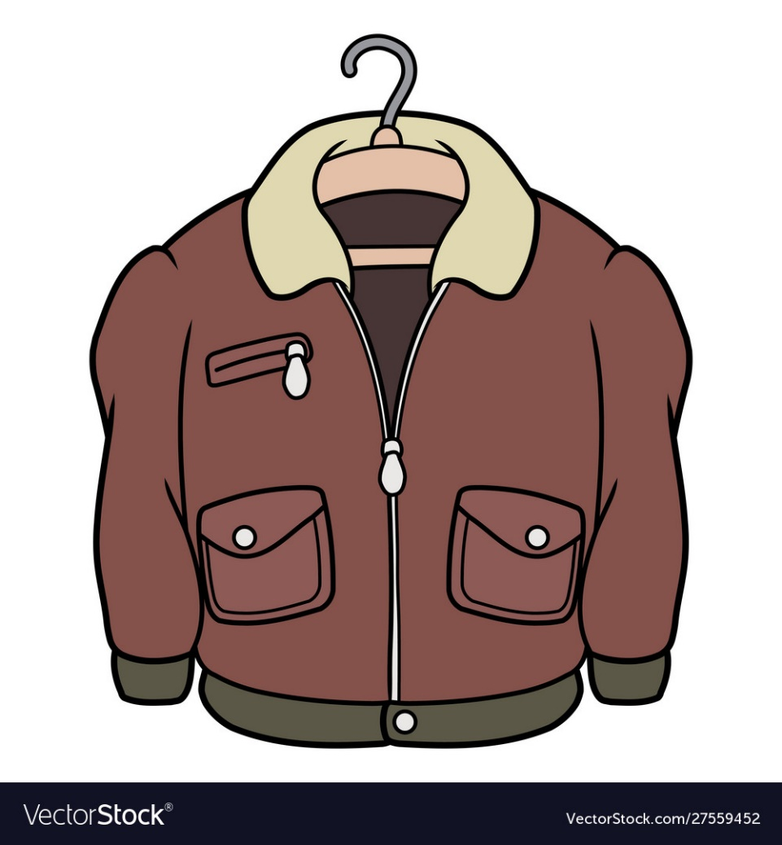
jacket
How much is the _________?
It's _____________________.
90.000 dong

Slide 14
blouse
How much is the _________?
It's _____________________.
70.000 dong

Slide 15

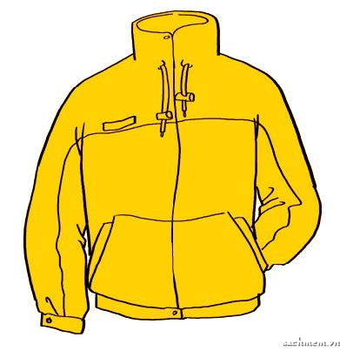
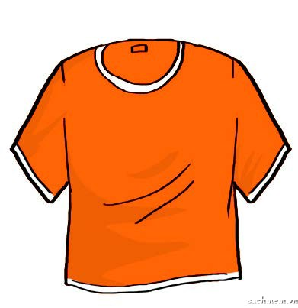
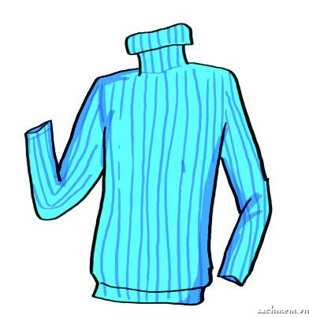

3. Listen and tick
1. 60,000 dong
2. 40,000 dong
3. 50,000 dong

Slide 16







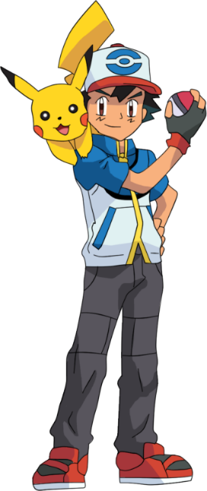
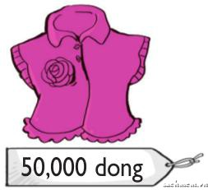




It’s fifty thousand dong.
Ms Huyền Phạm
0936.082.789
How much is the pink shirt?
How much is the pink blouse?
How much is the pink dress?
Notes:
Liên hệ: Ms Huyền Phạm - 0936.082.789 Nếu thầy cô muốn:
- Tham gia Khóa học làm powerpoint chuyên nghiệp
Học Tin học văn phòng từ cơ bản đến nâng cao
Đặt hàng thiết kế, soạn giáo án theo yêu cầu
Sở hữu các bộ giáo án powerpoint môn tiếng anh Mầm non và tiểu học.

Slide 17

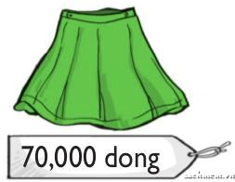
It’s seventy thousand dong.
Ms Huyền Phạm
0936.082.789
How much is the green blouse?
How much is the green skirt?
How much is the green T-shirt?
Notes:
Liên hệ: Ms Huyền Phạm - 0936.082.789 Nếu thầy cô muốn:
- Tham gia Khóa học làm powerpoint chuyên nghiệp
Học Tin học văn phòng từ cơ bản đến nâng cao
Đặt hàng thiết kế, soạn giáo án theo yêu cầu
Sở hữu các bộ giáo án powerpoint môn tiếng anh Mầm non và tiểu học.

Slide 18


The orange is ___________ dong.
Ms Huyền Phạm
0936.082.789
Threety thousand
Thirty thousand
Thirsty thousand
Notes:
Liên hệ: Ms Huyền Phạm - 0936.082.789 Nếu thầy cô muốn:
- Tham gia Khóa học làm powerpoint chuyên nghiệp
Học Tin học văn phòng từ cơ bản đến nâng cao
Đặt hàng thiết kế, soạn giáo án theo yêu cầu
Sở hữu các bộ giáo án powerpoint môn tiếng anh Mầm non và tiểu học.

Slide 19

80.000 dong
How much ____ the brown jacket?
Ms Huyền Phạm
0936.082.789
is
are
do
Notes:
Liên hệ: Ms Huyền Phạm - 0936.082.789 Nếu thầy cô muốn:
- Tham gia Khóa học làm powerpoint chuyên nghiệp
Học Tin học văn phòng từ cơ bản đến nâng cao
Đặt hàng thiết kế, soạn giáo án theo yêu cầu
Sở hữu các bộ giáo án powerpoint môn tiếng anh Mầm non và tiểu học.

Slide 20

The __________ is twenty
thousand dong.
Ms Huyền Phạm
0936.082.789
blue shirt
blue scarf
blue skirt
Notes:
Liên hệ: Ms Huyền Phạm - 0936.082.789 Nếu thầy cô muốn:
- Tham gia Khóa học làm powerpoint chuyên nghiệp
Học Tin học văn phòng từ cơ bản đến nâng cao
Đặt hàng thiết kế, soạn giáo án theo yêu cầu
Sở hữu các bộ giáo án powerpoint môn tiếng anh Mầm non và tiểu học.

Slide 21

________ is it?
It’s ninety thousand dong.
Ms Huyền Phạm
0936.082.789
How
How much
How many dress
Notes:
Liên hệ: Ms Huyền Phạm - 0936.082.789 Nếu thầy cô muốn:
- Tham gia Khóa học làm powerpoint chuyên nghiệp
Học Tin học văn phòng từ cơ bản đến nâng cao
Đặt hàng thiết kế, soạn giáo án theo yêu cầu
Sở hữu các bộ giáo án powerpoint môn tiếng anh Mầm non và tiểu học.

