Slide 1
WELCOM TO OUR CLASS

Slide 2
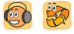

Unit
1
HELLO
Lesson 3
1
Listen and repeat.
b
bye
Bye, Nam.
h
hello
Hello, Nam.

Slide 3


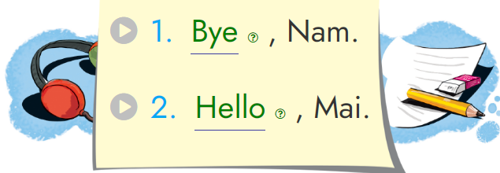
Unit
1
HELLO
Lesson 3
2
Listen and write.
Bye
Hello

Slide 4

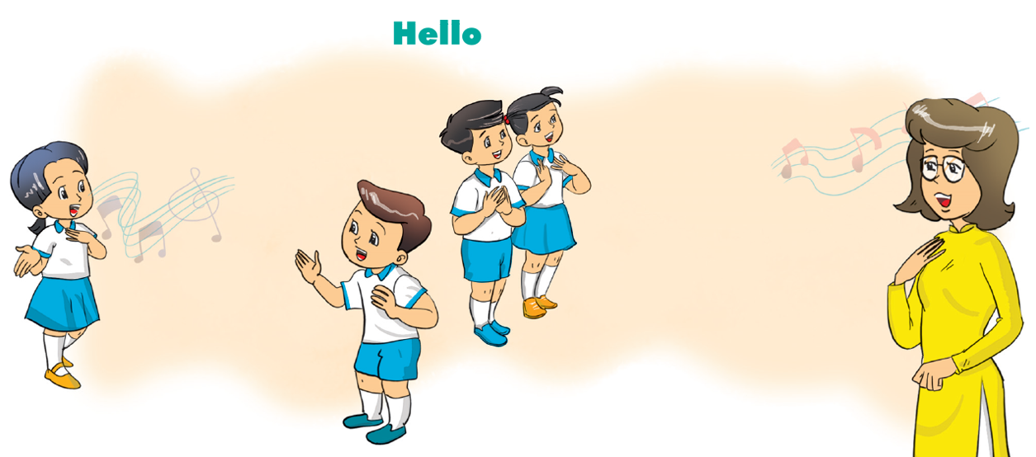
Unit
1
HELLO
Lesson 3
3
Let’s chant.
Hello, I’m Mai.
Hello, I’m Mai.
Hello. How are you ? Hello. How are you ?
Hi ,Mai.
Hi ,Mai.
I’m Nam.
I’m Nam.
Fine, thank you.
Fine, thank you.
And you ?
And you ?
Nice to meet you.
Nice to meet you.
Fine, thank you.
Fine, thank you.

Slide 5


Unit
1
HELLO
Lesson 3
4
Read and match.
1
Hello. I’m Miss Hien.
a
Hello, Nam. I’m Mai.
2
Hi. I’m Nam.
b
Bye, Nam.
3
Bye, Mai.
c
I’m fine, thanks.
4
How are you ?
d
Hello, Miss Hien.
Nice to meet you.

Slide 6
Unit
1
HELLO
Lesson 3
5
Read and write.
1.____________________. I'm Mai.
2. Hi, Mai. _________________ Nam.
3.______________to meet you, Miss Hien.
4.________________are you?
5._____________________, thanks.
Hello / Hi
I’m
Nice
How
I’m fine / Fine

Slide 7

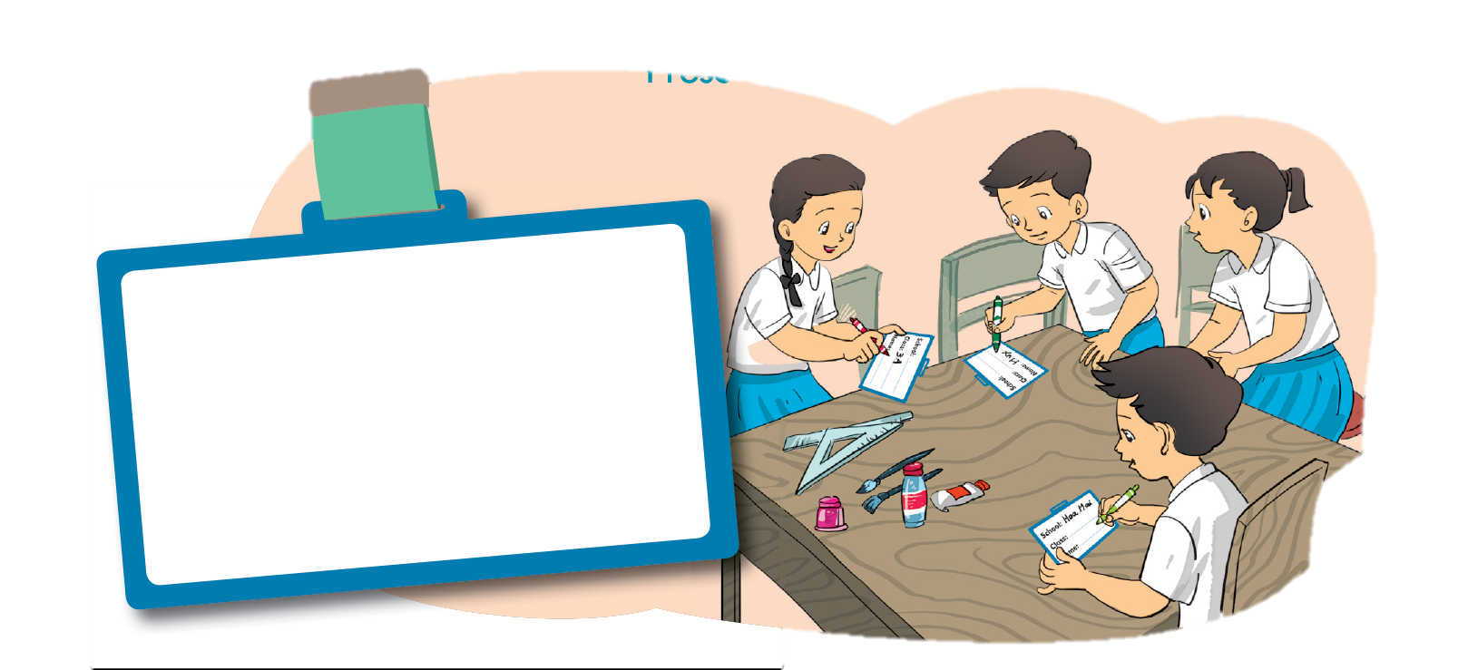
Unit
1
HELLO
Lesson 3
6
Project.
Make name cards for you and your friends.
Present them to your class.
School: ____________
Class: _____________
Name: ____________

